Slide 1
Central high school
WELCOME CLASS OF 2019!

Slide 2
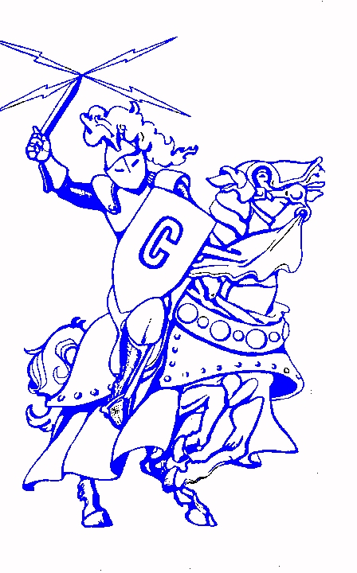
Mr. cody bull

Slide 3
Mr. roger freeman
PRINCIPAL

Slide 4
CHS cheerleaders

Slide 5
Mrs. Vicki Vest
GRADUATION SPECIALIST &
RTI² COORDINATOR

Slide 6
What is rti²?
The Tennessee Board of Education has mandated that the Response To Instruction & Intervention program will be implemented in all schools.
The program is designed to focus on the essential skills students need in Reading and Math.

Slide 7
Rti² is three tiered
There are three Tiers in RTI:
Tier 1: all students are in this tier, which delivers the regular curriculum instruction.
Tier 2: students whose assessment data shows a need for intervention will also be placed in this tier to receive additional help.
Tier 3: students whose assessment data shows a need for intensive intervention will be placed in this tier to receive more intensive help.
Enrichment: students who are not in Tier 2 or 3 will be placed in an enrichment class.

Slide 8
Rti² tiers
How are students placed in tiers?
Placement in the Tiers is based on multiple assessments.
Can students move between tiers?
Placement in the Tiers is reviewed and can change as students progress.

Slide 9
graduation
High School graduates make more money than those who have a GED or drop out: about $10,000 more per year!

Slide 10
Tips for success in high school
Make every class count—you need 22 credits to earn your diploma!
You are in charge of your education—take responsibility!
Set goals: long-term and short-term!
Get organized!
Learn to study!
Talk to your teachers, guidance counselors, etc.!
Get involved!

Slide 11
Mr. Brian trammell
SPECIAL EDUCATION

Slide 12
Special education
Transition meetings are currently being scheduled. For more information, contact
Brian Trammell
btrammell@mcminnschools.com
423-263-5541 extension 115

Slide 13
Mr. Doug Armstrong
ASSISTANT PRINCIPAL & ATHLETIC DIRECTOR

Slide 14
Sports at chs
Baseball
Basketball (Boys & Girls)
Cheerleading
Cross Country
Football
Golf

Slide 15
Sports at chs
Softball
Soccer (Boys & Girls)
Swimming
Tennis
Track
Volleyball

Slide 16
Mrs. Melanie walker
CAREER & TECHINCAL EDUCATION
DEPARTMENT HEAD

Slide 17
Why career & technical education?
Career and Technical Education (CTE) gives high school students, the chance to get a head start on preparing for college and careers.
In CTE programs you will learn how core school subjects like math, science and writing are used in real-life.
As a CTE student you have the opportunity to participate in hands-on training in your chosen program and gain real world experience through job shadows and internships.

Slide 18
Cte programs at central
Advanced Manufacturing NEW!
Agriculture, Food, & Natural Resources
Architecture & Construction
Business Management & Administration
Finance
Health Science
Human Services
Marketing
Transportation, Distribution, & Logistics

Slide 19
Ms. Anita Scruggs – director of guidance (M-Z)
MRS. AMBER MOORE – GUIDANCE COUNSELOR (A-L)

Slide 20
Tennessee promise
Tennessee Promise is both a scholarship and mentoring program.
Provides students a last-dollar scholarship, meaning the scholarship will cover tuition and fees not covered by the Pell grant, the HOPE scholarship, or TSAA funds.
Students may use the scholarship at any of the state’s 13 community colleges, 27 colleges of applied technology, or other eligible institutions offering associate’s degree programs.
In addition, Tennessee Promise participants must complete eight hours of community service per term enrolled, as well as maintain satisfactory academic progress (2.0 GPA) at their institution.

Slide 21
dr. lori Hutchinson
ASSISTANT PRINCIPAL

Slide 22
Clubs at chs
Anchor Club
Beta Club
DECA
FBLA
FCA
FCCLA
FFA
Fly Fishing Club
Fly Fishing Club

Slide 23
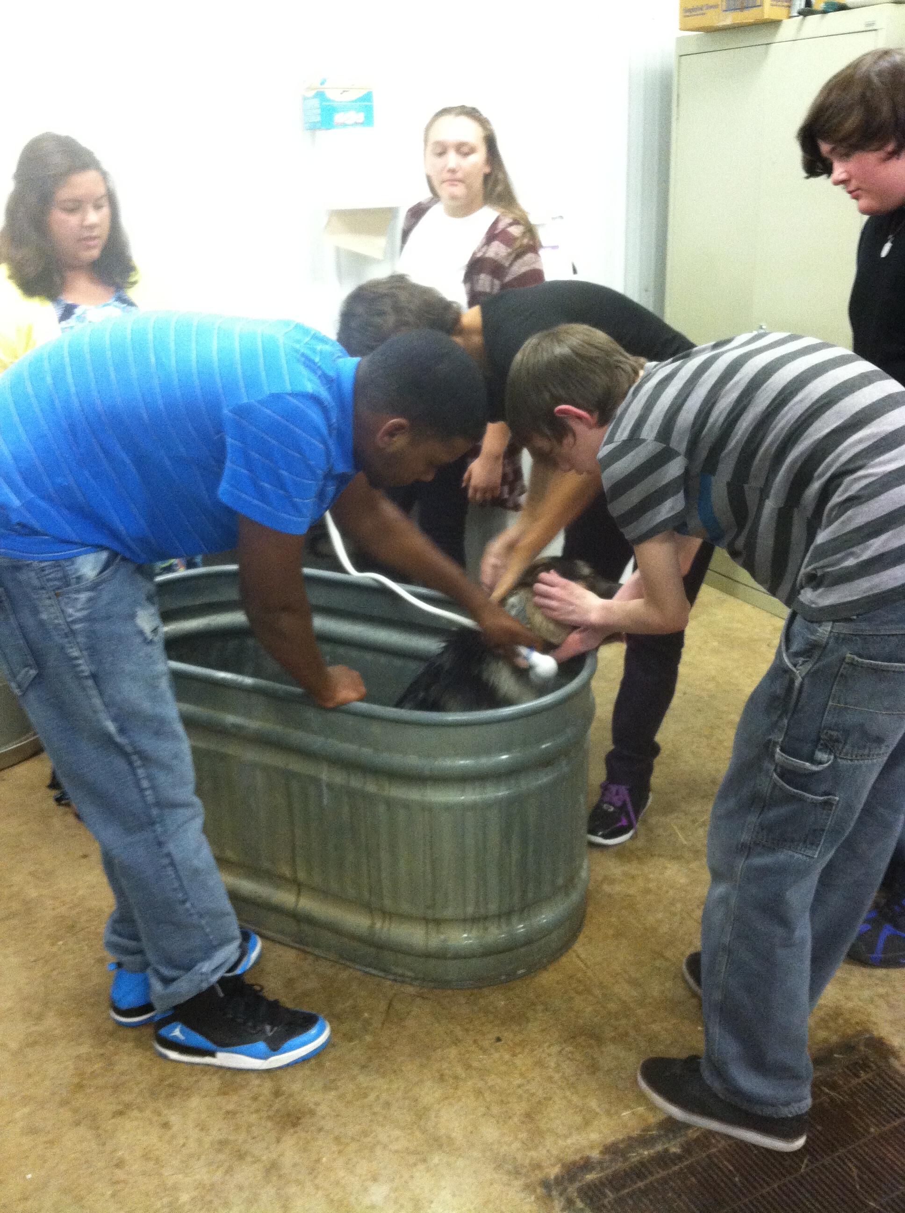
CLUBS AT chs
HOSA
Interact
National English Honors Society
Pep Club
Outdoor Club
Student Council
Skills USA
Central Harmony
FFA

Slide 24
clubs
The CHS Coffee Shop, The Charger Express, is now open in the Library for anyone who would like coffee, hot chocolate or tea!

