Slide 1
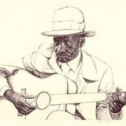
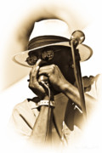
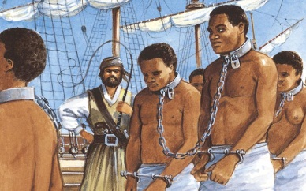
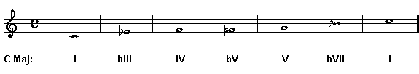
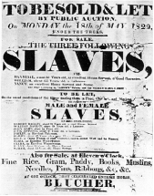
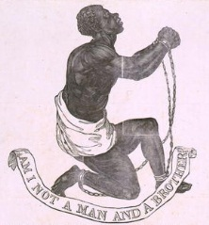
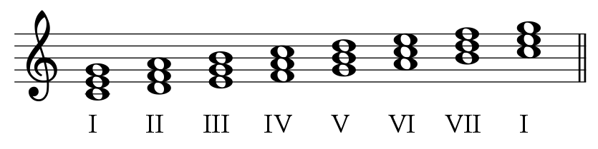
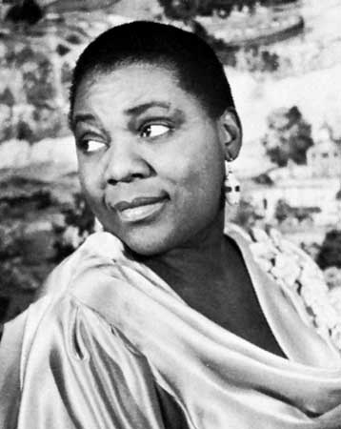
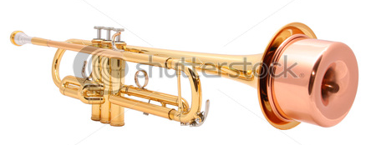
Blue Notes
12 Bar Blues
Slavery
The Blues
Vibrato
Slides
Blues scale
Blues music started in the southern
slave areas of America.
Slaves sang work songs and
spirituals that expressed their fears,
hopes and dreams, hence (feeling
blue). The music spread to the
northern cities and became the
Basis of all popular music today.
The blues scale is the scale that is used to improvise with.
They are chromatic notes which clash and add a dissonant quality to fit in with the expressive lyrics of the songs.
The rhythms in blues music are syncopated (off beat)
Blues singers add vibrato (a shaky / trembling quality) and slides (sliding up and down in pitch) to their vocal performance to express the lyrics that are often about hardship. They include short melodic phrases followed by an instrumental link.Etta James, AT LAST
Listen to Bessie Smith’s Careless Love Blues Bessie Smith, CARELESS LOVE
Brass instruments feature in Blues music. In this extract you will hear a trombone and a trumpet – both with mutes to portray a whining / talkative / buzzing / wah wah sound.
Blues became an inspiration for many other
types of music.
The 12 Bar Blues forms the basic structure upon which the blues is composed. The pattern is based on 3 chords with 4 beats per bar. In a major scale the chords are the 1st, 4th and 5th chords (I, IV & V) known as primary chords.
The 12 Bar Blues chord structure in C Major looks like this:
C / / / / C / / / / C / / / / C / / / / F / / / / F / / / /
C / / / / C / / / / G / / / / F / / / / C / / / / C / / / /
The dashes after each chord indicate that the chord is played 4 times in each bar. Performers improvise over this structure (make it up as they go along). Blues Improv

Slide 2
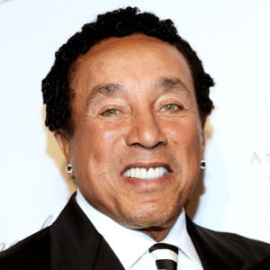
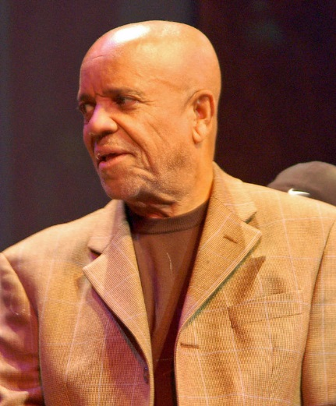
MOTOWN
Motown is an American record company. The company was founded by Berry Gordy, Jr. on January 12, 1959 in Detroit, Michigan as Tamla Records, and was incorporated as "Motown Record Corporation" on April 14, 1960. The name, a portmanteau of motor and town, is also a nickname for Detroit. Motown played an important role in the racial integration of popular music as an African American-owned record label which achieved significant crossover success. In the 1960s, Motown and its subsidiary labels were the most successful proponents of what came to be known as "The Motown Sound", a style of soul music. Soul music is a popular music genre that originated in the United States in the 1950s and early 1960s. It combined elements of African-American gospel music, rhythm and blues, and often jazz. with a distinct pop influence. During the 1960s, Motown achieved spectacular success for a small record company: 79 records in the Top Ten of the Billboard Hot 100 record chart between 1960 and 1969.^{[1]}
http://www.youtube.com/watch?v=--jWPzNNdN4&safe=active
Smokey Robinson
Once pronounced by Bob Dylan as America’s “greatest living poet,” acclaimed singer-songwriter Smokey Robinson’s career spans over 4 decades of hits. He has received numerous awards including the Grammy Living Legend Award, NARAS Lifetime Achievement Award, Honorary Doctorate (Howard University), Kennedy Center Honors and the National Medal of Arts Award from the President of the United States. He has also been inducted into the Rock ‘n’ Roll Hall of Fame and the Songwriters’ Hall of Fame. Born and raised in Detroit, Michigan, Robinson founded The Miracles while still in high school. The group was Berry Gordy’s first vocal group, and it was at Robinson’s suggestion that Gordy started the Motown Record dynasty. Their single of Robinson’s “Shop Around” became Motown’s first #1 hit on the R&B singles chart
http://www.youtube.com/watch?v=AQGXa3FiXKM&safe=active
During the course of his 50-year career in music, Robinson has accumulated more than 4,000 songs to his credit and continues to thrill sold-out audiences around the world with his high tenor voice, impeccable timing, and profound sense of lyric. Never resting on his laurels, Smokey Robinson remains a beloved icon in our musical heritage.
http://www.youtube.com/watch?v=5RDUYOSpH9w&safe=active

Slide 3
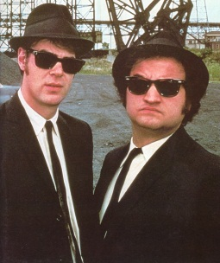
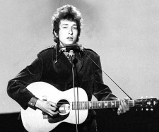
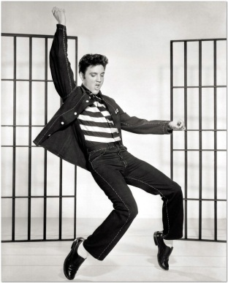
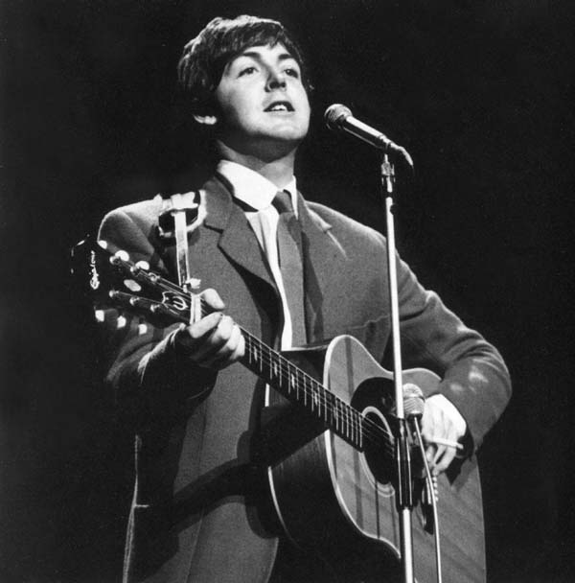
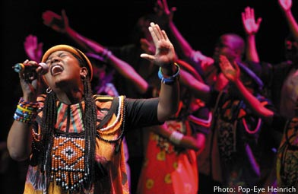
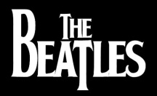

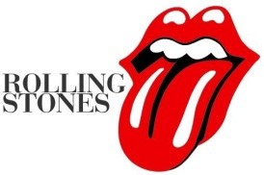
Rhythm and Blues developed through dance halls in Chicago. It mixed the Gospel style of music with blues instrumentation. It was much faster and louder than the blues.
Delta Rhythm Boys - Taking the'A' Train
Blues Brothers – Shake a Tail Feather: http://www.youtube.com/watch?v=rN5V-6yCbpg
Popular Music from the 1960’s
Pop Ballads are solo songs with a fairly slow tempo. They are usually in verse form and tell a story.
BALLAD OF CURTIS LOEW, Lynard Skynard
BRANDY, by Looking Glass
Popular song forms are often:
Introduction
Verse 1
Chorus
Instrumental link
Verse 2
Chorus
Middle 8
Chorus
Listen to Bob Dylan’s Blowin in the Wind. The song has a straightforward melody and a simple chord accompaniment on the acoustic guitar.
Bob Dylan, Blowin in the Wind
Rock N Roll is a fusion (mixture) of rhythm and blues and country and western music. Elvis Presley, Chuck Berry and Little Richard were popular in the Rock N Roll craze. Originally a string / double bass was used alongside acoustic guitars and piano but Rock n Roll helped to establish the lead guitar, rhythm guitar, bass guitar and drum kit.Elvis Presley, Jailhouse Rock
Gospel and Soul has its roots in African –American churches. It developed from spirituals. Gospel includes:
A powerful solo singer improvising over chords
The use of melisma (an extension of words e.g.
swee – ee –ee –eet Jesus)
Sliding into a note from a lower or higher pitch
An emotional quality
Strong harmonies in many parts
You tube link: http://www.youtube.com/watch?v=zXzfhG9NvFw
Soul Music is a mixture of rhythm and blues and gospel. Instead of the religious lyrics in gospel soul includes lyrics about love and relationships.
You tube link: http://www.youtube.com/watch?v=STKkWj2WpWM
More Rock N Roll
The Beatles and The Rolling Stones were rival bands that had a massive teen following in the 60’s and 70’s.
The Rolling Stones tried to be more extreme than The Beatles by using distortion (harsh / overdriven), feedback (a loud whining sound produced by amplifying the guitar) and power chords (an open chord using the 1st and the 5th note).
The Beatles - I Want to Hold Your Hand
Rollin Stones, Satisfaction

Slide 4
Country Music
Country music is a genre of American popular music that originated in the Southern United States in Atlanta, Georgia in the 1920s. Over the last century, the term Country Music is the used to describe the many styles that have developed. Country music originated from the folk music of mostly white, working-class Americans, who blended popular songs, music from immigrant communities, fiddle tunes, ballads, cowboy songs, and African American blues.
1920s Arkansas Traveler , Wreck of the Old 97
1930s-1940s That Silver Haired Dady of Mine, Gene Autry, Lovesick Blues, Hank Williams
1950s-1960s Folsom Prison Blues, Johnny Cash, Stand By Your Man, Tammy Wynette , Kaw-liga, Hank Williams
1970s-1980s - Elvira, Oak Ridge Boys , Blue Eyes Crying in the Rain, Willie Nelson, 9 to 5, Dolly Parton
1990s - Ropin' the Wind, Garth Brooks , Amazed, Lonestar
2000s to Present - Cruise, Florida Georgia Line, Need You Now, Lady Antebellum

Slide 5
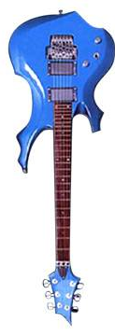



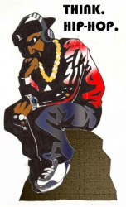
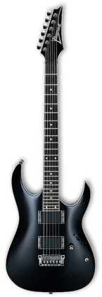
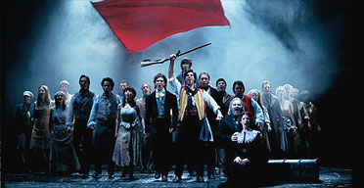
Rock Music
Hip-Hop
Musical Theatre
Instruments that play Rock music include lead guitar, rhythm guitar, bass guitar, keyboard and drum kit. There is a strong emphasis on the back beat – beats 2 and 4 in a 4/4/ beat.
4
4
1 2 3 4
Psychedelic Rock has strange lyrics and the use of exotic instruments. Technological effects like panning (moving sound between the 2 stereo speakers) and reverb (an electronic longer lasting sound) are used. Top 10
Progressive Rock takes an idea and spreads it across songs lasting up to 15 minutes or more. Often albums have a story to them e.g. Pink Floyd’s Dark Side of the Moon. https://www.youtube.com/watch?v=DLOth-BuCNY
Punk Rock includes lyrics that are anti-establishment. Fast tempos and distortion are used. Top 10 Punk Rock Songs
Hard Rock has riffs (repeated patterns) and lead guitar solos to show off the skills of the players. Hard rock often uses modal scales
Top 10 Slash Solos
Musicals are plays that use music to express emotion. Musicals make use of solo songs, ensembles and choruses accompanied by an orchestra.
Les Miserables, I Dreamed a Dream
Like opera, in musicals some words are sung however in most musicals spoken word is used much more than
Sung.
Lyrics and singing style are very expressive and dramatic. Words are pronounced. Intonation (pronunciation) is very important.
Phantom of the Opera
Vocal acrobatics are used in musicals. Male singers often have falsetto voices (very high vocal range). You Tube Link: Bring Him Home – Les Miserables
Les Miserables, Bring Him Home
Hip-Hop emerged in New York in the 1970’s. DJ’s played percussion loops (drum samples of sound that were looped round again and again) to create a strong rhythmic beat.
You Tube Link: Hip Hop
http://www.youtube.com/watch?v=Jn5RMwUyE3A&feature=related
In Hip Hop everything is built up in layers. There are midi drum patterns (computerized patterns) a bass line, supporting orchestration (synthesizer, strings, piano, etc).
In the ‘break’ drums play a short solo.
Rapping is also a feature of Hip Hop.
Loops were originally created on tape but nowadays musicians can create their own and add samples (sections of other songs pre-recorded) which are looped (played over and over again), synthesized (made electronic) and modified in many different ways.
HAPPY
Rhythm & Bass (R&B) is a form of Hip Hop where there is an emphasis on a strong beat. Lyrics often include urban, city issues.
You Tube Link:
Good Life – Kanye West
http://www.youtube.com/watch?v=FEKEjpTzB0Q

Slide 6
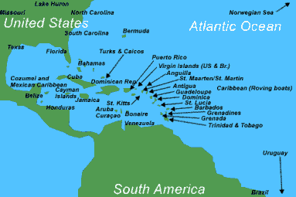
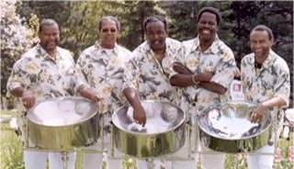
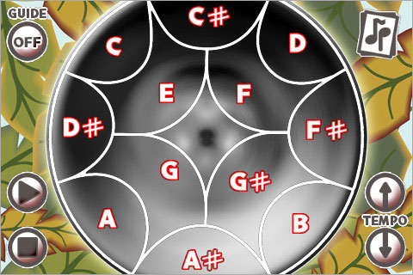


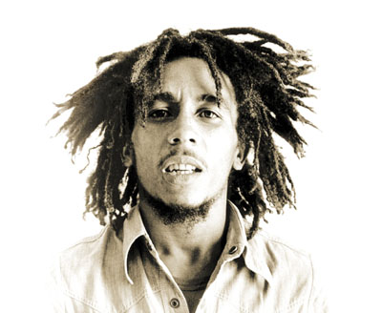
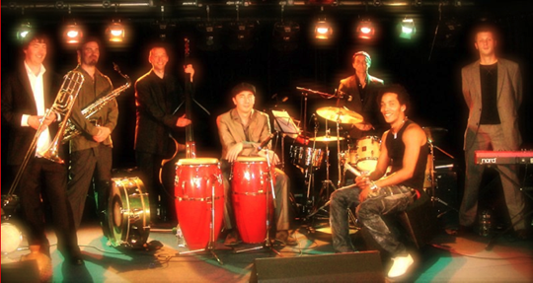
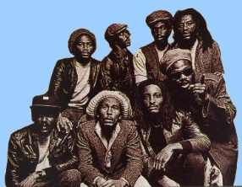
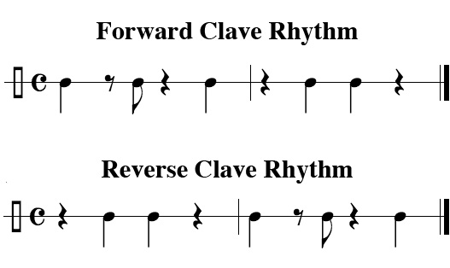
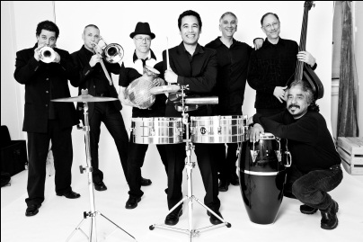
Caribbean & South American Music
The Caribbean is a group of islands between the USA and South America.
Reggae music has it’s origins in Jamaica towards the end of the 1960’s. It was built on riffs, syncopated rhythms and a strong backbeat played on the electric bass guitar with emphasis on beats 2 and 4 of the bar. Lyrics were about love, peace, freedom and revolution.
Calypso came from Trinidad and Tobago at the start of the 20th Century. Lyrics are about island life and can be political. Calypso music is used in carnivals as celebratory music. Instruments used are brass, saxophones, drums and electric guitars. Steel drums are also a feature of Calypso music. You Tube Link:
http://www.youtube.com/watch?v=8xNyMrKYVkg&feature=related
Salsa means ‘sauce’ in Spanish. It is a type of dance music associated with Cuba, South America (Latin America). Salsa uses a 4/4 time signature and is based on a repeated rhythm called a clave (pronounced Clar – vae) around which musicians play different rhythmic accompaniments. You Tube Link: http://www.youtube.com/watch?v=pLqasxGYWX8
Jamaicans use their religion, Rastafarianism, to influence their lives and their music. They wear dreadlocks in their hair and the green, red & yellow colors of the Rastafarian flag.
Instruments used in Salsa are Congas, Bongos, Claves, Maracas, Trumpet, Saxophone, Piano,
Timbales, Guiro,
Drum Kit, Cowbells,
Trombone, Cabasa,
String Bass, guitars!
ONE LOVE
Instruments used in reggae music are electric guitars, synthesizers, piano, drum kit.

Slide 7
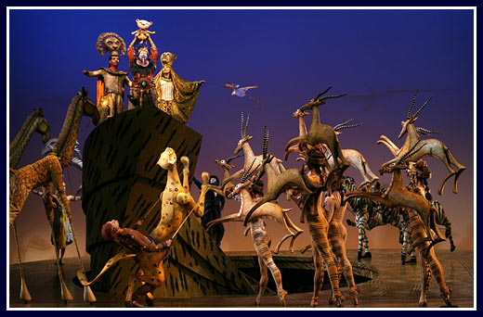
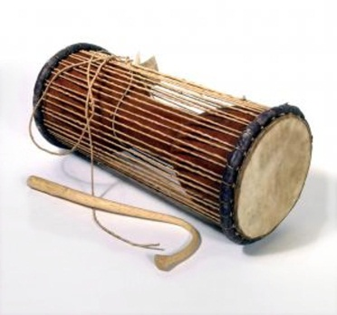
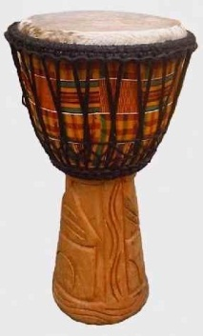
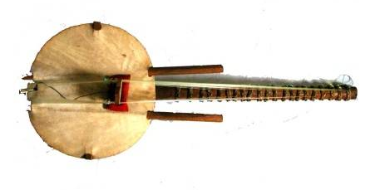
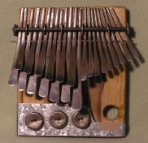
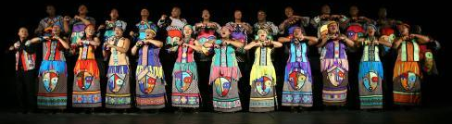
African Music
Call & Response
Djembe
Kora
Choral Singing
Rhythmic Cycle
Mbira
African music has many functions: religious, ritualistic, folklore, myth. Music is often combined with dance.
African choral music includes call and response. The solo singer starts by singing a melody (call) which is repeated (response) by other singers. It is common for different melodies to be sung at the same time producing polyphonic / contrapuntal textures. At other times harmonic / homophonic texture may be used. This is created by singing in thirds, fourths or fifths. Unison (singing the same melody at the same time) and parallel motion (2 voices singing up or down in pitch but keeping the same interval between notes) are also used.
You Tube Link: Circle of Life
http://www.youtube.com/watch?v=RXSyJ4CeUXo
African music has had a major influence on the development of popular music contributing rhythms, structures, melodic features and the use of improvisation.
You Tube Link: Paul Simon – You can call me Al
http://www.youtube.com/watch?v=HOiVaE-pKqM&feature=related
The roots of Gospel music are in African culture.
You Tube Link: Soweto Gospel Choir
http://www.youtube.com/watch?v=zd6sy5DKpxk
South African Apartheid in the 1980’s separated black and white South Africans. Labi Siffre wrote this song to express the emotions of the black South Africans.
You Tube Link: Something inside so Strong
http://www.youtube.com/watch?v=7B-4Lsrx8IA&feature=fvst
Tama – Talking Drum
Djembe
African Drumming is important in African Culture. It has been used for communication for hundreds of years. There are tama (talking drums) and djembe (single headed drum). They come in different sizes to produce different pitches.
You Tube Link : Tama http://www.youtube.com/watch?v=nnNvZWmsnTg&feature=related
You Tube Link: Djembe
http://www.youtube.com/watch?v=VT2J1Ot9N5c
African drumming and instrumental music makes use of repetition and ostinato (repeated pattern), cyclic structure (structures that go round and round like a loop), improvisation (making it up as you go along), polyrhythmic and polyphonic textures (rhythms and melodies that weave in and out of one another / cross over).
Two examples of African melodic instruments are the Kora and the Mbira.
You Tube Link: Kora
http://www.youtube.com/watch?v=clgFw3RbI-k&feature=related
You Tube Link: Mbira (Thumb Piano)
http://www.youtube.com/watch?v=YbPVFMMIvqM&feature=related
Kora
Mbira

Slide 8
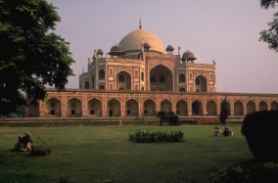
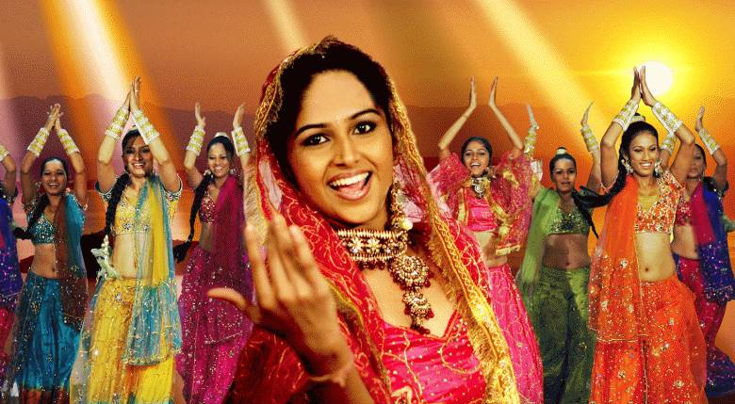
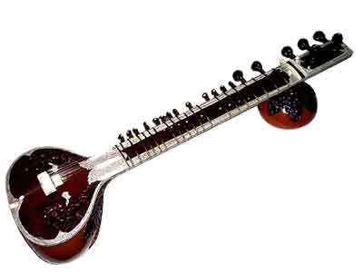
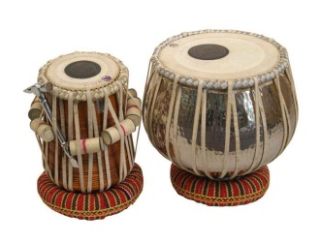
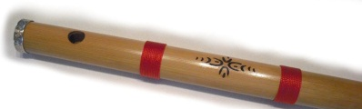
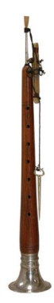
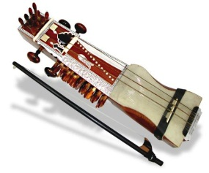
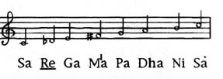
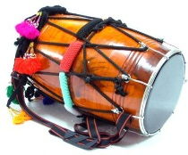
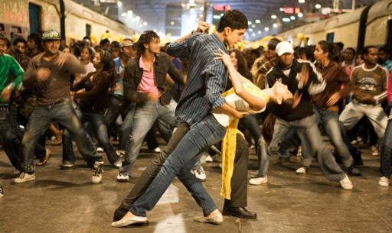
Raga
Tala
Drone
Bollywood
Indian Music
There are three common elements in Indian Music. The melody (raga) which is usually improvised from a scale called a rag, the drone (kharaja) which is usually an accompaniment of two notes a fifth apart in the bass and the rhythm (tala) which is organized into repeated cycles.
Apart from the human voice, some of the common instruments found in classical Indian Music are:
Indian Instruments You Tube Links:
Sitar & Tabla
http://www.youtube.com/watch?v=hTPxqUtlLdo
Sarangi & Table
http://www.youtube.com/watch?v=1PmMSDFyuAw&feature=related
Bansuri
http://www.youtube.com/watch?v=7QuDEx3_Ygo
Shenai & Tabla
http://www.youtube.com/watch?v=WKG5QCuap5E&feature=related
Sarangi (plucked and bowed string instrument)
Sitar
(plucked string instrument)
Bansuri (Indian bamboo flute)
Shenai (Indian oboe style instrument)
Tabla (2 drums)
A rag (pronounced with a long ‘a’) is a scale that a melody can be improvised from. Rags are associated with different occasions even times of day. Marwa is an evening rag consisting of C, Db, E, F#, G, A, B, C (look at the Indian names for the notes:
The tala is a rhythmic pattern that forms a basis for a set of
repeating cycles. Sam is the first beat of the cycle, Matras
are the individual beats in the cycle and Bols are improvised
rhythms which contrast the main beat. You Tube Link: Tabla
http://www.youtube.com/watch?v=DrLN36uyZJ0&feature=related
A raga performance contains all three of the elements: melody (based on a rag e.g. the Marwa rag), tala (rhythm played on the tabla drums) and drone (played on the lower strings of the sitar). The opening section is called the Alap and the final section is called the Gat.
Bhangra is traditionally a kind of folk music and dance. It is now associated with a fusion (mixture) between Western popular music styles and features of Indian Classical Music. Bhangra is characterized by the use of Indian Instruments such as the dhol (an Indian drum), repetitive rhythms and the Punjabi language (with typical shouts of ‘hoi’ mixed with Western instruments such as the synthesizer. You Tube Link: Dhol http://www.youtube.com/watch?v=QmTFXzkD32s&feature=fvwrel
Bollywood is the Indian Hollywood. Indian movies incorporate all types of Indian culture with expressive and flamboyant dances and music. One of the most famous Western films based around an Indian family is ‘Slumdog Millionaire’ with it’s catchy soundtrack. You Tube Link: Jai Ho
http://www.youtube.com/watch?v=vRC4QrUwo9o
Dhol (Indian drum)

