Slide 1
History of Halloween Presentation
Reginald Multimedia Design 3rd period 10/26/2012

Slide 2
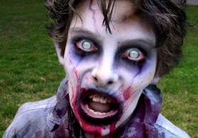
How did Halloween get its name?
Halloween was originally called All Hallows' Eve which means the evening before All Saints' Day. "Hallow" is an Old English word for "saint". This was shortened to Hallowe'en and finally to Halloween. Satanists have adopted Hallowe'en as one of their three main seasonal days of celebration. The others are Walpurgus Nacht on MAY-1 and the Satanist's birthday. All-Saints-Day and All-Hallows-Eve were never celebrated together. it has always been the day after.
http://wiki.answers.com/Q/How_did_Halloween_get_its_name

Slide 3
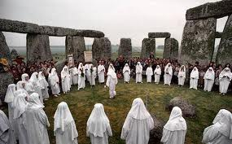
When did Halloween start to be celebrated?
The many customs we have today in relation to Halloween have their origins in the religious practices of the Romans and the Druids, therefore dating back many centuries. The Romans worshiped various gods and on October 31, a special feast was held in honor of Pomona, goddess of the fruit trees. Later, the Druids, an ancient order of Celtic priests in Britain, made this feast an even more extensive celebration by also honoring Samhain, lord of the dead. This was normally done on November 1 and it was therefore decided to conveniently honor both Pomona and Samhain on October 31 and November 1. www.holybible.com/resources/halloween.htm

Slide 4
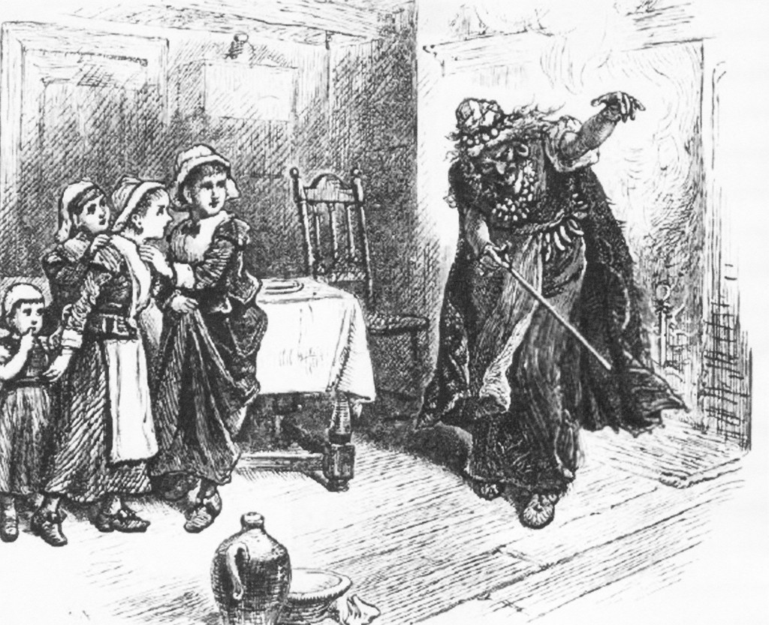
What is the connection between Salem and Halloween?
The City of Salem, Massachusetts celebrates Halloween with a month-long series of “Haunted Happenings,” culminating on Halloween Night with a citywide costume party and fireworks over the harbor. It seems appropriate; everyone knows the story of the Salem girls whose accusations of witchcraft, in 1692, sent a score of their neighbors to the gallows. Salem has long been known as the “Witch City.” But is this nickname justified. http://www.historypressblog.net/2012/10/03/five-surprising-facts-about-salem-witchcraft/

Slide 5
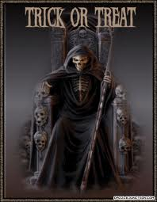
How old is too old to go trick-or-treating?
In Belleville, Ill., if your kid goes trick-or-treating after the age of 13, you could be slapped with a $25 fine.
In Newport News, Va., parents could be fined up to $250.
Here, in Lancaster County, there are no such ordinances governing the Halloween tradition.
Instead, police count on parents and kids to use common sense when deciding what age is too old for trick-or-treat night, which is Friday from 6 p.m. to 8 p.m. http://lancasteronline.com/article/local/304705_How-old-is-too-old-to-go-trick-or-treating-.html

Slide 6
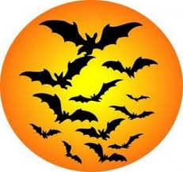
Why are black and orange the colors that are used to represent Halloween?
Because it resembles the orange light of the lantern and the black of the night it was used in.
http://wiki.answers.com/Q/Why_are_the_colors_orange_and_black_used_to_represent_Halloween

Slide 7
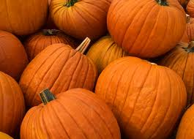
What do pumpkins have to do with Halloween?
They are supposed to warn away evil spirits!
http://wiki.answers.com/Q/What_do_pumpkins_have_to_do_with_Halloween

Slide 8
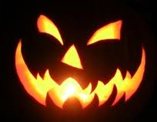
What is the story behind the legend of Jack-o-lantern and where did it get its name?
A modern jack o' lantern is typically a carved pumpkin, although originally typically large turnips. It is associated chiefly with the holiday of Samhain and Halloween and was named after the phenomenon of strange light flickering over peat bogs, called ignis fatuus or jack o' lantern. In a jack o' lantern, typically the top is cut off, and the inside flesh then scooped out; an image, usually a monstrous face, is carved out, and the lid replaced. It is typically seen during Halloween.
http://en.wikipedia.org/wiki/Jack-o'-lantern

Slide 9
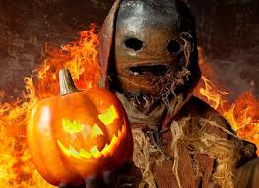
Why couldn’t carved pumpkins be used for Halloween in Ireland in the 14th century?
Believe ot or not, original jack-o'-lanterns were carved from potatoes and turnips. Pumpkins, indigenous to the Americas, were not used for carving until much later.
The legend of the first jack-o'-lantern comes from Ireland and involves a man called Stingy Jack. The legend has it that Stingy Jack had a drink with the Devil. Jack, being stingy, didn't want to pay for the drinks, so he tricked the Devil into turning into a coin. Jack put the coin inside his pocket next to a sliver cross that prohibited the Devil from changing back. Stingy Jack was able to get the Devil to promise him that he would be left alone for a year, and that when Jack died, the Devil would not claim his soul. http://lacrossetribune.com/news/local/article_0777df1c-0377-11e1-9951-001cc4c002e0.html

Slide 10
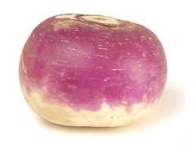
What vegetable was originally used for jack-o-lanterns?
Turnips were originally used. They were used because they looked like skeletons head. These were considered to contain (the heads) wisdom and the spirit and were stuck to the door to scare away the demons by the Celts. The Irish did it to remember Stingy Jack who wandered the earth with a turnip with a light in it because he either
http://wiki.answers.com/Q/What_vegetable_was_originally_used_to_make_a_Jack_o_lantern

