Slide 1
OUTPUT DEVICES
A SHORT PREVIEW ON OUTPUT DEVICES

Slide 2
WHAT IS AN OUTPUT DEVICE?
Devices that are used to get the processed data from the computer are called as Output Devices.
In other words the devices used to get results from a computer are called as Output Devices

Slide 3
Types of Output Devices
Soft Copy Output Devices
Devices that produce the kind of output which can be used only on a computer.
Example Speakers, Display screens

Slide 4
Types of Output Devices
Hard Copy Output Devices
Devices that produces the output which can be used without a computer also.
Example Printers

Slide 5
Printers
Printers are the hard copy output device that can print the information on a printing medium using different types of techniques.
Printers are divided into two categories
Impact Printers
Non impact printers

Slide 6
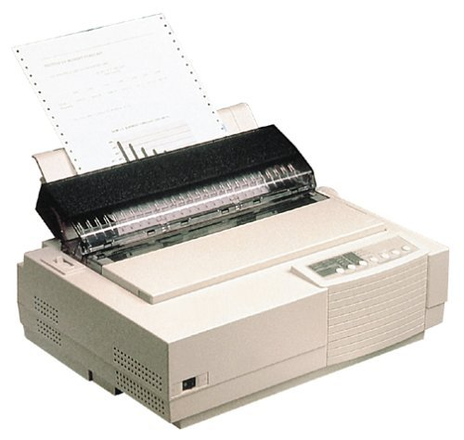
Impact Printer
An impact printer prints by making a physical contact with the printing medium.
Example Dot Matrix Printer

Slide 7
Dot Matrix Printer
Prints by striking the printing medium with small metallic pins through an ink ribbon.
Striking pins leaves a small dot on the printing medium
Arranging these tiny dots systematically creates a print on the paper.

Slide 8
Advantages of Dot Matrix
Very cheap printing.
Can be used to print Carbon Copies
Can be used to print on continuous stationery paper.
Good for printing utility bills or the kind of bulk printing which does not require a high quality of print.

Slide 9
Disadvantages of Dot Matrix
Creates a poor quality of print.
Creates a lot of noise while printing due to metallic pins striking the paper at high speeds
Slow printing speed.
Cannot print in multi colours
Not suitable for graphics printing
Expensive to purchase

Slide 10
Inkjet Printer
An inkjet printer prints by spraying a jet of ink on paper.
The Printing mechanism does not makes any physical contact with printing medium, so it is in category of Non-Impact printer.
Suitable for printing small quantities with high quality and multicolor.

Slide 11
Advantages Inkjet Printer
Able to print in multicolour
Cheap to buy
Quiet printing
Quality of printing is good
Light weight and small in size

Slide 12
Disadvantages of Inkjet Printer
Slower printing speed.
Printing Cost is high due to expensive ink
Print can smudge
Very delicate

Slide 13
Laser Printer
Produce a high quality output by using Laser light for printing.
Professional quality prints
Used in offices, business for printing high quality prints at a very good speed
Can be used for high volume printing

Slide 14
Advantages of Laser Printer
Very less noise while printing
High printing speed
High quality of printing
Not expensive to use
Best for high quality bulk printing

Slide 15
Disadvantages of Laser Printer
Expensive to buy
Coloured printing is expensive and available on very expensive Laser Printers.
Produce Ozone and other pollutants which can cause damage to environment

Slide 16
3D Printer
A 3D printer is used to create prototype 3D models using a technique called Tomography
Thin layers of material is slowly built up making the desired shape.
Used in industries to make prototype models without actually making the actual product.

Slide 17
Advantages of 3D Printer
Saves a lot of money and time on making prototype models.
Material used to print the model can be reused
Scaled models of products can be produced that gives a clear idea of how the final product will look like.

Slide 18
Disadvantages of 3D Printer
3D Printers are expensive to buy
Slow at building the shape
Final product is not very fine and needs some retouching before it can be used which adds few more steps and devices in completing the job.
Technology is still growing

Slide 19
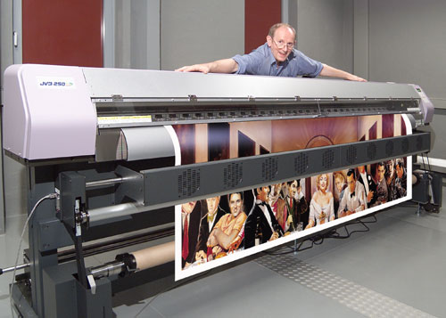
Plotter
Plotters are used to print on large size papers and with high quality and precision.
Plotters are large size devices with extensive printing technology.
Used for commercial purpose b companies and business houses.
Used for printing CAD designs, maps, high precision engineering drawings

Slide 20
Features of a Plotter
Plotters can produce huge size printouts
Quality of printing is extremely high
Slow in printing, can take several hours to finish one drawing
Expensive to buy, use and maintain

Slide 21
Display Devices
Display devices are soft copy output devices which show the output on a display screen.
Displays are the essential part of any computer system because without a proper display it is impossible to use the device.
Display devices have originated over a long time and there are many types available in the market. We will look at some of them

Slide 22
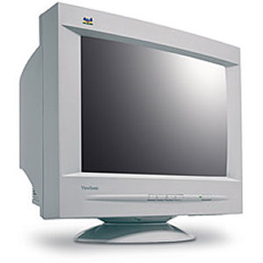
Cathode Ray Tube (CRT)
Uses a large size hollow tube of glass painted with Phosphorous on one side to display.
Old technology used in old televisions and computer monitors.

Slide 23
Advantages of CRT
Higher quality of image than other screens
Angle of viewing is very wide as compared to other screens.

Slide 24
Disadvantages of CRT
Heavy and large body
Produce too much heat in operation
Consume more power as compared to other devices
Flicker during operation that can cause headache and eyesight problems

Slide 25
TFT / LCD Monitors
Made up of tiny crystals which can emit different colors of light on applying electric current.
Controlled by a microprocessor
Used in Laptop computers as primary display

Slide 26
Advantages of TFT / LCD
Lightweight and small in size
Produce less glare or emitting light than CRT
Consume less power
Produce very less heat
Do not flicker during operation

Slide 27
Disadvantages of LCD / TFT
Angle of viewing a TFT is very much narrow
Display quality is not as good as CRT
Cannot be used with light pens. Light pens are sometimes must for working with CAD applications

Slide 28
Projectors
Projectors takes the video input from a computer or a DVD player and projects it on a large screen by zooming the display several times.
Used for presentations.
Used for advertising in shopping malls
Used to show movie in theaters and home cinema systems.

Slide 29
Features of Projector
Many people can see the display together
Small in size
Quality of display is not distorted
Expensive to buy and maintain
Sometimes difficult to setup
Display can be fuzzy if interfered by external light

