Slide 1
Carpe Diem Poetry

Slide 2
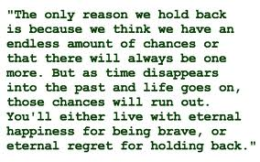
Carpe Diem
A Latin phrase that means “seize the day”

Slide 3
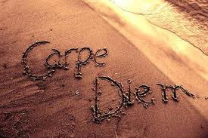
Quick Write
What would you do if you had twenty-four hours left to live?

Slide 4
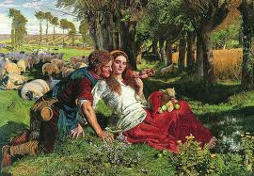
Pastoral Poetry
Set in an idealized countryside inhabited by handsome shepherds and beautiful women
Living in harmony with nature
Longing or nostalgia for simpler, more innocent times

Slide 5
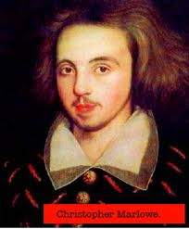
Christopher Marlowe
(1564-1593)
Son of a Canterbury shoemaker
Won scholarships to Cambridge University
A spy; helped keep track of Roman Catholics (Queen Elizabeth)
Wrote plays and poems
Stabbed to death in a bar fight
The Tragical History of Dr. Faustus

Slide 6
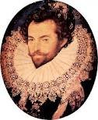
Sir Walter Raleigh
(1552-1618)
Queen Elizabeth’s confidential secretary and captain of her guard
Passionately devoted to colonizing the Americas
  One of the first Englishmen to smoke tobacco and grow potatoes
Convicted of treason during King James’s reign and executed
only about 35 of his poems survived

Slide 7
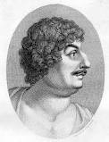
Robert Herrick
(1591-1674)
An apprentice to his jeweler uncle
Entered a university at age 22
Lived in London as a member of Ben Jonson’s circle of friends
Ordained a priest
Died at 83

Slide 8
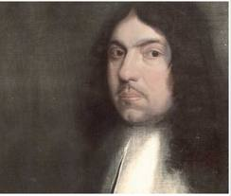
Andrew Marvell
(1621-1678)
Son of a clergyman
Cambridge University
Traveled abroad; worked as a tutor
Served as a member of Parliament
Wrote only for his friends and his personal entertainment
Housekeeper sold his poems to a publisher after his death

Slide 9
Sonnets
“little sound; song”
14 lines
Conforms to strict patterns of rhythm and rhyme
Turn
  Question-answer
  Problem-solution
  Theme-comment
3 types of sonnets
  Petrarchan/Italian
  Shakespearean/English
  Spenserian

Slide 10
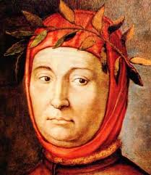
Petrarchan/Italian
Francesco Petrarca
Two parts
  Octave – 8 line section; (abbaabba)
  Sestet – 6 line section;(ccdeed)

Slide 11
Sonnet 42
Petrarch
The spring returns, the spring wind softly blowing
Sprinkles the grass with gleam and glitter of showers
Powdering pearl and diamond, dripping with flowers,
Dropping wet flowers, dancing the winters going:
The swallow twitters, the gloves of midnight are glowing
With nightingale music and madness; the sweet fierce powers
Of love flame up through the earth; the see-soul towers
And trembles; nature is filled to overflowing…
The spring returns, but there is no returning
Of spring for me. O heart with anguish burning!
She that unlocked all April in a breath
Returns not…And these meadows, blossoms, birds
These lovely gentle girls – words, empty words
As bitter as the black estates of death!

Slide 12
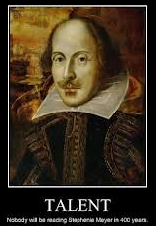
Shakespearean/English
Iambic pentameter
Four parts
  3 quatrains – 4 lines each (abab cdcd efef)
  Couplet – 2 lines (gg)

Slide 13
Sonnet 18
Shakespeare
Shall I compare thee to a summer’s day?
Thou art more lovely and more temperate.
Rough winds do shake the darling buds of May,
And summer’s lease hath all too short a date.
Sometime too hot the eye of heaven shines,
And often is the gold complexion dimmed;
And every fair from fair sometime declines,
By chance, or nature’s changing course untrimmed.
But thy eternal summer shall not fade,
Not lose possession of that fair thou owest,
Nor shall Death brag thou wander’st in his shade
When in eternal lines to time thou grow’st.
So long as men can breathe, or eyes can see,
So long lives this, and this gives life to thee.

Slide 14
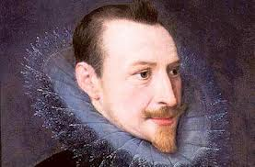
Spenserian
Edmund Spenser
  “the poet’s poet”
Iambic pentameter
Four Parts
  3 quatrains (abab bcbc cdcd)
  couplet (ee)

Slide 15
Sonnet 30
Edmund Spenser
My love is like to ice, and I to fire;
How comes it then that this her cold so great
Is not dissolved through my so hot desire,
But harder grows the more I her entreat?
Or how comes it that my exceeding heat
Is not delayed by her heart frozen cold,
But that I burn much more in boiling sweat,
And feel my flames augmented manifold?
What more miraculous thing may be told
That fire which all thing melts, should harden ice,
And ice which is congealed with senseless cold,
Should kindle fire by wonderful device?
Such is the power of love in gentle mind,
That it can alter all the course of kind.

