Slide 1
Parts of a Computer

Slide 2
Parts of a Computer
A computer has various parts, and each part performs a specific function. These parts can be classified as input devices, output devices, CPU and memory, motherboard, expansion cards, storage devices and services, and ports and connections.

Slide 3
Input Devices

Slide 4
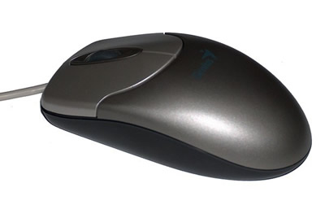
Mouse
A device that you use to interact with items displayed on the computer screen. A standard mouse has a left and a right button.
You use the left button to select items and provide instructions by clicking an active area on the screen. You use the right button to display commonly used menu items on the screen.

Slide 5
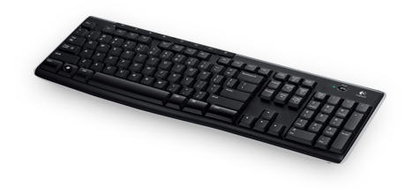
Keyboard
A set of keys that resembles a keyboard on a typewriter. You use the keyboard to type text such as letters or numbers into the computer.

Slide 6
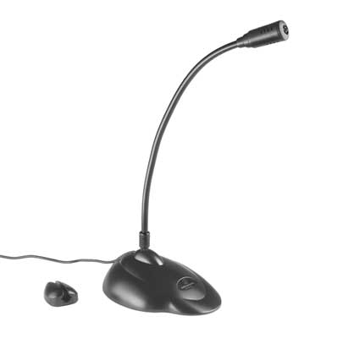
Microphone
A device that you can use to talk to people in different parts of the world. You can record sound into a computer by using a microphone. You can also record your speech and let the computer convert it into text.

Slide 7
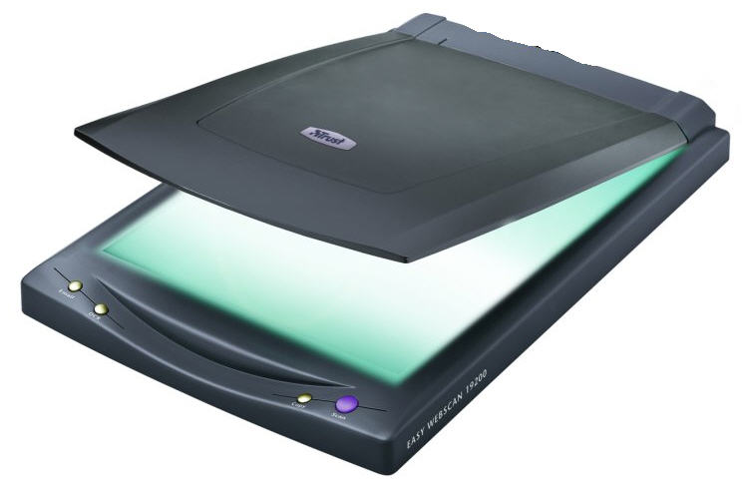
Scanner
A device that is similar to a photocopy machine. You can use this device to transfer an exact copy of a photograph or document into a computer. A scanner reads a page and translates it into a digital format that a computer can read.

Slide 8
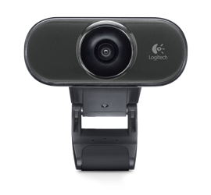
Webcam
A device that is similar to a video camera. It allows you to capture and send live pictures to other users. For example, a Webcam allows your friends and family to see you when you are communicating with them.

Slide 9
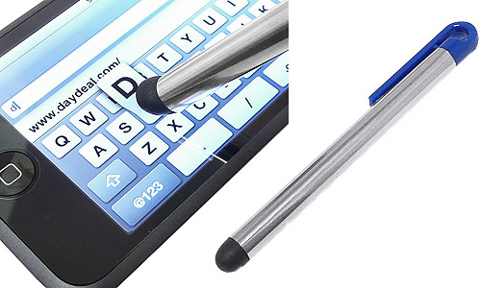
Stylus
A pointing device, similar to a pen, used to make selections and enter information by tapping on a touch sensitive surface.

Slide 10
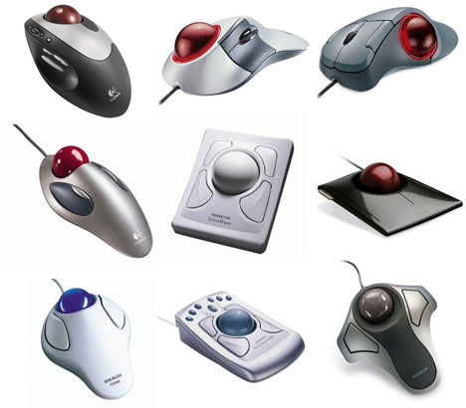
Trackball
A pointing device that is an alternative to a mouse. A trackball consists of a ball that is rotated to move the pointer on a computer screen. You can use a trackball when you have limited desk space.

Slide 11
Output Devices

Slide 12
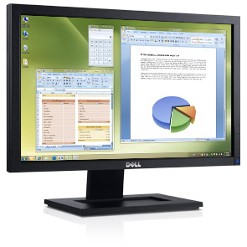
Monitor
A device that is similar to a television. It is used to display information in the form of text and graphics.

Slide 13
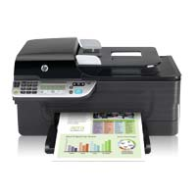
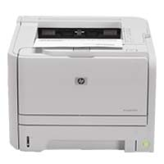
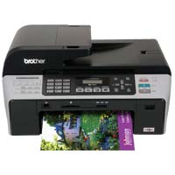
Printer
A device that you use to transfer text and images from a computer to a paper or to another medium, such as a transparency film. You can use a printer to create a paper copy of whatever you see on your monitor.

Slide 14
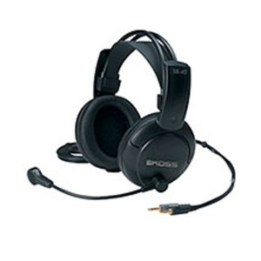
Speakers and Headphones
A device that allows you to hear sounds. Speakers may either be external or built into the computer.

Slide 15
CPU and Memory
The CPU is a device that interprets and runs the commands that you give to a computer. It is the control unit of a computer. The CPU is also referred to as the processor.
Memory is where information is stored and retrieved by the CPU. There are three main types of memory.

Slide 16
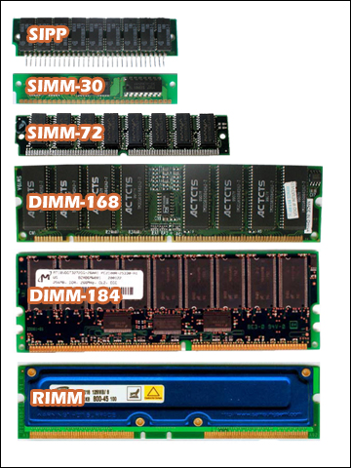
Random Access Memory (RAM)
It is the main memory of a computer and allows you to temporarily store commands and data. The CPU reads data and commands from RAM to perform specific tasks. RAM is volatile, which means it is available only while the computer is turned on. The contents of RAM must be copied to a storage device if you want to save the data in the RAM.

Slide 17
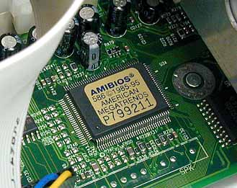
Read Only Memory (ROM)
It is the memory that retains its contents even after the computer is turned off. ROM is nonvolatile, or permanent, memory that is commonly used to store commands, such as the commands that check whether all parts of the computer are working properly before you can actually work with the computer.

Slide 18
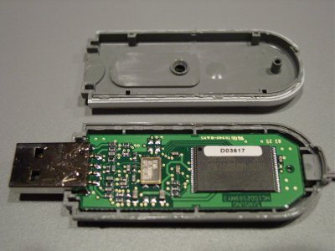
Flash Memory
It is a nonvolatile memory that retains data even after a computer is turned off. Unlike in ROM, you can erase or modify stored information.

Slide 19
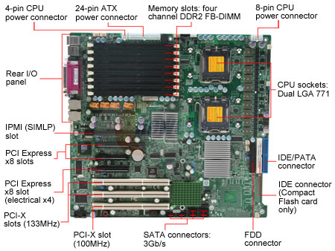
Motherboard
The motherboard is the main circuit board inside a computer. It has tiny electronic circuits and other components on it. The motherboard connects input, output, and processing devices together and tells the CPU how to run.

Slide 20
Expansion Card
An expansion card is a circuit board that can be attached to a motherboard to add features such as video display and audio capability to your computer. An expansion card improves the performance of your computer and enhances its features. Expansion cards are also called expansion boards.
Video card, NIC, Sound card

Slide 21
Storage Devices & Services
You use storage devices to store computer information. Storage devices come in many forms. Some examples are hard drive or disk, CD-ROM, floppy disk, and DVD-ROM. Storage devices can be divided into two types, internal storage devices and external storage devices.

Slide 22
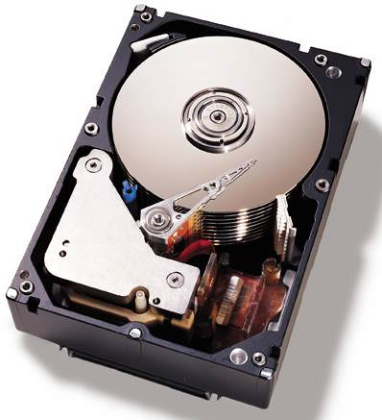
Hard disk
A magnetic disk that is usually the main storage device on most computers. It can be an external or an internal device.

Slide 23
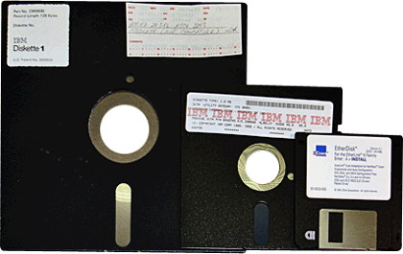
Floppy Disk
A portable storage device that allows you to store a small amount of data. A disadvantage of this disk is that it can be easily damaged by heat, dust, or magnetic fields.

Slide 24
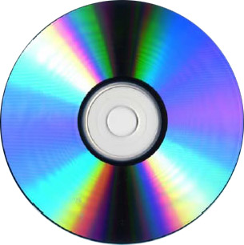
CD-ROM
A portable storage medium that allows you to store 400 times more data than on a floppy disk. It is less prone to damage than a floppy disk.

Slide 25
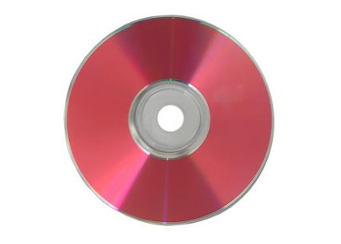
DVD-ROM
A portable storage medium that is similar to a CD-ROM; however, it can store larger amounts of data than a floppy disk or a CD-ROM. A DVD-ROM is commonly used to store movies and videos.

Slide 26
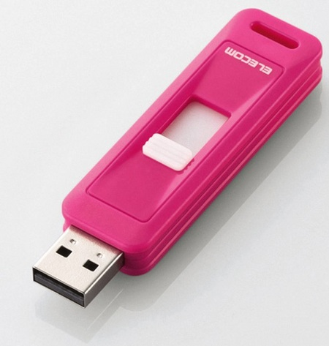
USB Flash Drive
A small portable storage device that is typically the size of a thumb. USB flash drives have less storage capacity as compared to an external hard-drive but are more durable and easy-to-use. They can be plugged into any computer with a USB drive and as such are a very popular medium of storage.

Slide 27
Cloud Storage
A modern, fast growing storage service that uses the Internet and central remote servers to maintain and store data and applications. Windows Live SkyDrive is an example of cloud storage service. SkyDrive provides enough free storage for thousands of documents and photos, has powerful permissions settings, and offers Microsoft Office Web Apps that you can access online.

Slide 28
Ports and Connections
A port is a channel through which data is transferred between input/output devices and the processor. There are several types of ports that you can use to connect a computer to external devices and networks.

Slide 29
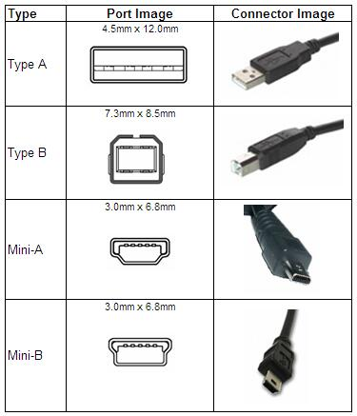
Universal Serial Bus (USB) port
You use this to connect peripheral devices such as a mouse, modem, keyboard, or printer to a computer.

Slide 30
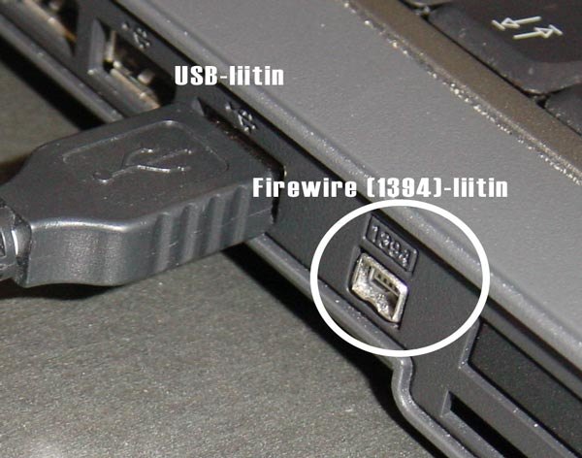
Firewire
You use this to connect devices such as a digital camera. It is faster than a USB port.

Slide 31
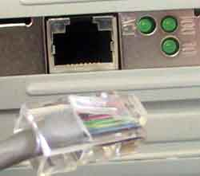
Network Port
You use this to connect a computer to other computers to exchange information between the computers.

Slide 32
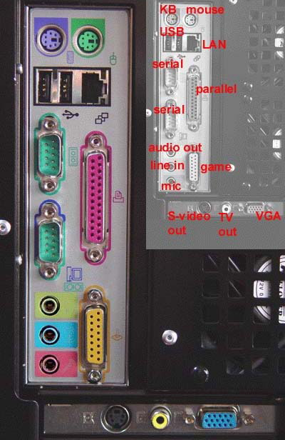
Parallel Port & Serial Port
You use these ports to connect printers and other devices to a personal computer. However, the USB port is now preferred to connect peripheral devices because it is faster and easier to use.

Slide 33
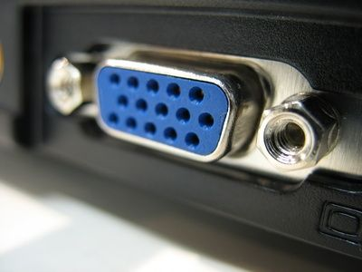
Display Adapter
You connect a monitor to a display adapter on your computer. The display adapter generates the video signal received from a computer, and sends it to a monitor through a cable. The display adapter may be on the motherboard, or on an expansion card.

Slide 34
Power
A motherboard and other components inside a computer use direct current (DC). A power supply takes alternating current (AC) from a wall outlet and converts it into DC power.

