Slide 1
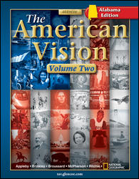
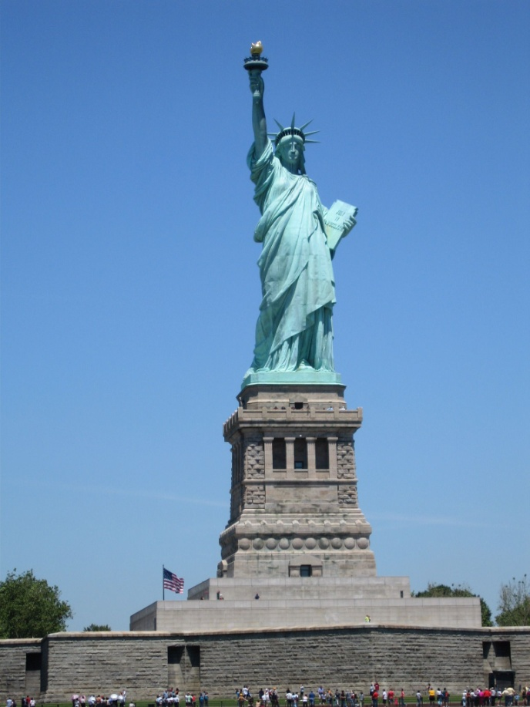
American History 2 Chapter 15

Slide 2
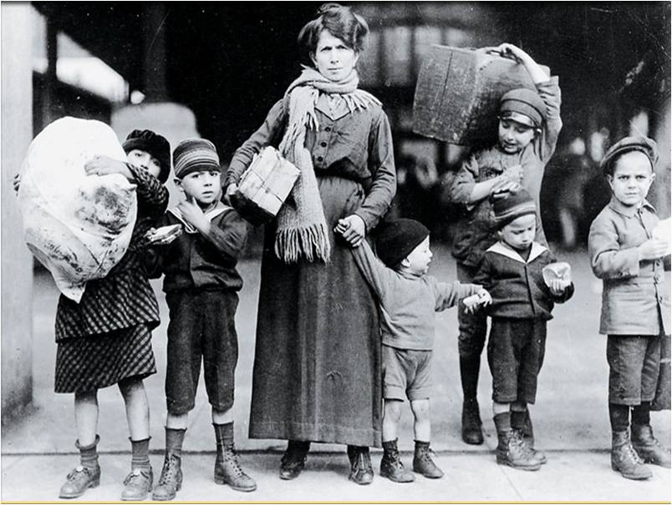
Chapter 15
15.1 Immigration
15.2 Urbanization
15.3 The Gilded Age
15.4 The Birth of Reform

Slide 3
Alabama Standards
ACOS: 1. Explain the transition of the United States from an agrarian society to an industrial nation prior to World War I.
AHSGE Standard V: 2. Evaluate the concepts, developments, and consequences of industrialization and urbanization.

Slide 4
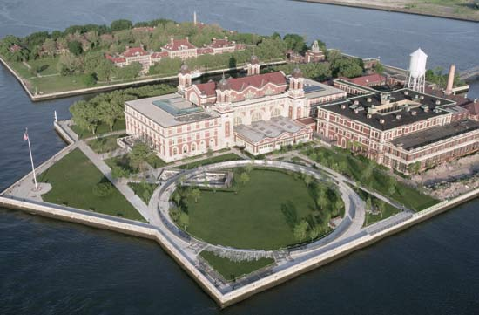
15.1 Immigration
European Immigrants
Asian Immigration
Resurgence of Nativism
Additional Activities

Slide 5
European Immigrants
Most of the “New” immigrants came from southern and eastern Europe.
America offered immigrants:
Employment
few immigration restrictions
avoidance of military service
religious freedom
chance to move up the social ladder.

Slide 7
European Immigrants
Most immigrants took the difficult trip to America in steerage, the least expensive accommodations on a steamship.
They usually ended at Ellis Island, a small island in New York Harbor.
It served as a processing center for most immigrants arriving on the East coast after 1892.
Immigrants at Ellis Island

Slide 8
European Immigrants
Most immigrants passed through Ellis Island in a day.
Some were separated from family and even sent back to Europe due to health problems.
Immigrants at Ellis Island

Slide 9
European Immigrants
Most immigrants settled in cities.
They lived in neighborhoods that were separated into ethnic groups.
They duplicated their homelands, including language and religion.
Many immigrants adapted to American culture.

Slide 10
European Immigrants
Additional Activity: Read about Vincent Scilipoti.

Slide 11
European Immigrants: Discussion Question:
What helped immigrants adjust to living in the United States?
Learning English
Adapting to the American culture.
Learning skills
Earning money
Living among their own ethnic group
Immigrants at Ellis Island

Slide 12
Asian Immigration
Chinese immigrants were lured to the U.S. by
Severe unemployment
poverty
famine
California Gold Rush
Taiping Rebellion in China
demand for railroad workers in the U.S.

Slide 13
Asian Immigration
They worked as laborers, servants, skilled tradesmen, and merchants.
Japanese immigrants also cross the Pacific.
In 1910 a barracks was opened on Angel Island in California.
Asian immigrants waited sometimes for months for the results of immigration hearings.

Slide 14
Physicals at Angel Island

Slide 15
What do you think caused the large changes in immigration?

Slide 16
The Resurgence of Nativism
The increase in immigration led to nativism, an extreme dislike for foreigners by native-born people and the desire to limit immigration.
The Irish faced discrimination in the 1840s and 1850s.
In the early 1900s, the Asians, Jews, and eastern Europeans were the focus of nativism.

Slide 17
The Resurgence of Nativism
Nativism led to the forming of two anti-immigrant groups:
The American Protective Association had 500,000 members by 1887.
The founder, Henry Bowers, wanted to stop immigration, especially catholics.
In the 1870s, Denis Kearny organized the Workingman’s Party of California to stop Chinese immigration.

Slide 18
Click the mouse button or press the Space Bar to display the answer.

Slide 19
The Resurgence of Nativism
In 1882 Congress passed the Chinese Exclusion Act.
It barred Chinese immigration for 10 years.
It also prevented the Chinese already in America from becoming citizens.

Slide 20
The Resurgence of Nativism
This act was renewed by Congress in 1892, made permanent in 1902, and not repealed until 1943.

Slide 22
Additional Activities
Turn to page 466 in The American Vision.

Slide 23
15.2 Urbanization
Americans Migrate to the Cities
The New Urban Environment
Separation by Class
Urban Problems
Urban Politics
Mobile, Alabama

Slide 24
Alabama Standards
ACOS: 1.) Explain the transition of the United States from an agrarian society to an industrial nation prior to World War I.
AHSGE Standard V: 2. Evaluate the concepts, developments, and consequences of industrialization and urbanization.

Slide 25
Americans Migrate to the Cities
Urbanization increased in the late 1800’s.
Immigrants stayed in the cities
They worked long hours for little pay.
Many believed their standard of living had improved in the U.S.

Slide 26
Americans Migrate to the Cities
Farmers began moving to cities because of:
better paying jobs
electricity
running water
plumbing
entertainment.

Slide 27
The New Urban Environment
Housing and transportation needs changed as more people moved to the cities.
As the price of land increased, building owners began to build skyscrapers.

Slide 28
The New Urban Environment
Chicagoan Louis Sullivan contributed to the design of skyscrapers.
In the late 1800s, various kinds of mass transit developed like horsecars and electric trolley cars.

Slide 30
Separation by Class
It was easy to tell where the wealthy, middle class, and working class people lived.
Wealthy families built fancy houses in the heart of the city.

Slide 31
Separation by Class
The middle class, which included doctors, lawyers, engineers, and teachers, tended to live away from the city.
Most of the working class lived in city tenements, or dark and crowded multi-family apartments.

Slide 32
Urban Problems
The growth of cities resulted in an increase in crime, fire, disease, and pollution.
Native-born Americans blamed immigrants for the increase in crime.
Alcohol contributed to crime in the late 1800s.
Contaminated drinking water from improper sewage disposal resulted in epidemics of typhoid fever and cholera.

Slide 33
Urban Problems Discussion Question:
Were native-born Americans correct in blaming immigrants for the increase in crime and violence?
Why or why not?

Slide 34
Urban Politics
The political machine, an informal political group designed to gain and keep power, provided benefits in exchange for votes.
Party bosses ran the political machines and controlled the city’s money.
George Plunket was one of New York City’s most powerful party bosses.

Slide 35
Urban Politics
Many of the politicians became wealthy due to fraud or graft–getting money through dishonest or questionable means.
The most famous New York Democratic political machine was Tammany Hall.
William M. Tweed ran the Tammany Hall machine until he was arrested for corruption in 1874.

Slide 36
Who stole the People’s Money…’Twas him!

Slide 37
Urban Politics
Thomas and James Pendergast ran state and city politics in Kansas City, Missouri from the 1890s to the 1930s.

Slide 38
Just for fun…
What young politician did Tom Pendergast help get started in politics?
Hint: He later became a U.S. President!

Slide 39
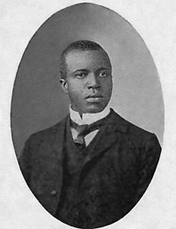
15.3 The Gilded Age
A Changing Culture
Social Darwinism
Realism
Popular Culture
Scott Joplin
www.pandora.com

Slide 40
Alabama Standards
ACOS: 1.) Explain the transition of the United States from an agrarian society to an industrial nation prior to World War I.
AHSGE Standard V: 2. Evaluate the concepts, developments, and consequences of industrialization and urbanization.

Slide 41
A Changing Culture
In 1873 Mark Twain and Charles Warner co-wrote the novel, The Gilded Age.
Historians use this term to refer to the time between 1870 and 1900.
The term “gilded” refers to something being gold on the outside while the inside is made of cheaper material.
This was a time of growth, but corruption and poverty also increased.

Slide 42
A Changing Culture
Industrialization and urbanization gave way to new values, art, and forms of entertainment.
A strong belief during the Gilded Age was the idea of individualism.
This is the belief that regardless of your background, you could still rise in society.
Horatio Alger, a minister, left the clergy and wrote over 100 novels about rags-to-riches stories.

Slide 43
Social Darwinism
Herbert Spencer first proposed the idea of Social Darwinism.
Spencer took Charles Darwin’s theory of evolution and natural selection and applied it to human society.
Spencer supported the idea of the survival of the fittest.
He concluded that society progressed and became better because only the fittest people adapted and survived.
Herbert Spencer

Slide 44
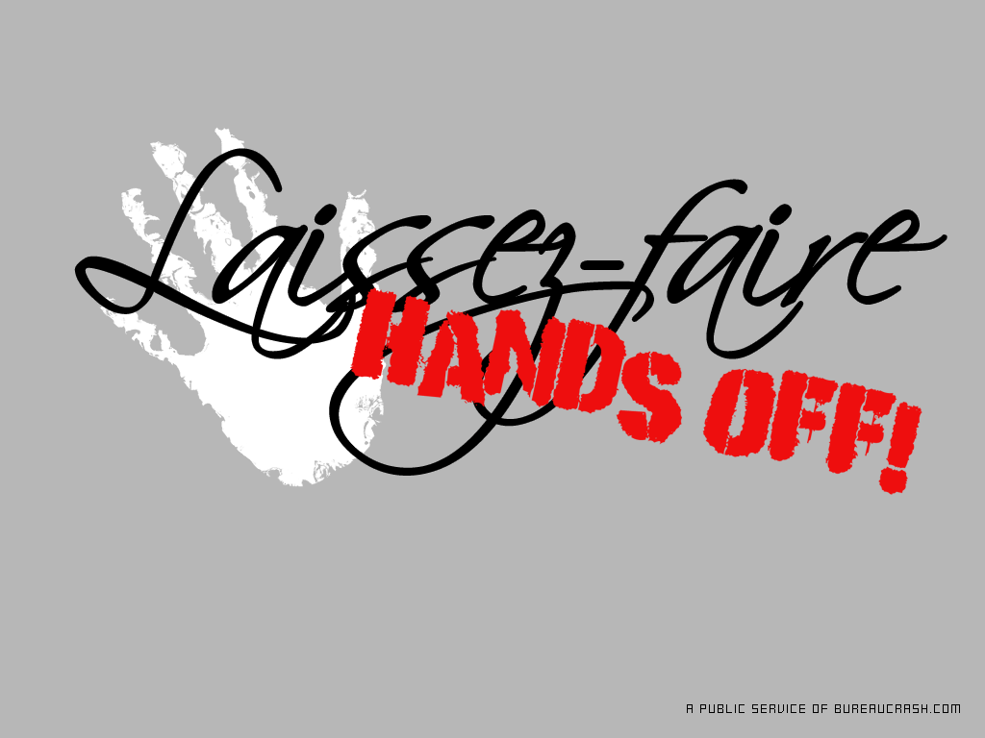
Social Darwinism
Industrial leaders agreed with Social Darwinism.
Social Darwinism paralleled laissez-faire.
Many opposed the idea of Darwin’s conclusions about the origin of new species.
They rejected the theory of evolution because it went against the Bible’s account of creation.

Slide 45
Social Darwinism
Andrew Carnegie believed in Social Darwinism and laissez-faire.
He softened Social Darwinism with his Gospel of Wealth.
This philosophy stated that wealthy Americans should engage in philanthropy, using great fortunes to further social progress.

Slide 46
Realism
Realism portrayed people in realistic situations instead of idealizing them like the romantic artists did.
Thomas Eakins painted ordinary living in a realistic fashion.
He used realistic detail and precise lighting.
A Self-Portrait of Thomas Eakins

Slide 49
Realism
William Dean Howells wrote realistically about American life.
Mark Twain wrote Adventures of Huckleberry Finn in 1884.
Twain is thought to have written the first true American novel.
Mark Twain

Slide 50
Realism
Henry James portrayed the lives of the upper class in his 1881 novel, Portrait of a Lady.
Edith Wharton won a Pulitzer Prize for the novel The Age of Innocence.
He portrayed the complicated lives of the upper-class in New York in the 1870s.

Slide 51
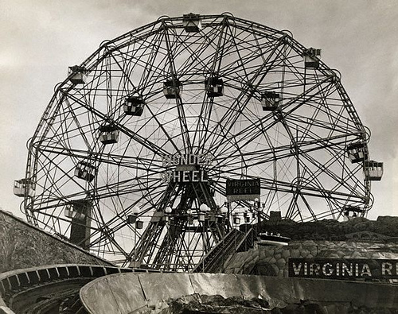
Popular Culture
In the late 1800s, people had more money to spend on entertainment.
Work became separate from home.
People started “going out” to public entertainment.
During the 1800s, the saloon acted like a community and political center for male workers.

Slide 52
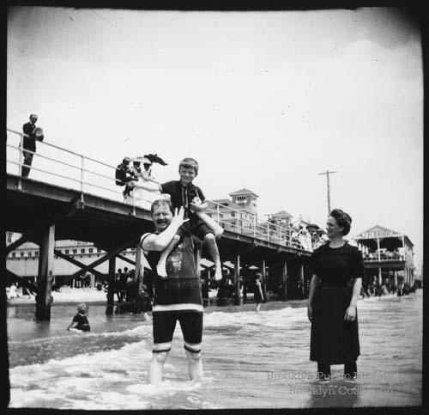
Popular Culture
Coney Island in New York was an amusement park that attracted working class families and single adults.
It offered amusements such as water slides and railroad rides.

Slide 53
Popular Culture
Baseball appeared in the U.S. in the early 1800s.
In 1869 the first salaried team, the Cincinnati Red Stockings, was formed.
Football and basketball also became popular.

Slide 54
Popular Culture
In the early 1880s, vaudeville became popular.
It was adapted from the French theater and combined animal acts, acrobats, gymnasts, and dancers in its performance.

Slide 58
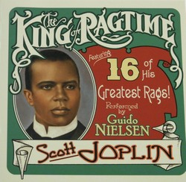
Popular Culture
People also began enjoying ragtime music.
The most famous African American ragtime composer was Scott Joplin, the King of Ragtime.
www.pandora.com

Slide 59
15.4 The Birth of Reform
Social Criticism
Naturalism in Literature
Helping the Urban Poor
Public Education
Booker T. Washington

Slide 60
Alabama Standards
ACOS: 1.) Explain the transition of the United States from an agrarian society to an industrial nation prior to World War I.
AHSGE Standard V: 2. Evaluate the concepts, developments, and consequences of industrialization and urbanization.

Slide 61
Social Criticism
In 1879, Henry George wrote a book called Progress and Poverty.
It challenged the ideas of Social Darwinism and laissez-faire economics.

Slide 62
Social Criticism
In 1883 Lester Frank Ward’s Dynamic Sociology argued that humans were unlike animals because they could think and plan ahead.
He concluded that it was cooperation and not competition that caused people to succeed.
He wanted government to help solve societal problems.

Slide 63
Social Criticism
These ideas became known as Reform Darwinism.
In 1888 Edward Bellamy’s Looking Backward 2000–1887 tells the story of a perfect society in the year 2000.

Slide 64
Naturalism in Literature
Realists argued that people could make choices to improve their situation.
In naturalism, writers criticized industrial society.
They suggested that some people failed in life due to circumstances they could not control.
Jack London

Slide 65
Naturalism in Literature
Prominent naturalist writers included Stephan Crane, Frank Norris, Jack London, and Theodore Dreiser.
All wrote stories of characters caught up in situations they could not control.
Jack London

Slide 66
Helping the Urban Poor
Several organizations formed to help the needy:
The Social Gospel movement
Salvation Army
YMCA
women’s clubs
settlement houses
temperance movements

Slide 67
Helping the Urban Poor
Minister Washington Gladden was an early supporter of the Social Gospel movement.
He wanted to apply “Christian Law” to social problems.
From 1870 to 1920, supporters worked to better conditions in cities through charity and justice.

Slide 68
Helping the Urban Poor
Baptist minister Walter Rauschenbusch later led the movement.
He believed that competition was the cause of many social problems.
Many churches began offering gyms, social programs, and daycare.

Slide 69
Helping the Urban Poor
In 1878 the Salvation Army offered aid and religious counseling to urban poor.
The YMCA helped industrial workers and urban poor through Bible studies, prayer meetings, citizenship training, and group activities.

Slide 70
Helping the Urban Poor
Dwight L. Moody was an evangelical Christian and president of the Chicago YMCA.
By 1867 Moody brought his revival meetings to other cities.
He was against Social Gospel and Social Darwinism.
He felt the way to help the poor was by redeeming their souls and not by providing them with services.

Slide 71
Helping the Urban Poor
The settlement house movement tried to improve the living conditions of the poor.
Jane Addams set up settlement houses in poor neighborhoods.
Addams opened Hull House in 1889.

Slide 72
Helping the Urban Poor
Lillian Wald established a Henry Street settlement house in New York City.
Medical care, recreation programs, and English classes were provided at settlement houses.

Slide 73
Public Education
Industry needed better-trained workers.
More schools and colleges developed in the late 1800s.
Americanization, or becoming knowledgeable about American culture, was key to the success of immigrants.

Slide 74
Public Education
Booker T. Washington improved education for African Americans by forming the Tuskegee Institute in Alabama in 1881.
The grammar school system divided students into eight separate grades.

Slide 75
Public Education
The Morrill Land Grant Act gave federal land grants to states for the purposes of establishing agricultural and mechanical colleges.
The number of women’s colleges also increased.

Slide 76
Public Education
Free libraries provided education to city dwellers.
Andrew Carnegie donated millions toward the construction of libraries.

Slide 77
Test Tomorrow!

