Slide 1
American Government
Chapter Three: The Constitution

Slide 2


Alabama Course of Study
Chapter 3: The Constitution
2.) Analyze purposes, organization, functions, and principles of the Constitution of the United States and the Bill of Rights.
9.) Identify constitutional provisions of the legislative branch of the government of the United States.
10.) Identify constitutional provisions of the executive branch of the government of the United States.
11.) Identify constitutional provisions of the judicial branch of the government of the United States.

Slide 3
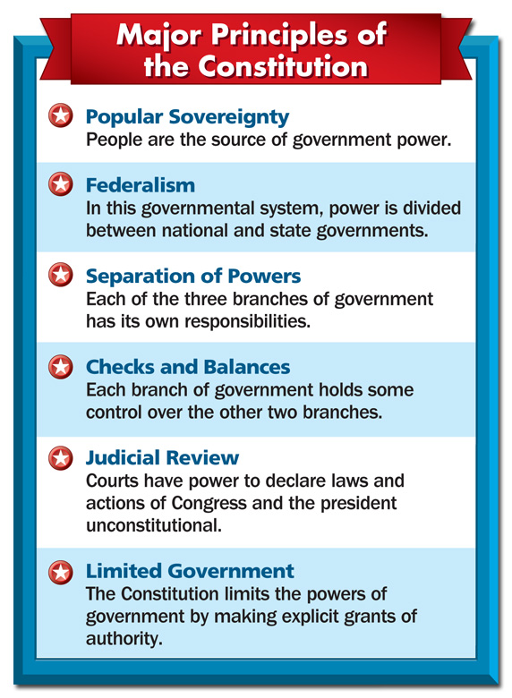
3.1 The Structure and Principles
Structure
Six Basic Principles
  Popular Sovereignty
  Federalism
  (federal system of powers)
  Separation of Powers
  Checks and Balances
  Judicial review
  Limited Government

Slide 4
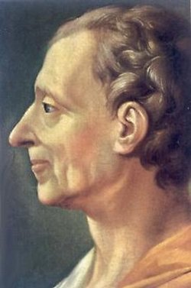
Structure
The U.S. Constitution follows Montesquieu's ideas about separation of powers.
It has three parts to it:
  1 Preamble
  7 Articles
  27 Amendments

Slide 5
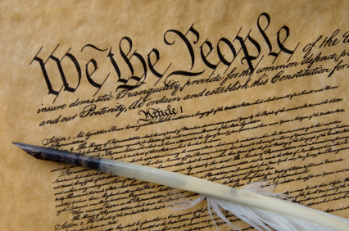
Structure
Preamble
  The Preamble outlines the goals of the Constitution.
  “We the People of the United States,
    in Order to form a more perfect Union,
    establish Justice,
    insure domestic Tranquility,
    provide for the common defense,
    promote the general Welfare, and
    secure the Blessings of Liberty to ourselves and our Posterity,
  do ordain and establish this Constitution for the United States of America.”

Slide 7
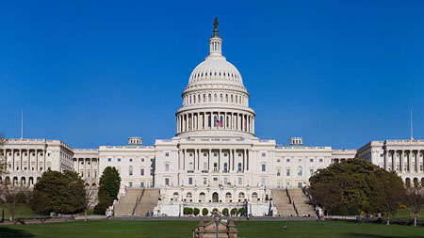
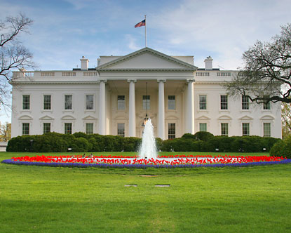
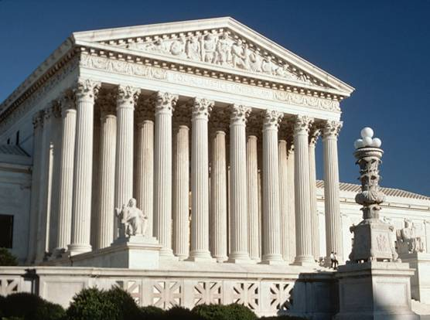
Structure
Seven Articles
  Each article discusses a different topic.
    Article I: The Legislative Branch
    Article II: The Executive Branch
    Article III: Judicial Branch
    Article IV: National/ State Relations and Obligations
    Article V: Methods of Amendment
    Article VI: Supremacy of the Constitution as law
    Article VII: Process of Ratifying the Constitution
  The articles may be divided into sections

Slide 8
Structure
27 Amendments
  The amendments are changes to the original constitution.
  Although the Constitution is over 200 years old, it has only been changed 27 times.

Slide 9
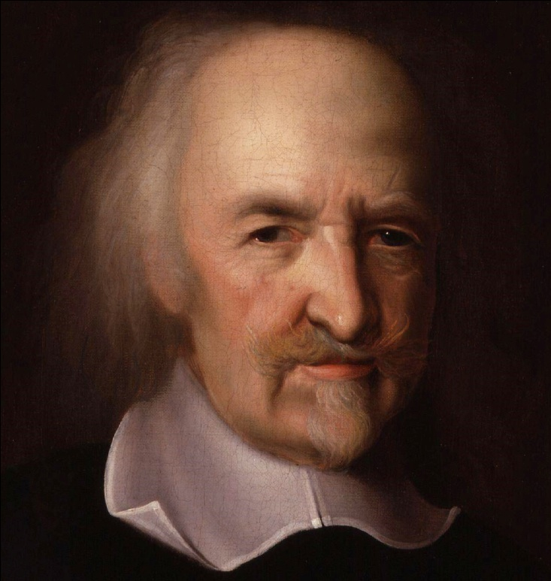
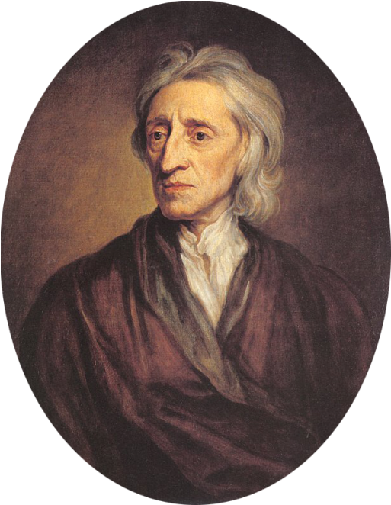
Six Key Principles
Popular Sovereignty
  It is rule by the people.
  The U.S. government gets its authority through the consent of the governed.
Above: Thomas Hobbes
Below John Locke

Slide 10
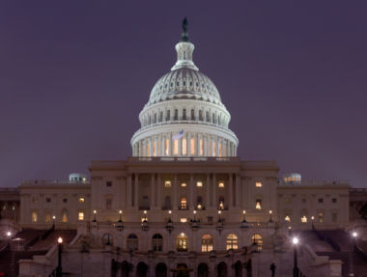
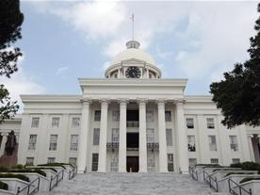
Six Key Principles
Federalism (federal system of powers)
  This divides the powers of government between two levels of government.
  The idea of federalism is found in the tenth amendment.
  It states that powers not granted to the national government belong to the states.
  It gives the national government sovereignty to act for the country while leaving states power to control local matters.

Slide 12
Six Key Principles
Separation of Powers
  The Constitution established three separate branches of government: the legislative, executive, and judicial branches.
  The legislative branch consists of Congress (the House of Representatives and the Senate) and is responsible for making laws.
  The executive branch consists of the president and the vice president and is responsible for carrying out, or enforcing, the laws.
  The judicial branch consists of the Supreme Court and other federal courts and is responsible for interpreting the laws.

Slide 13


Slide 15
Six Key Principles
Checks and balances
  This system prevents the misuse of power by any one branch.
  It gives each branch some control over the other two.
  Examples: (You don’t have to write this part!)
    Congress may pass bills but the president may veto them, and Congress can override the veto with a two-thirds vote of both houses.
    The President makes treaties with foreign nations, but they must be ratified by two-thirds of the Senate.
    The Supreme Court may declare laws unconstitutional, but Congress may amend the Constitution

Slide 16
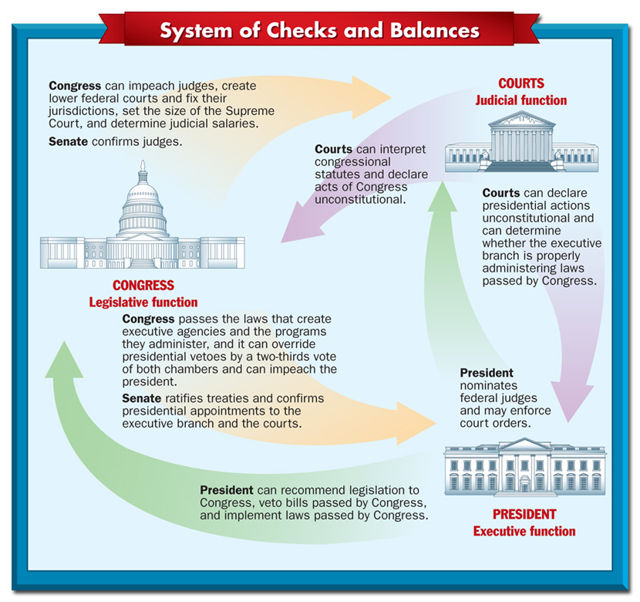

Slide 18
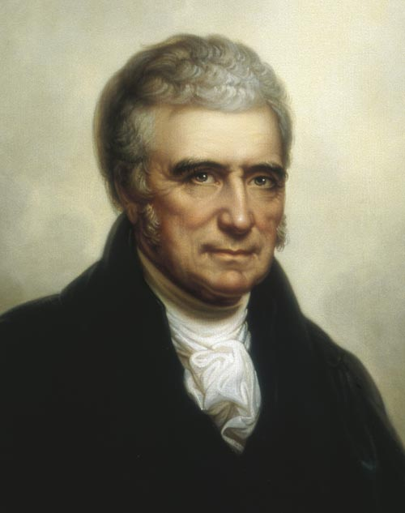
Six Key Principles
Judicial review
  Judicial review is defined as "the power of the courts to declare laws and actions of local, state, or national governments invalid if they violate the Constitution."
  The Founders did not elaborate on this concept in the Constitution.
  Marbury v. Madison firmly established the concept in 1803.
John Marshall

Slide 20
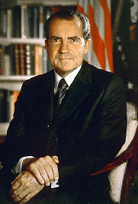
Six Key Principles
Limited Government
  The Constitution restricts the actions and powers of government.
  An example of limited government in action includes Richard Nixon's involvement in the Watergate Affair.

Slide 21
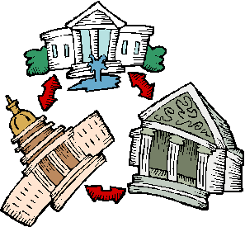
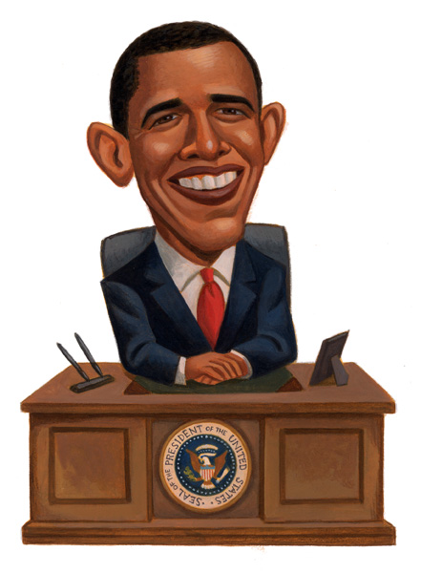
3.2 The Three Branches of Government
The Legislative Branch
The Executive Branch
The Judicial Branch

Slide 22
Alabama Course of Study
Chapter 3: The Constitution
2.) Analyze purposes, organization, functions, and principles of the Constitution of the United States and the Bill of Rights.
9.) Identify constitutional provisions of the legislative branch of the government of the United States.
10.) Identify constitutional provisions of the executive branch of the government of the United States.
11.) Identify constitutional provisions of the judicial branch of the government of the United States.

Slide 23

The Legislative Branch
Article I of the Constitution establishes a bicameral legislature.
It lists the enumerated powers of Congress mostly found in Article I, Section 8.
These powers address economic, security, and civil issues.

Slide 24
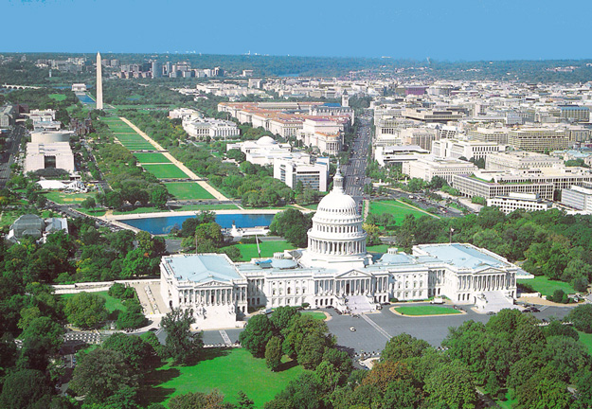
The Legislative Branch
The elastic clause gives Congress the power to do whatever is "necessary and proper" to fulfill its duties.

Slide 25
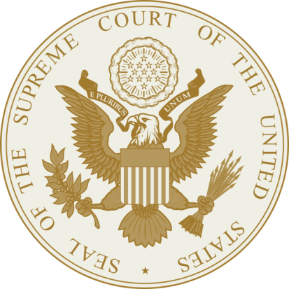
The Legislative Branch
The first time the Supreme Court interpreted the elastic clause was in 1819 in the McColloch v. Maryland.
  The Court favored a broad interpretation.
  It allowed Congress to have other powers if necessary to carry out its responsibilities mentioned in the Constitution.

Slide 26
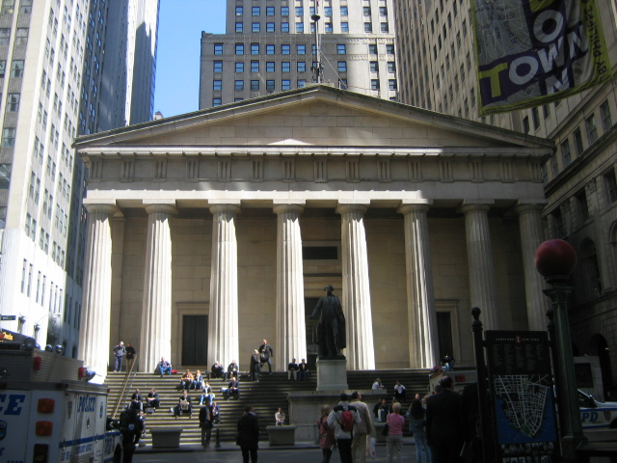
The Legislative Branch
Congress moved from Federal Hall in New York to Philadelphia in 1790.
Federal Hall in NYC

Slide 27
The Executive Branch
The president is the head of the executive branch.
Article II, Sections 2 and 3 address most of the president's powers.
The Constitution gives the President both vague and specific powers.

Slide 28
The Executive Branch
The federal bureaucracy also makes up the executive branch.

Slide 29
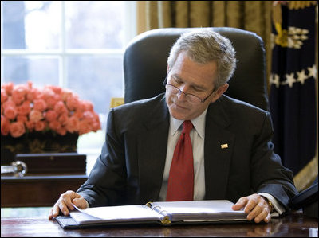
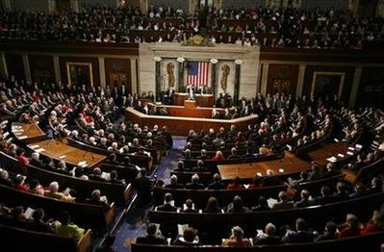
The Executive Branch
The president helps set the agenda for legislation.
  This is often accomplished through the president's State of the Union address.
  The State of the Union address is required by Constitution in Article II, Section 3.
  Political parties often hinder cooperation between the president and congress.

Slide 30
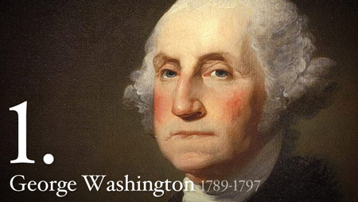
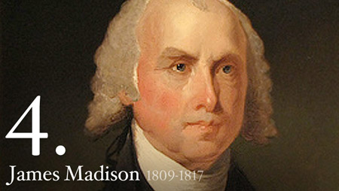
The Judicial Branch
The Founders intended the judicial branch to be the weakest of the three.
The U.S. has two systems of courts: the federal courts and the state courts.
The two court system is sometimes called the dual court system.

Slide 31
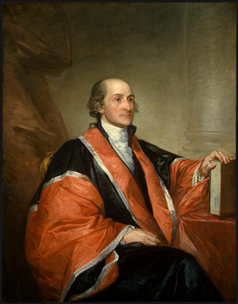
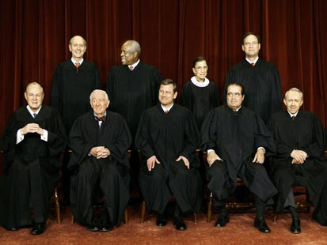
The Judicial Branch
Every court has limited jurisdiction.
Jurisdiction is a court's authority to hear and rule on a case.
John Jay was the first Supreme Court chief justice.

Slide 32
The Judicial Branch
Justices had to travel to hear appeals when the Court was not in session.
Congress created the modern federal court system in 1891.

Slide 33
The Judicial Branch
The Supreme Court did not have its own building until 1935.
In Marbury v. Madison, the Court established judicial review drastically increasing the power of the judicial branch.

Slide 34
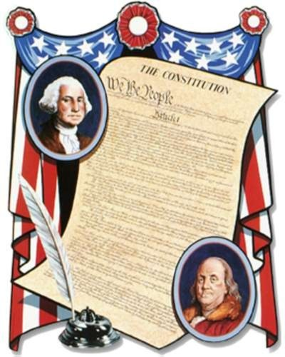
3.3 The Amendment Process
Amendments
How to Propose an Amendment
How to Ratify an Amendment
Informal Changes
Just for Fun: History of the Amending Process

Slide 35


Amendments
Article V describes how to amend the Constitution.
Amendments must first be proposed and then ratified.
Proposing amendments happens on a national level.
Ratifying amendments happens on a state level.

Slide 36
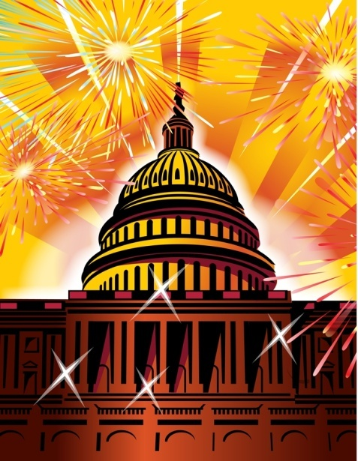
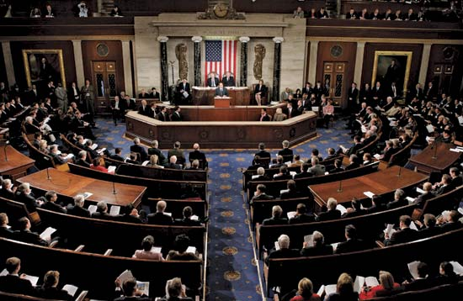
How to Propose an Amendment
The first method is to gain two-thirds vote of each house of Congress on a suggested amendment.
All amendments to date have followed this process.
Congress may also call for a national convention.

Slide 37
How to Propose an Amendment
The national convention may propose any number of amendments once in session.
  (In theory, the convention could be called to address one specific amendment but propose a number of different amendments.)
  This method is controversial as a result.

Slide 38
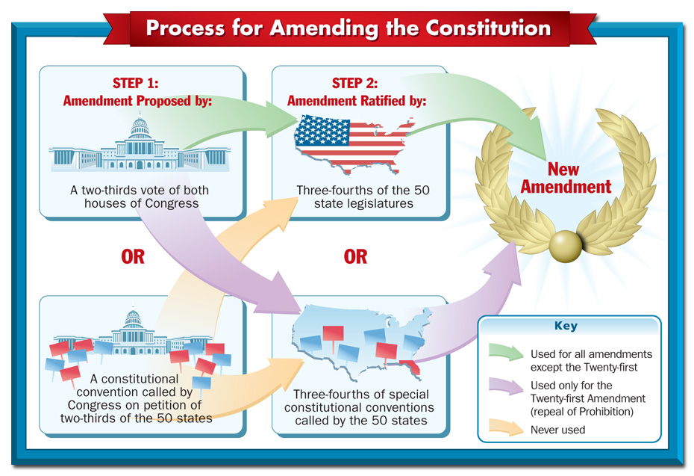

Slide 39
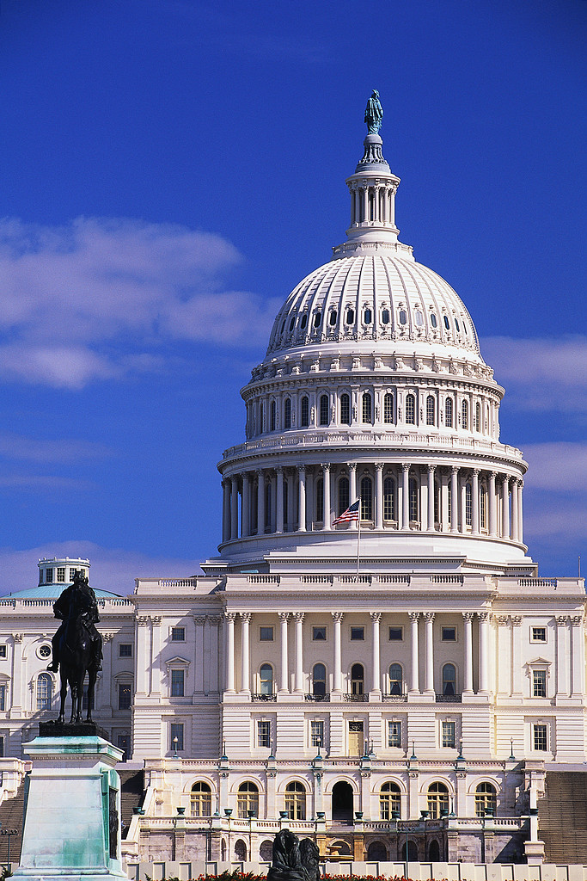
How to Ratify an Amendment
The first method: Three-fourths of the states’ legislatures approve the amendment.
The second method: The states’ call for special constitutional conventions, and three-fourths of the conventions must approve the amendment.

Slide 40
How to Ratify an Amendment
Congress decides which method should be used.
The second method has only been used once when the 21st amendment was ratified.

Slide 41
How to Ratify an Amendment
Congress may also put time limits on how long the states have to ratify the amendments.
  The 27th amendment was passed more than 202 years after it was proposed.
  Today, Congress normally puts a seven year limit on the ratification process.

Slide 43
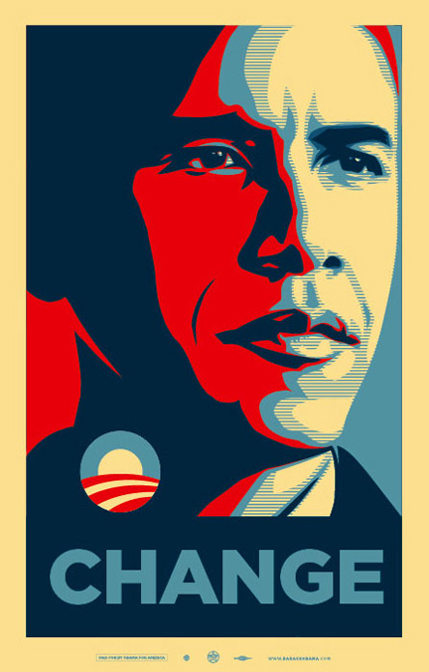
Informal Changes
These changes do not actually change the wording of the Constitution.
Congress may change some of the Constitution’s provisions through law.
For example, Congress creates the Cabinet departments although these positions are not mentioned in the Constitution.

Slide 44
Informal Changes
There are five sources of informal change:
  Congressional Action—Congress expands the provisions of the Constitution through law. Ex: taxes
  Executive Action—The president expands his powers through his actions. Ex: Executive agreements

Slide 45
Informal Changes
  Court Decisions—The courts interpret what the Constitution actually means. Justices may promote judicial activism or restraint. They may also overturn previous decisions.
  Party Practices—The U.S. did not have political parties in 1787, but today they impact how government is organized and how it operates.

Slide 46
Informal Changes
  Custom—Some traditions are not specifically mentioned in the Constitution but still influence how the Constitution is implemented. Ex: Washington’s two-term presidency, FDR’s four terms

Slide 47
Just for Fun:
History of the Amending Process
Over 10, 000 amendments have been suggested to Congress.
  1876: To abolish the U.S. Senate
  1878: To replace the office of the president with an Executive Council of Three
  1893: To rename the U.S. the “United States of the Earth”
  1893: To abolish the U.S. Army and Navy

Slide 48
Just for Fun:
History of the Amending Process
  1914: To make divorce illegal
  1916: To put all acts of war to a national vote and require those who vote yes to register for military service
  1933: To limit personal wealth to $1 million
  1971: To declare American citizens have the right to a pollution-free envirnoment
Congress has formally proposed 33 amendments.
Only 27 amendments have been ratified.

Slide 49
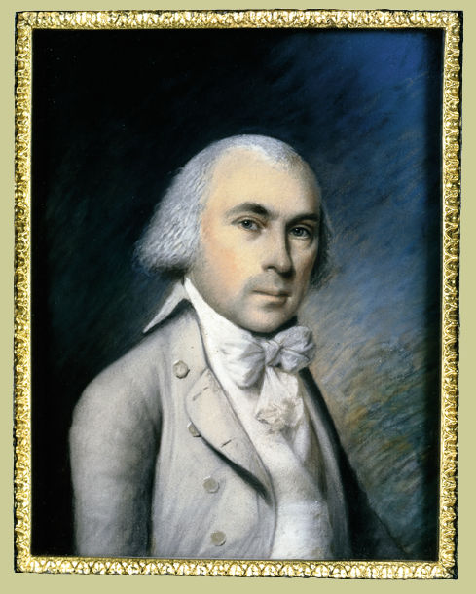
3.4 Amendments
The First Amendment
The Second Amendment
The Third Amendment
The Fourth Amendment
The Fifth Amendment
Sixth Amendment
Seventh Amendment
Eighth Amendment
Ninth Amendment
Tenth Amendment
Early Amendments
Civil War Amendments
Later Amendments

Slide 50
The First Amendment
“Congress shall make no law respecting an establishment of religion, or prohibiting the free exercise thereof; or abridging the freedom of speech, or of the press; or the right of the people peaceably to assemble, and to petition the Government for a redress of grievances.”

Slide 51
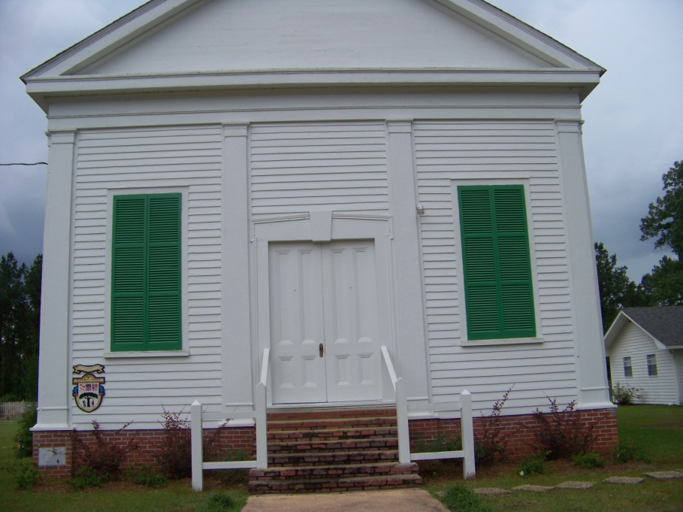
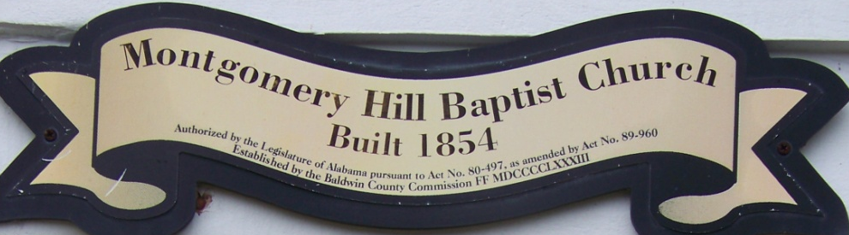
The First Amendment
Freedom of religion, speech, press and assembly is established in the first amendment.
The concept of separation of church and state is based on the first amendment.

Slide 52





The First Amendment
Freedom of speech also applies to printed materials.
Slander and libel are not protected under the first amendment.
  Slander is false speech intended to damage a person’s reputation.
  Libel is similar but applies to printed materials.

Slide 53

The Second Amendment
“A well regulated Militia, being necessary to the security of a free State, the right of the people to keep and bear Arms, shall not be infringed.”

Slide 54
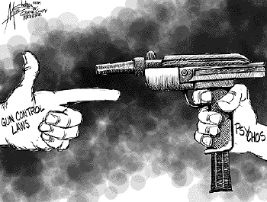
The Second Amendment
It originally protected the militia’s to have arms for security purposes.
Citizens have the right to keep and carry weapons.
These rights are
limited, for example,
when public safety
is at risk.

Slide 55
The Third Amendment
“No Soldier shall, in time of peace be quartered in any house, without the consent of the Owner, nor in time of war, but in a manner to be prescribed by law.”

Slide 56
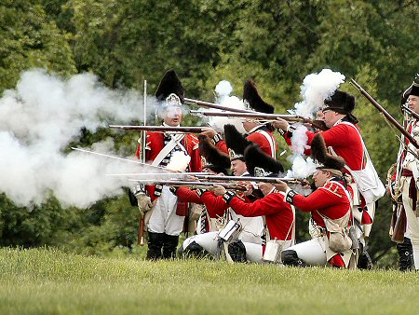
The Third Amendment
The British violated this right prior to the Revolution.
The government can no longer force civilians to house soldiers.

Slide 57
The Fourth Amendment
“The right of the people to be secure in their persons, houses, papers, and effects, against unreasonable searches and seizures, shall not be violated, and no Warrants shall issue, but upon probable cause, supported by Oath or affirmation, and particularly describing the place to be searched, and the persons or things to be seized.”

Slide 58


The Fourth Amendment
It protects against unreasonable
searches and seizures.
This protects Americans’ rights to privacy within reason.
A search must be based on probable cause.
A search warrant or arrest warrant provides police permission to search or arrest areas or people allegedly associated with a crime.

Slide 59
The Fifth Amendment
“No person shall be held to answer for a capital, or otherwise infamous crime, unless on a presentment or indictment of a Grand Jury, except in cases arising in the land or naval forces, or in the Militia, when in actual service in time of War or public danger; nor shall any person be subject for the same offence to be twice put in jeopardy of life or limb; nor shall be compelled in any criminal case to be a witness against himself, nor be deprived of life, liberty, or property, without due process of law; nor shall private property be taken for public use, without just compensation.”

Slide 60
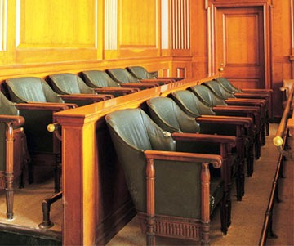
The Fifth Amendment
A Grand Jury must determine if there is enough evidence for the accused to go trial.
Double jeopardy is outlawed.
The accused does not have to testify if answers may self-incriminate.

Slide 61

The Fifth Amendment
Government has the right of eminent domain but must pay fair compensation for property seized for public use.

Slide 62
Sixth Amendment
“In all criminal prosecutions, the accused shall enjoy the right to a speedy and public trial, by an impartial jury of the State and district wherein the crime shall have been committed, which district shall have been previously ascertained by law, and to be informed of the nature and cause of the accusation; to be confronted with the witnesses against him; to have compulsory process for obtaining witnesses in his favor, and to have the Assistance of Counsel for his defence.”

Slide 63

Sixth Amendment
Accused criminals have the right to a speedy and public trial by an impartial jury.
They may also request a change of venue if an impartial jury cannot be found.
They have the right to know
what charges are them.
They also have the right to be
defended by a lawyer.

Slide 64
Seventh Amendment
“In Suits at common law, where the value in controversy shall exceed twenty dollars, the right of trial by jury shall be preserved, and no fact tried by a jury, shall be otherwise re-examined in any Court of the United States, than according to the rules of the common law.”

Slide 65
Seventh Amendment
If a person sues another for $20 or more, then a jury must hear the case unless both sides agree to a judge’s decision.
Typically, federal courts do not hear civil cases unless a large amount of money is involved.

Slide 66
Eighth Amendment
“Excessive bail shall not be required, nor excessive fines imposed, nor cruel and unusual punishments inflicted.”

Slide 67

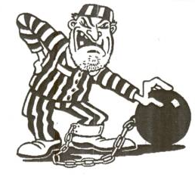
Eighth Amendment
Bail cannot be set at an unreasonable amount in relation to the charges.
This amendment protects against cruel and unusual punishment.

Slide 68
Ninth Amendment
“The enumeration in the Constitution, of certain rights, shall not be construed to deny or disparage others
retained by the people.”

Slide 69
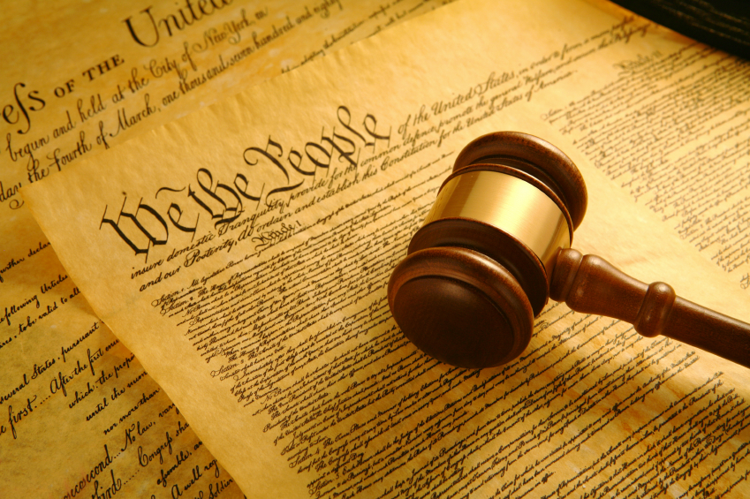
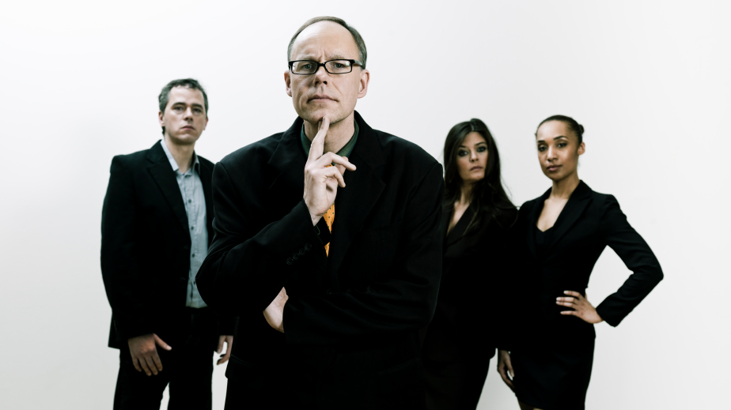
Ninth Amendment
This amendment acknowledges the people have other rights not mentioned in the Constitution.

Slide 70
Tenth Amendment
“The powers not delegated to the United States by the Constitution, nor prohibited by it to the States, are reserved to the States respectively, or to the people.”

Slide 71
Tenth Amendment
This amendment reaffirms the idea of federalism.
This reserves all other powers for the states.

Slide 72
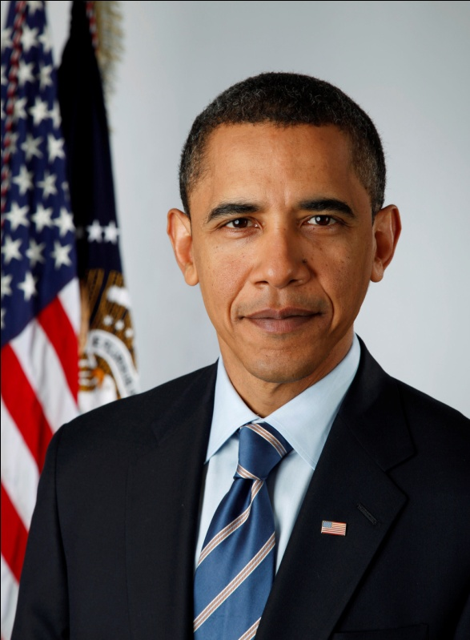
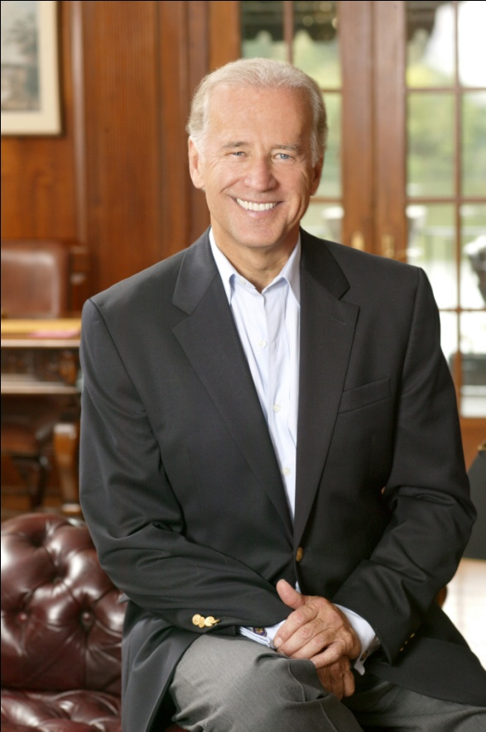
Early Amendments
The 11th and 12th amendments along with the Bill of Rights put the finishing touches on the original Constitution.
The 11th amendment requires lawsuits against states must be tried in state court , not a federal court.
The 12th amendment requires electors cast separate ballots for the president and vice president.

Slide 73
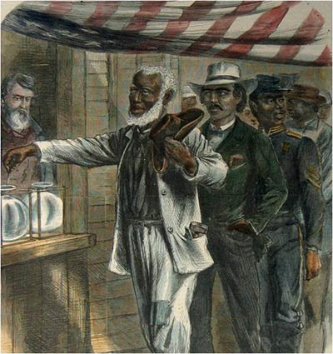
Civil War Amendments
The 13th amendment abolished slavery.
The 14th amendment maintains all people born in the U. S. are citizens with full rights of American citizenship.
The 15th amendment prohibits the denial of voting rights based on color, race, or previous condition of servitude.

Slide 74

Later Amendments
The 16th amendment gave the federal government the power to tax income.
The 17th amendment allows the people to vote for senators instead of state legislatures.

Slide 75
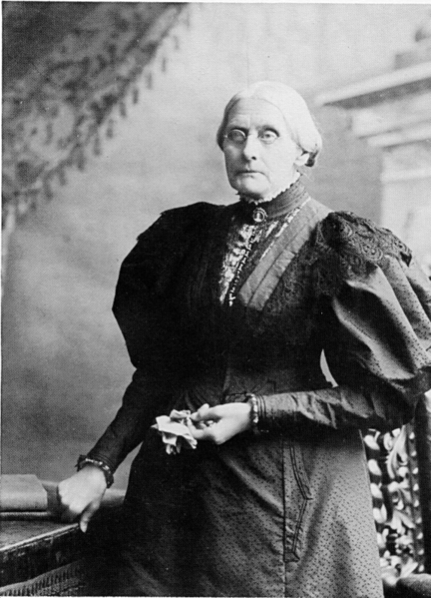
Later Amendments
The 18th amendment outlawed the manufacture, sale and transportation of alcohol illegal.
The 19th amendment gave women the right to vote.
Susan B. Anthony

Slide 76
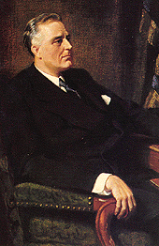
Later Amendments
The 20th amendment set the inauguration date earlier to prevent lame duck presidents.
The 21st amendment repealed the 18th amendment.
The 22nd amendment limits presidential terms to two terms.

Slide 77
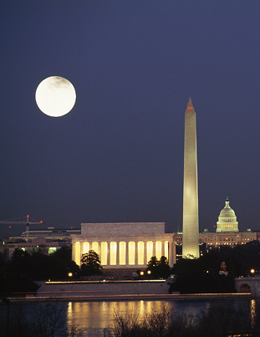
Later Amendments
The 23rd amendment granted Washington, D.C. residents three presidential electors.
The 24th amendment abolished the poll tax.
The 25th amendment established a the process of succession for the presidency.

Slide 78
Later Amendments
The 26th amendment lowered the federal and state voting age to 18.
The 27th amendment makes congressional pay raises effective after the term of passage.

Slide 79
TEST TOMORROW!!

