Slide 1
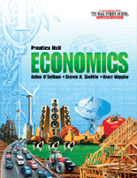
Chapter Five: Supply
12th Grade Economics
Mr. Chancery

Slide 2
DOK Question
How do suppliers decide what goods and services to offer?

Slide 3
Chapter 5 Vocabulary
22 Vocabulary terms on page 129

Slide 4

Chapter 5: Supply
5.1 What is Supply?
5.2 The Theory of Production
5.3 Cost, revenue, and Profit Maximization

Slide 5
5.1 What is Supply?
Read this section.

Slide 6

5.1 What is Supply?
Basics of Supply
Change in Quantity Supplied
Change in Supply
Elasticity of Supply
Determinants of Supply Elasticity

Slide 7

Alabama Course of Study
3. Analyze graphs to determine changes in supply and demand and their effect on equilibrium price and quality.

Slide 8
5.1 What is Supply?
Daily Objectives
Understand the difference between the supply schedule and the supply curve.
Explain how market supply curves are derived.
Specify reasons for a change in supply.

Slide 9
Main Idea
For almost any good or service, the higher the price, the larger the quantity that will be offered for sale.

Slide 10
Basics of Supply
Supply is the amount of a product that would be offered for sale at all possible prices in the market.
The Law of Supply states that suppliers will normally offer more for sale at high prices and less at lower prices.

Slide 11
Basics of Supply
A supply curve illustrates the information on a supply schedule.
There are two types of supply curves: an individual and a market curve.

Slide 12
Basics of Supply
A supply curve has an upward slope.

Slide 13
Guided Practice
How do you explain that prices and quantities move in the same direction in a supply schedule?
Producers will produce high quantities at the highest prices and low quantities at the lowest prices.

Slide 14
Change in Quantity Supplied
A change in quantity supplied is the change in the amount offered for sale in response to a change in price.
Producers can change the amount produced in response to the prices.
  If prices are too low, they can slow or stop production.
  If prices are high, they can increase production.

Slide 15
Change in Supply
A change in supply is when suppliers offer different amounts of products for sale at all possible prices.
There are several factors that can change supply:
  Cost of inputs
  Productivity levels (ex: more motivated employees)
  Technology
  Taxes or the level of subsidies
  Expectations
  Government regulations
  Number of sellers

Slide 16
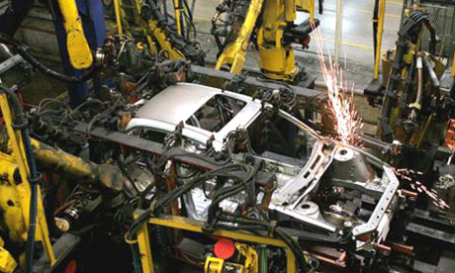
Guided Practice
Why does new technology almost always increase supply?
It generally leads to greater efficiency, which lowers production costs.

Slide 17
Elasticity of Supply
Supply is elastic when a small increase in price leads to a LARGER increase in output—and supply.
Supply is inelastic when a small increase in price causes LITTLE change in supply.
Supply is unit elastic when a change in price causes a PROPORTIONAL change in supply.

Slide 18
Read three elasticities on page 119.

Slide 19
Determinants of Supply Elasticity
Determinants of supply elasticity are related to how quickly a producer can act when the change in price occurs.
If adjustments can be made quickly, supply is elastic.
If adjustments are complex and take time , supply is inelastic.
If substitutes are available, supply is elastic.

Slide 20
DOK
How does the law of supply affect the quantity supplied?

Slide 21
5.2 The Theory of Production
Read this section.

Slide 22
Alabama Course of Study
3. Analyze graphs to determine changes in supply and demand and their effect on equilibrium price and quality.

Slide 23
5.2 The Theory of Production
Daily Objectives
Explain the theory of production.
Describe the three stages of production.

Slide 24
The Theory of Production
Main Idea: A change in the variable input called labor, results in a change in production.
Law of Variable Proportions
The Production Function
Three Stages of Production

Slide 25
Law of Variable Proportions
The theory of production generally is based on the short run, a period of production that allows producers to change only the amount of the variable input called labor.
This contrasts with the long run, a period of production long enough for producers to adjust the quantities of all their resources, including capital.

Slide 26
Law of Variable Proportions
For example, Ford Motors hiring 300 extra workers for one of its plants is a short-run adjustment.
If Ford builds a new factory, this is a long-run adjustment.

Slide 27

Law of Variable Proportions
In the short run, output will change as one variable input is altered, but other inputs are kept constant.

Slide 28
Law of Variable Proportions
The Law of Variable Proportions looks at how the final product is affected as more units of one variable input or resource are added to a fixed amount of other resources.

Slide 29
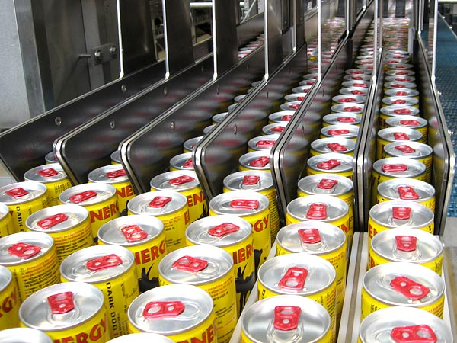
Law of Variable Proportions
Economists prefer that only a single variable be changed at any one time so the impact of this variable on total output can be measured.

Slide 30
The Production Function
The concept illustrates the Law of Variable Proportions within a production schedule or a graph.
It describes the relationship between changes in output to different amounts of a single input while others are held constant.

Slide 31
The Production Function
Total product is the total output the company produces.
A production schedule shows that, as more workers are added, total product rises until a point that adding more workers causes a decline in total product.

Slide 32
The Production Function
Marginal product is the extra output or change in total product caused by adding one more unit of variable input.

Slide 33

Discussion Question
From you experience in working in groups for a class assignment, how many students make up a productive team?
When is adding more group members likely to “cause a decline in total product”?

Slide 34
Three Stages of Production
In Stage I, (increasing returns), marginal output increases with each new worker. Companies are tempted to hire more workers, which moves them to Stage II.
In Stage II, (diminishing returns), total production keeps growing but the rate of increase is smaller; each worker is still making a positive contribution to total output, but it is diminishing.

Slide 35
Three Stages of Production
In Stage III (negative returns), marginal product becomes negative, decreasing total plant output.

Slide 36
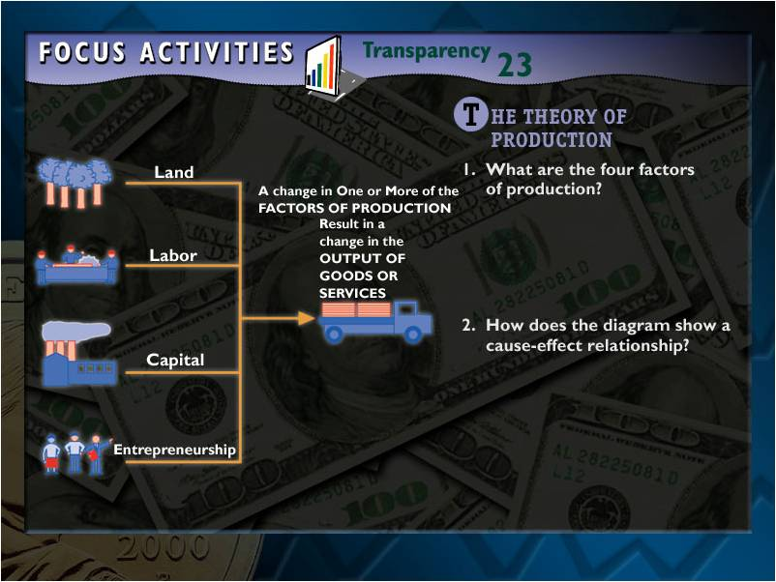

Slide 37
5.3 Cost, revenue, and Profit Maximization
Read this section.

Slide 38
Alabama Course of Study
3. Analyze graphs to determine changes in supply and demand and their effect on equilibrium price and quality.

Slide 39
5.3 Cost, Revenue, and Profit Maximization
Daily Objectives
Define four key measures of cost.
Identify two key measures of revenue.
Apply incremental analysis to business decisions.

Slide 40
5.3 Cost, Revenue, and Profit Maximization
Main Idea: Profit is maximized when the marginal costs of production equal the marginal revenue from sales.
Measures of Cost
Applying Cost Principles
Measures of Revenue
Marginal Analysis

Slide 41
Measures of Cost
Overhead is one of many different measures of costs.
Fixed costs are those that a business has even if it has no output. These include management salaries, rent, taxes, and depreciation on capital goods.
Variable costs are those that change when the rate of operation or production changes, including hourly labor, raw materials, freight charges, and electricity.

Slide 42

Measures of Cost
Total cost is the sum of all fixed costs and all variable costs.
Marginal cost is the extra (variable) costs incurred when a business produces one additional unit of a product.

Slide 43

Discussion Question
What are the fixed costs of running a high school? The variable costs?

Slide 44

Applying Cost Principles
A self-service gas station is an example of high fixed costs with low variable costs. The ratio of variable to fixed costs is low.
E-commerce is an example of an industry with low fixed costs.

Slide 45

Measures of Revenue
Total revenue is the number of units sold multiplied by the average price per unit.
Marginal revenue is the extra revenue connected with producing and selling an additional unit of output.
Bill Gates

Slide 46

Marginal Analysis
Marginal analysis, is comparing the extra benefits to the extra costs of a particular decision.
The break-even point is the total output or total product the business needs to sell in order to cover its total costs.

Slide 47



Marginal Analysis
Businesses want to find the number of workers and the level of output that generates maximum profits.
The profit-maximizing quantity of output is reached when marginal cost and marginal revenue are equal.

