Slide 1

Entry #2
Lab Safety

Slide 2

General Safety Rules
1. Listen to or read ALL instructions.
2. Wear safety goggles to protect your eyes.
3. Notify your teacher if any spills or accidents occur.

Slide 3
Wear gloves when you are told to do so.
5. During lab work, keep your hands away from your face.
6. Tie back long hair.

Slide 4

Roll up loose sleeves.
Know the location of first
aid supplies.
9. Keep your work area uncluttered.

Slide 5

Never eat, drink or sniff anything in the lab.
11. Never “horse around” or play practical jokes in the laboratory.

Slide 6




Spongebob Lab Safety Challenge

Slide 7

B. Glassware Safety
1. Chipped or cracked glassware should not be used. Show it to the teacher.
2. Broken glassware should not be disposed of in a classroom trashcan. There is a special glass disposal container for it.
3. When pouring liquids into glassware, make sure the container you are pouring into is resting on a table at least a hands breadth from the edge.

Slide 8
B. Glassware Safety
4. Pour down a glass stirring rod to prevent liquids from splattering.
5. If a piece of glassware gets broken, do not try to clean it up by yourself. Notify the teacher.
6. When inserting glass tubing into a rubber stopper, apply a lubricant to the glass and use a twisting motion.

Slide 9
B. Glassware Safety
7. Do not place hot glassware in water. Rapid cooling may make it shatter.

Slide 10
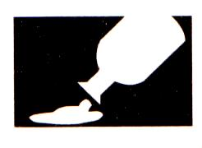
C. Chemical Safety
1. Wear protective goggles and a lab apron whenever heating or pouring hazardous chemicals.
2. Never mix chemicals together unless you are told to do so (and then only in the manner specified).
3. Never taste any chemicals (you should never taste anything in the lab).

Slide 11
C. Chemical Safety
4. If you need to smell the odor of a chemical, waft the fumes toward your nose with one hand. Do not put your nose over the container and inhale the fumes.
5. Never pour water into a concentrated acid. Acid should be poured slowly into water.

Slide 12
C. Chemical Safety
6. Follow the instructions of your teacher when disposing of all chemicals.
7. Wash your hands after handling hazardous chemicals.

Slide 13

D. Electrical Safety
1. Lay electrical cords where no one can trip on them or get caught in them.
2. Be sure your hands and your lab area are dry before using electrical equipment.
3. Never poke anything into electrical outlets.

Slide 14
D. Electrical Safety
4. Unplug cords by pulling the plug and not the cord.
5. Unplug all electrical equipment at the end of the lab period.

Slide 15
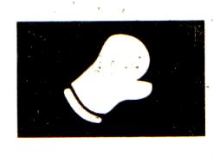
E. Heating Safety
1. Let burners and hotplates cool down before touching them. Test to see if they are cool enough by bringing the back of your hand close to them.
2. Use tongs and/or protective gloves to handle hot objects.
3. Never reach across an open flame or burner.

Slide 16
pya
4. The only type of glassware that may safely be heated is either Kimax or Pyrex.
5. Always point the top ends of test tubes that are being heated away from people.
6. When heating a test tube, move it around slowly over the flame to distribute the heat evenly.

Slide 17
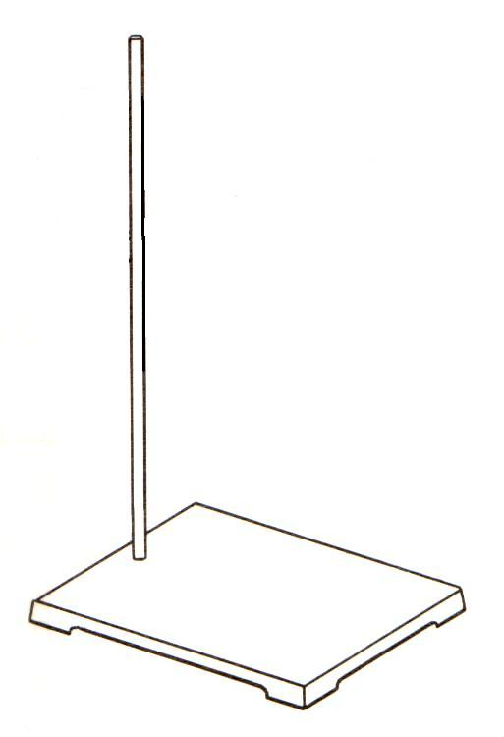
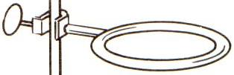
E. Heating Safety
7. Only glassware that is thoroughly dry should be heated.
8. Heat glassware by placing it on a wire gauze platform on a ringstand. Do not hold it in your hand.

Slide 18

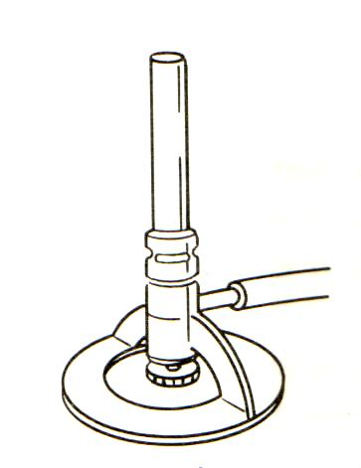
E. Heating Safety
9. When lighting a burner, wait until the striker is in place before you turn on the gas.
10. The amount of air can be adjusted by the air supply valve below the tube of the burner. This regulates the flame temperature and color.
11. Never leave a burner or hotplate unattended.

Slide 19
First Aid
Injury: Burns
To Do: Immediately flush with cold water until burning sensation is lessened.

Slide 20

First Aid
Injury: Cuts, bruises
To Do: Do not touch an open wound without safety gloves. Pressing directly on minor cuts will stop bleeding in a few minutes. Apply cold compress to bruises to reduce swelling.

Slide 21
First Aid
Injury: Fainting
To Do: Provide fresh air and have the person recline so that their head is lower than the rest of their body.

Slide 22

First Aid
Injury: The eyes
To Do: Flush eyes immediately with plenty of water for several minutes. If a foreign object is lodged in the eye, do not allow the eye to be rubbed.

Slide 23

First Aid
Injury: Poisoning
To Do: Find out what substance was responsible for the poisoning and alert the teacher immediately.

Slide 24
First Aid
Injury: Spills on the skin
To Do: Flush with large quantities of water. For acid spills, apply baking soda solution. For base spills, apply vinegar or boric acid.

Slide 25
First Aid
Injury: Electrical shock
To Do: Shut off the current at the source. Remove wire with rubber gloves. Alert the teacher immediately.

Slide 26
Lab Safety Contract/Guide
Edgewood Independent School District
Safety Contract
Required of ALL Middle School and High School
Science Students

