Slide 1
How We Came to Be
1/20/2015
Entry 2

Slide 2
Question:
How do cells make sure that DNA is well protected?
How does the message of DNA get out of the cell?
Please write your answers to the questions.
Hypothesis:

Slide 3
Procedure:
In the lab, please follow your teacher’s step-by-step instructions.
NO EATING OR DRINKING (in the lab OR out of the lab)

Slide 4
Data:
Glue In DNA Worksheet.

Slide 5
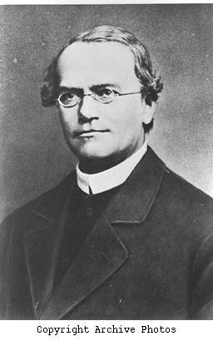
Conclusion:
Gregor Mendel
The basic laws of heredity were first formed during the mid-1800’s by an Austrian botanist monk named Gregor Mendel. Because his work laid the foundation to the study of heredity, Mendel is referred to as “The Father of Genetics.”

Slide 6
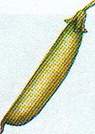
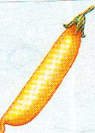
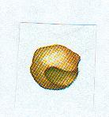
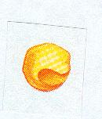
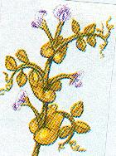

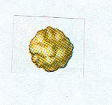
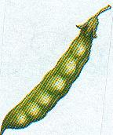
Mendel’ Pea Plants
Mendel based his laws on his studies of garden pea plants. Mendel was able to observe differences in multiple traits over many generations because pea plants reproduce rapidly, and have many visible traits such as:
Pod color
Seed Color
Plant Height
Green
Yellow
Green
Yellow
Seed Shape
Tall
Short
Pod Shape
Wrinkled
Round
Smooth
Pinched

Slide 7
Mendel’s Experiments
Mendel noticed that some plants always produced offspring that had a form of a trait exactly like the parent plant. He called these plants “purebred” plants. For instance, purebred short plants always produced short offspring and purebred tall plants always produced tall offspring.
X
Short Offspring
Purebred Short Parents
X
Purebred Tall Parents
Tall Offspring

Slide 8
Mendel’s First Experiment
Mendel crossed purebred plants with opposite forms of a trait. He called these plants the parental generation , or P generation. For instance, purebred tall plants were crossed with purebred short plants.
X
Parent Tall
P generation
Parent Short
P generation
Offspring Tall
F1 generation
Mendel observed that all of the offspring grew to be tall plants. None resembled the short short parent. He called this generation of offspring the first filial , or F1 generation, (The word filial means “son” in Latin.)

Slide 9
Mendel’s Second Experiment
Mendel then crossed two of the offspring tall plants produced from his first experiment.
Parent Plants
Offspring
X
Tall
F1 generation
3⁄4 Tall & 1⁄4 Short
F2 generation
Mendel called this second generation of plants the second filial, F2, generation. To his surprise, Mendel observed that this generation had a mix of tall and short plants. This occurred even though none of the F1 parents were short.

Slide 10
Dominant and Recessive Genes
Mendel went on to reason that one factor (gene) in a pair may mask, or hide, the other factor. For instance, in his first experiment, when he crossed a purebred tall plant with a purebred short plant, all offspring were tall. Although the F1 offspring all had both tall and short factors, they only displayed the tall factor. He concluded that the tallness factor masked the shortness factor.
Today, scientists refer to the “factors” that control traits as genes. The different forms of a gene are called alleles.
Alleles that mask or hide other alleles, such as the “tall” allele, are said to be dominant.
A recessive allele, such as the short allele, is masked, or covered up, whenever the dominant allele is present.

Slide 11
Homozygous Genes
What Mendel refered to as a “purebred” plant we now know this to mean that the plant has two identical genes for a particular trait. For instance, a purebred tall plant has two tall genes and a purebred short plant has two short genes. The modern scientific term for “purebred” is homozygous.
short-short
short-short
short-short
X
Short Parents
Short Offspring
According to Mendel’s Law of Segregation, each parent donates one height gene to the offspring. Since each parent had only short genes to donate, all offspring will also have two short genes (homozygous) and will therefore be short.

Slide 12
Hybrid Alleles
In Mendel’s first experiment, F1 offspring plants received one tall gene and one short gene from the parent plants. Therefore, all offspring contained both alleles, a short allele and a tall allele. When both alleles for a trait are present, the plant is said to be a hybrid for that trait. Today, we call hybrid alleles heterozygous.
tall-tall
short-tall
short-tall
short-short
X
Parent Short
P generation
Parent Tall
P generation
Offspring Tall
F1 generation
Although the offspring have both a tall and a short allele, only the tall allele is expressed and is therefore dominant over short.

Slide 13
Dominant Alleles
Mendel observed a variety of dominant alleles in pea plants other than the tall allele. For instance, hybrid plants for seed color always have yellow seeds.
Green & Yellow Allele
Yellow Seed
However, a plant that is a hybrid for pod color always displays the green allele.
Green & Yellow Allele
Green Pod
In addition, round seeds are dominant over wrinkled seeds, and smooth pods are dominant over wrinkled pods.

Slide 14
Law of Dominance
Certain alleles are dominant.
If those alleles are present then the organism will display those traits.
Some alleles are recessive and are hidden by dominant traits.
Recessive alleles are only displayed if passed from both parents.

Slide 15
Law of Segregation
The two members of a gene pair (alleles) segregate (separate) from each other in the formation of gametes.
Half the gametes carry one allele, and the other half carry the other allele.
This is why sibling with the same parents may seem very different from each other.

Slide 16
Law of Independent Assortment
when two or more characteristics are inherited, individual hereditary factors assort independently during gamete production, giving different traits an equal opportunity of occurring together.
According to Mendels’ Law of Independent Assortment, the gene pairs will separate during the formation of egg or sperm cells. The plant will donate one allele from each pair. The plant will donate either a yellow or green seed allele, either a yellow or green pod allele, and a wrinkled or round seed allele. It will always donate a wrinkled pod shape. The donation of one allele from each pair is independent of any other pair. For example, if the plant donates the yellow seed allele it does not mean that it will also donate the yellow pod allele.

Slide 17
Homework:
Disease Project
Poster (information: disease, statistics, treatment, life expectancy, 3 pictures)
Presentation (Less than 3 minutes; no reading from the poster; the more you practice the better it will be; more points will be given to students that use their notecards very little)
Karyotype (printed or drawn)

Slide 18
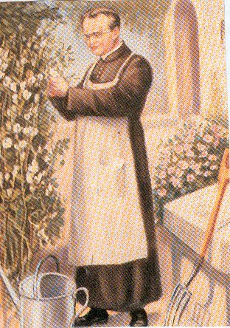
THE END

