Slide 1
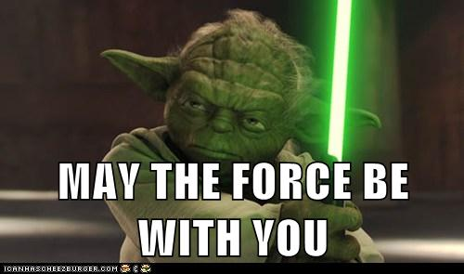
Match the vocabulary word and its correct definition.
Force
Gravity
Mass
Weight
Friction
Law of Universal Gravitation
Force that resists the motion of two surfaces that are touching
Gravitational force exerted on an object
Attractive force that exist between all objects that have mass
Push or pull on an object
Amount of matter in an object
All objects are attracted to each other by a gravitational force

Slide 2
Add these Vocabulary words to look up and learn:
Unbalanced force
Balanced force
Net force

Slide 3
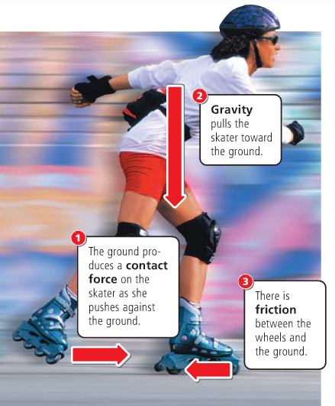
There are many different forces which act on objects such as gravity and friction
Notes:
Instructional Approach(s): The teacher should use the images on the slide to illustrate examples of gravity and friction.

Slide 4
Forces occur in pairs and they can be either balanced or unbalanced
Notes:
Instructional Approach(s): The teacher should present the information on the slide while the students record the important information on their notes

Slide 5
Forces
If forces are balanced the object doesn’t move
If forces are unbalanced the object will do one of the following things:
  Begin to move
  Stop moving
  Change direction
  Speed up
  Slow down

Slide 6
Balanced Forces
When two forces acting on an object are equal in size, but are opposite in direction, we say the forces are balanced.
Balanced forces do not cause a change in motion.
Notes:
Instructional Approach(s): The teacher should present the information on the slide while the students record the important information on their notes

Slide 7
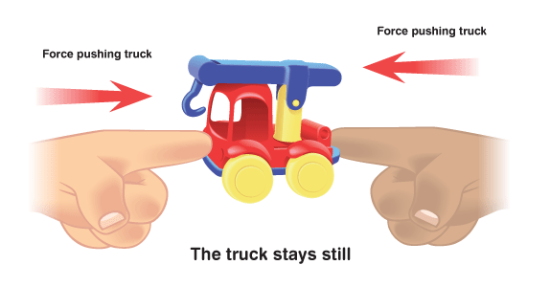
Balanced Forces
Notes:
Instructional Approach(s): The teacher should present the illustration to provide an example of balanced forces.

Slide 8
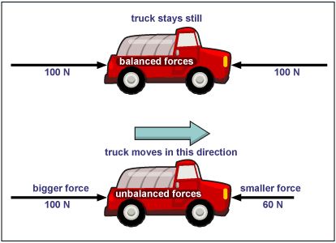
Force Diagrams
Notes:
Instructional Approach(s): The teacher should present the illustration to provide an example of unbalanced/balanced forces.

Slide 9
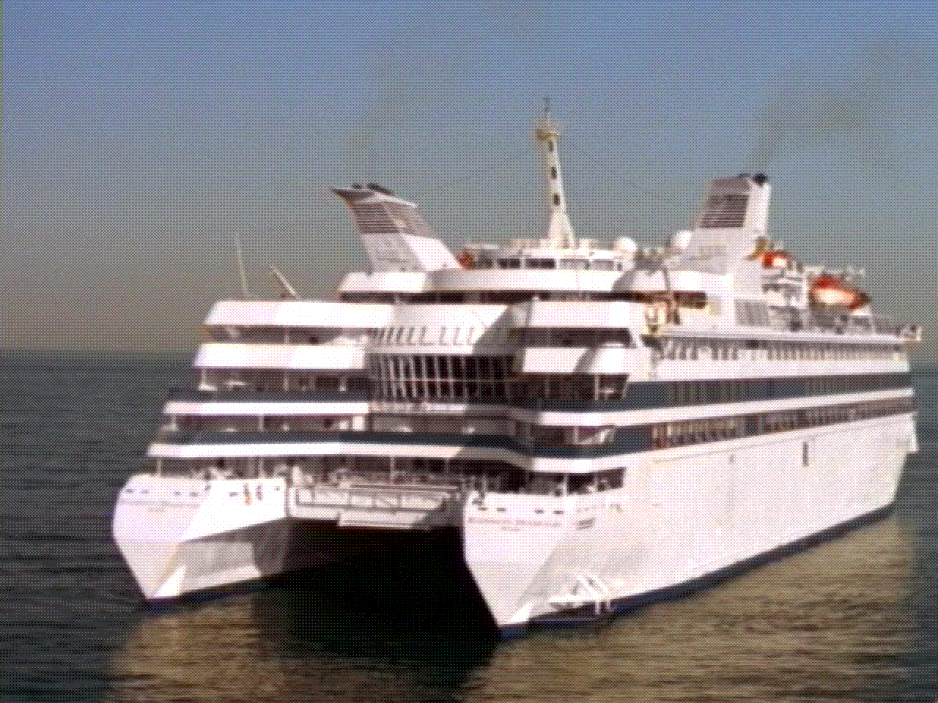
Balanced Forces
The ship is floating on the water, the forces are balanced. Which forces are acting on the ship?
Because Gravity’s force [down] and the water’s force [up] are equal the ship stays afloat.
Water’s
upward force
Gravity
Notes:
Instructional Approach(s): The teacher should present the illustration to provide an example of balanced forces. The teacher should ask the class or call on students to answer the question. Click the mouse to reveal the answer.

Slide 10
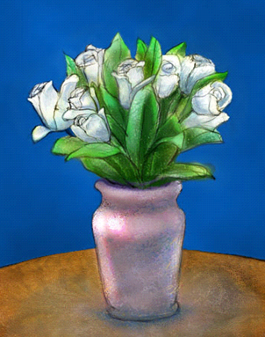
Balanced Forces
The vase is resting on the table. It is not moving, therefore the forces must be balanced.
Which forces are acting on the vase?
Have a look around the classroom and name some of the balanced forces in action on different objects.
Gravity
Table’s Upward
Force
Notes:
Instructional Approach(s): The teacher should present the illustration to provide an example of balanced forces. The teacher should ask the class or call on students to answer the question. Click the mouse to reveal the answer.

Slide 11
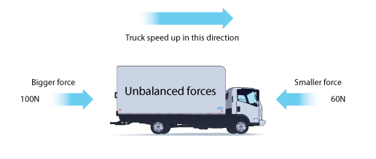
Unbalanced Forces
When two forces are acting on an object and are not equal in size, we say the forces are unbalanced.
Unbalanced forces cause a change in motion by changing the object’s speed or direction.
Notes:
Instructional Approach(s): The teacher should present the illustration to provide an example of unbalanced forces.

Slide 12
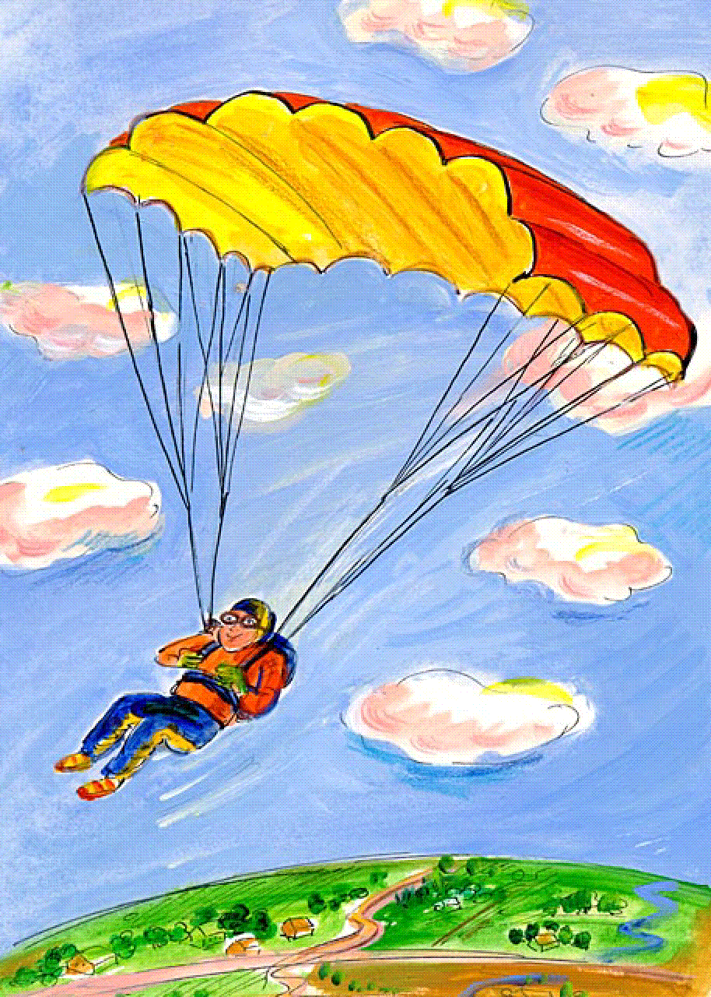
Unbalanced Forces
The man and the parachute are slowly falling to the ground.
Which forces are acting on the parachute?
Which force is bigger? How can you tell?
Air resistance is pushing upwards
Gravity is pulling the man to the ground
Gravity is the bigger force.
We can tell this because the direction of movement of the man and the parachute is the same as the direction of the force of gravity.
Notes:
Instructional Approach(s): The teacher should present the illustration to provide an example of unbalanced forces. The teacher should ask the class or call on students to answer the question. Click the mouse to reveal the answer.

Slide 13
Unbalanced Forces
Air resistance is pushing upwards
The same forces are acting on the elephant, but without a parachute there is much less air resistance.
Gravity is a much bigger force. Because there is a bigger difference between the force pulling downwards and the force pushing upwards, the elephant falls much more quickly than a man with a parachute.
Gravity is pulling to the ground
Notes:
Instructional Approach(s): The teacher should present the illustration to provide an example of unbalanced forces. The teacher should ask the class or call on students to answer the question. Click the mouse to reveal the answer.

Slide 14
Forces
Each team is exerting a force – what happens if the pulling force produced by each team is equal?
What would happen if the team on the left were able to produce a bigger pulling force than the team on the right?
Notes:
Instructional Approach(s): The teacher should present the illustration to provide an example of forces. The teacher should ask the class or call on students to answer the question. Answer: Balanced force. Unbalanced force.

Slide 15

Unbalanced Forces
Based on the forces shown:
Which arm wrestler will likely win?
Which direction will both arms move?
Notes:
Instructional Approach(s): The teacher should present the illustration to provide an example of unbalanced forces. The teacher should ask the class or call on students to answer the question. Answer: Blue. Left.

Slide 16

Unbalanced Forces
4 N, left
10 N, right
Which direction will the rope move?
Notes:
Instructional Approach(s): The teacher should present the illustration to provide an example of unbalanced forces. The teacher should ask the class or call on students to answer the question. Click the mouse to reveal the answer.

Slide 17
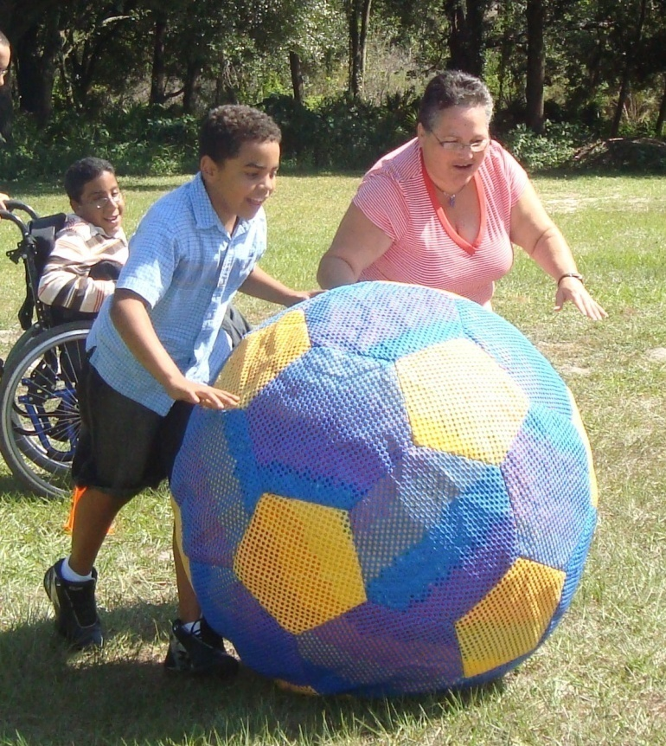



Unbalanced Forces
Which direction will the ball roll?
Notes:
Instructional Approach(s): The teacher should present the illustration to provide an example of unbalanced forces. The teacher should ask the class or call on students to answer the question. Click the mouse to reveal the answer.

Slide 18
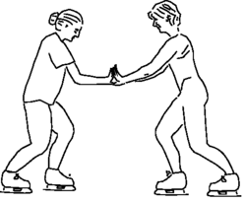
Look at the diagram below. Both women are wearing ice skates on an ice rink. If both women push off from one another, which woman will most likely move the furthest? Why?
Julie will move the furthest because Jennifer’s push will most likely have more force
Jennifer weighs 175 pounds
Julie weighs 130 pounds
Notes:
Instructional Approach(s): The teacher should present the illustration to provide an example of unbalanced forces. The teacher should ask the class or call on students to answer the question. Click the mouse to reveal the answer.

Slide 19
Types of Forces
Contact force: created between two touching objects (holding a pencil, hugging someone, etc)
Gravity: force of attraction between two objects, Earth’s gravity pulls on all objects
Friction: a force that resists motion between two surfaces that are pressed together

Slide 20
Force is measured by :
Newton (N)
1 newton = accelerating a 1 kg object at 1 m/s each second
1 pound = 4.448 newtons

Slide 21
Combining forces
Usually, more than one force is exerted on an object at the same time.
The sum of all forces acting on an object is called the net force.
You need to look at the net force in order to figure out if or how an object will move.

Slide 22
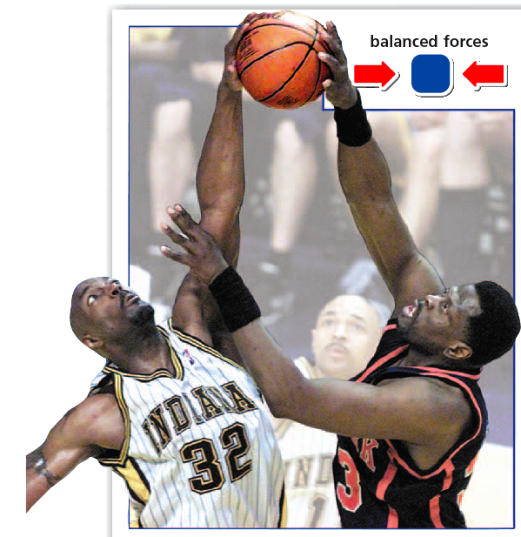
Balanced Forces
Net force = zero
No change in motion
(object is not moving)
List 3 examples of balanced forces:
  Paper on desk
  You in the chair
  Flag not moving

Slide 23
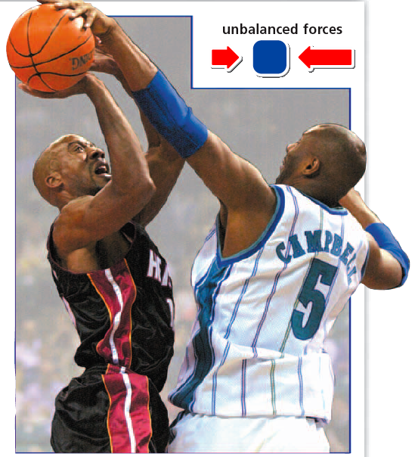
Unbalanced Forces
There is a net force acting on an object.
Causes a change in motion
Possible to add the forces together to find the size & direction of the net force.

Slide 24
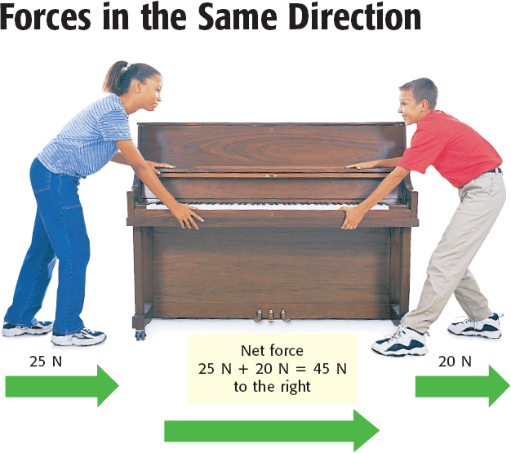
Unbalanced forces
If the forces are moving in the same direction, add the forces.
Example:
  Girl pushes 25 N to the right
  Boy pulls 20 N to the right
  Net Force = 45 N to the right
  The piano moves to the right

Slide 25
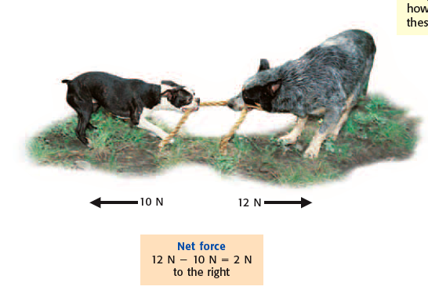
Unbalanced forces
If the forces are moving in opposite directions, subtract the forces.
Example:
  Dog #1 pulls 10 N to the left
  Dog #2 pulls 12 N to the right
  Net Force = 2 N to the right

Slide 26



Slide 27
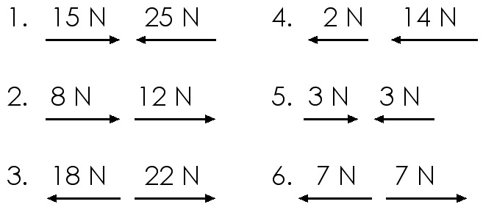
You Try It: Calculating Net Force

Slide 28
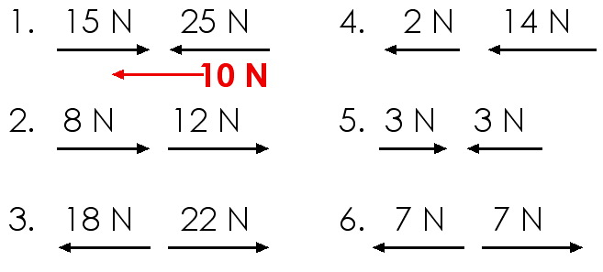
You Try It: Net Force

Slide 29
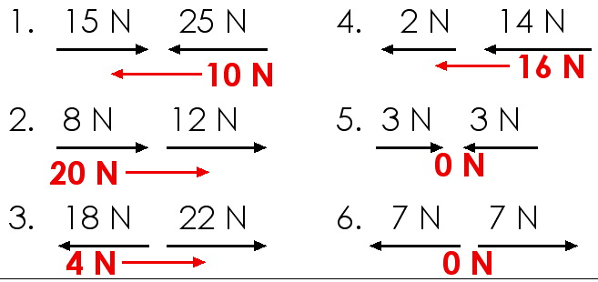
You Try It: Net Force

Slide 30
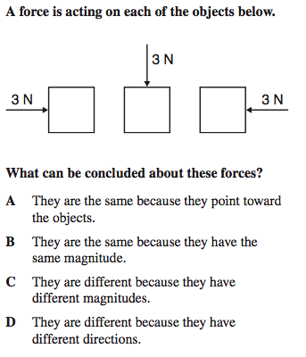
Sample Test Question #1
Answer: D
  Each box has the same magnitude of force (3 N), but in 3 different directions.
  That makes them totally different from one another.
  D is the only possible answer.

Slide 31
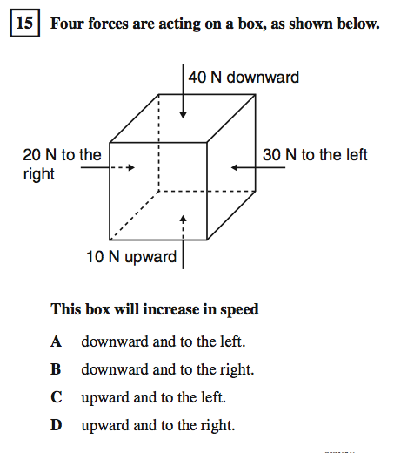
Sample Test Question #2
Answer: A
  The box will move 30 N downward & 10 N to the left

Slide 32
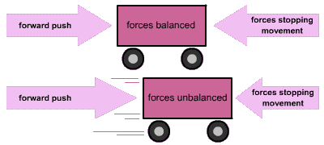
Draw this in your little book in “additional notes”

Slide 33
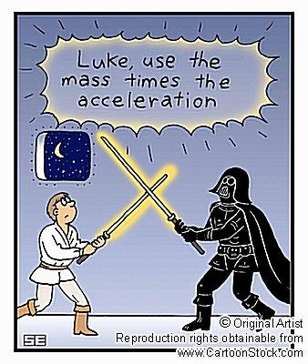

Slide 34


