Slide 1
Bell Ringer:
Indicate whether each sentence below is TRUE or FALSE. If the sentence is false, change the underlined word to make the sentence true.
Archaeology is the study of the future based on what people left behind.
History teaches you how cultures were similar and how they were different.
A fossil is a part or imprint of something that was never alive.
A primary source is information gathered by someone who did not take part in or witness an event.

Slide 2
Key Terms:
history
culture
archaeology
fossil
artifacts
primary source
secondary source
geography
landforms
climate
environment
region
resources
values
resources

Slide 3
If you were there…
You are a student helping scholars uncover the remains of an ancient city. One exciting day you find a jar filled with bits of clay on which strange symbols have been carved. You recognize the marks as letters because for years you have studied the language of the city’s people. This is your chance to put your skills to use!
What might you learn from the ancient writings?

Slide 4
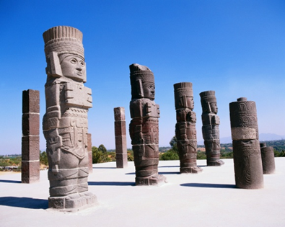
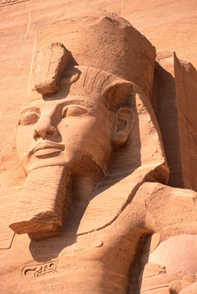
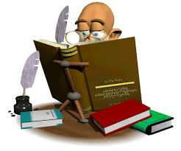
What is History?
History is the study of the past.
Historians are people who study the past to understand people’s culture.
-Culture is the knowledge, beliefs, customs, and values of a group of people.

Slide 5
What is Archaeology?
Archaeology is the study of the past based on what people left behind.
Archaeologists, or people who study archaeology, explore places where people
once lived, worked, or fought.
The things that people leave in these places can range from stone tools to computers.
Objects can be examined to learn about the past and are clues to how people once lived.

Slide 6
How are the fields of history and archaeology similar?

Slide 7
We can improve our understanding of people’s actions and beliefs through the study of history.
History can…
teach you about yourself
teach you about other peoples and different cultures
provide you with a better understanding of where you live
Perspective is huge in our view of history. Think of how people view things differently depending on which side you are on.
Name two groups who might view the history of the U.S differently.

Slide 8
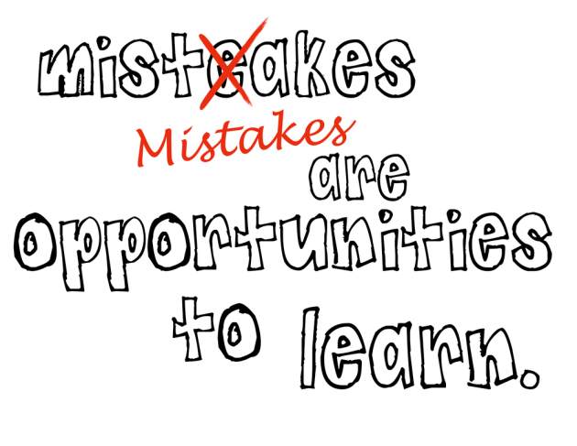
History teaches you how to better know yourself.
Without your personal history, you would not have an identity.
It has made you who you are.
History is just as important for groups as it is for individuals. (ex. Countries keep records.)
History teaches us about the experiences we have been through and the values we share.

Slide 9
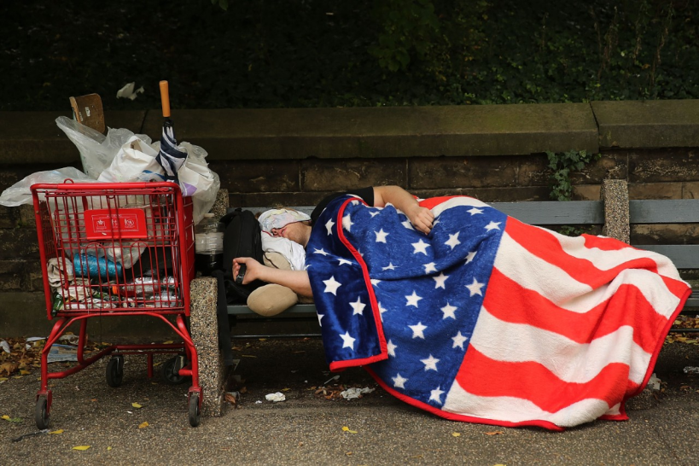
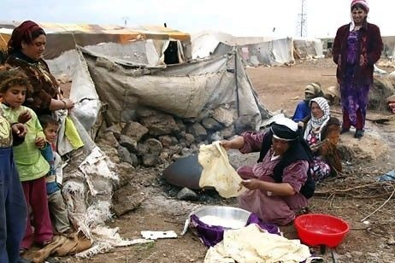
History teaches us about others.
History shows how cultures are similar and different.
You can understand why people think the way they do by studying history.
This knowledge promotes tolerance and can help build social harmony. (how to get along with each other)

Slide 10
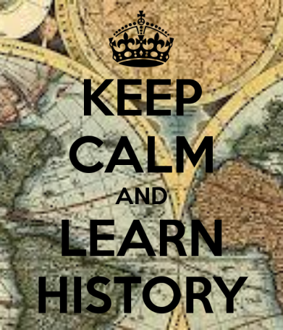
History teaches you about the world.
History explains how today’s events are shaped by past events.
It also helps you develop mental skills, such as asking questions.
History promotes good decision-making skills.
“The purpose of history is not the reader’s enjoyment at the moment of reading it, but the improvement of the reader’s soul, to save him from the stumbling at the same stumbling block many times over.”-Polybius

Slide 11
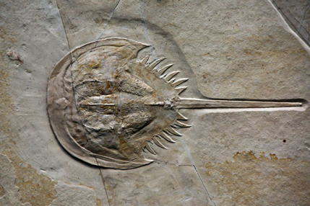
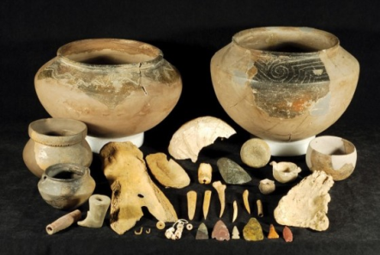
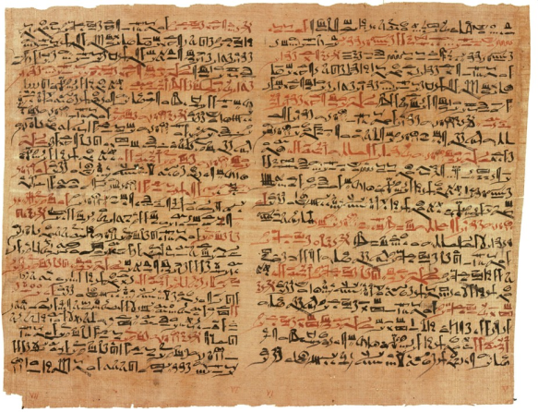
Historians use clues from various sources to learn about the past.
Fossils and artifacts give information about early humans.
-A fossil is a part or an imprint of something that was once alive.
-Artifacts are objects created and used by humans.
Writing is another important source of information.

Slide 12
Sources of Information
A primary source is an account of an event that is created by someone who took part in or witnessed the event.
A secondary source is information gathered by someone who did not take part in or witness an event.
As historians review and reanalyze information, their interpretations can change.

Slide 13
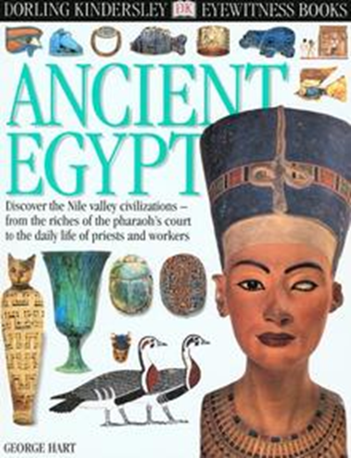
Sources of Information
Primary Source or Secondary Source?

Slide 14
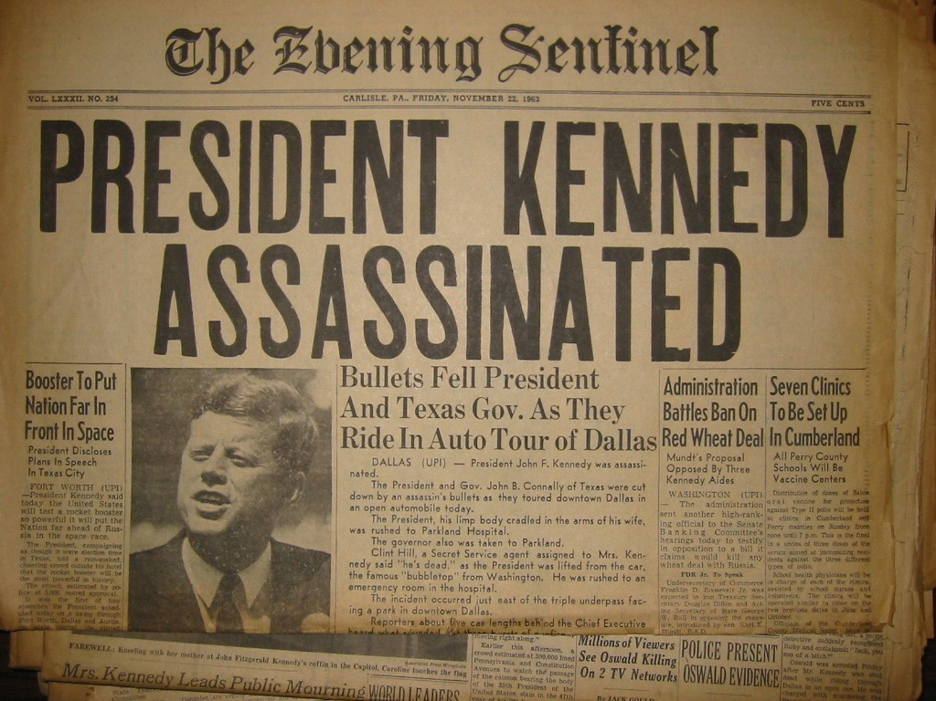
Sources of Information
Primary Source or Secondary Source?

Slide 15
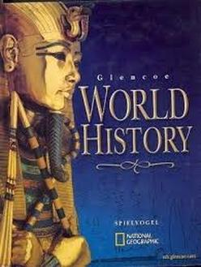
Sources of Information
Primary Source or Secondary Source?

Slide 16
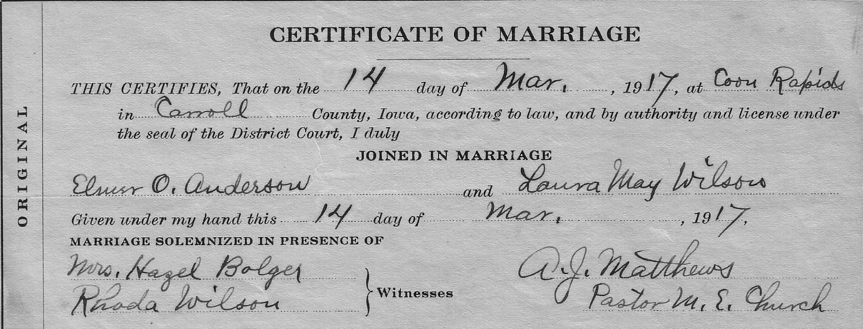
Sources of Information
Primary Source or Secondary Source?

Slide 17
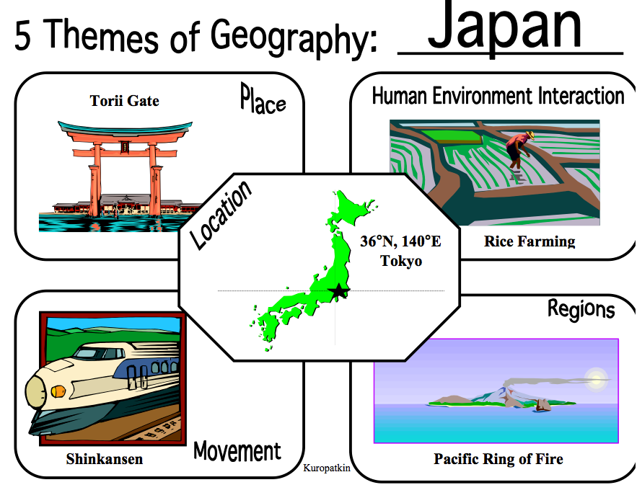
Studying Geography
The Big Idea
Physical geography and human geography contribute to the study of history

Slide 18
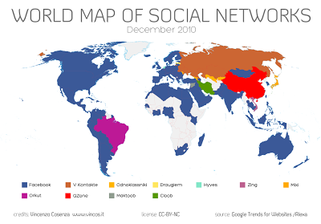
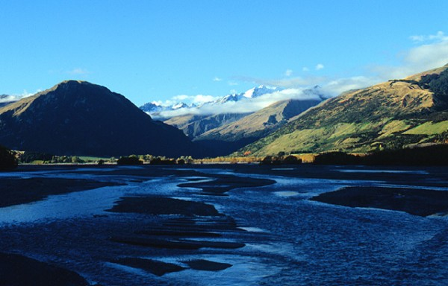
Geography is the study of places and people.
Geography includes the study of both physical and cultural features.
Physical geography is the study of the earth’s land and features.
Human geography is the study of people and the places where they live.

Slide 19
Physical Geography
Landforms are the natural features of the land’s surface.
Climate is the pattern of weather conditions in a certain area over a long period of time.
Landforms and climate are part of a place’s environment.

Slide 20
Human Geography
Geographers study people and the places where they live.
They also study how the environment affects people.

Slide 21
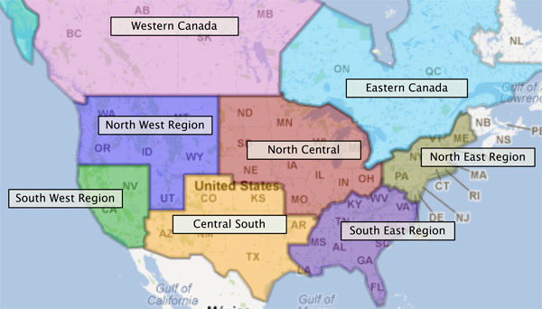
Studying location is important to both physical and human geography.
Location is the exact description of where something is.
To study various locations, geographers use maps.
Learning about regions is another key part of studying geography.

Slide 22
Location
Every place on the Earth has a specific location.
No two places in the world are exactly alike.
By comparing locations, geographers learn more about the factors that affect each of them.

Slide 23
Maps
A drawing of an area
Maps focus on different things, such as features, cities, or boundaries.
Most maps have symbols to represent different things.

Slide 24
Regions
An area with one or more features that make it different from surrounding areas
The features of a region can be physical, such as forests or grassland.
Human features, such as language or religion, also define regions.

Slide 25
Geography and history are closely connected.
Resources in an area were critical to early settlement.
Early people developed vastly different cultures because of their environments.
Geography has helped shape history and has affected the growth of societies.

Slide 26
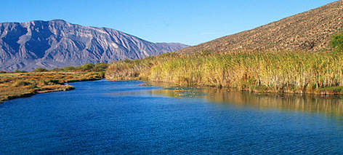
Resources
Materials found in the earth that people need and value
Essential early resources included water, animals, fertile land, and stones for tools.

Slide 27
Geography Shapes Cultures
People developed different cultures based on their environment.
Some people developed religious beliefs based on the geography of their area.
Geography affected the growth of civilizations. The first societies formed along rivers.
Some geographic features protected areas from invasion.

Slide 28
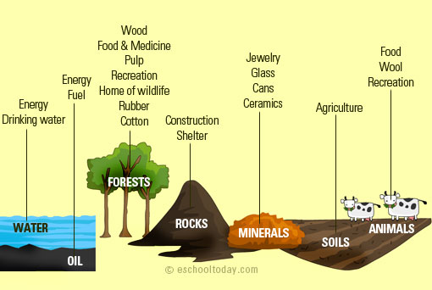
Geography Influences History
People in areas with many natural resources could use them to get rich and to build powerful cities.
Geography causes weather-related problems such as floods and food shortages.
People can affect geography by planting trees, building lakes, or creating wastelands.

Slide 29
Mapping the Past pp. 20-21
Examine the map to see what you can learn about the city of Teotihuacan and the people who lived there. Draw and complete the chart below.
What does the Map Show | What We Can Learn
Size:
Religion:
Technology:

Slide 30
This is the end of the chapter presentation of lecture notes.
Click the HOME or EXIT button.

Slide 31
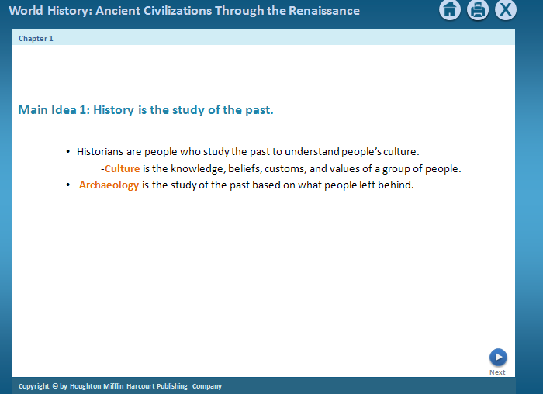
Print Slide Show
On the File menu, select Print
In the pop-up menu, select Microsoft PowerPoint If the dialog box does not include this pop-up, continue to step 4
In the Print what box, choose the presentation format you want to print: slides, notes, handouts, or outline
Click the Print button to print the PowerPoint presentation

