Slide 1
What functions does the White House serve?
Jot Notes now

Slide 2
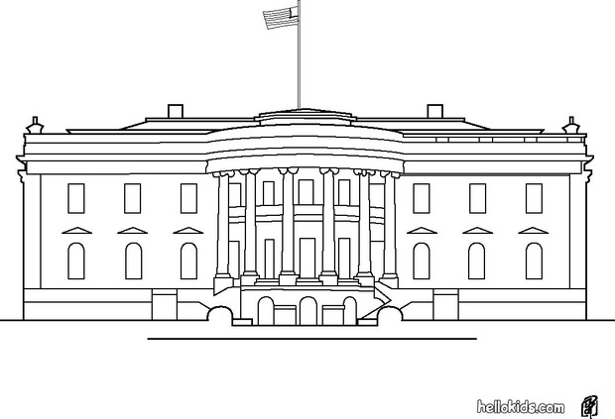
Brief History of White House
The White House was designed in 1790 by George Washington and Pierre L ‘Enfant.
The house was completed in 1800.
President John Adams (2nd President of the United States) was the first President to live in the White House.

Slide 3
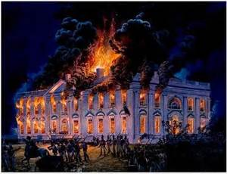
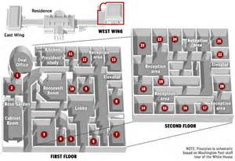
What Has It Gone Through?
The house has survived 1 fire: 1814 (during the War of 1812)
Many renovations! Currently it has 132 rooms and 35 bathrooms.

Slide 4
The Blue Room
The Blue Room is the center of the State Floor of the White House. The Blue Room has been the customary place for presidents to formally receive guests.
In this room on June 2, 1886+, President Grover Cleveland became the first and only president to be married in the White House.

Slide 5
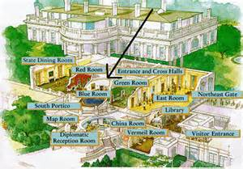
Purpose…
The room is used for receptions and receiving lines, and is occasionally set for small dinners.

Slide 6
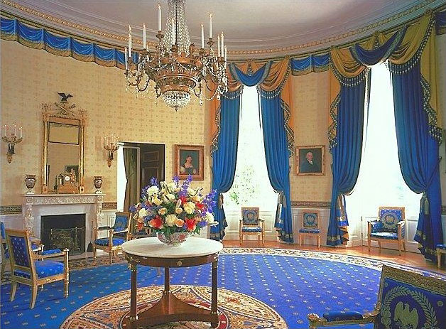
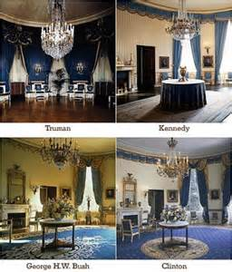
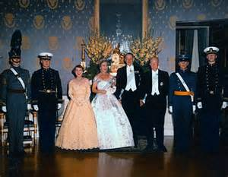

Slide 7
The Green Room
The Green Room is located on the first floor of the White House, has been a favorite of the Presidents and their families.
Among the most historically significant events in our nation’s history occurred here—the signing of our first declaration of war!
First Lady Jackie Kennedy redecorated and refurbished the Green Room in 1961.

Slide 8
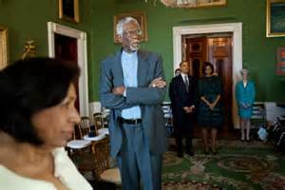
Purpose
It is used for small receptions and teas.

Slide 9
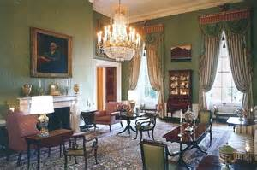
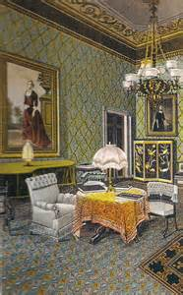
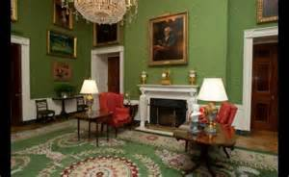

Slide 10
The Red Room
The Red Room received its name in the 1840s from its red color scheme.
Beginning in 1809, First Lady Dolley Madison held Wednesday Drawing Rooms that opened the doors for socializing between members of opposite political parties.
In 1933, First Lady Eleanor Roosevelt hosted the first of many press conferences for women reporters!

Slide 11
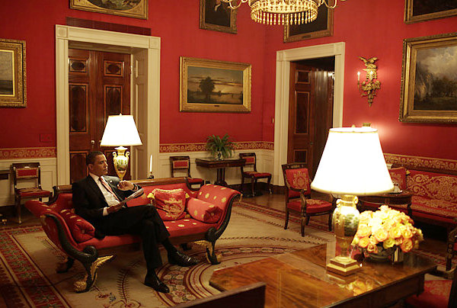
Purpose
The room has served as a parlor and music room, and recent presidents have held small dinner parties in it.

Slide 12
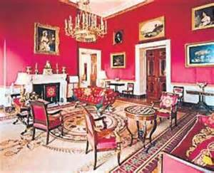
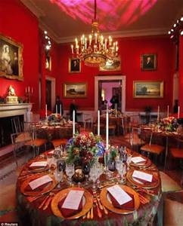
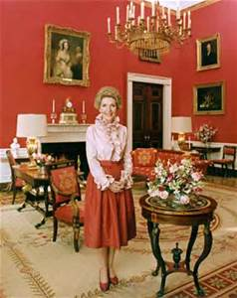

Slide 13
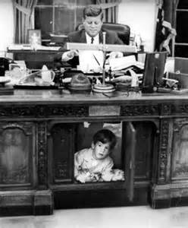
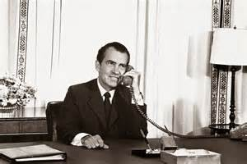
The Oval Office
Serves as the President’s personal office! However, it was not used until 1902 as an office.
Over the years, many drawing and pictures have come from this location.

Slide 14
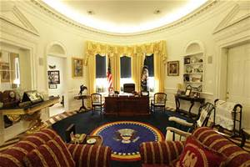
Purpose
This is the location for private meetings and conversations with aides and advisors.

Slide 15
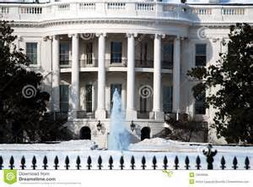
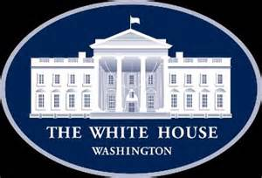
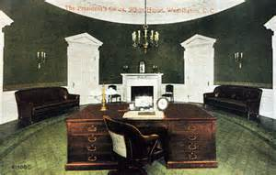

Slide 16
The Cabinet Room
Opens directly into the Oval office and overlooks the famed Rose Garden.
The centerpiece of the room is a large oval table, a gift from President Nixon in 1970, surrounded by leather chairs.
Each chair is specifically assigned, with a placard on the back indicating the position of the person meant to sit there. The president is seated in the center.

Slide 17
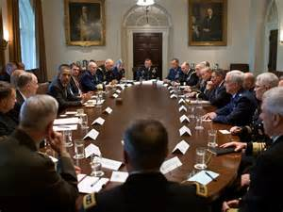
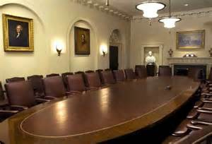
Purpose
Serves as both a public and private space for presidents to communicate with cabinet secretaries and advisors.

Slide 18
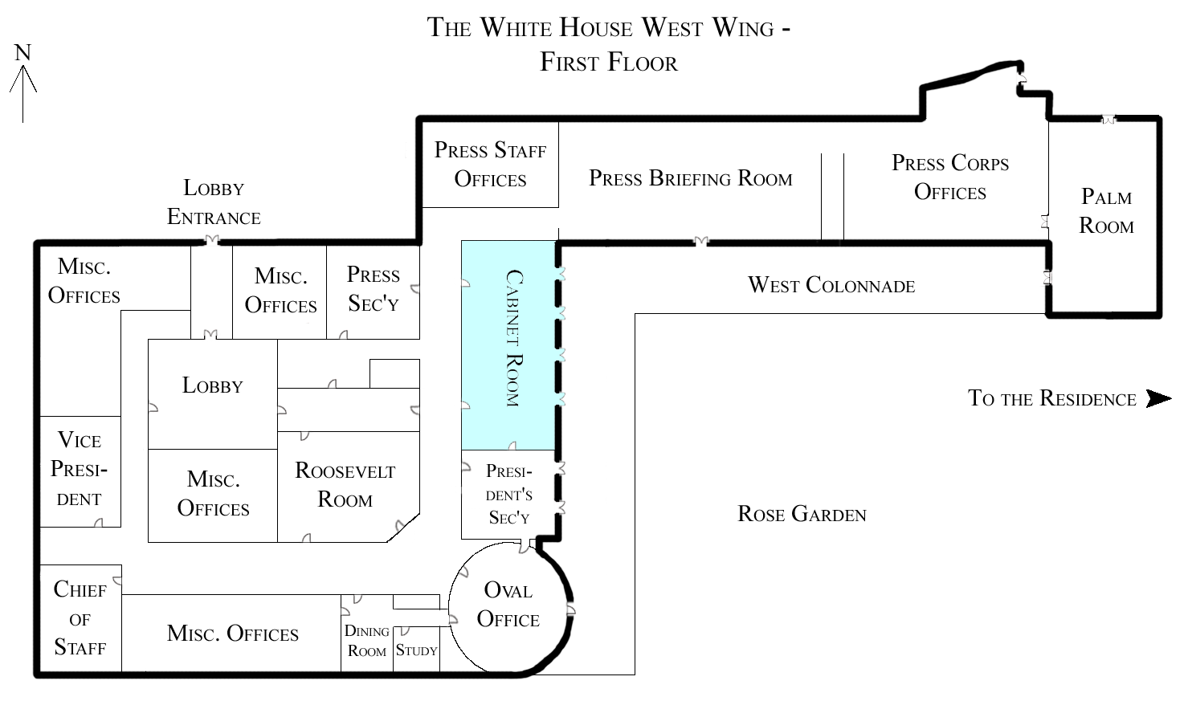

Slide 19
The Press Room
White House press corps gathers here to hear daily briefings form and ask questions of the White House press secretary.
Centrally located within the West Wing and includes doors to the Rose Garden that allow media quick access to outdoor events.

Slide 20
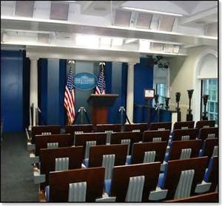
Purpose
In 1933 is was used as a therapy pool for President Franklin Roosevelt.
President Nixon converted the space into the current press briefing room.

Slide 21
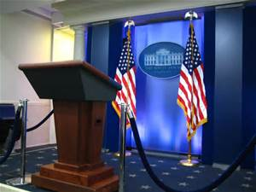
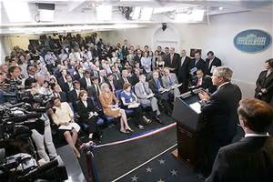

Slide 22
Family Life
The White House served as the home for the president and his family since November 1800. Over the years, it has been the site of many family gatherings.
On September 9, 1893, Esther Cleveland, child of President Grover Cleveland, was born here.
President Cleveland was the only president to get married here, but several daughters of presidents have been wed here.

Slide 23
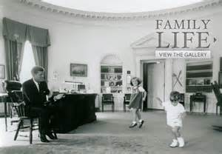
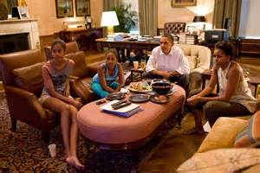
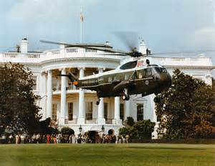
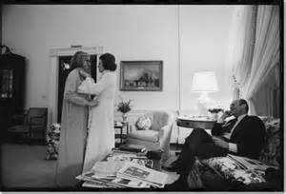

Slide 24
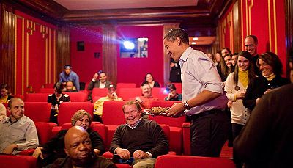

Slide 25
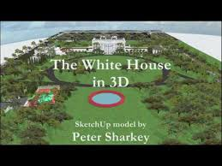
White House 3 D Tour

