Slide 1
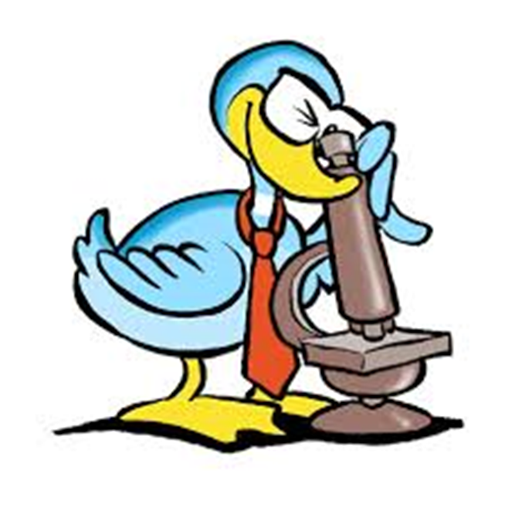
Parts of the Microscope
Notes:
Students will have their microscopes out, for reference as we go through each of the steps. As an introduction, students will be asked what kinds of things they can do with this tool.

Slide 2
What is a microscope?
A microscope is a type of lab equipment that magnifies the image of an object so that small details can be observed.
The word “micro” means small.
The word “scope” means to see or view

Slide 3
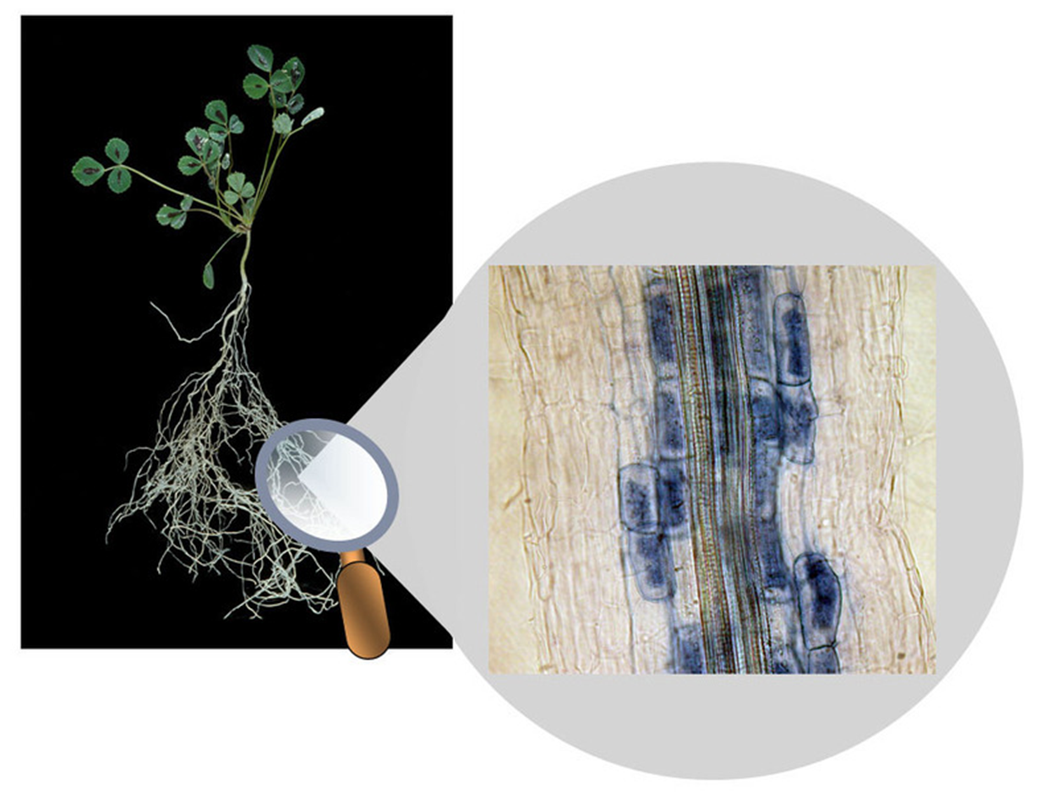
Magnified cells from
plant root

Slide 4
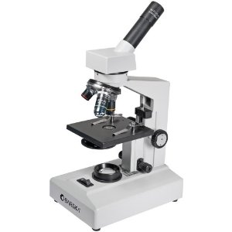
Light Microscope
Most common type used in schools
Uses a compound lenses to magnify objects
Compound lenses bend or refract light to make the object beneath them appear closer.

Slide 5
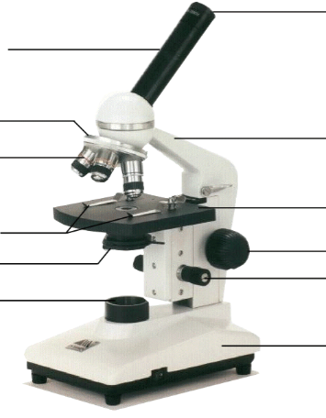
Microscope parts (pg. R14)
Eyepiece
Body Tube
Nosepiece
Arm
Objective Lens
Stage
Stage Clips
Diaphragm
Coarse Focus
Fine Focus
Light
Base
Notes:
This is the exact version of the microscope used in class. Students will be identifying the parts on the microscopes at their desks as we go along and what their functions are.

Slide 6
Microscope parts
Eyepiece: allows you to see object on slide by 10 times its normal size
Body tube: separates the lens in the eyepiece from the objective lens
Nosepiece: holds the objective lenses
Notes:
This is the exact version of the microscope used in class. Students will be identifying the parts on the microscopes at their desks as we go along and what their functions are.

Slide 7
Microscope parts
Objective lens: 40X (high power) magnifies to 400 times normal size, 10X (low power) magnifies to 100 times normal size; 4X (scanning power) magnifies to 40 times normal size
Stage: supports the slide
Diaphragm: used to control the amount of light passing through the lens
Notes:
This is the exact version of the microscope used in class. Students will be identifying the parts on the microscopes at their desks as we go along and what their functions are.

Slide 8
Microscope parts
Coarse adjustment: knob used to move the stage up and down
Fine adjustment: knob used to make to lens focused
Arm: used to hold and support the body above the stage
Stage clip: used to hold slide in place
Base: bottom support of microscope
Notes:
This is the exact version of the microscope used in class. Students will be identifying the parts on the microscopes at their desks as we go along and what their functions are.

Slide 9
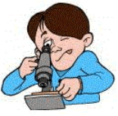
How to use microscope
Always carry with 2 hands
Hold the base and the arm
Do not force knobs
Always store covered
Keep objects clear of desk and cords
Notes:
Teacher demonstrates how to hold the microscope, where the lens paper is located and how to use it. Students will be invited to turn the knobs and observe the stage as it moves up and down. Teacher will demonstrate how to store the microscope.

Slide 10
How to draw specimens
1. Always use pencil - you can erase and shade areas
2. All drawings should include clear and proper labels (and be large enough to view details). Drawings should be labeled with the specimen name and magnification.

Slide 11
How to draw specimens
3. Labels should be written on the outside of the circle. The circle indicates the viewing field as seen through the eyepiece, specimens should be drawn to scale .
**if your specimen takes up the whole viewing field, make sure your drawing reflects that.

Slide 12
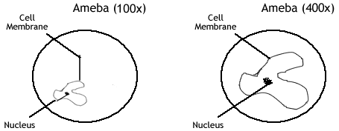
How to draw specimens

Slide 13
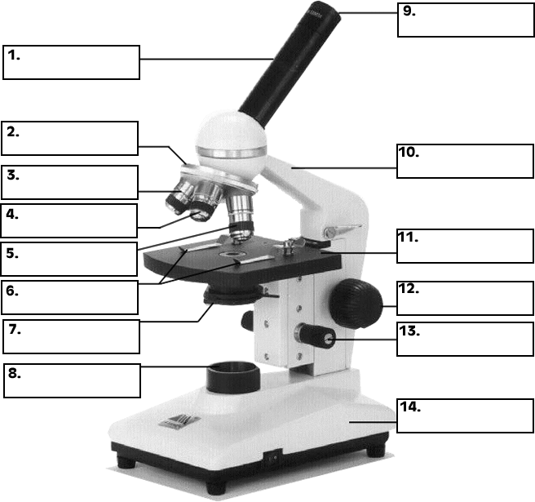
Practice Labeling the Parts

Slide 14
Practice labeling the parts
Body tube
Nosepiece
Scanning objective lens (4x)
Low power objective lens (10x)
High power objective lens (40x)
Stage clips
Diaphragm
8. Light
9. Eyepiece
10. Arm
11. Stage
12. Coarse Adjustment
13. Fine Adjustment
14. Base

