Slide 1
“Dangers of Social Media”

Slide 2
“…Consumer Reports last year said 7.5 million children under the age of 13 were using the site (Facebook), including more than five million under the age of 10. High-profile cases of so-called cyberbullying have added to the concern. Facebook counts 900 million users around the world.” by: Anton Troianonski and Shayndi Raice “Facebook Explores Giving Kids Access”

Slide 3
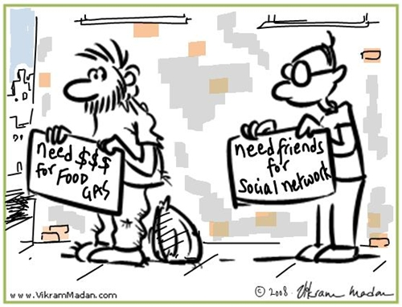
“…social networking is having an impact on the social skills of today’s youth and I’m worried about the effect it will have for my friends and peers in terms of employment.”
-17 year old “recovering” Facebook user

Slide 4
Will your child be able to get through life with fragmented sentences, abbreviated words and mere grunts if they can’t be bothered speaking, but what happens when they leave the security of the school yard? …when they’re meeting a possible employer and can’t construct a proper sentence let alone participate in a whole verbal conversation without mentioning an LMFAO or WTF or OMG or “yep” or “huh” ???
This might happen to your child with too much social networking—TOO YOUNG!

Slide 5
When was the last time you checked your child’s:
Contact list on their cell phone
Application (app) downloads on the iPad, iPods, phones, or other devices
Song downloads for appropriate/inappropriate artists/lyrics
Photos/videos on their devices
Understanding about social networking

Slide 6
When was the last time you allowed your child to:
Be alone with 50, 100, or 500 people that you didn’t know?
Take a “selfie” picture while wearing a bathing suit and have it plastered on a billboard over 459?
Be alone with a boy or a girl for an undetermined amount of time because he/she is one of their “friends”?
Gather all 500 of his/her “friends” for a get together at your house?
Repeatedly get bullied, ridiculed, exploited, or manipulated while you stood around and watched?
Drink a beer or a glass of wine or smoke a cigarette, just because you said it was “ok” (one little fib) and not dangerous as long as you’re careful and “talk” to me about it despite the age restrictions?

Slide 7
Social Networking…
It’s all those things you would NEVER allow your child to do in your presence, at any age especially UNDER AGE 13!
As a matter of fact…there’s no guarantee it won’t be just a dangerous and harmful to those that are OVER 13!

Slide 8
SOCIAL NETWORKS LIKE:
Facebook
Twitter
Kik
Tumblr
Snapchat
Instagram
FourSquare…to name a few of the most popular… TODAY
(THERE WILL BE A “NEW” APP tomorrow!)
CREATE UNNECESSARY SOCIAL PRESSURES FOR OUR STUDENTS…

Slide 9
WHAT ARE WE DOING?
“Across the nation, millions of young people are lying about their ages so they can create accounts on popular sites like Facebook and ‘other sites of app accounts’. These sites require users to be 13 or older, to avoid federal regulations that apply to sites with younger members. But to children, that rule is a minor obstacle that stands between them and what everybody else is doing.
Parents regularly go along with the age inflation, giving permission and helping children set up accounts. They often see it as a minor fib that is necessary to let their children participate in the digital world.”
THIS SETS OUR YOUNG KIDS UP FOR DISASTER…

Slide 10
These websites and apps encourage:
Sharing photos
Finding new friends even TALKING TO STRANGERS like Omegle chatroom…
Building stronger friendships/relationships
Networking with like-minded people (ok?)
Keeping in touch with one another
Strong “safety” precautions
Privacy, privacy, privacy! Right!
Individuality, free expression, just be yourself…
You’ll have a million friends and 424 likes on your photo by bedtime-- “if you follow me, I’ll follow you back”
Nobody will ever see your “picture” after 10 secs (snapchat) WRONG!
Your parents won’t tell you about what your friends are chatting about on the bus or in the hall—just go to tumblr and you can find a picture of it—free and uncensored! OR type in what you want to see at Instagram….

Slide 11
In actuality…. these sites/apps create:
Manipulation
Self-consciousness
Weakened self-esteem
Exploitation
Anxiousness, anxiety
Insecurity
Cyber-bullying
Social pressures
Cheating
Secrecy
Withdrawal
Dishonesty
Rudeness
Addiction (think of your own usage…)
And a host of other undesirable traits…(under age 13)

Slide 12
ISN’T THAT ENOUGH…
“…researchers and other critics say allowing children to break the rules sends the wrong message. And, they argue, it sets children loose in a digital world they may not be prepared for — exposing them to the real-life threats of inappropriate content, contact from strangers and the growing incidents of bullying by computer….”
“LIKE” YOUR CHILD ENOUGH, TO SAY “NO” TO
SOCIAL NETWORKING UNDER AGE 13!

