Slide 1

Digital Citizenship
Presented by: Christie Willis

Slide 2



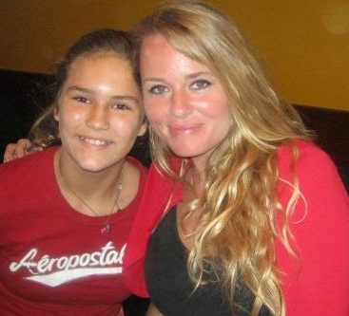

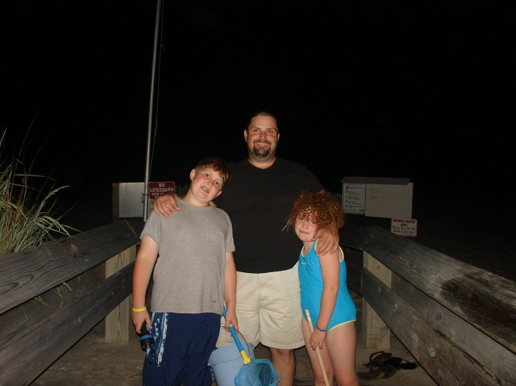
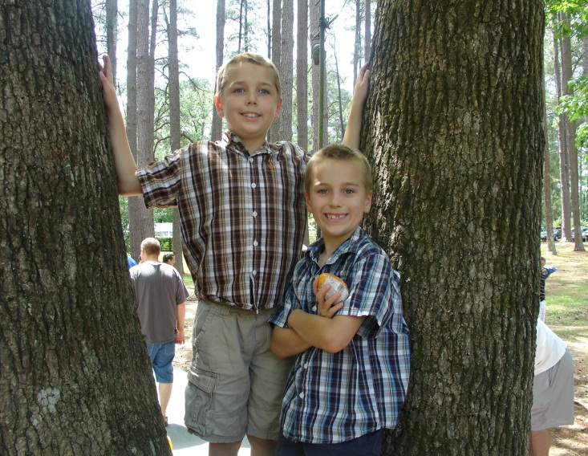
All About Me!

Slide 3

Digital Natives…
Click below to watch video! This may take a few seconds to load!

Slide 4

“We need to teach kids to respect the past but to live in the future.”
…Marc Prensky

Slide 5


Slide 6
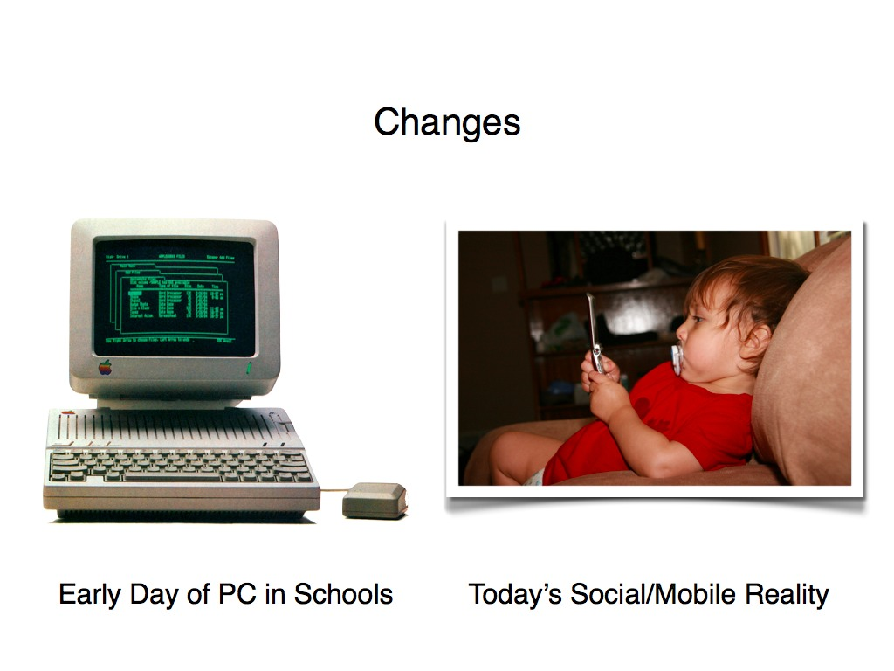

Slide 7
What is United States Citizenship?
“Citizenship is the common thread that connects all Americans. We are a nation bound not by race or religion, but by the shared values of freedom, liberty, and equality” (U.S. Citizenship and Immigration Services).
As a citizen, we have to abide by rights and responsibilities that we should all exercise and respect!

Slide 8

What is a Digital Citizen?
“Digital Citizenship can be defined as the norms of appropriate, responsible behavior with regard to technology use.”
As a digital citizen, we have to abide by the rights and responsibilities in regards to the usage of Technology!

Slide 9

There are 9 elements of Digital Citizenship:
Digital Access
Digital Commerce
Digital Communication
Digital Literacy
Digital Etiquette
Digital Law
Digital Rights & Responsibilities
Digital Health & Wellness
Digital Security

Slide 10

Digital Access…
Full participation in society.
Digital exclusion of any kind will not promote technology enhancement for users in an electronic society!
Places or organizations with limited digital connectivity should be addressed.
We should all have equal digital access.

Slide 11
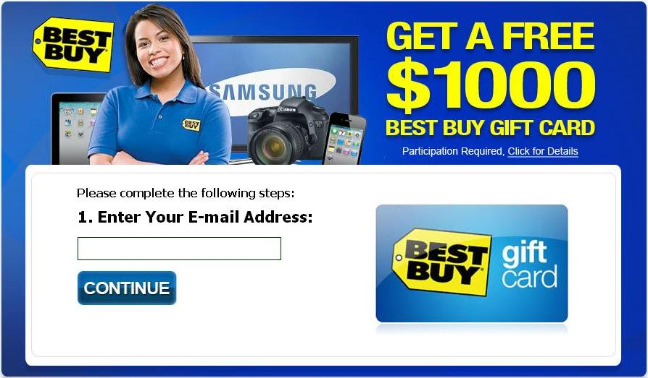
Digital Commerce…
Users need to understand that a large part of our global market economy is done digitally.
We are able to go online and purchase many items such as toys, clothing, cars, food, etc. They are readily available by the touch of a keyboard.
Users need to learn how to be effective consumers in a new digital economy and understand what is legal and moral!

Slide 12

Digital Commerce Video…
Click below to watch video. This may take a few seconds to load!

Slide 13

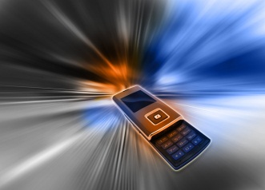
Digital Communication…
Communication with other people digitally.
  E-mail
  Cell phones
  Instant messaging
People are able to keep in constant communication with anyone else.
We have the ability to collaborate from anywhere anytime.
We need to make appropriate decisions due to so many digital options.

Slide 14
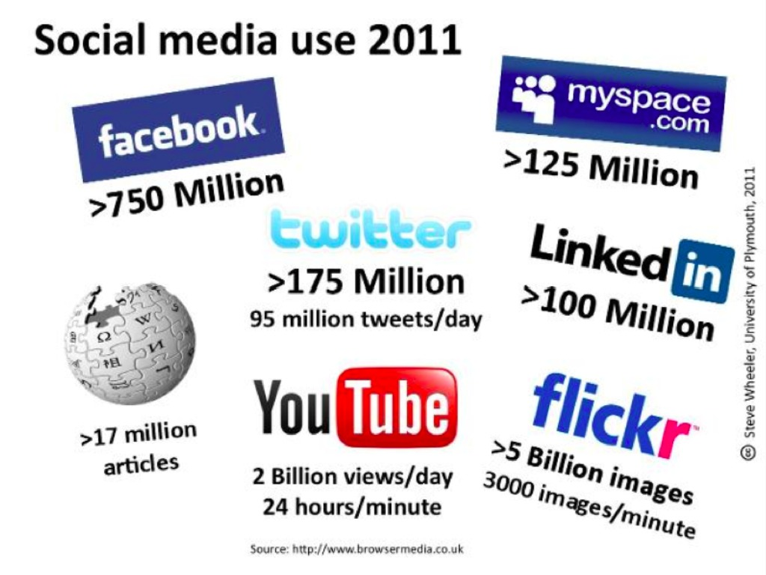
Social Media Sites…
Top 15 Most Popular
Facebook LiveJournal
Twitter Tagged
Instagram Orkut
Linkedin CafeMom
Pinterest Ning
mySpace Meetup
Google Plus + myLife
DeviantArt Multiply

Slide 15
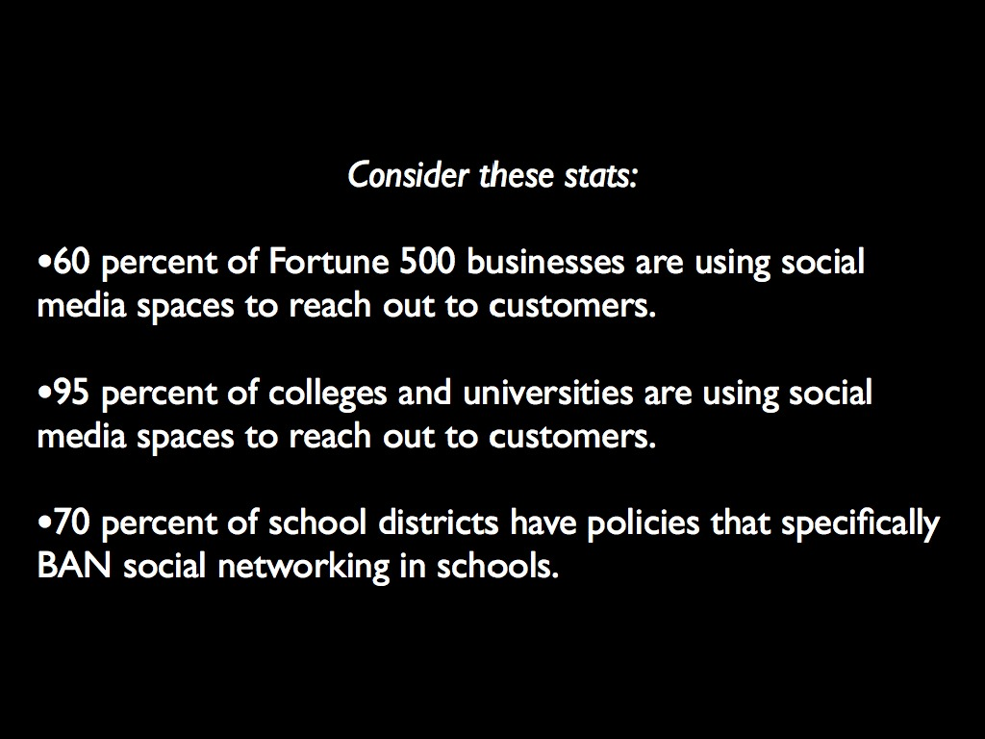

Slide 16
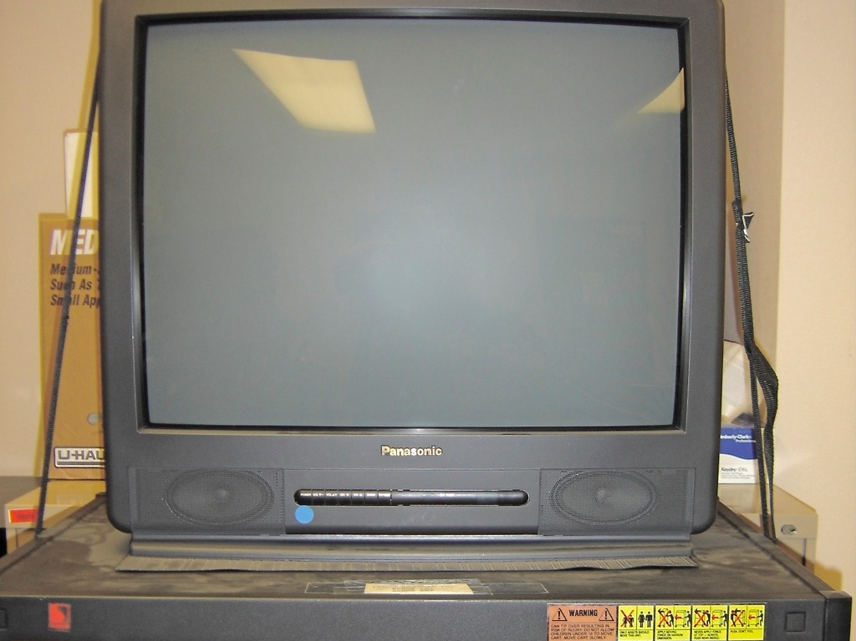
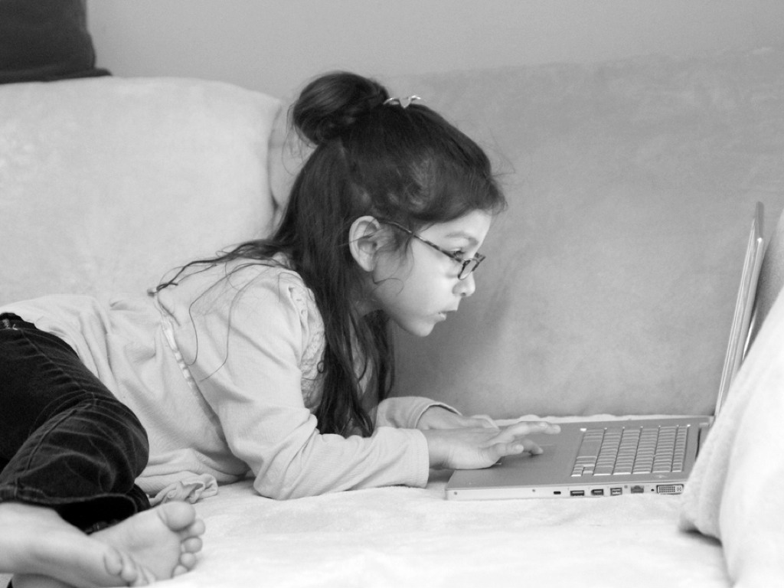
Before
Now

Slide 17

Digital Literacy…
The process of teaching and learning about technology and the use of technology.
Learners must be taught to learn anything, anytime, and anywhere.
As new technologies emerge, learners need to learn how to use that technology quickly and appropriately.
Digital Citizenship involved educating people in a new way-these individuals need a high degree of information literacy skills.

Slide 18
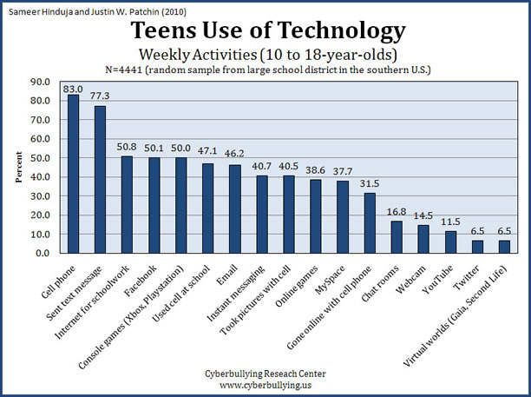
Teens Usage of Technology

Slide 19
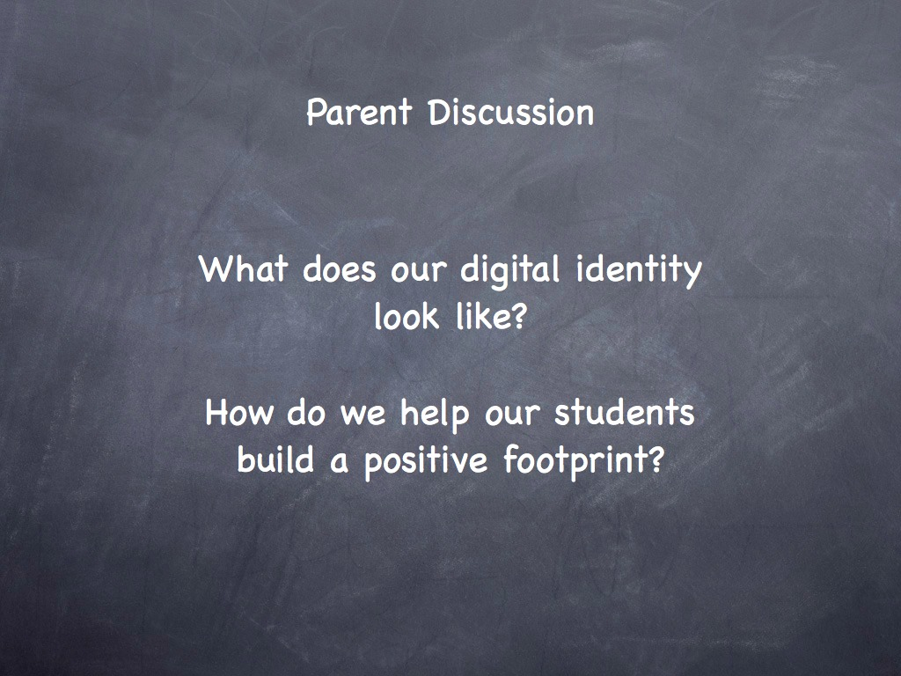
Digital Footprint…

Slide 20
Digital Etiquette…
Electronic standards of conduct or procedure.
We understand what inappropriate behavior is when we see it, but we need to teach digital etiquette (appropriate conduct) before that technology is used.
Unfortunately, technology gets banned to stop the inappropriate use; we should be teaching etiquette rules so that these digital devices can be used!

Slide 21
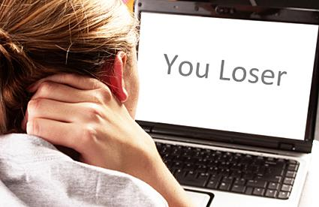
Cyber Bullying…

Slide 22


Slide 23
Cyberbullying…It needs to stop!
Click below to watch video! This may take a few seconds to play!

Slide 24

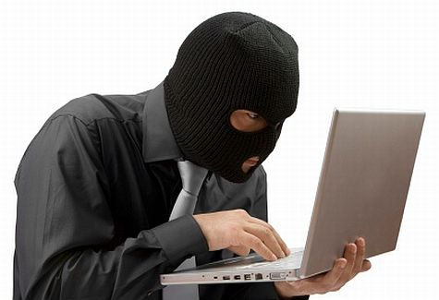
Digital Law…
Ethics of Technology with a Society
Users need to understand that stealing or causing damage to other people’s work, identity, or property online is a crime.
Hacking into others information, downloading illegal music, plagiarizing, creating viruses, sending spam or stealing someone’s identity or property is unethical.

Slide 25
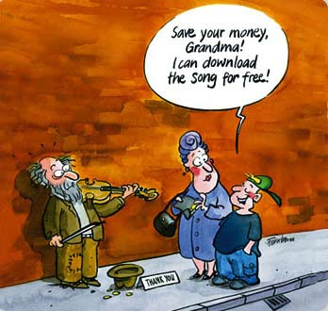
Piracy…

Slide 26
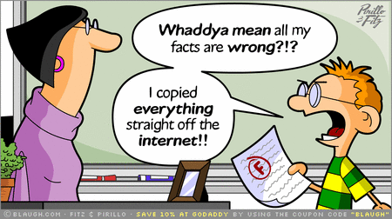
Plagiarism…

Slide 27
Digital Rights & Responsibilities…
Those freedoms extended to everyone in a digital world.
Digital citizens have the right to privacy, free speech, etc.
Basic digital rights must be addressed, discussed, and understood in the digital world.

Slide 28
Digital Health & Wellness…
Physical and psychological well-being in a digital technology world.
Eye safety, repetitive stress syndrome, and sound ergonomic practices are issues that need to be addressed in a new technological world.

Slide 29
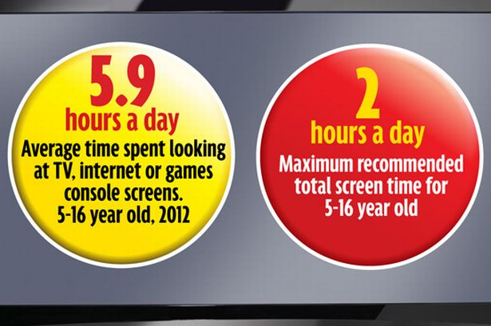

Slide 30
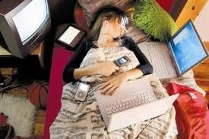

Slide 31
Health Problems…
Because of the high usage time on Technology:
  Students miss more school
  Stomach aches
  Sleeping problems
  Anxiety and depression
  Shortened attention spans

Slide 32
Parents can…
Role model good technology time practices.
  If a child always watches their parents constantly checking their cell phone or downloading applications, they will pick up on this and mimic your behavior.
  Limit the amount of time kids spend on technology devices

Slide 33
“Technology has certainly provided amazing advances in a short amount of time. But, as most things in life, it’s important that people don’t overuse the technology. There is a fine line between incorporating technology into your life or your child’s life to enhance it, and having it completely overtake your existence.”

Slide 34


Slide 35
Digital Security…
Electronic precautions to guarantee safety.
Just as we put locks on our doors at home and in our cars, we need to put a lock on our digital devices.
We need to have virus protection, backups of data, and surge control of equipment.
We must protect our information for outside forces that might cause disruption or harm.

Slide 36

Ways to promote…
Strong Passwords
Never give out personal information online to people you don’t know
Anti-Virus Protection
Keep profiles private
Block those who make you feel uncomfortable on the Internet
Talk to a parent/trusted adult about issues online

Slide 37



Concerns: Is your child 13 years of age?
Snapchat app

Slide 38
Giving Credit Where Credit is Due!
U.S. Citizenship and Immigration Services Website
HerndonPatch
Google Images
Slidshare.com

Slide 39
Thank you all for attending! I hope you have gained some insight as to what Digital Citizenship is all about! Please feel free to contact me anytime in regards to any of these issues. I am always here to help!
My email is chwillis@hoover.k12.al.us

