Slide 1
DNA Fingerprinting
Chapter 13

Slide 2
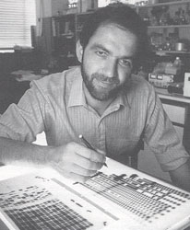
History
Scientists first discovered DNA in the 1800’s but it had no interest for the legal system until 1985 when Alec Jeffrey’s revealed his research that suggested that DNA is a unique as a fingerprinting. (thus the term DNA fingerprinting)

Slide 3
Question
Which scientist(s) discovered the shape of DNA?
Mendel
Pasteur
Watson and Crick
Leone and Lattes

Slide 4
The Basics
We have about 60 trillion cells and each of those cells contains a full set of our chromosomes
46 (2 sets of 23) in a regular cell
23 (one set) in a sperm or egg cell
You inherit 1 set of chromosomes (23) from your mother and one set (23) from your father.
Your sex cells (sperm or egg) only have one set that is randomly made from a mixture of your two sets.
.

Slide 5
Question
Why do sperm and egg only have 23 chromosomes instead of 46?
They only get the chromosomes from your mom
They only get the chromosomes from your dad
They only get the chromosomes from the parent of the same sex
So that when egg and sperm meet (fertilization) the embryo gets 46 not 92.

Slide 6
Question
What percentage of your DNA matches your father?
25%
50%
75%
It’s different from person to person

Slide 8
Question
A. Male
B. Female

Slide 9
The Basics
Chromosomes are found in the nucleus of a cell
They typically take the form of chromatin
Chromosomes are made of DNA (deoxyribonucleic acid). DNA is in the shape of a spiral double helix (twisted ladder)

Slide 10
DNA

Slide 11
DNA
DNA has three parts
Sugar (deoxyribose)
Phosphate
Nitrogen base (Adenine, Cytosine, Thymine, or Guanine)
The sugar and phosphates make up the sides of the ladder. The nitrogen bases make up the rungs.

Slide 12
Question 4
Which of these is true?
Adenine bonds with Guanine
Guanine bonds with Thymine
Cytosine bonds with Adenine
Adenine bonds with Thymine

Slide 15
Did you know?
If you unwound the DNA from one chromosome it would stretch over 6 feet.

Slide 16
DNA
It is the sequence of nitrogen bases (A,C,T, G) that make each person’s DNA unique.
A is always found paired with T; C is always found paired with G.
However, the large majority of the sequence is identical person to person (99.9%)
It is the .1% difference in the sequence that causes us to be unique.
There are about 3 billion base pairs in a Human’s DNA.

Slide 17
Question 5
What percentage of our DNA sequence matches that of a banana?
5 %
10%
50%
75%

Slide 18
The Basics
On our chromosomes there are about 30,000 genes.
Genes are the basic unit of heredity.
Each gene has a single function (in other words it codes for a single protein.)
It codes for something by having a specific set of base pairs.
A change in the base pair order can change what the gene codes for.
Together, the proteins our genes code for make us who we are.

Slide 19
Question 6
True or False
Each chromosome contains hundreds of different genes.

Slide 20
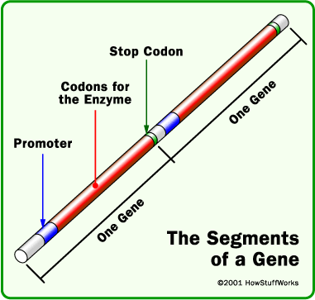
Genes on a Chromosome

Slide 22
Alleles
Each person has two copies of each gene (one from each parent)
Those two copies are referred to as alleles from that gene.
If the alleles are the same we say the person is homozygous
If the alleles are different we say the person is heterozygous

Slide 23
Tandem Repeats
A region of a chromosome that contains multiple copies of a DNA sequence arranged in a repeating fashion.
CAGCAGCAGCAGCAGCAGCAGCAGCAG
Roughly 30% of our DNA
Large variation in number of repeats from person to person. (This is what makes our DNA unique)
Follow basic Mendelian inheritance (Think Punnett Squares)

Slide 24
Question 7
These repeating sequences tend to code for
Nothing
Very important proteins
Genetic diseases
Physical characteristics

Slide 25
Genome
The total amount of genetic material in a cell.

Slide 26
VNTR
Variable Number of Tandem Repeats
This is why DNA testing works
Refers to the length of tandem repeats in the DNA of individuals
The chances of anyone having the same results are less than one in a million.

Slide 27
Other types of DNA
The DNA we are familiar with is nuclear DNA. It is our genetic material.
However, there is also mitochondrial DNA in your mitochondria.
Mitochondrial DNA comes only from your mother.
Why?
Your mitochondrial DNA matches all your maternal relatives.

Slide 28
Nuclear DNA vs. Mitochondrial DNA
Nuclear DNA is more useful in that it can be linked to a specific person.
Mitochondrial DNA however lasts longer (more stable)
There are thousands of mitochondria in a cell so there is a lot of mitochondrial DNA in each cell.

Slide 29
Question 8
Mitochondrial DNA: Nuclear DNA
Class : Class
Individual : Class
Class : Individual
Individual : Individual

Slide 30
DNA Replication
Our body has to copy DNA every time we need a new cell.
DNA replicates through a process called semiconservative replication. It follows complementary base pairing rules.
The primary enzyme responsible is DNA polymerase

Slide 31
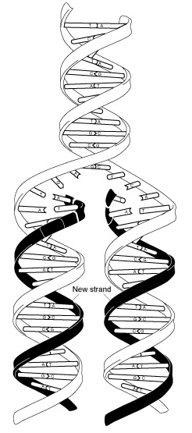
DNA Replication

Slide 32
Why is DNA useful?
Identifying unknown victims
Linking serial crimes
Identifying the number of assailants
Identifying additional victims
Identifying suspects using a database
Exonerating the wrongly convicted
Whether the sample is from one person
The minimum number of contributors
The gender if the sample is from a single person
Whether a male was involved if it is a mixed sample
Whether the donors are biologically related

Slide 33
Where can DNA be found?
Licked stamp or envelope
Chewing gum
Cigarette
Sweatbands or caps
Semen stains
Blood
Saliva from bitemarks
Feces or vomit
Skin under fingernails
Body tissue on the bumper of a car

Slide 34
Reference samples
Reference samples are taken from:
Hair containing the root
Blood sample
Cheek swab

Slide 35
Collecting DNA
Care should be taken to avoid contamination
Disposable forceps, change gloves between items, Package separately
Must be air dried before packaging to avoid mold (which destroys the evidence)
Evidence should be kept cold
Contamination is usually easily seen in the lab (if more than 2 bands are present)
If blood can’t be seen it can be detected with luminol without any damage to the DNA.

Slide 36
Question 9
What other substance glows when exposed to luminol?

Slide 37
Collection of DNA
It is necessary only to collect 36 dna-bearing cells in order to have enough DNA to test and some new test can go as low as 9 cells
Samples should never be packaged in air tight containers to prevent the accumulation of moisture and increase bacteria and fungal growth which could destroy DNA
Should be packaged in paper bags or ventilated boxes

Slide 38
DNA Restriction
Restriction enzymes can be added to DNA to cut (cleave) the DNA at specific sequences.

Slide 39
Restriction Enzymes

Slide 40
RFLP
Restriction Fragment Length Polymorphisms
Involves splicing repeating segments out of the DNA via restriction enzymes.
Number of repeats a person has will vary from person to person (remember—VNTRs)
Number of repeats a person has can be determined by running the sample in an electrophoresis gel.

Slide 41
Electrophoresis

Slide 42
RFLP
The gel is spiked with ethidium bromide which causes the DNA bands to glow when exposed to UV light
The resulting fragments will be of different sizes based on a person’s unique DNA.

Slide 43
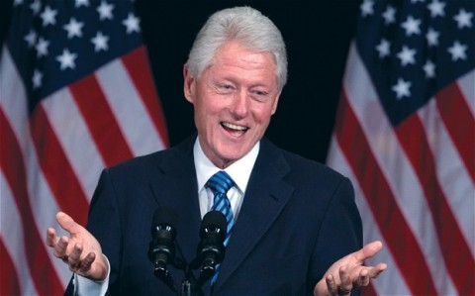
Question 10
What very famous Congressional trial depended on RFLP testing?

Slide 44
RFLP
It was the first accepted protocol.
Fame was short lived. It was replaced by STR.
Most famous case—Clinton impeachment

Slide 45
In the Lab
DNA found at a crime scene needs to be replicated in order to be tested.
Outside of the body, DNA can be replicated by using a technique called PCR.

Slide 46
Steps of DNA testing
1. Extraction
2. Amplification
3. Analysis
4. Comparison

Slide 47
PCR Machine

Slide 48
PCR
Polymerase Chain Reaction
Replicates even the smallest sample of DNA.
Takes about 90-100 minutes to give you millions of copies of DNA.
Uses a thermostable enzyme called Taq Polymerase. (let’s replication happen at a higher temp which makes it faster)
Taq is very expensive and is isolated from bacteria that live in deep sea thermal vents
Without PCR, forensic testing would be impossibly slow

Slide 49
Stages of PCR

Slide 50
Steps of PCR
1) Denature DNA- heat to 95°C
2) Anneal Primers- cool to 55°C
3) Polymerization- 72°C using Taq Polymerase

Slide 52
PCR Revolution
From 85-95, RFLP was dominant but in 1995 PCR changed everything.
PCR replicates DNA much the same way as the body except much faster and only small segments (identified by the attachment of primers)
Works with smaller segments of DNA than RFLP which means it is less likely to degrade (break down)
Only need one-billionth of a gram

Slide 53
STR
Short Tandem Repeats
Newest form of DNA testing
Location on the chromosomes where short sequences of DNA (3-7 base pairs) repeat themselves.
Because the strands are so short they can often be recovered from a body even after tremendous decomposition
Short length makes the ideal for PCR replication

Slide 54
Question 11
How many STRs (genes) are tested when doing standard DNA testing?

Slide 55
STR
Once copied the fragments can be run on an electrophoresis gel and their length can be determined (number of repeats)
Hundreds of STRs exist
13 have been used to form the national database (CODIS)
The more STRs that match the better the probability

Slide 56
Did you know?
Forensic DNA testing looks at portions of the DNA with no known purpose. These are called noncoding strands or “introns”

Slide 60
CODIS
Combined DNA Index System
All 50 states mandate the collection of DNA from criminals convicted of certain crimes (types of crimes are decided by states)
Sex offender
Felony offender (Alabama)
Felony arrest (Alabama as of 10/2010)
All arrest (Virginia)
Maintained by the FBI but it contains databases from all jurisdictions.
Over 9.7 million profiles

Slide 61
CODIS
35 million profiles world-wide
NY recently started collecting from all convictions (felony and misdemeanor)
If your conviction is overturned, you can petition to have your sample removed
70% of hits came from profiles from criminals convicted of nonviolent crimes
51% of rape hits had a prior conviction for burglary (a nonviolent crime)

Slide 62
CODIS
Based on 13 STRs; when all 13 match a sample---it is considered a match
Functions:
Provides a way to link serial crimes
Identify suspects
Hits just get you probable cause for a warrant to collect a new sample for comparison.
49 hits/month in AL making it #1 in the nation.

Slide 63
Amelogenin gene
When conducting STR analysis, scientists look at the amelogenin gene to determine sex.
This gene is on both the X and Y chromosomes but it is 6 bp shorter on the X.
In a female you should only see one band on the gel whereas in a male you should see 2.

Slide 65
Y-STRs
New test that looks only at STRs on the Y chromosome
Can help in sexual assault cases
Female DNA (victim) will not be present since she doesn’t possess the Y chromosome.
Helpful since samples are often mixed

Slide 66
Colin Pitchfork 1983
First ever DNA-based manhunt
First time DNA evidence was ever used to solve a crime.
Rape and murder of two very young girls.
Every man was required to submit a sample.
At first there was no match but it was later revealed that Pitchfork had asked a friend to fake his.

Slide 67
Tommie Lee Andrews 1986
First time DNA was used in the US.
Rape of a woman in Orlando, FL.
DNA was able to connect Andrews to multiple rapes.
He was sentenced to more than 100 years in prison.

Slide 68
Ian Simms (1988)
Body of a missing young woman was never found but her blood (and earring back) were found in Simms apartment.
First time DNA was used to convict with no body.
DNA from blood was matched to the young woman’s parents.

Slide 69
Kirk Bloodsworth 1984
Rape and murder of a nine year old female.
Convicted despite having an alibi
Retried in 1986 and convicted again
Semen stain was tested in 1992 and proven not to be Bloodsworth’s
Released after nine years in prison

