Slide 1
Vertebrate Evolution
Chapters 30-33

Slide 2
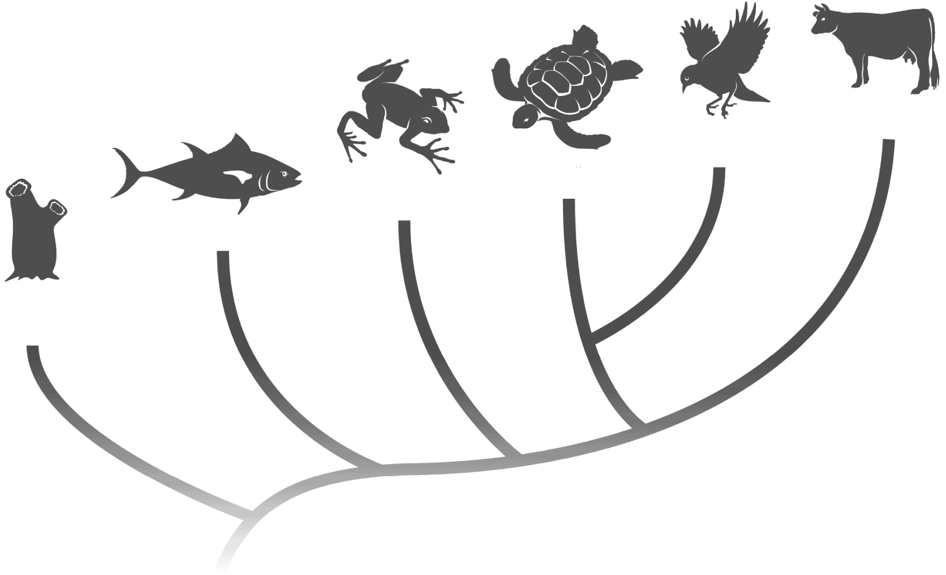
Mammals
Birds
Reptiles
Amphibians
Fishes
Nonvertebrate chordates
Invertebrate ancestor

Slide 3
The process by which organisms maintain constant internal conditions such as temperature and water content is…

Slide 4
Regulation of Body Temperature
Ectotherm – body temperature is controlled through losing and gaining heat from the environment
Endotherm –generates and retains heat inside its body

Slide 5
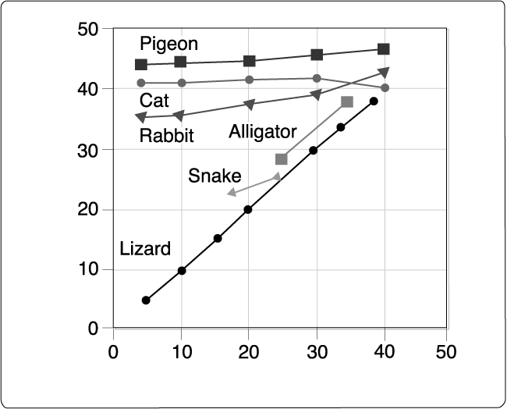
Which of the following is an ectotherm?
Body Temperature (°C)
Environmental Temperature (°C)

Slide 6
Respiration
Oxygen is required to…..
Carry out cellular respiration - Break down glucose to obtain energy in the form of ATP

Slide 7
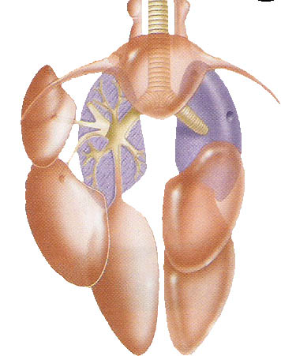
Blood carries oxygen to the cells
The circulatory system transports blood and materials throughout the body

Slide 8
Water Retention
Most chemical reactions in the body take place in water
Animals (and plants!) had to acquire ways to retain water once they became land-dwelling

Slide 9
Bell Ringer: Copy down the questions and answer using your Geological Time Scale
What do scientists estimate the age of the earth to be?
In what period did jawless fish appear and when did this period begin? Jawed fish?
What period was the “Age of Fishes” and when did this period begin?

Slide 10
The Fishes
Ectothermic (so are amphibians and reptiles)
Water is a good environment for ectotherms – the temperature of water doesn’t change as quickly as air temperature
Use gills for respiration
External fertilization (so do amphibians)

Slide 11
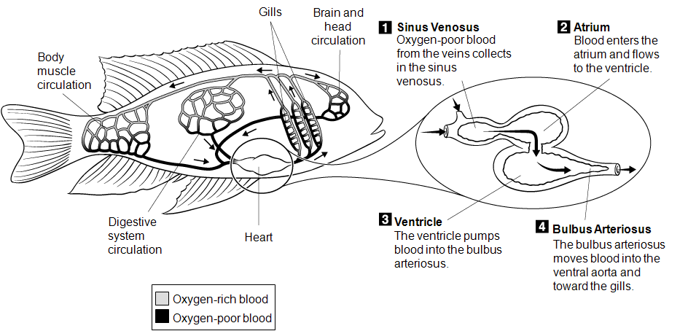
Single-loop circulation

Slide 12
Bell Ringer: Copy down the questions and answer using your Geological Time Scale
In what period do amphibians first appear in the fossil record? Give the dates of this period.
In what period do reptiles first appear in the fossil record? Give the dates of this period.
What period is the “Age of the Reptiles”? Give the dates of this period.
What reptilian ancestors were dominant during this period?

Slide 13
The Amphibians
Amphibia means ____________________
Developed strong limb bones for walking and lungs to breath air

Slide 14
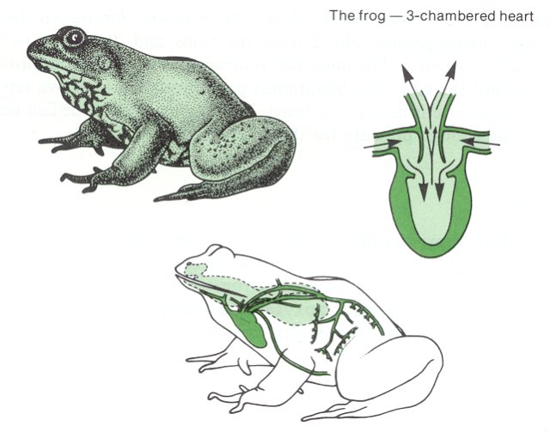
Amphibians – double loop circulation
First loop carries blood between the heart and the lungs
Second loop carries blood between the heart and the tissues

Slide 15
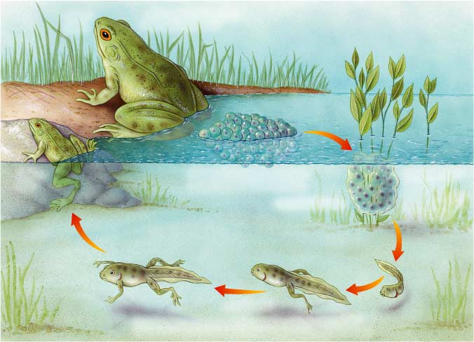
Most fishes and amphibians have external fertilization – female lays eggs in water and male fertilizes externally
Must have water 1) for sperm to swim to egg and 2) to keep eggs moist

Slide 16
The Reptiles
Adapted to terrestrial life
Dry, scaly skin to keep water in
Modified excretory systems
Shelled eggs that do not require water
Internal fertilization – increases chances of success, allows a direct means of fertilization
Bird and mammals too!

Slide 17
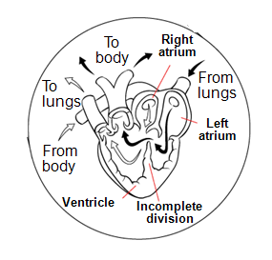
Reptiles – double loop circulation
Most reptiles have 3 chambers, but crocs and alligators have 4

Slide 18
Reptile’s and bird’s amniotic egg has protective membranes and does not require water

Slide 19
Bell Ringer: Copy down the questions and answer using your Geological Time Scale
In what period do birds first appear in the fossil record? Give the dates of this period.
In what period do mammals first appear in the fossil record? Give the dates of this period.
Humans are mammals. In what period do humans first appear in the fossil record? Give the dates of this period.

Slide 20
Birds and Mammals
Endotherms generate heat using high metabolic rates, which means they require more __________________!
Birds have feathers
and mammals have
fur to retain heat

Slide 21
The respiratory system of birds is one-way
Oxygen-rich air enters the air sacs then flows into the tubes of the lungs
Oxygen-rich and oxygen-poor blood never mix
Allows more efficient metabolism and allows respiration at high altitudes

Slide 22
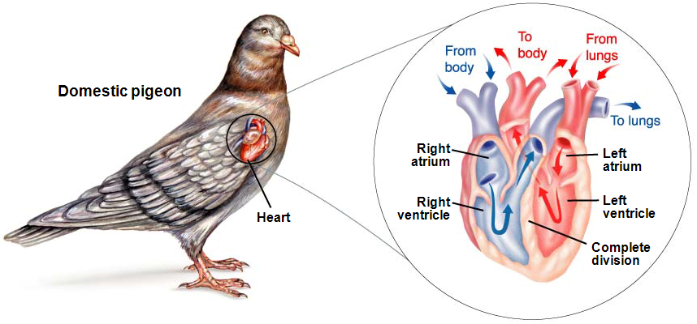
Birds and mammals – double loop circulation and 4 chambers
Separated into 2 different sides, one oxygen-rich and one oxygen-poor

Slide 23
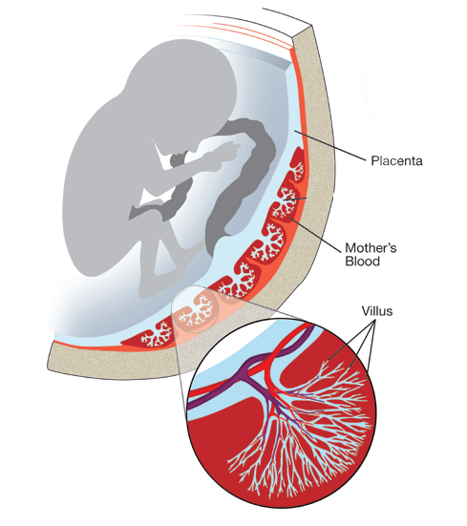
Placental mammals have a structure called the placenta which allows the embryos tissues to join with the mothers
Used for exchange of nutrients, oxygen, and carbon dioxide

