Slide 1
Chapter 6
Terrestrial biomes

Slide 2
Biome
a major regional terrestrial community with its own type of climate, vegetation, and animal life

Slide 3
Q. What determines biomes?
A. Mainly climate
Q. What determines climate?
A. Many things, including tilt of earth’s axis, proximity to oceans, presence of mountains, wind currents

Slide 4
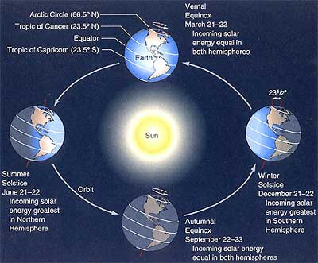
Tilt of earth’s axis affects climate in different parts of the world

Slide 5
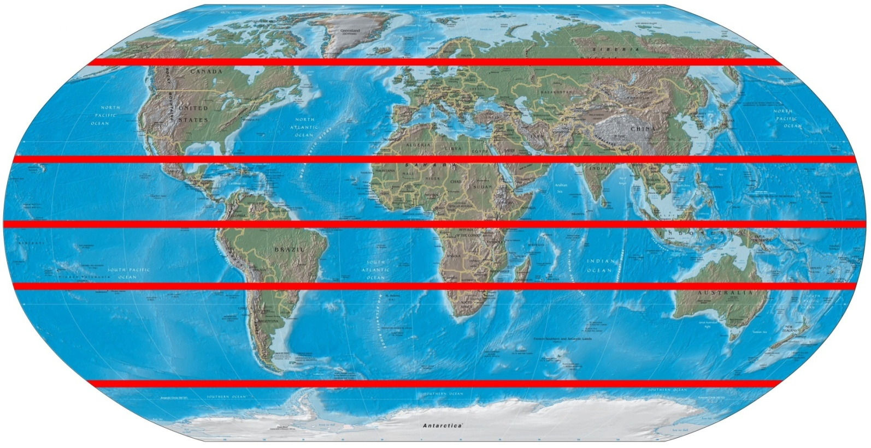
Zones of the earth
Arctic
Temperate
Tropic of cancer
Tropical
Tropic of Capricorn
Temperate
Antarctic
Equator

Slide 6
Q. Which two aspects of climate determine biomes most?
A. Temperature and precipitation

Slide 7
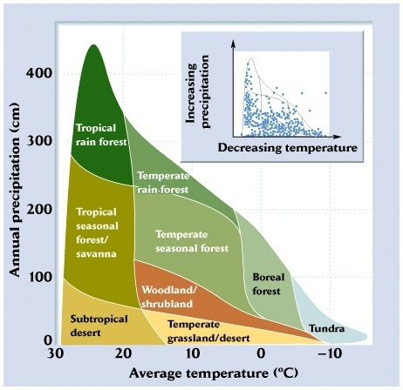
Whittaker Biome Diagram – shows relationship between precipitation and temperature

Slide 8
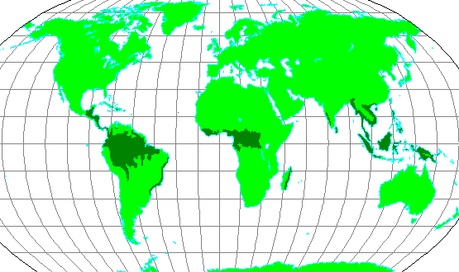
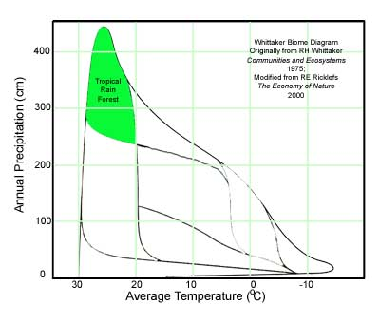
Tropical Rain Forest

Slide 9
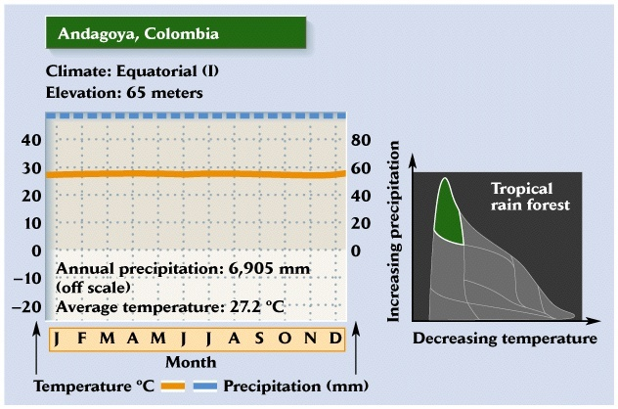
Tropical Rain Forest
-found near the equator (between Tropic of Cancer and Tropic of Capricorn)
-temperature varies little from approximately 23°C
-the length of daylight varies from 12 hours by less than one hour
-highest rainfall of all biomes

Slide 10
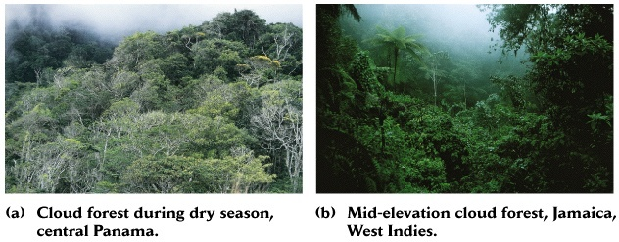
Tropical Rain Forest
- highest biodiversity of all biomes
canopy trees up to 150 feet tall
(tall tree in AL would be 50 feet)
- largest biome, on an area basis
-soils are generally unfertile
-nutrients and carbon stored
in plant biomass, not soils
-rapid decomposition

Slide 11
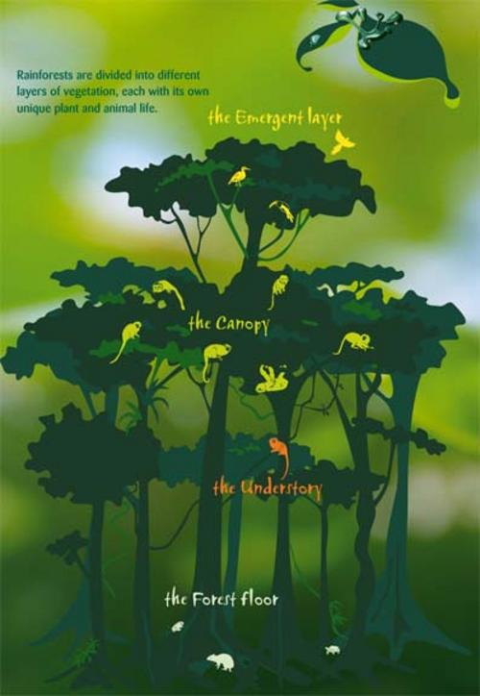
Layers of rainforest
emergent layer- top, most light
canopy – 90% of species live in this layer
understory – filtered light, epiphytes grow on trees (type of commensalism)
forest floor – little light, many fungi

Slide 12
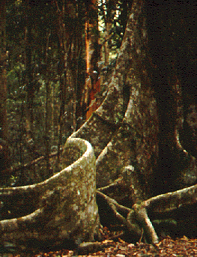
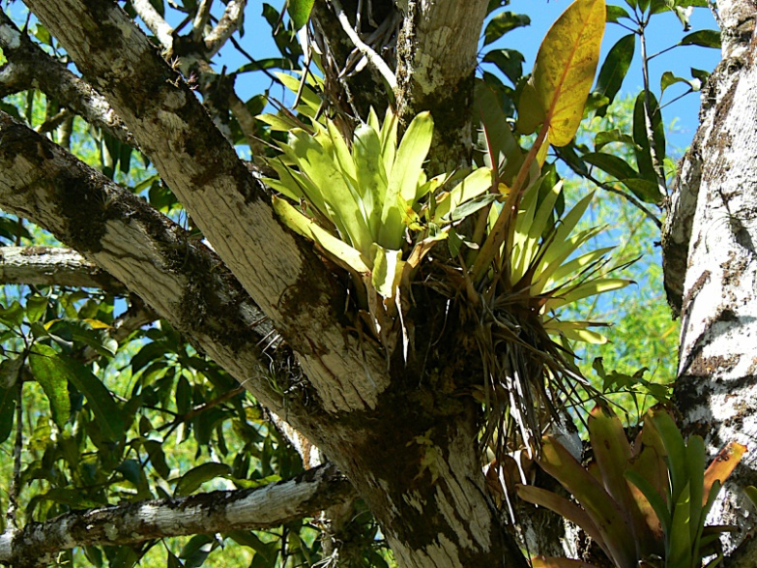
Adaptations of plants and animals
Buttresses provide support for trees in thin soil
Large leaves provide advantage in competition for light
Epiphytes grow on tall trees to reach light
Many animals have evolved as specialists to occupy a certain niche (reduces competition)

Slide 13
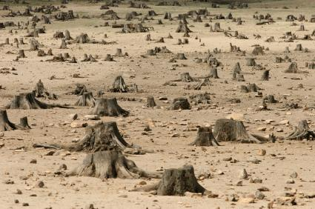
Threats to biomes
Tropical Rainforest – deforestation, urbanization, pollution, collection of species to sell, slash and burn agriculture

Slide 14
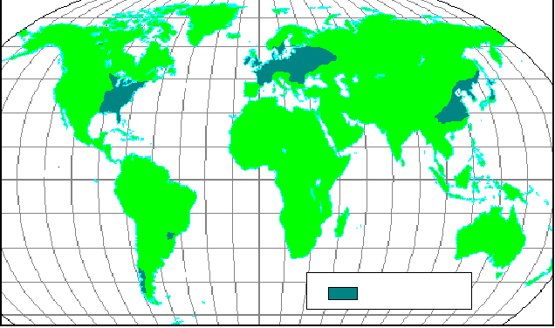
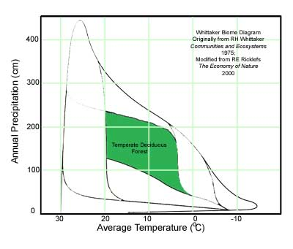
Temperate Deciduous Forest

Slide 15
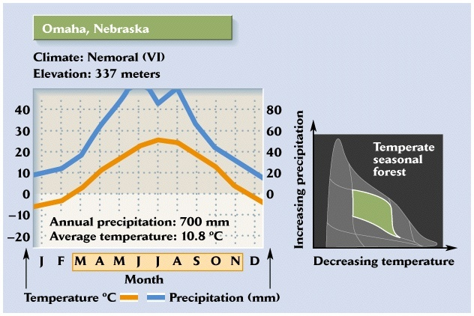
Temperate Deciduous Forest
-distinct winter season,
frost a defining feature
-summer usually moist

Slide 16
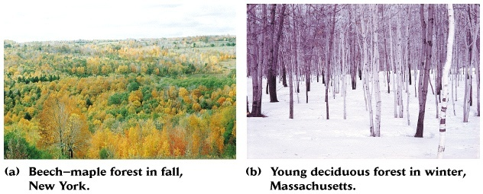
Temperate Deciduous Forest
-relatively large tree biomass
-called the deciduous forest,
but contains evergreen trees as well

Slide 17
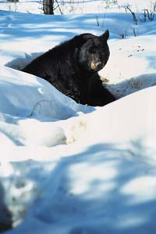
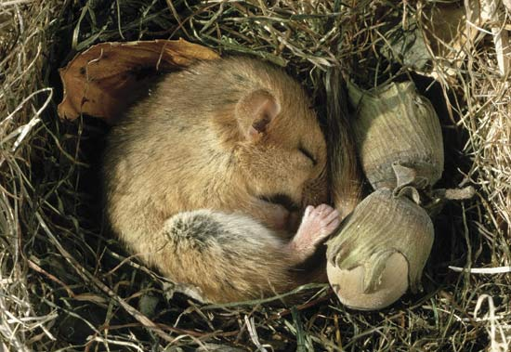
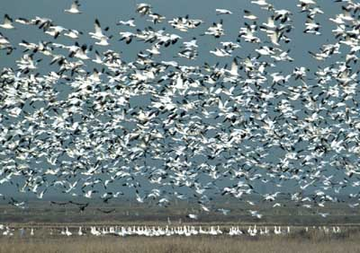
Temperate Deciduous Forest
Adaptations of plants and animals
Trees are deciduous
Many animals hibernate or migrate to avoid winter temps

Slide 18
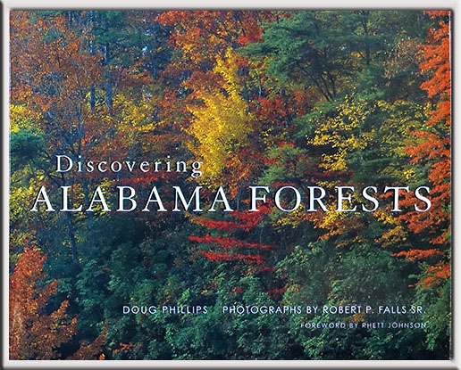
Temperate Deciduous Forest
Sweet Home Alabama – this is our biome!

Slide 19
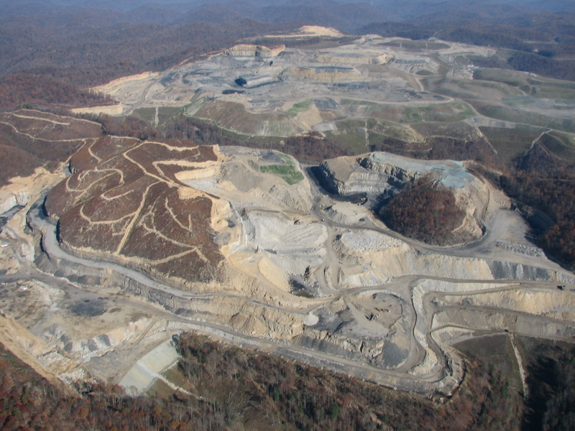
Threats to biomes
Temperate Deciduous Forest – deforestation, acid rain, logging, urbanization, mountain top mining

Slide 20
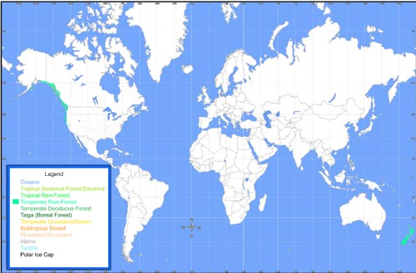
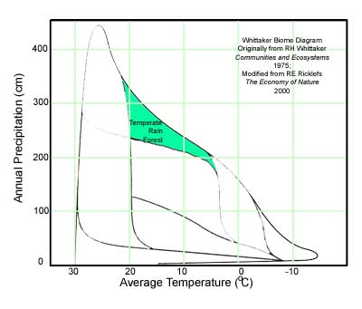
Temperate Rain Forest
Pacific Northwest, New Zealand

Slide 21
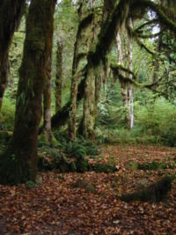
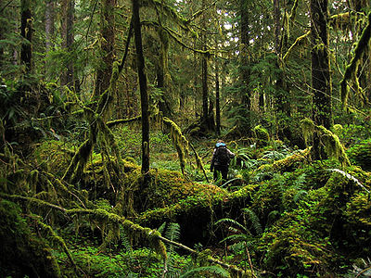
Temperate Rain Forest
Located in temperate zones in North America (Pacific northwest), Australia and New Zealand near oceans
High precipitation (>1400mm) , high humidity and moderate temperatures (mean 4-12°C)
Lush growth of conifers, ferns, epiphytes
Low instance of fires due to high moisture

Slide 22
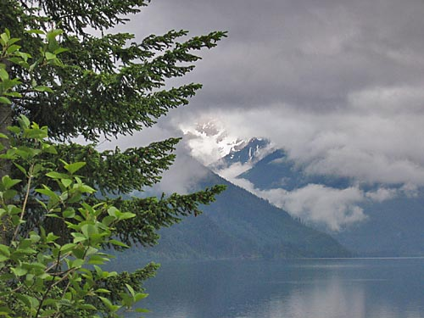
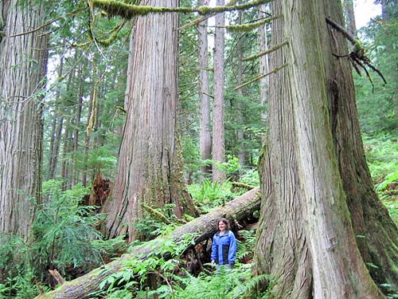
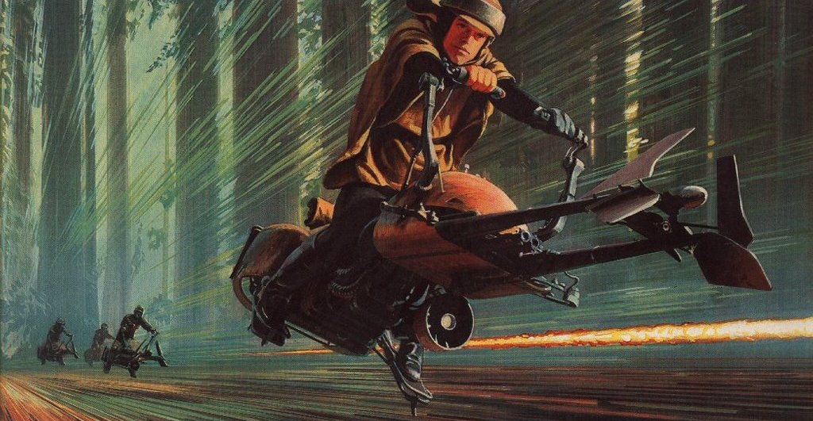
Scenes of Planet Endor of Star Wars filmed in temperate rainforest of Pacific Northwest

Slide 23
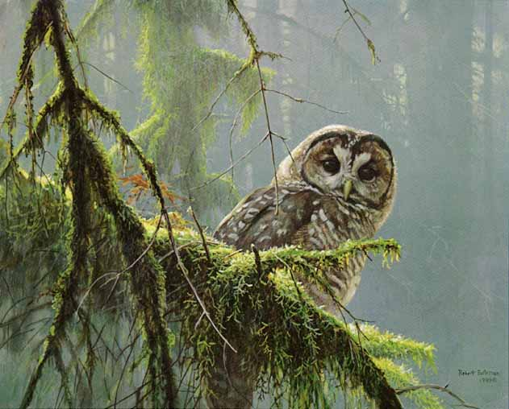
Threats to biomes
Temperate Rainforest – logging, loss of old growth forests (spotted owl controversy)

Slide 24
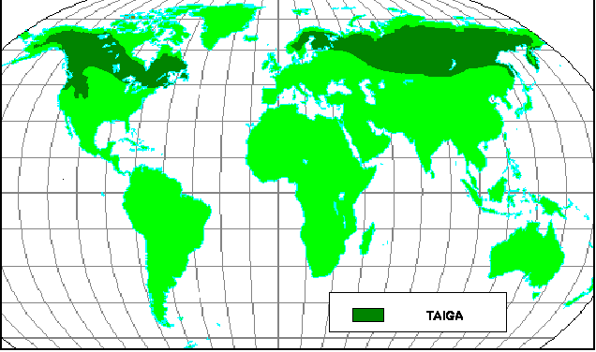
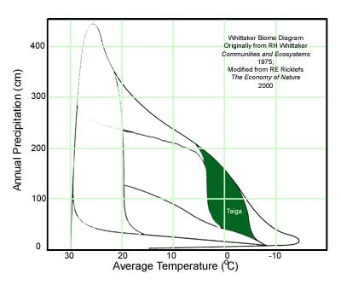
Boreal Forest or Taiga

Slide 25
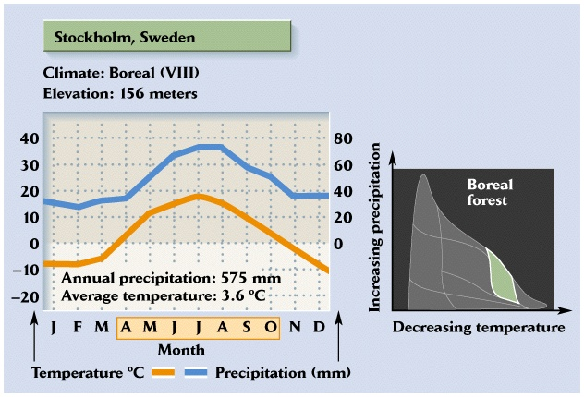
Boreal Forest or Taiga
-severe winters,
Mean average temp can be < 0 deg C
-low rainfall
-short growing season

Slide 26
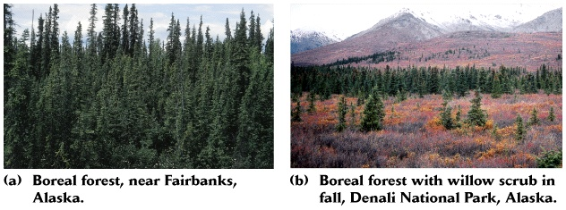
Boreal Forest or Taiga
-10-20 m trees
evergreen needle
and deciduous
-second largest biome,
on an area basis
-fire dominated, but on longer
timescale than grassland
-more nutrients and carbon
stored in soils than plants
-slow decomposition

Slide 27
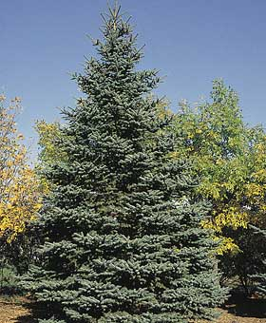
Boreal Forest or Taiga
Adaptations of plants
needle shaped leaves with thick cuticle retain water, can survive cold
cone-shaped trees can shed snow without losing branches

Slide 28
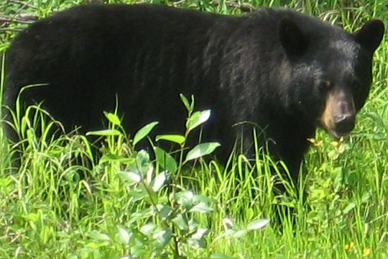
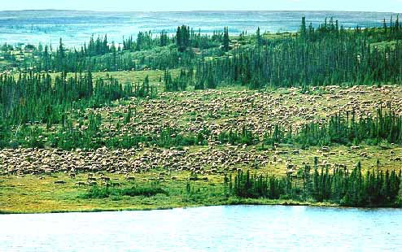
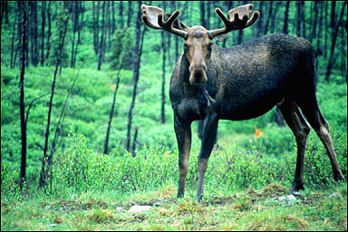
Boreal Forest or Taiga
Adaptations of animals
Thick fur to withstand cold
Migration, hibernation
Caribou migration

Slide 29
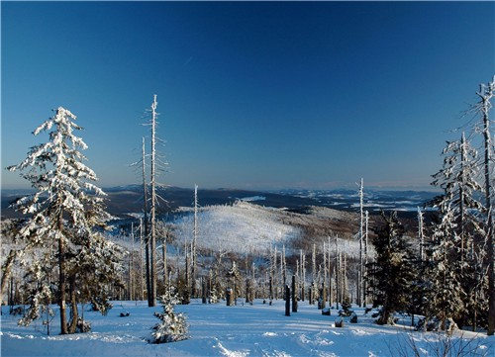
Threats to biomes
Boreal Forest – acid rain

Slide 30
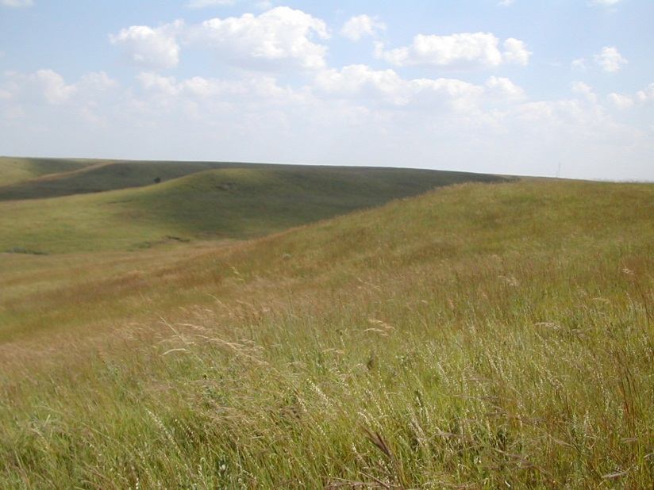
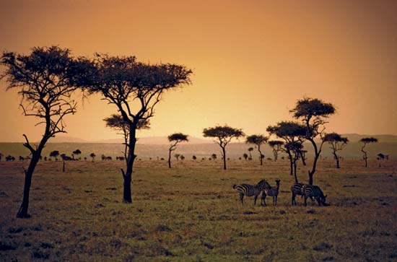
Grasslands
Tropical and temperate locations
Characterized by
vast seas of grass with some small trees and shrubs
extremely fertile soil
grazers
little precipitation
may have wet and dry seasons
maintained by fire

Slide 31
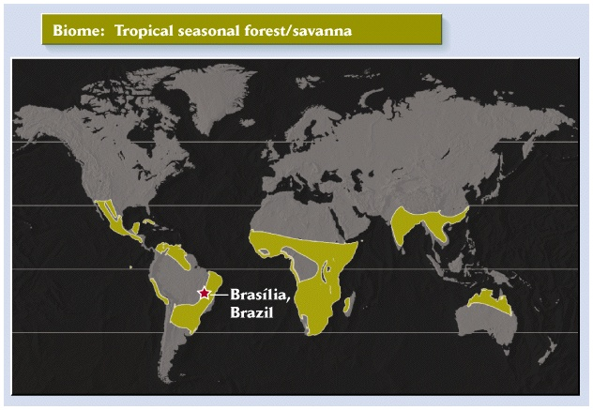
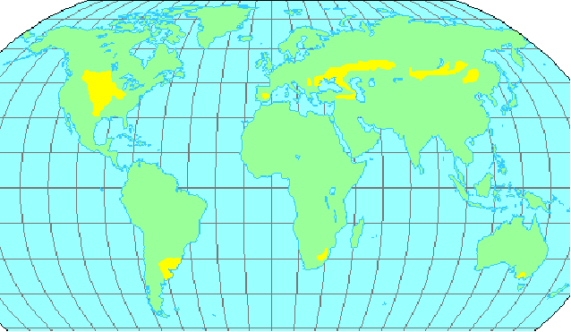
Grasslands
(Color both onto one map)
Tropical grasslands
(= savanna)
Temperate grasslands
(= prairie, steppes, pampas)

Slide 32
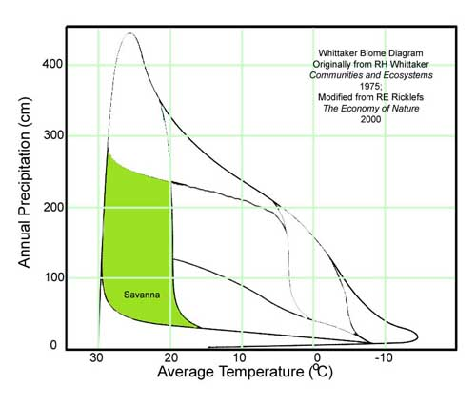
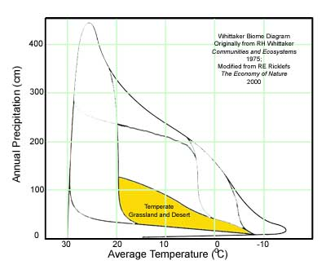
Grassland
(Color both onto one diagram)

Slide 33
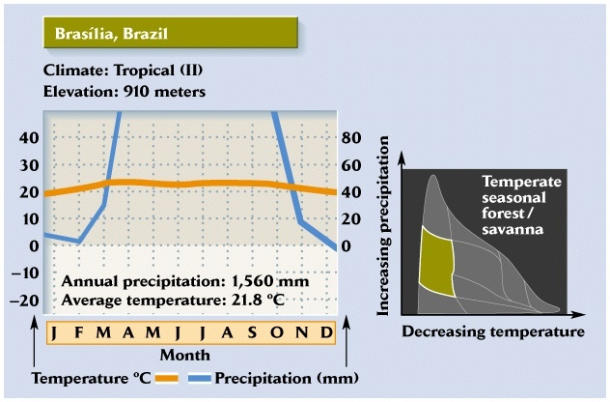
Tropical Savanna
-found in the tropics (but > 10° latitude)
-pronounced dry season
with <5 cm rainfall in some months

Slide 34
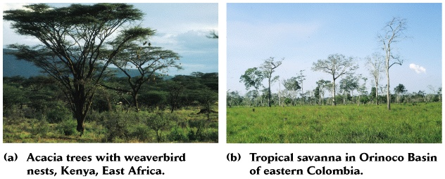
Tropical Savanna
-scattered trees and grass
-fire an important natural
part of the biome that keeps
trees from moving in
- grazing by animals
also contributes to
predominance of grasses
as they crop plants close
to the ground

Slide 35
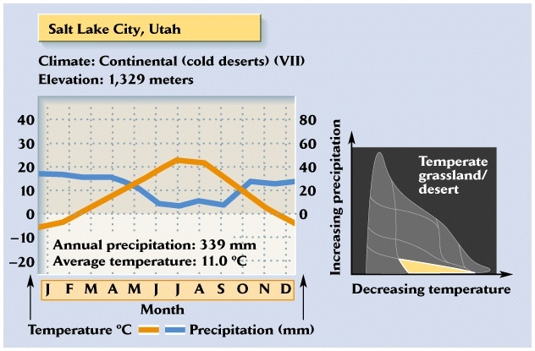
Temperate Grassland
-similar to tropical savanna, but with cold winter
-relatively hot summer
-potential evapotranspiration > ppt

Slide 36
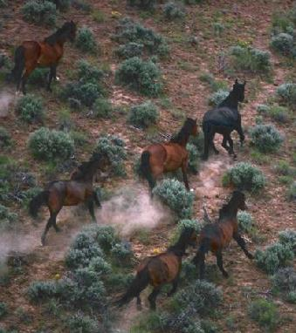
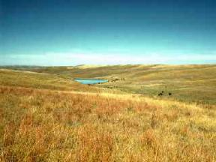
Temperate Grassland
-scattered trees and shrubs
-trees are short statured
-fire & grazing by animals
also contribute to
predominance of grasses

Slide 37
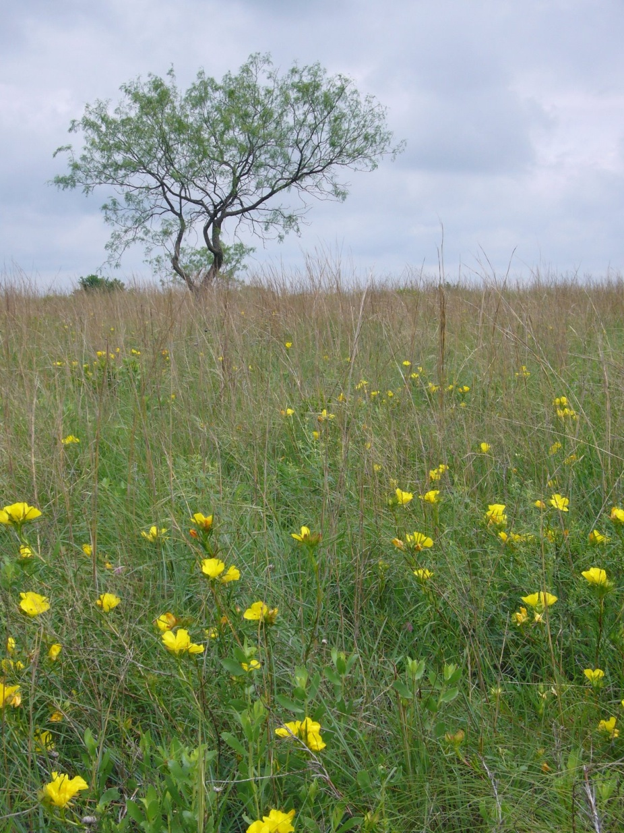
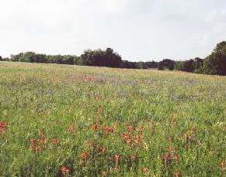
Temperate grasslands
Prairies of North America
Texas, where more than 98% of the prairie is now gone

Slide 38

Temperate grasslands
Steppes of Mongolia

Slide 39


Temperate grasslands
Steppes of Russia

Slide 40

Grasslands (Tropical and Temperate)
Adaptations of plants
Grasses have extensive root system for efficient water absorption and to allow quick regrowth after fire or grazing

Slide 41

Grasslands (Tropical and Temperate)
Adaptations of animals
Grazing adaptations (teeth, digestive system)
Migrate to avoid dry periods
Wildebeest migration

Slide 42


Threats to biomes
Grasslands (tropical and temperate) – encroachment of agriculture due to extremely fertile soil, fire suppression
Former grasslands in Colorado now fields of circular crops due to irrigation systems (pivot irrigation)

Slide 43


Desert

Slide 44

Desert
-hot or cold deserts exist
-characterized by low precipitation <25cm,
sporadic

Slide 45

Desert

Slide 46

Desert
Adaptations of plants
Succulents – term for plants such as cactuses with thick fleshy stems and leaves that store water
Thick cuticle, roots spread out near surface help conserve water
Thorns prevent animals from eating plants

Slide 47

Desert
Adaptations of animals
Many are nocturnal to avoid heat of day
Estivation – similar to hibernating, but during dry season
Spadefoot toad burrows in mud

Slide 48


Threats to biomes
Desert –
urbanization (more people choose to live there now that we can irrigate)
recreation damages fragile ecosystems (desert crust – interwoven mats of lichens, fungi, and algae anchor and protect desert soils; can take centuries to form and a few minutes to destroy)

Slide 49


Chaparral
(=Mediterranean or woodland shrubland)
Note how it is along coasts
Color in this red section

Slide 50

Chapparal
-mild winters
-seasonal rainfall:
winter rain, summer drought
-located along coasts,
effect of ocean is to
moderate climate

Slide 51



Chaparral/Mediterranean Biome
Desirable place to live!

Slide 52



Chaparral
Adaptations of plants and animals
Plants contain oils that encourage fires, maintains shrubby community
Plants can regrow quickly from small remains after fire
Many animals camouflaged
rosemary

Slide 53

Threats to biomes
Chaparral – fire suppression, urbanization, recreation

Slide 54


Tundra

Slide 55

Tundra
-severe winters
-short growing season,
cool summer
-arctic or alpine

Slide 56

Tundra

Slide 57

Tundra
Permafrost – layer of permanently frozen soil under the topsoil, limits plant growth

Slide 58

Tundra
Adaptations of plants and animals
Small size of plants allows absorption of limited heat from soil, reduces exposure to wind
Migration and hibernation of animals common
Caribou eating willow

Slide 59





Camouflage changes with the seasons
Arctic hare – winter → summer
Arctic fox – winter → summer

Slide 60

Threats to biomes
Tundra – oil exploration threatens fragile ecosystems, oil spills

Slide 61


Effect of Altitude
Increasing altitude has the same effect as increasing latitude (see p. 145)
Alpine – refers to community above the treeline (comes from Alps)

Slide 62


