Slide 1
Chapter 12: Air

Slide 2
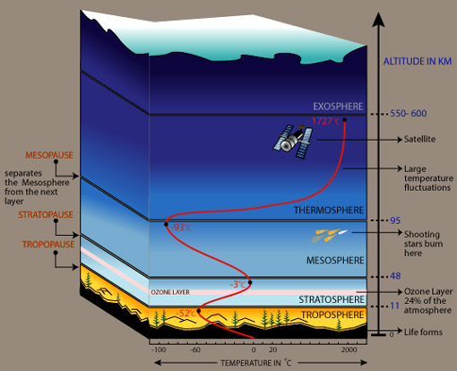
Review of atmospheric layers
What layers of the atmosphere do you think we will focus on in Environmental Science? Why?

Slide 3
Functions of the atmosphere
Greenhouse effect makes life possible
Protects life on earth from radiation, objects from space
Part of the cycling of water, carbon, and nitrogen which are necessary for life

Slide 4
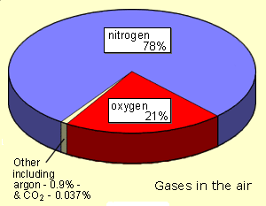
What do living things need from the air that makes up the atmosphere?
Oxygen
Carbon dioxide
Nitrogen
Water

Slide 5

Our Objective for this chapter:
Understand how humans have impacted the air that all living things need for life

Slide 6
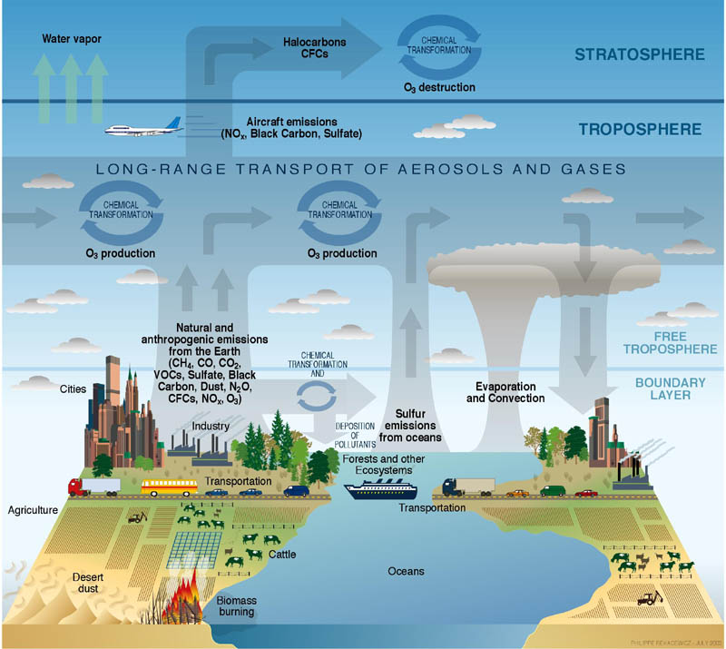
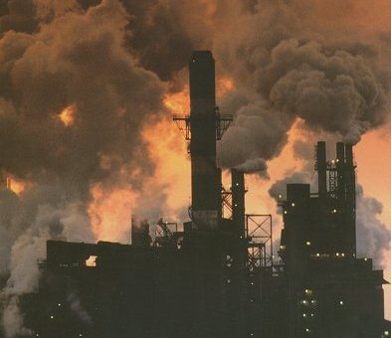
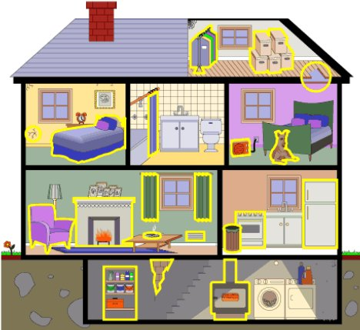
Three areas to look at:
Chapter 13: Atmosphere
(Climate change and ozone depletion)
Chapter 12: Outdoor air pollution
Chapter 12: Indoor air pollution

Slide 7
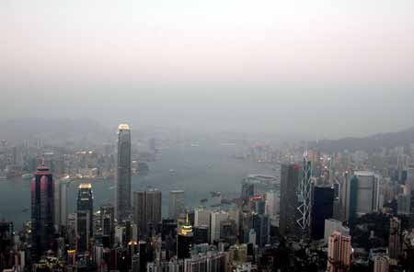
Outdoor Air Pollution

Slide 8
Two categories of outdoor air pollutants
Primary pollutants – a pollutant that is put directly into the air by human activity (Ex: soot from burning wood)
Secondary pollutants – pollutants that form when a primary pollutant comes into contact with other primary pollutants or with naturally occurring substances and a chemical reaction takes place (Ex: ground level ozone)
We will look at examples of both types of pollutants

Slide 9
Primary Outdoor Air Pollutants
Carbon monoxide (CO)
- a gas that you can’t detect it with your senses (colorless, odorless)
- poisonous to living things, keeps your blood from carrying oxygen normally, can be fatal in high doses
- sources: incomplete burning of
fossil fuels by vehicles, industry

Slide 10
Primary Outdoor Air Pollutants
Carbon dioxide (CO₂)
- gas that comes from burning fossil fuels (removing carbon from “sinks” and releasing it into air)
- contributes to global warming by increasing greenhouse effect

Slide 11
Primary Outdoor Air Pollutants
Nitrogen oxides – NO_{x} is a generic term for nitric oxide (NO) or nitrous oxide (NO₂)
- gases that are products of combustion
- contributes to “smog” or “haze”
- contributes to formation of ground level ozone
- bad for respiratory system

Slide 12
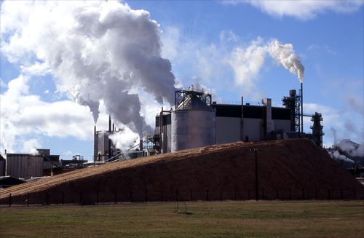
Primary Outdoor Air Pollutants
Sulfur Dioxide – SO₂
- gas produced from burning materials that contain sulfur, such as coal and petroleum products; also released from paper mills
- pungent, irritating odor, smells like a match that has just been struck
- contributes to acid rain (we will study that in more detail later)
- bad for respiratory
system

Slide 13

Primary Outdoor Air Pollutants
Volatile organic compounds – VOCs
- toxic gases that easily vaporize from certain liquids and solids
- from gasoline, methane (from wetlands, cows, rice agriculture, landfills, burning biomass)
- contribute to smog
- contributes to formation
of ground level ozone
- may cause cancer

Slide 14
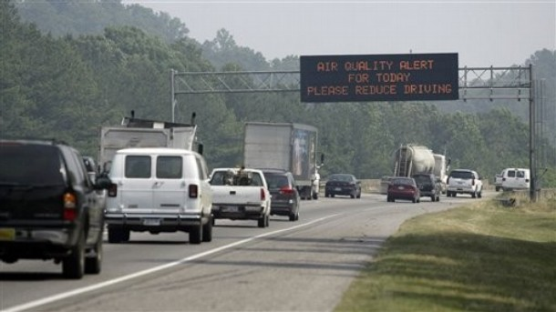
Primary Outdoor Air Pollutants
Particulate matter
- tiny particles that get into the air
- from burning fuels, wood
- can form haze that reduces visibility
- can cause cancer, respiratory illnesses
- can corrode outdoor structures
- Ex: summer, 2007, wildfires in other states led to a smoky haze in B’ham

Slide 15
Secondary Outdoor Air Pollutants
Formation of secondary pollutants – these occur when a primary pollutant undergoes a chemical reaction with another chemical and forms a new chemical
Photochemical smog –
- a mixture of pollutants that make the air look hazy
- result from chemical reactions between primary and secondary pollutants
- the chemical reactions are activated by sunlight

Slide 16
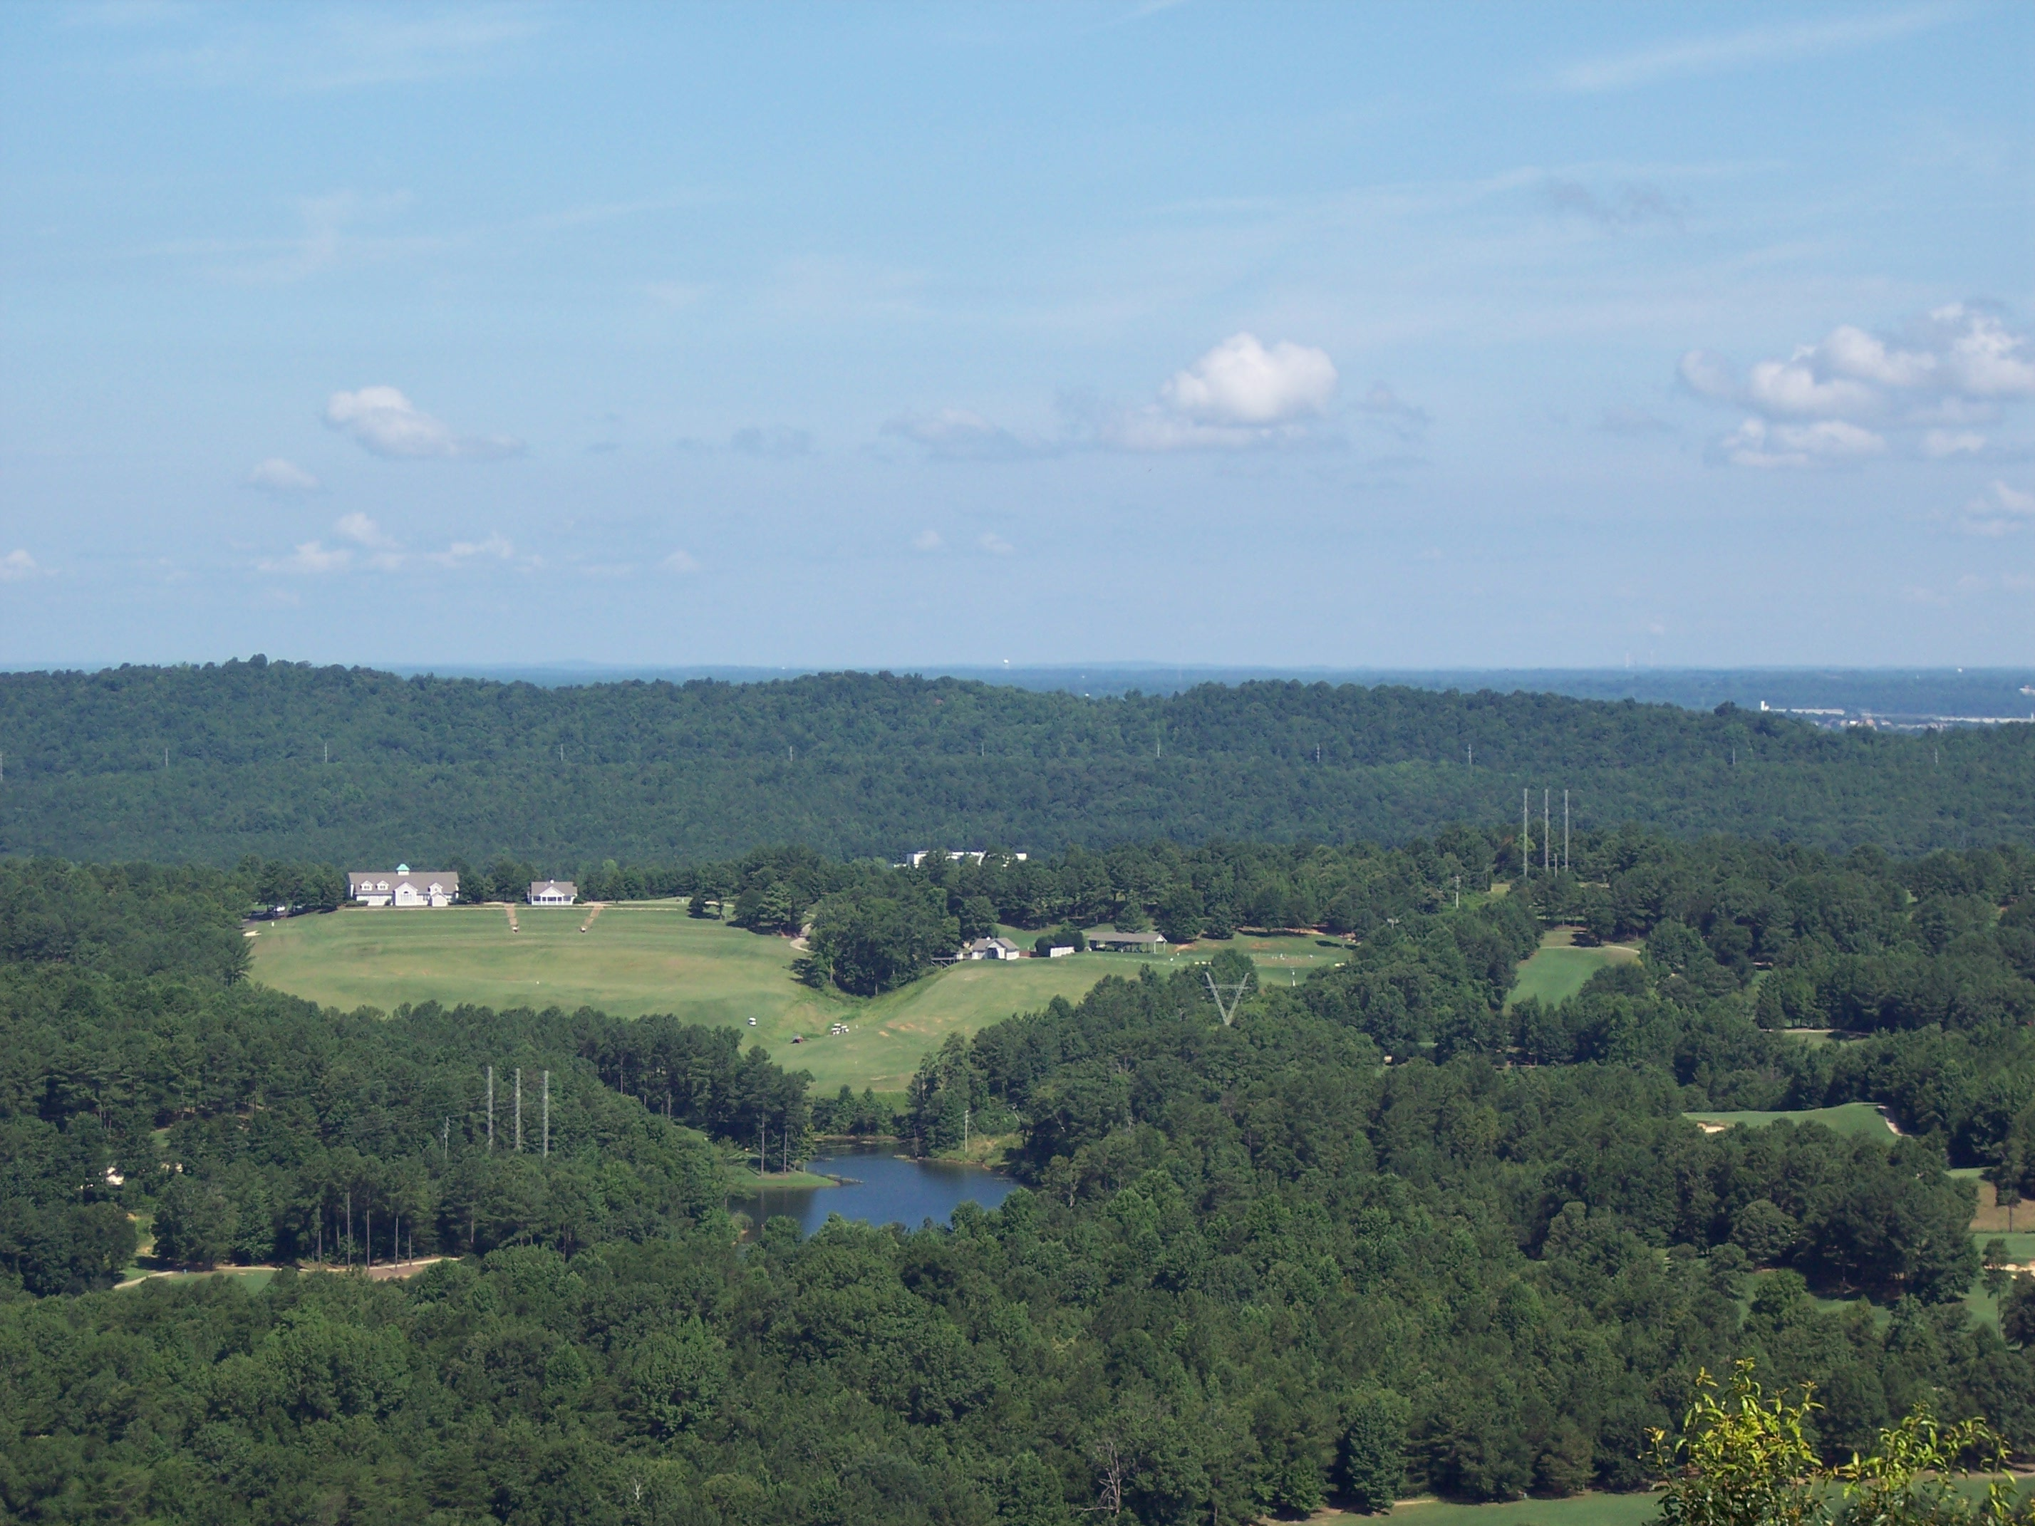
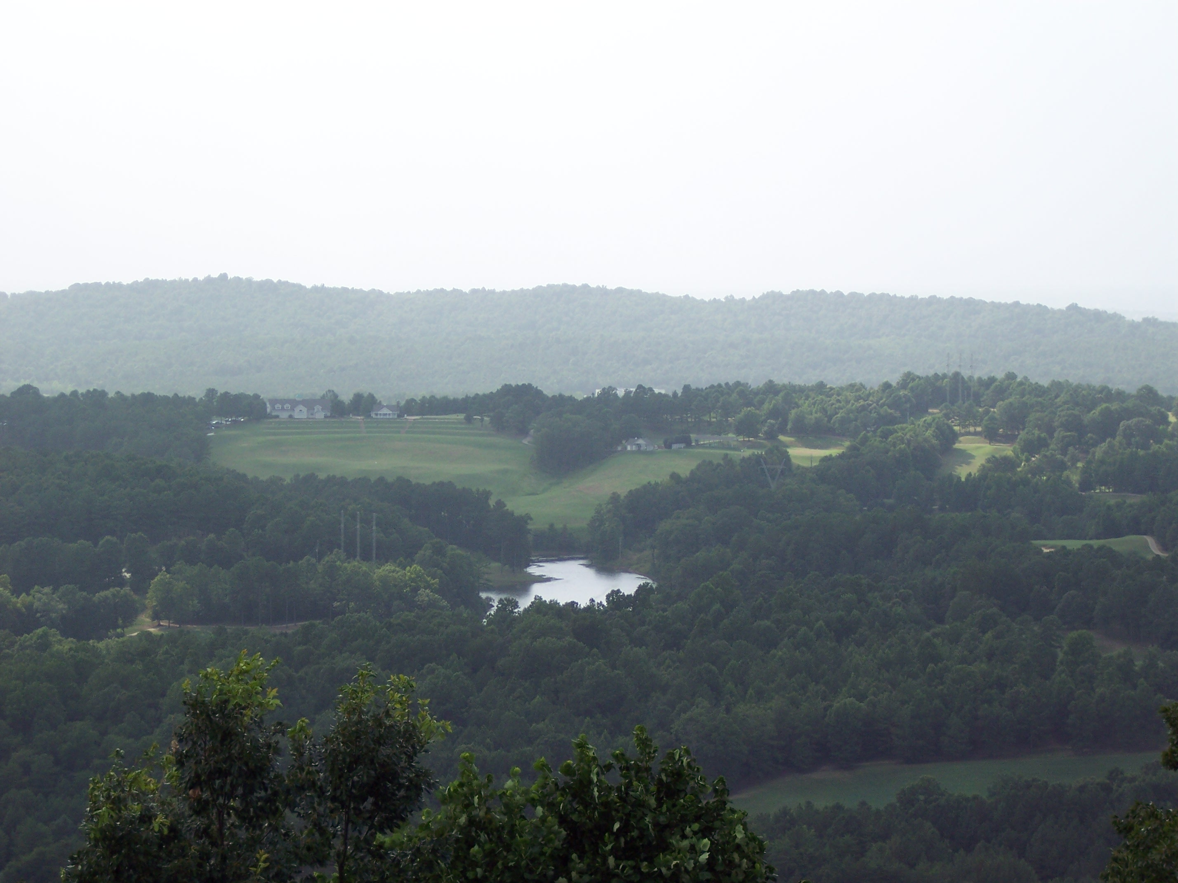
View from same location on Shades Mtn. taken on two very different summer days in the same month:
Clear skies – notice how far you can see into the distance
Hazy skies caused by presence of photochemical smog

Slide 17
A specific secondary pollutant:
Ground level ozone (O₃)
a secondary pollutant that is formed when NO_{x} react with VOCs in heat and light
especially a problem in summer
irritates eyes and respiratory system, worsens asthma
damages plants, rubber in tires, fabrics and paints
Summary of ground level ozone production:
NO_{x} + VOCs + heat + light → ozone

Slide 18
Have you seen this before?
Orange ozone alert issued for Friday
Posted by Press-Register Staff June 21, 2007 4:11 PM
Categories: Breaking News
The U.S. Environmental Protection Agency issued an orange alert for Friday, meaning that outdoor conditions are expected to be unhealthy for sensitive groups.
An orange alert indicates that high levels of ozone, a type of air pollution, could have a negative impact on the health of active children and adults, as well as people with respiratory diseases. Prolonged outdoor exertion should be limited, the EPA says.

Slide 19
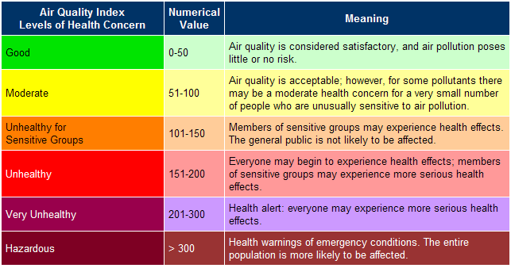
Air Quality Index http://airnow.gov/index.cfm?action=airnow.currentconditions

Slide 20
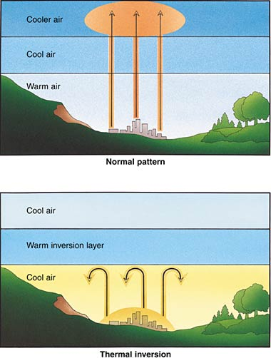
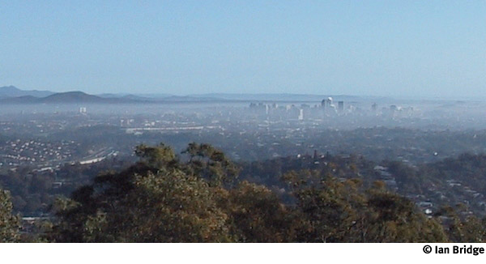
Special problems with outdoor air pollution
Temperature inversion – when the air above is warmer than the air below and pollution can be trapped
Brisbane, Australia
Notes:
20

Slide 21
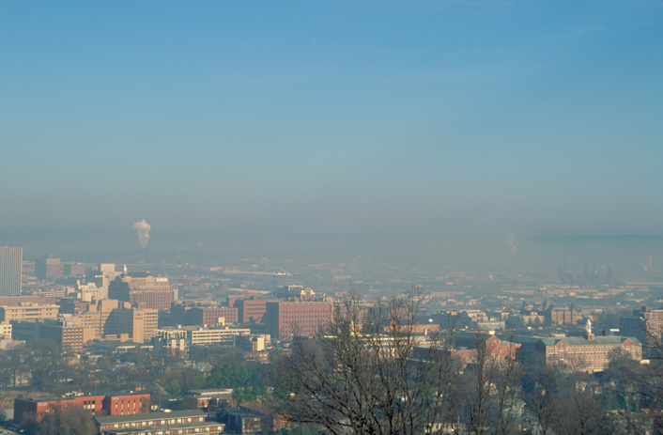
Can you identify this smoggy city?

Slide 22
It’s Birmingham, Alabama.
Because it is located in a valley, it sometimes has a lot of smog trapped in the atmosphere.
Also, Birmingham has a lot of industry which contributes to air pollution.

Slide 23
Other examples of secondary air pollutants:
Secondary pollutants lead to the formation of acid rain
Generally, this is what happens:
Burning fossil fuels releases SO₂ and NO_{X} (primary pollutants), which combine with water in the atmosphere to form sulfuric acid and nitric acid (secondary pollutants)
These fall to the earth as “acid rain” which has negative effects on aquatic and terrestrial ecosystems

Slide 24
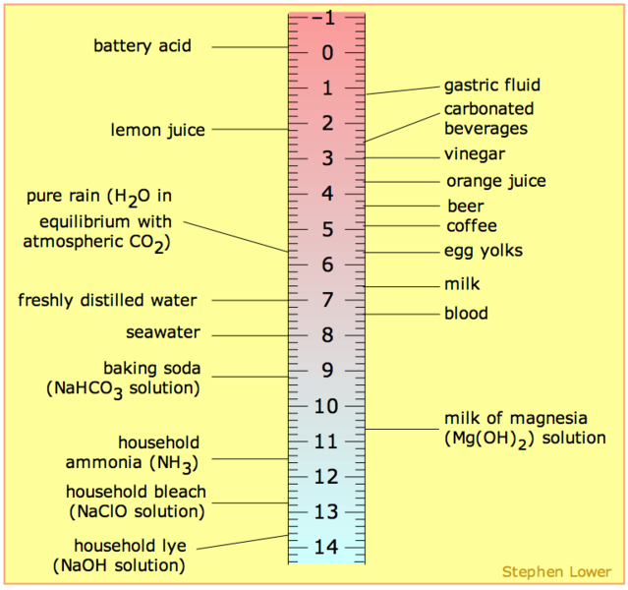
Review of pH:
pH is a measure of how acidic or basic a substance is
Range of pH scale is 0-14 (with 0 being most acidic)
Each whole number on the scale indicates a ten-fold change in pH
Notes:
24

Slide 25
Normal conditions
Normal precipitation is slightly acidic
(pH 5.5) because naturally occurring CO₂ combines with water in the air to form carbonic acid
CO₂ + H₂O H₂CO₃
Notes:
25

Slide 26
Acid rain formation:
Sulfur dioxide combines with water in air to form sulfuric acid in precipitation
SO₂ + H₂O H₂SO₄
Nitrogen oxides combine with water in air to form nitric acid in precipitation
NO₂ + H₂O HNO₃

Slide 27
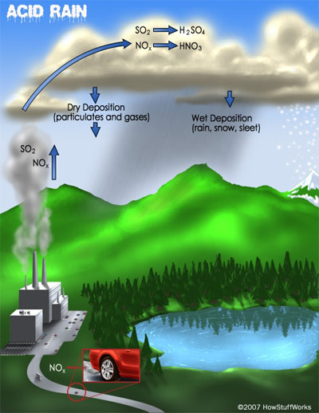
Notes:
27

Slide 28
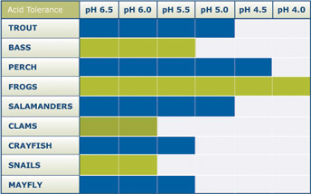
Acid Rain Effects
Any precipitation under pH 5 is considered acidic – this can have negative effects on ecosystems, especially aquatic ones
Notes:
28

Slide 29
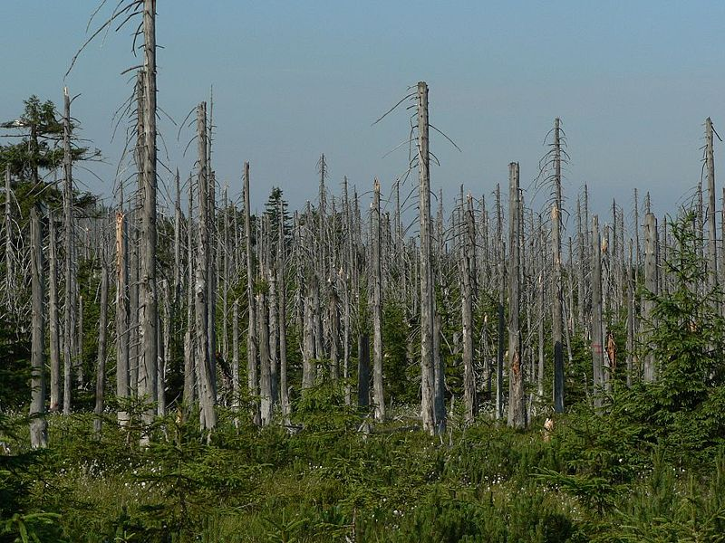
Forests can be affected by acid rain – directly and indirectly
How? Next slide…..
Notes:
29

Slide 30
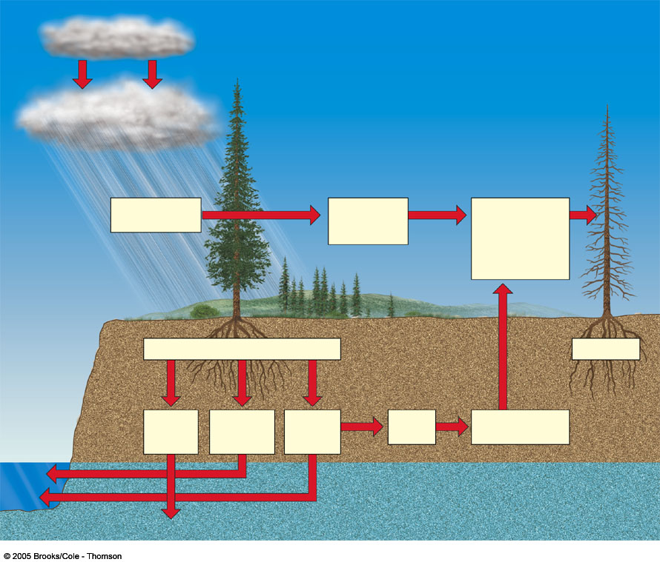
Emission
Acid
deposition
SO₂
H₂O₂
PANs
NO_{X}
O₃
Others
Increased
Susceptibility
to drought,
extreme cold,
insects, mosses,
and disease
organisms
Direct damage
to leaves and bark
Reduced
photosynthesis
and growth
Soil acidification
Tree death
Leaching of
Soil nutrients
Acid
Release of
toxic
metal ions
Root
damage
Reduced nutrient
and water uptake
Groundwater

Slide 31
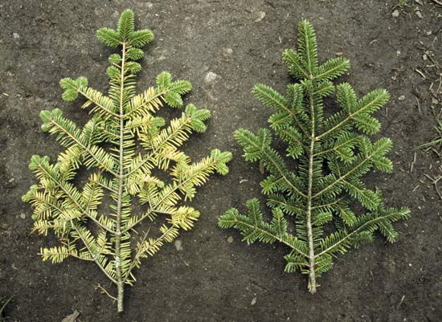
Acid Rain Effects
Damage to needles of evergreens
Notes:
31

Slide 32
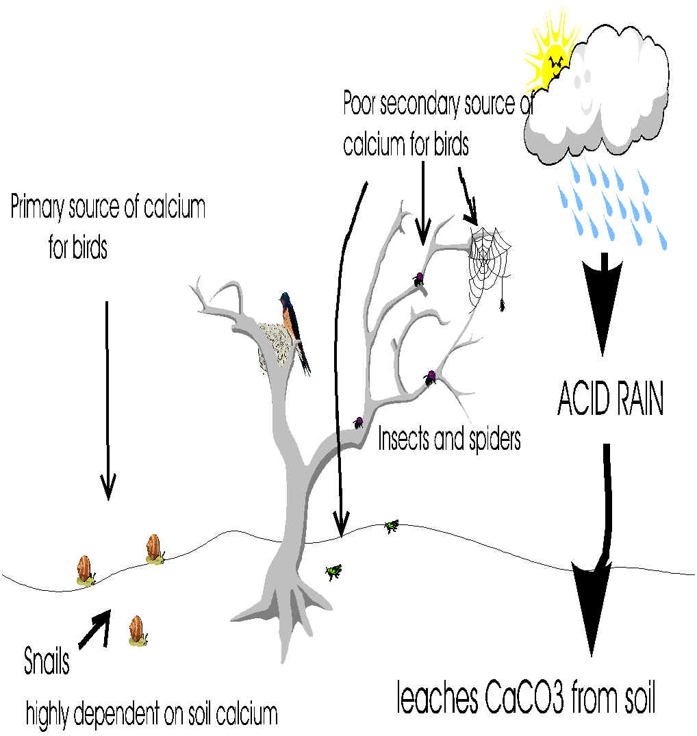
Acid Rain Effects
Acid rain can affect entire food webs
In one case of acid rain pollution in the Netherlands, acid rain caused loss of calcium from the soil
As a result, snails that depended on soil calcium for their shells could not live and birds that fed on snails had weakened egg shells, lower reproductive success
Notes:
32

Slide 33
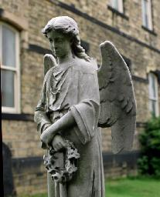
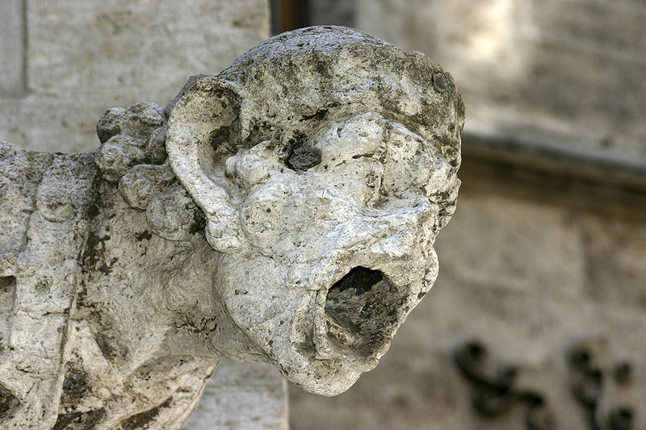
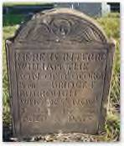
Acid Rain Effects
Damage can also be done to certain types of stone statues, grave stones and buildings
Notes:
33

Slide 34
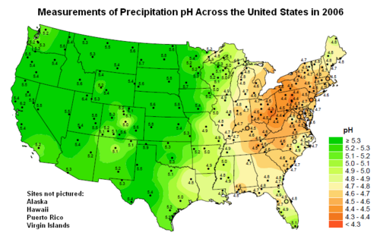
Acid Rain
Locations that produce the pollutants aren’t always where the acid rain falls
See p. 317 map
What part of the U.S. has had more trouble with acid rain?
Where are the states that produce the pollutants that contribute to acid rain?
Notes:
34

Slide 35
Controlling Air Pollution: It’s the Law!
Clean Air Act, 1970, strengthened 1990
- ambitious legislation to make U.S. air cleaner
- primarily to protect human health, secondarily to protect environment and property
- criteria pollutants are common pollutants found in the air that are monitored by the EPA because they cause damage to human health, the environment or property
- six criteria pollutants are followed by the EPA:
1. ozone (O₃)
2. sulfur dioxide (SO₂)
3. nitrogen oxides (NO_{x})
4. carbon monoxide (CO)
5. particulate matter
6. lead
- also monitors hazardous air pollutants or HAPs – chemicals released from chemical plants, dry cleaners, motor vehicles and more, that have serious health and environmental effects

Slide 36
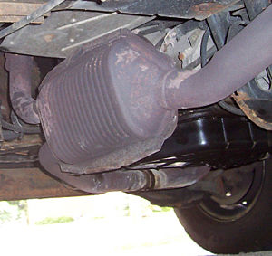
Controlling Air Pollution
Related to vehicles:
- no more leaded gasoline (Clean Air Act of 1996 banned its use in regular vehicles)
- emissions standards
- catalytic converters introduced in 1970s to clean exhaust before it leaves cars (converts harmful chemicals into less harmful chemicals)
- developing alternative fuel for vehicles, such as cleaner burning natural gas and ethanol
- creating zero-emissions vehicles (ZEV), such as cars powered by electricity
- efforts to improve mass transit

Slide 37
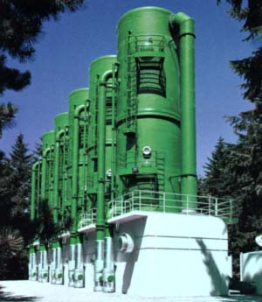
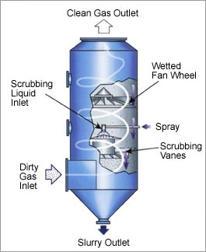
Controlling Air Pollution
Related to industry:
- EPA sets standards that must be met or fines can be imposed
- scrubbers: devices to clean air before it is released from factories and industries

Slide 38
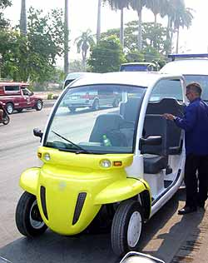
Controlling Outdoor Air Pollution
So you don’t want to buy an electric car…
Let’s create a list of ways
you can reduce outdoor
air pollution:

Slide 39
Anything we forgot? Here’s an EPA list of how to reduce outdoor air pollution:
Keep tires properly inflated and aligned.
In the summertime, fill gas tank during cooler evening hours to cut down on evaporation. Avoid spilling gas and don't "top off" the tank. Replace gas tank cap tightly.
Avoid waiting in long drive-thru lines, for example, at fast-food restaurants or banks. Park your car and go in.
When possible, use public transportation, walk, or ride a bike.
Get regular engine tune ups and car maintenance checks (especially for the spark plugs).
Use an energy-conserving (EC) grade motor oil.
Ask your employer to consider flexible work schedules or telecommuting.
Report smoking vehicles to your local air agency.
Join a carpool or vanpool to get to work.
Conserve energy - turn off appliances and lights when you leave the room.
Recycle paper, plastic, glass bottles, cardboard, and aluminum cans. (This conserves energy and reduces production emissions.)
Keep woodstoves and fireplaces well maintained. You should also consider replacing old wood stoves with EPA-certified models. Visit www.epa.gov/woodstoves.
Plant deciduous trees in locations around your home to provide shade in the summer, but to allow light in the winter.
Buy green electricity-produced by low-or even zero-pollution facilities.
Connect your outdoor lights to a timer or use solar lighting.
Wash clothes with warm or cold water instead of hot.
Lower the thermostat on your water heater to 120°F.
Use low-VOC or water-based paints, stains, finishes, and paint strippers.
Test your home for radon-a dangerous, radioactive gas that is odorless and tasteless. If the test shows elevated levels of radon, the problem can be fixed cost effectively. Visit www.epa.gov/radon.
Choose not to smoke in your home, especially if you have children. If you or your visitors must smoke, then smoke outside. Visit www.epa.gov/smokefree.
Choose efficient, low-polluting models of vehicles. Visit www.epa.gov/greenvehicles.
Choose products that have less packaging and are reusable.
Shop with a canvas bag instead of using paper and plastic bags.
Buy rechargeable batteries for devices used frequently
http://www.epa.gov/air/caa/peg/reduce.html

Slide 40
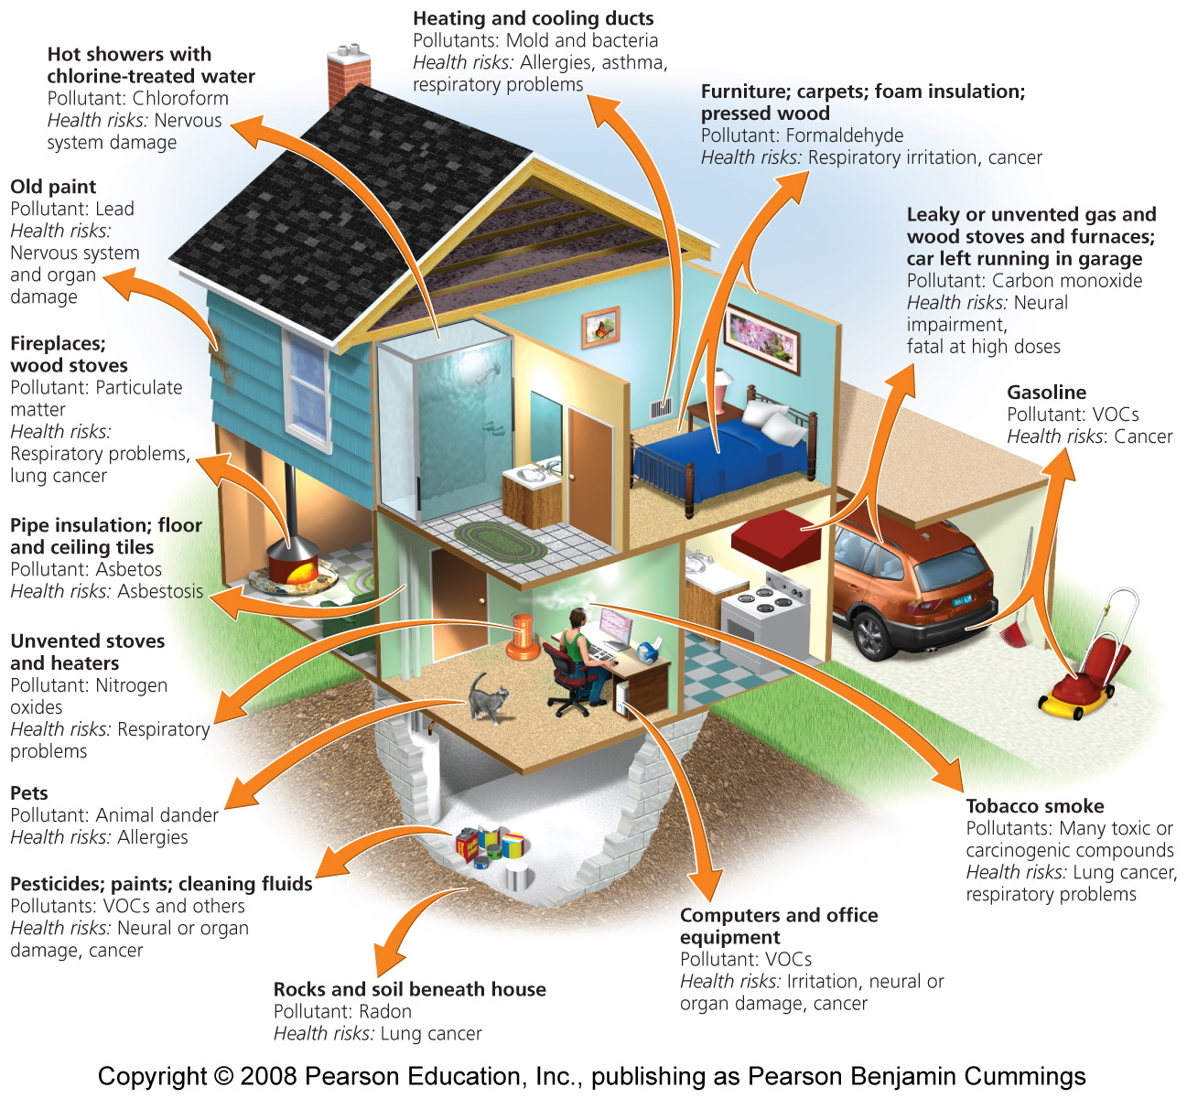
Indoor air pollution is also a problem for people

Slide 41
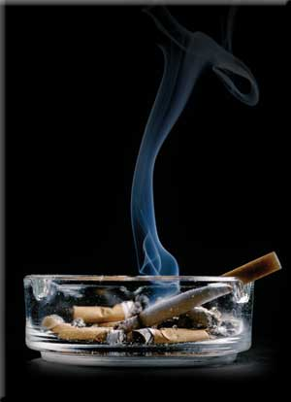
Indoor Air Pollutants
See diagram, p. 311
Chemicals:
VOCs – from dry cleaning, paints, furniture
Formaldehyde – in adhesives, plywood, carpets
Cleaners
Carbon monoxide – faulty furnaces, cars in garages – can be fatal
Tobacco smoke
Notes:
41

Slide 42
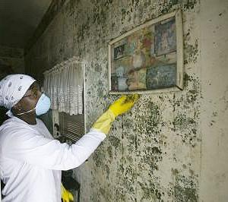
Indoor air pollutants
Biological:
Fungi – mold spores; some people are allergic to them; can come from air ducts, moist walls, etc; problem after Katrina
Bacteria – some can be airborne and can be distributed in air ducts, water droplets at spas; Ex: Legionnaire’s disease
Notes:
42

Slide 43
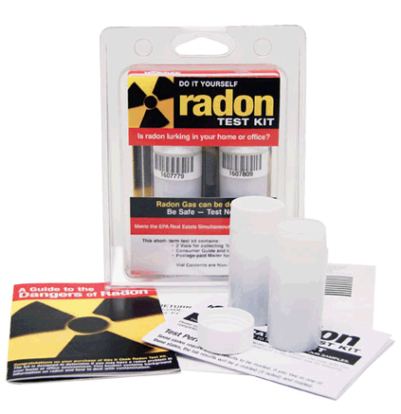
Indoor Air Pollutants
Radiation
Radon – colorless, odorless radioactive gas that comes from the decay of uranium; can seep into buildings; can cause cancer
Notes:
43

Slide 44
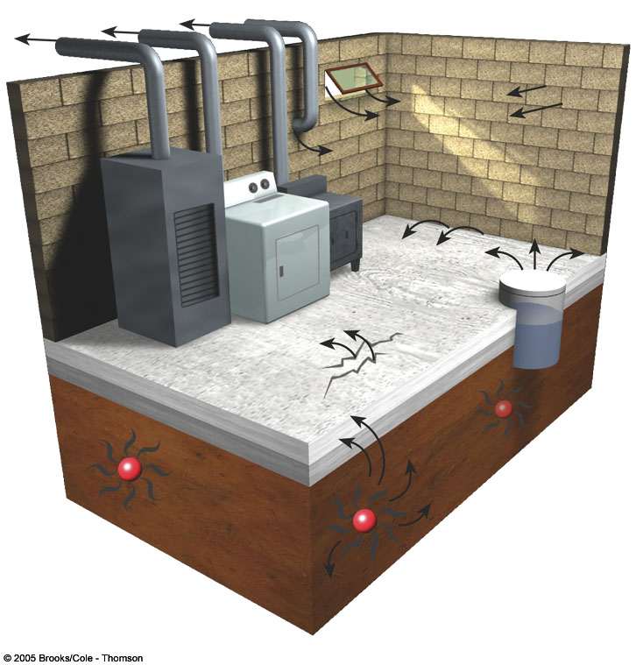
Outlet vents for furnaces and dryers
Open window
Open window
Openings
around
pipes
Openings
around
pipes
Cracks in wall
Cracks in wall
Slab joints
Wood stove
Clothes
dryer
Cracks in floor
Sump
pump
Furnace
Slab
Radon-222 gas
Uranium-238
Soil

Slide 45
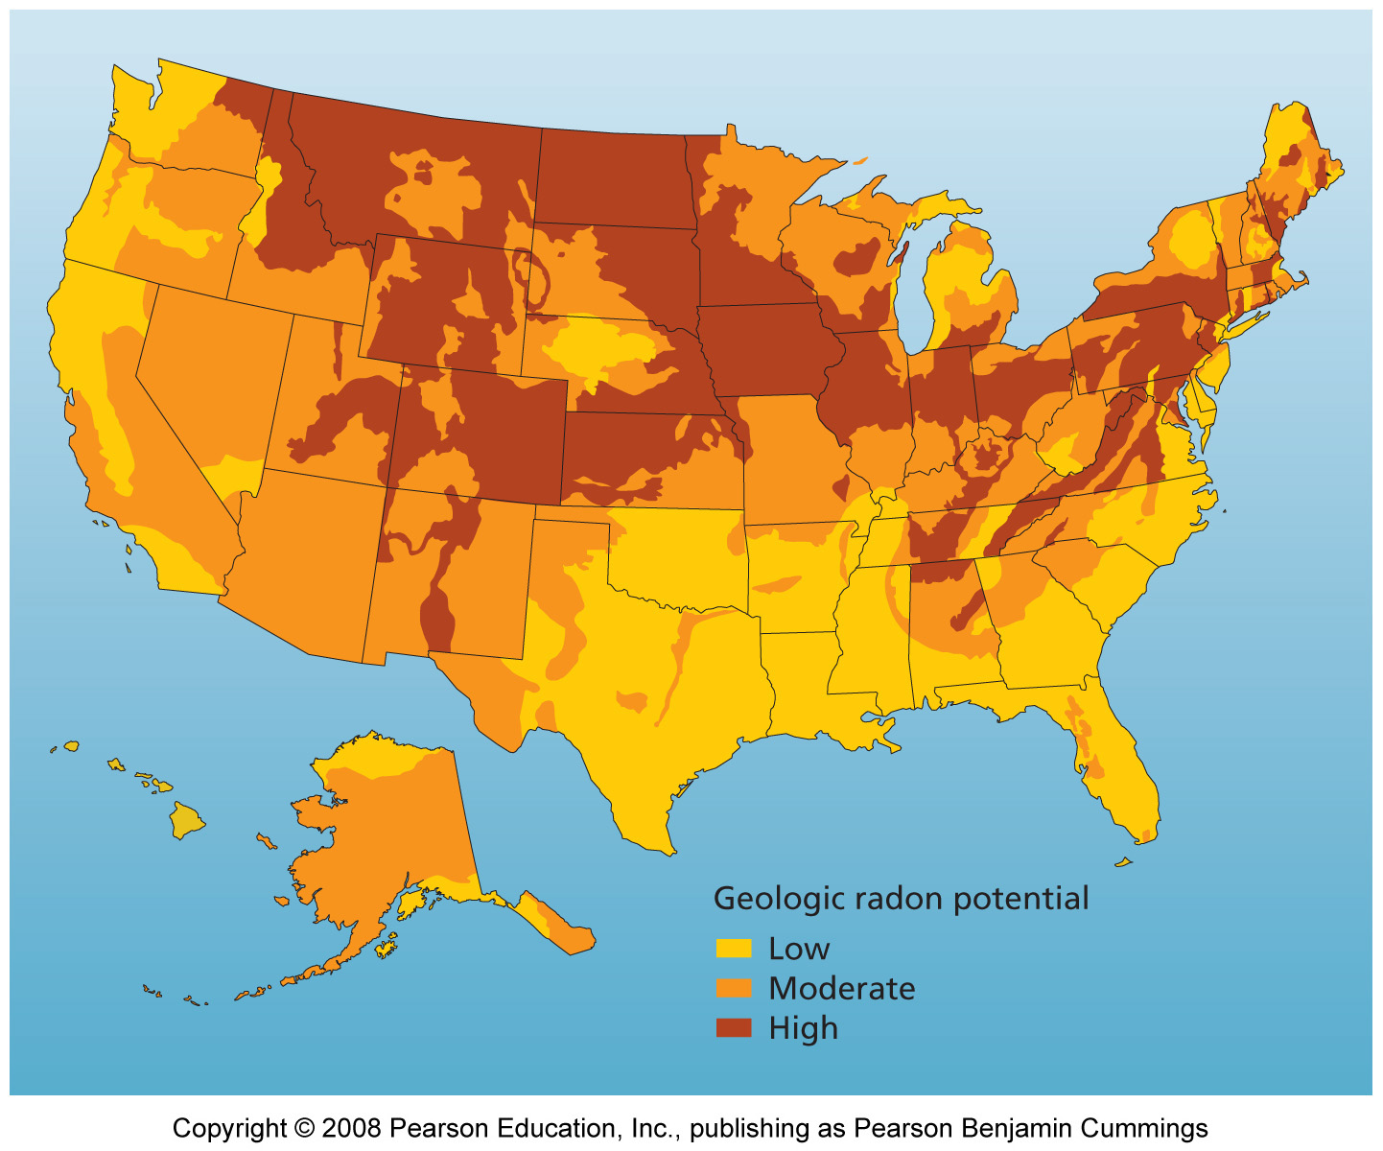
Radon risk across the U.S.

Slide 46
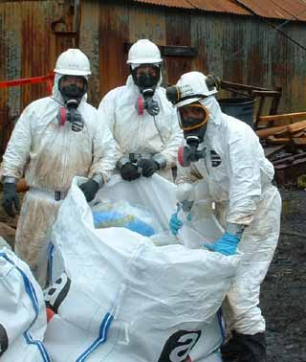
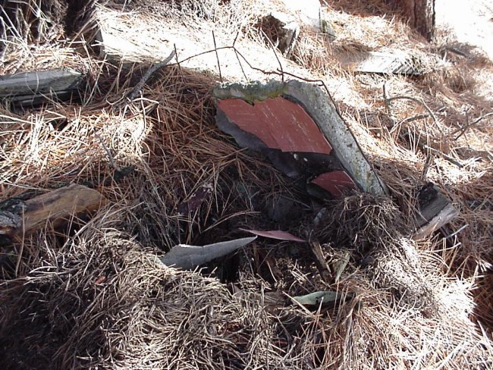
Indoor Air Pollutants
Asbestos – fire-resistant material used in many building materials until they were banned in the 1970s
Becomes a problem if it is disturbed and the fibers that make up asbestos become airborne, lodge in lungs, cause cancer
Notes:
46

Slide 47
Indoor Air Pollutants
Sick Building Syndrome – when something about a building is making people sick, they get better when they leave the building
Symptoms – headaches, fatigue, eye irritation, dizziness
Often due to newer airtight construction which limits flow of fresh air
May be caused by chemical, biological or any other pollutant
Notes:
47

Slide 48
Two other types of “air” pollution
Noise pollution
Light pollution

Slide 49
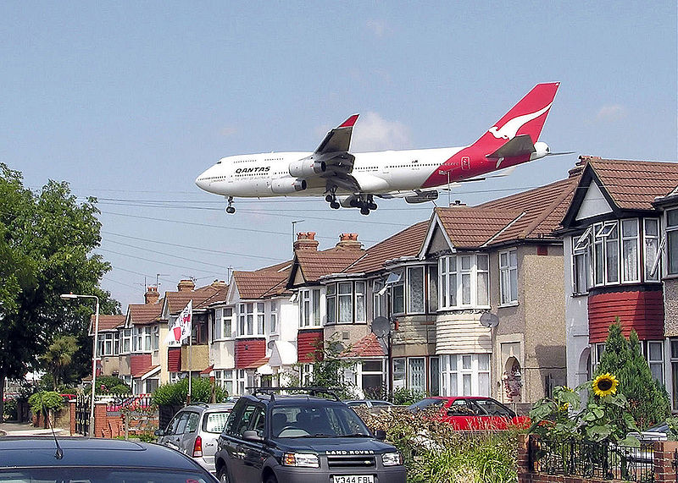
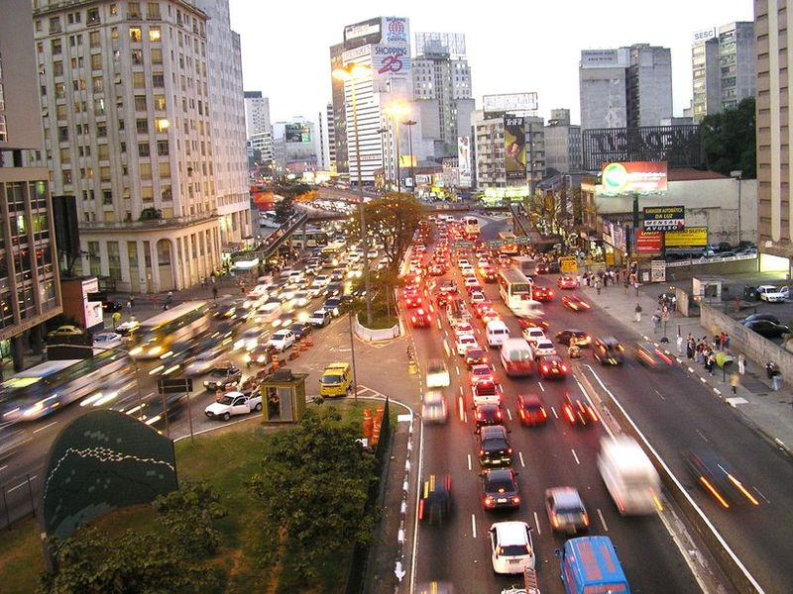
Noise Pollution
Unnecessary and unwanted noise
Can cause health issues, including loss of hearing, stress, high blood pressure, loss of sleep, reduced productivity
In the U.S., roadway noise is the biggest contributor to environmental noise
The Noise Pollution and Abatement Act of 1972 sets limits on noise for everything from industry to heating/AC units in homes to vehicles and planes

Slide 50
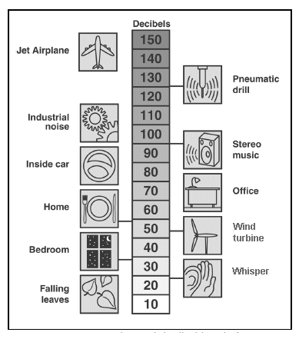
Noise level is measured in decibels

Slide 51
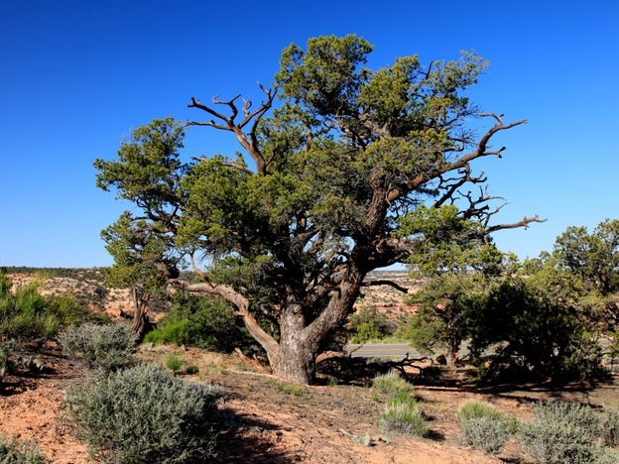
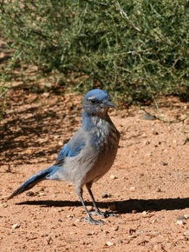
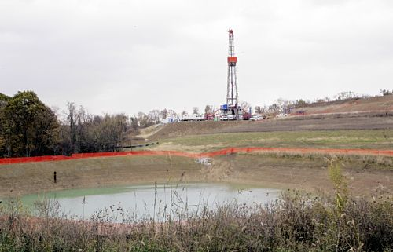
Noise Pollution
Study of the effects of noise from natural gas drilling sites in the desert of northwestern New Mexico
http://www.npr.org/2012/03/26/149236074/pipe-down-that-noise-might-affect-your-plants
Pinyon pine
Scrub Jay
Natural gas well

Slide 52
Light Pollution
Unnecessary and unwanted light
Inefficient use of light that results in light going into the sky, into places it is not intended
No health damage, but reduces quality of environment, affects some wildlife, such as sea turtles and birds
Also, results in wasted energy

Slide 53
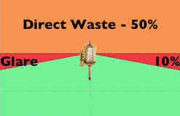
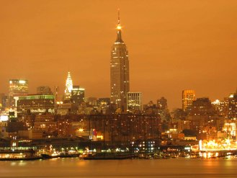
Light Pollution
Skyglow – hazy glow visible in the night sky near urban areas
Aiming lights downward increases efficiency

Slide 54
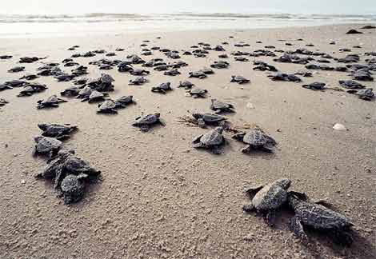
Light Pollution
Sea Turtles are negatively affected by light pollution
Eggs are laid in nests on the beach
Hatchlings use light reflected from the ocean’s surface to find their way to sea
Sometimes they will follow
bright lights of tennis courts,
parking lots, etc. and
go away from the ocean

Slide 55
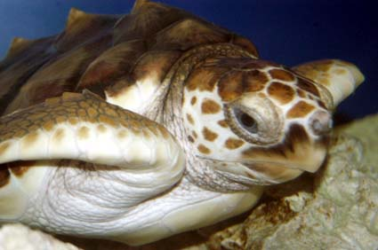
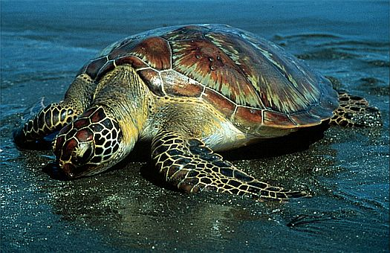
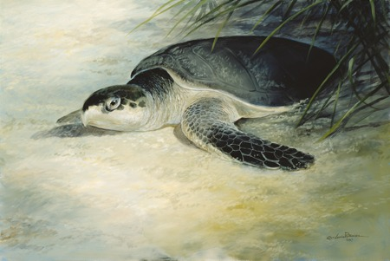
Light Pollution
Three Alabama species affected by light and water pollution:
Loggerhead sea turtle – status: threatened
Green sea turtle - status: threatened
Kemps Ridley – status: endangered

Slide 56
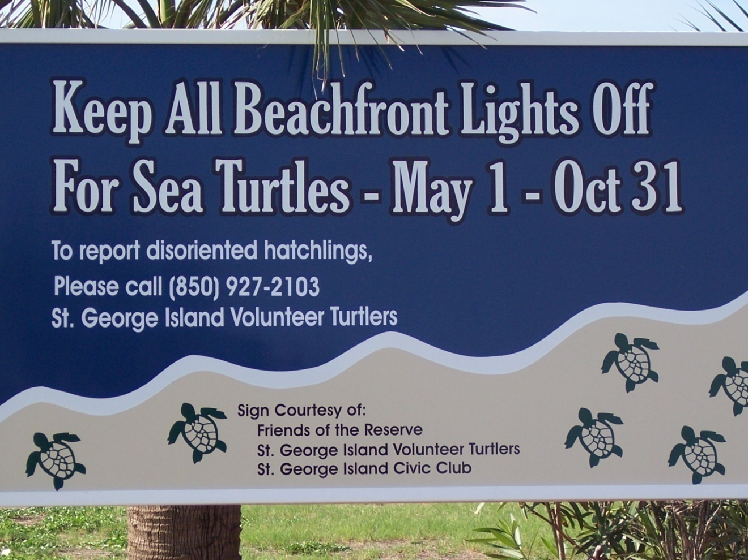
Light Pollution

Slide 57

Light Pollution
Migratory birds also use cues from the sun and stars and can become disoriented by lights on oil platforms at sea, sometimes circling until they are exhausted and then falling into the sea
Researchers at Dauphin Island Sea Lab have recorded songbirds in the guts of sharks
Researchers on platforms in the
North Sea replaced lights with
green-colored lights and it reduced
the circling behavior

