Slide 1
Business Technology Applications
Hardware and Software Components

Slide 2
What is a Computer?
An electronic device
Operates under the control of instructions stored in its memory

Slide 3
What is a Computer?
Can accept data (input)
Can manipulate data (process)
Can produce information (output)
Stores results for future use

Slide 4
What is a Computer?
A collection of devices that function together as a system

Slide 5
What is a computer
A computer is a tool you can use for a variety of tasks including creating documents, storing information, playing games, learning a new skill, and connecting to the Internet.

Slide 6
What is an input device?
Any hardware component that allows you to enter data, programs, command and user responses into a computer.

Slide 7


What is an input device?
Keyboard
Mouse
Scanner
Digital camera
Microphone

Slide 8
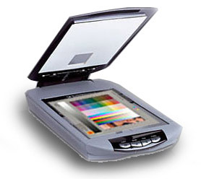
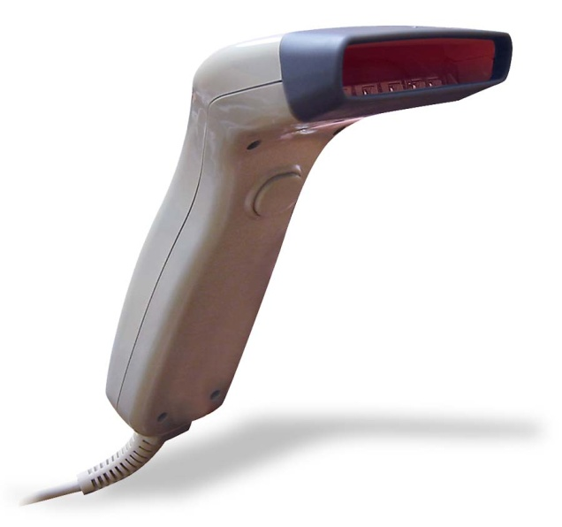
Scanners
an optical input device used to convert text and images into computer readable form.

Slide 9
Digital Camera
An input device that can instantly view and print pictures that you take without using film.
Pictures are stored in the camera’s memory or on a memory card.

Slide 10
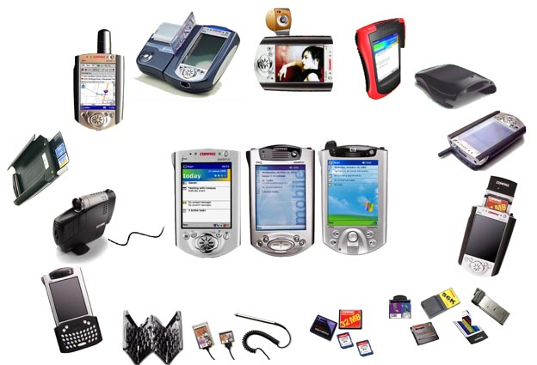
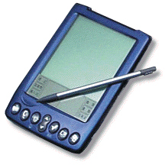
PDA
(Personal Digital Assistant)- is a palmtop specialized to store phone numbers, calendars, schedules, and personal information.

Slide 11
What is an output device?
Output devices make the processed information available for use.
Output can be presented in many forms. Example: printed report, presentation on the screen

Slide 12
What is an output device?
Monitors
Printers
Speakers

Slide 13
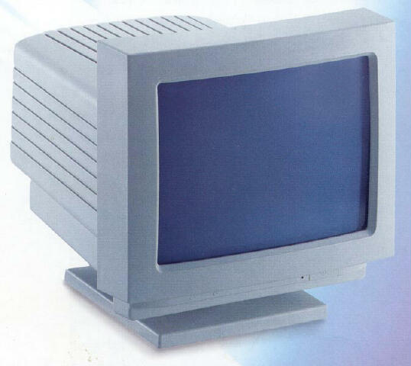
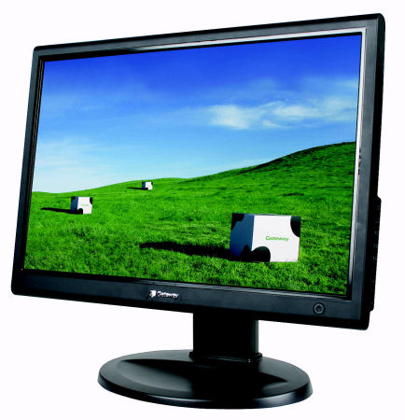
Monitor
a device that receives output from a computer and displays it visually.

Slide 14
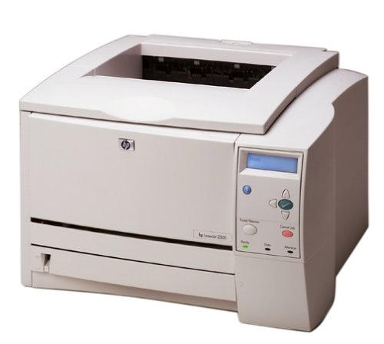
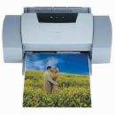
Printer
computer output device that provide hard copy, a permanent record of a computer’s output.
INKJET
PRINTER
LASER
PRINTER

Slide 15

Information Processing Cycle
Input
Process
Output
Store

Slide 16
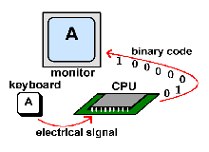

Slide 17

How Does a Computer Know What to Do?
It must be given a detailed set of instructions that tell it exactly what to do.
These instructions are called computer programs or software.

Slide 18
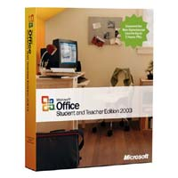
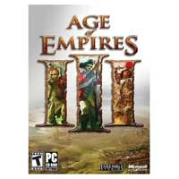
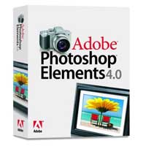
Software
Is a set of programming instructions used to accomplish a certain task.

Slide 19
Categories of Software
System Software – consists of programs to control the operations of computer equipment. Instructions in the Operating System tell the computer how to perform the functions of loading, storing and executing an application program and how to transfer data.
Application Software – programs that tell a computer how to produce information.

Slide 20
Operating System
Handles common tasks of using a computer, including starting the computer, starting a program, printing a document, and storing a file.
The operating system takes your commands and translates them into language that the hardware can understand.

Slide 21
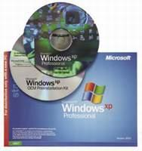
All computers require an operating system to work.
New computers come with an operating system.
The most common
operating system
is Microsoft Windows.

Slide 22

Commonly used Application software
Word processing software
Microsoft Word
Electronic spreadsheet software
Microsoft Excel
Database software
Microsoft Access
Presentation graphics software
Microsoft PowerPoint

Slide 23
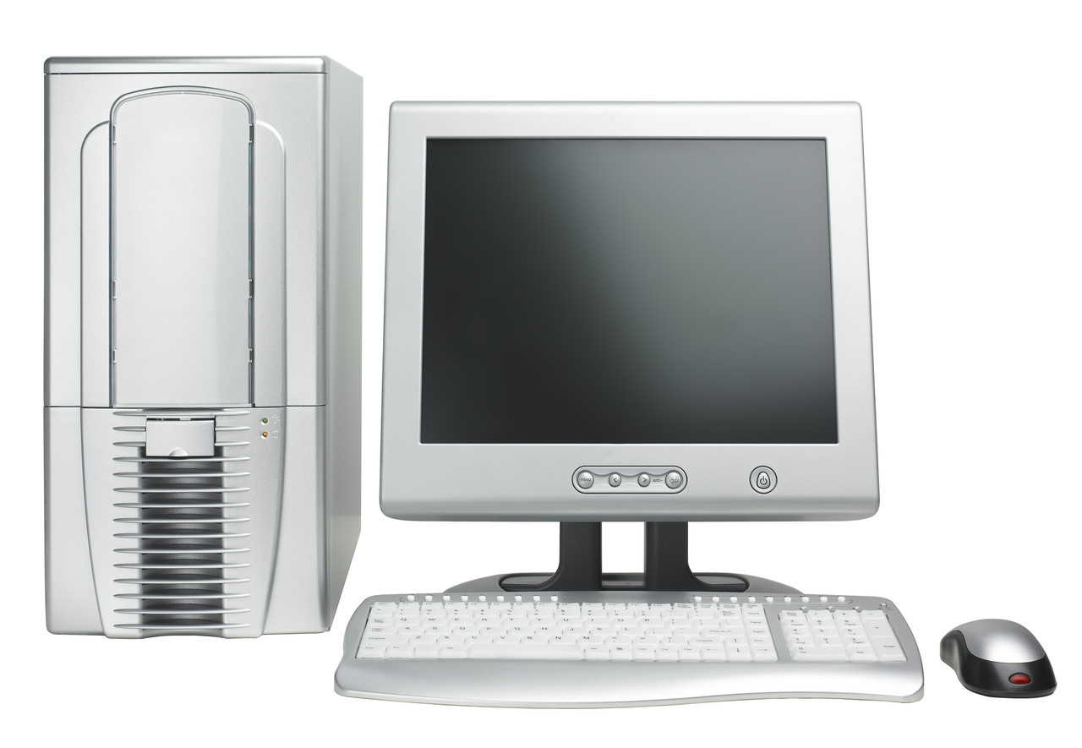
Hardware
Consists of the physical components that make up a computer.
Monitor
Tower
Keyboard
Mouse

Slide 24
Examples of Hardware
CPU
Monitor
Keyboard
Mouse
Speakers
Digital camera
Printer
Modem
CD/DVD Burner
Microphone
Scanners

Slide 25
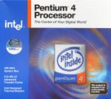

Inside a Computer
CPU-Central Processing Unit- “The Brain” of the computer.
It determines the speed and power of your computer.

Slide 26
Binary
The CPU processes data and handles instructions using the binary system.
Binary- uses two digits : 0 for off and 1 for on.

Slide 27
Bit
The smallest unit of data
A vast number of on and off switches

Slide 28
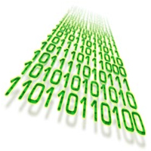
Byte
To represent data, such as a letter, the computer groups together bits.
A group of 8 bits is called a byte.
The 8 bits can be arranged into 256 combinations.

Slide 29
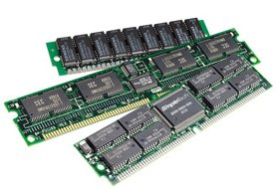
Memory
Memory is another determining factor in speed and performance.
The more memory, the faster the computer (and the more expensive).

Slide 30
How Memory Works
The processor stores basic instructions, but it cannot store programs or data.
To store this information, the computer’s memory, is called RAM.
Computer has two types of memory: ROM and RAM

Slide 31
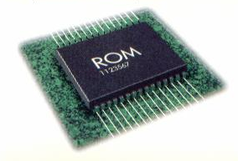
ROM
ROM-Read Only Memory-It is permanent storage, and can not be changed.
  Contains data and instructions that have been burned in.
  ROM contain instructions for starting a computer, checking for hardware devices, and starting the operating system.

Slide 32
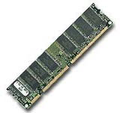
RAM
Random Access Memory
Instructions and data that are stored temporarily in RAM.
If you lose power all the data will be lost.

Slide 33
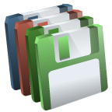
Storage Devices
Used to store instructions and data when they are not being used in memory.

Slide 34
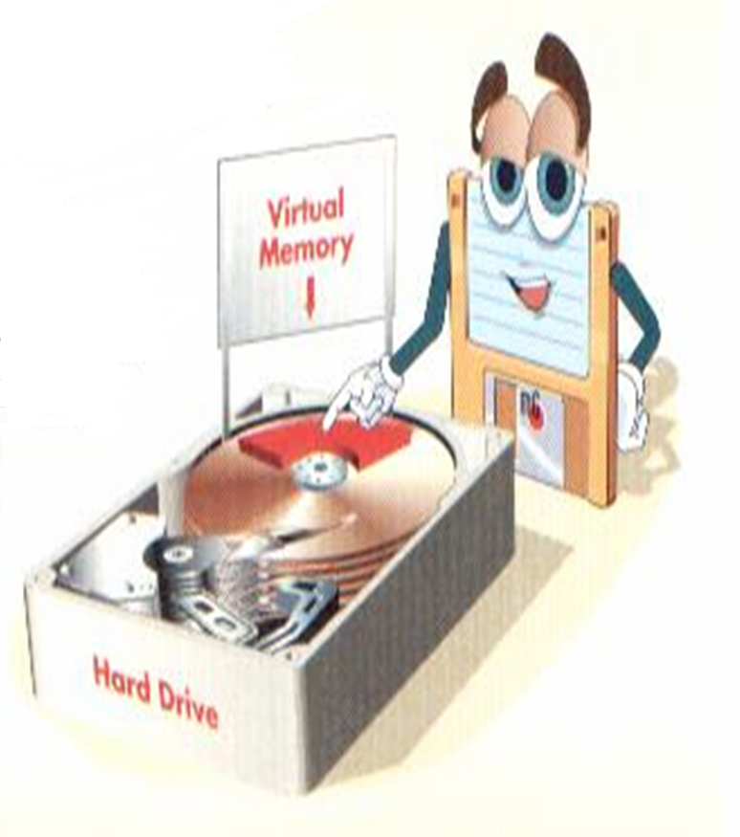
Hard drive
a magnetic storage device inside your computer system for permanent storage.

Slide 35
Hard Drives Vary 3 Ways
Capacity (size)- measured in megabytes or gigabytes.
  One megabyte would be equal to 1 to 1 1\2 floppy disks.
Speed
Drive standard

Slide 36
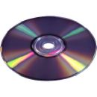

CD-RW
compact disk method of data storage with capacity to record, be erased, and then reuse.

Slide 37

DVD
a high-capacity optical storage medium that includes both recording and playback.

Slide 38
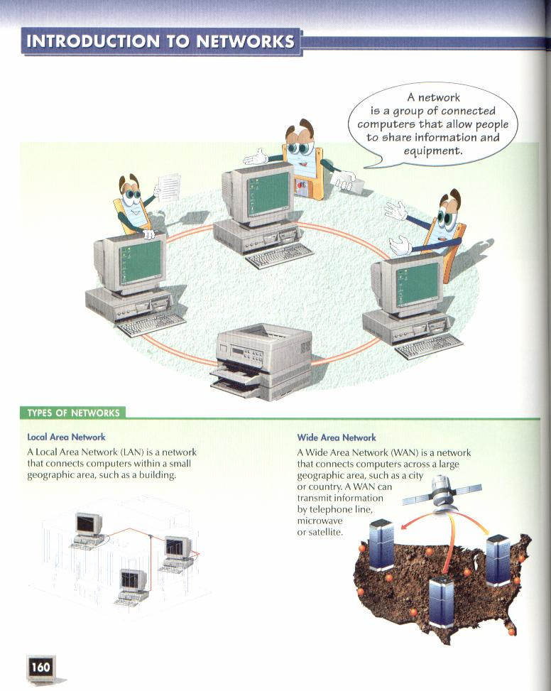
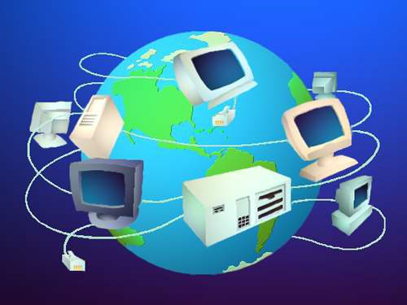

Slide 39
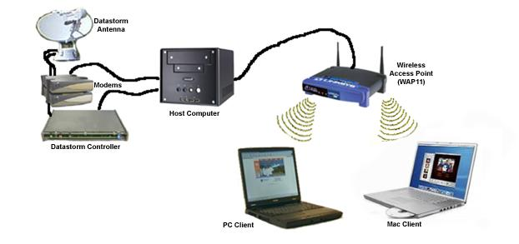
Network
a system of computers interconnect so they can share data and programs.

Slide 40
Inside a Computer
Motherboard- is the main circuit board that moves data between components.
All the devices inside a computer are connected to the motherboard.

Slide 41
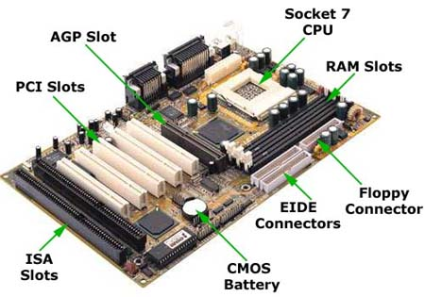

Slide 42
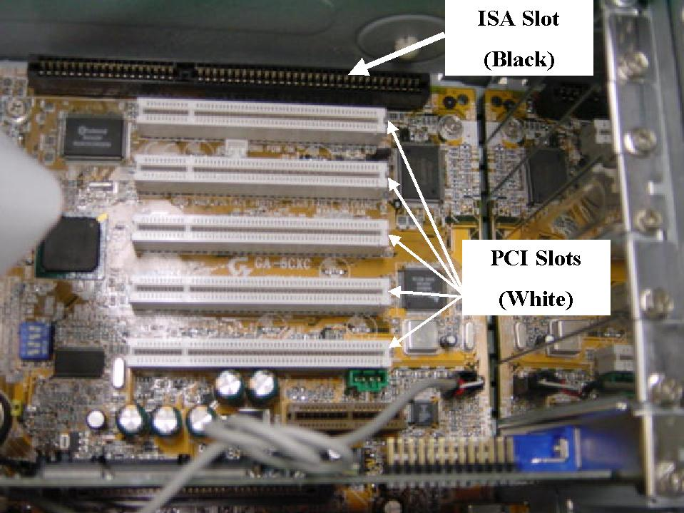
Expansion Slots
allows you to add other devices such as a Video Card to the motherboard.
Expansion Slots

Slide 43
Cards added to Expansion Slots
Video Card-an expansion that allows a user to capture video images and sounds.
Modem Card- modems are used to communicate via the telephone with other computers through the Internet.

Slide 44
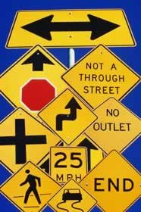
Bus
Main communication path on the motherboard made of tiny wires
The size of the Bus is important because it affects the performance of a computer.
The Bus size is measured
in bits-16-bits, 32 bits,
64-bits.

Slide 45
Computer Speed and MHz
A. The clock speed of a computer is measured in megahertz.
B. A Hertz is a single up and down movement of an electromagnetic wave.
C. mega - millions of oscillating waves per second.

Slide 46
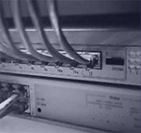
Switch
a standard telephone network in which each location has a number that is used to connect to the system.

Slide 47
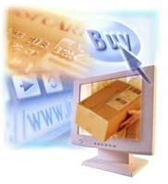

E-Commerce
business conducted on the Internet

Slide 48
Hacking
data that can be stolen, erased, or modified

Slide 49
Copyright Laws
software manufactures protect their product by copyrighting. Register the originality of a written or artist effort through the U.S. Copyright Office.

Slide 50
Software Licensing
specifies on how many people can use the software and the number of computers on which the software may be installed

Slide 51

Flaming
the act of posting insulting or abusive attacks on others through Internet connections.

Slide 52
Spamming
The posting or sending of irrelevant and unwanted messages over the Internet.

Slide 53
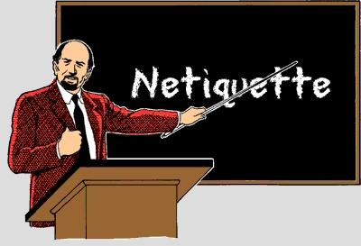
Netiquette
Using proper manners when using an online service or the Internet

Slide 54
Netiquette Tips for E-Mail
When forwarding an e-mail be careful not to violate the sender’s privacy when forwarding an e-mail.
Always cite materials that you gather from the internet. It is important to give other people credit for their work.
Cool off before answering an e-mail from someone who has upset you.

Slide 55
Resist attacking the author of a posting. It is considered “Flaming”
When you use capital letters, it is considered YELLING OR SHOUTING!!
Keep your messages short.
Just like in a letter, include a greeting and closing with your name.
Fill in the subject line of an e-mail.

