Slide 1
ACOS 3
Relate major tissues and organs of the skeletal, circulatory, reproductive, muscular, respiratory, nervous, and digestive systems to their functions.
Arranging in order the organizational levels of the human body from the cell through organ systems

Slide 2
Brain Drawing

Slide 3
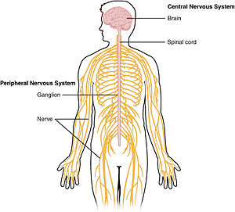
Homeostasis is the regulation of steady, life-maintaining conditions inside an organism, despite changes in its environment.
Stimulus is any internal or external change that brings about a response.
Your nervous system is one of several control systems used by your body to maintain homeostasis.

Slide 4
The nervous system is made up of the brain, spinal cord, and nerves.
Neurons are nerve cells which are the basic functioning units of the nervous system.

Slide 5
Dendrites receive impulses from other neurons and sends them to the cell body.
Axons carry impulses away from the cell body.

Slide 6
Sensory neurons receive information and send impulses to the brain or spinal cord.
Motor neurons then carry impulses from the brain or spinal cord to muscles or glands throughout your body.

Slide 7
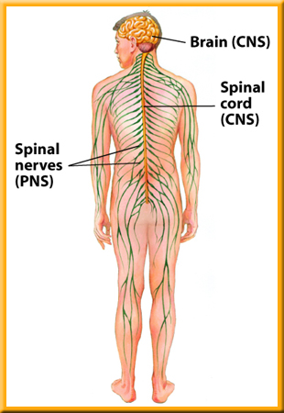
The central nervous system is made up of the brain and spinal cord.
The peripheral nervous system is made up of all the nerves outside the CNS.

Slide 8
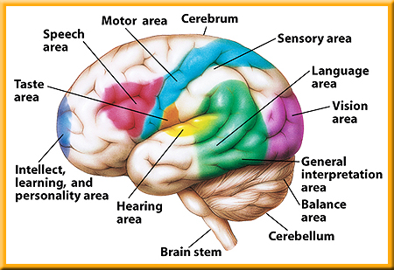
The brain coordinates all of your body activities.
The brain is made up of approximately 100 billion neurons.

Slide 9
The brain is divided into three major parts:
brain stem
cerebellum
cerebrum

Slide 10
The cerebrum is the place where thinking takes place and is the largest part of the brain.
The cerebrum is also where impulses from the senses are interpreted, memory is stored, and movements are controlled.

Slide 11
The cerebellum is where stimuli from the eyes, ears, and muscles are interpreted.

Slide 12
The cerebellum is able to coordinate voluntary muscle movements, maintain muscle tone, and help maintain balance.

Slide 13
The brain stem is at the base of the brain and controls involuntary actions such as heartbeat, breathing, and blood pressure.

Slide 14
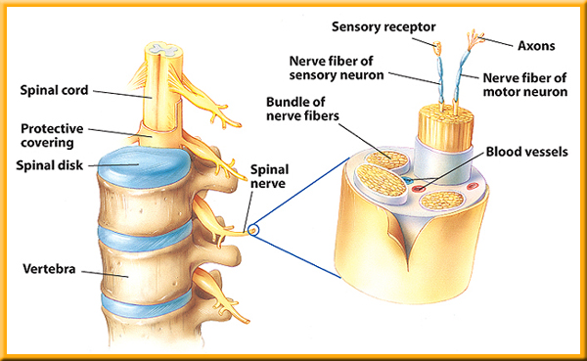
Your spinal cord is made up of a bundle of neurons that carry impulses from all parts of the body to the brain and from the brain to all parts of your body.

Slide 15
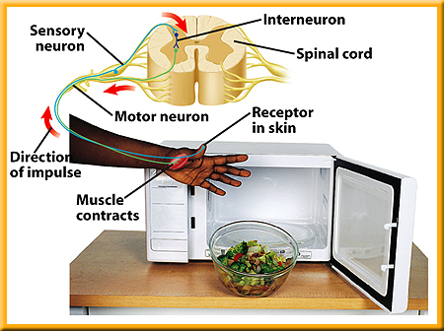
A reflex is an involuntary, automatic response to a stimulus.
Reflex responses are controlled in your spinal cord, not in your brain.

