Slide 1

Welcome to Physical Education
Mrs. Fleming

Slide 2

About Me
Auburn Graduate in Physical Education

Slide 3
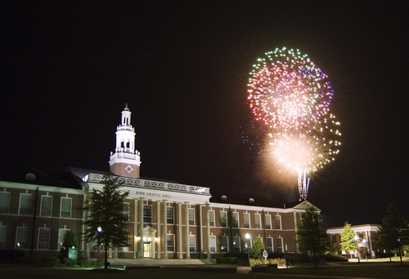
Masters from Troy University
Collaborative K-6

Slide 4
Physical Education Rules
Follow Directions
No screaming when Indoors or hallways
Keep Hands and Feet off others
Be Kind
Have Fun!

Slide 5
Daily Routines
Walking to playground
Fun Run
Skill of the day\week
Fun games
Jungle gym time
Back to class

Slide 6
Jungle Gym Rules
No hanging upside down
Go down slide in sitting position
No sitting on top of playground
No running under monkey bars
No throwing of wood shavings or dirt
No jumping out of swings

Slide 7
Indoor Activities
Exercise to Music
Aerobics
Rotation stations
Bean Bag Activities
Small Group\ Whole Group Activities
Health Lessons

Slide 8

Yearly Activities
SOCCER BOWL
JUMP ROPE for HEART
FIELD DAY
FITNESS TESTING

Slide 9
Why Wear Tennis Shoes?
Protection from ant bites
Protection from sliding and falling while climbing
Twisting ankles
Cutting foot

Slide 10
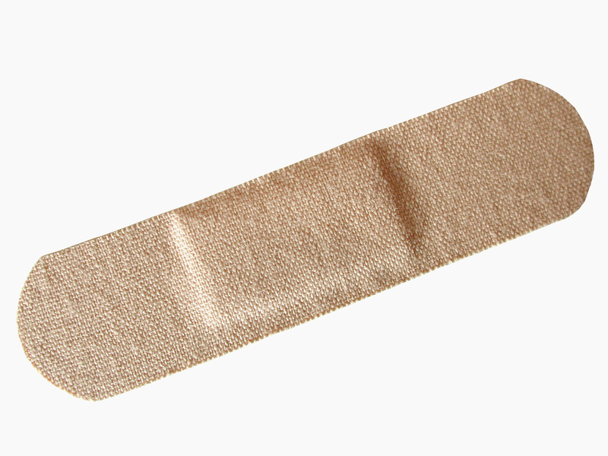
Health and Miscellaneous Concerns
Asthma\Inhalers
EpiPens
Parent Notes
Open sores
Bathroom Breaks
Emergency Procedures
Bullying

Slide 11
Any Questions??????

Slide 12

Call Me!
334-372-444

