Slide 1
Welcome to Third Grade!

Slide 2
Ms. Countryman
Reading
Language/ Spelling
Social Studies

Slide 3
Mr. Saffold
Math
Science
Creative Writing / Cursive Writing

Slide 4
Please Be on Time for School.

Slide 5
Sometimes being absent from school is unavoidable. Please send your child back to school with an excuse as soon as possible.

Slide 6
Language Grades

Slide 7
Reading Grades

Slide 8
Math Grades
Chapter Test
Weekly Skill / Midpoint Check
Math Journal / Vocabulary Test
Timed Fact Test

Slide 9
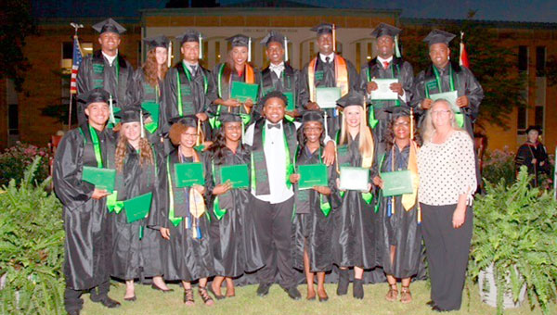

Slide 10
Let’s make this a great year!

