Slide 1
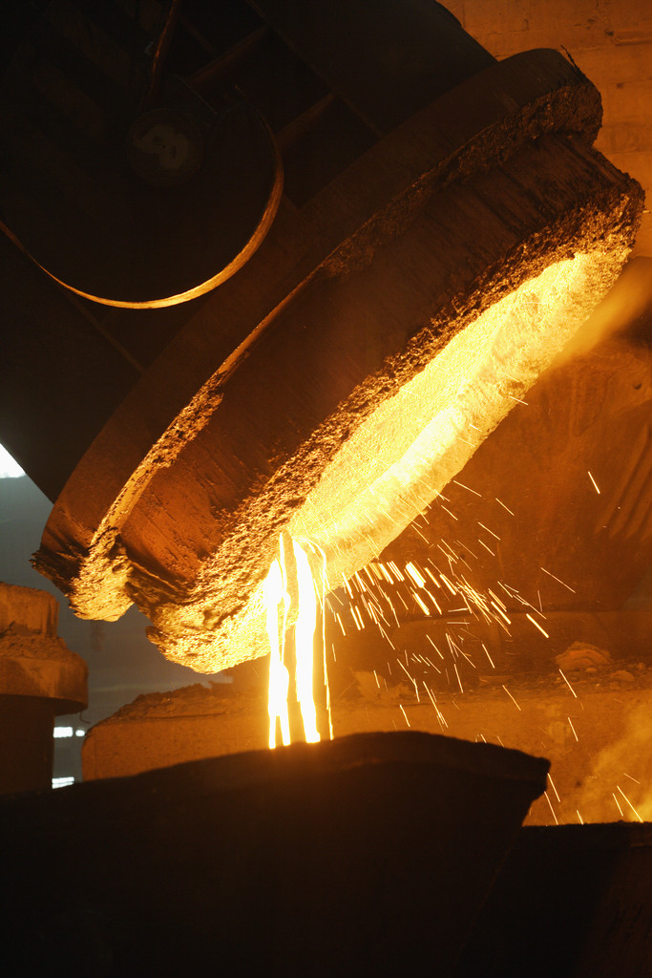
Chapter 19
The Growth of Industry
1865-1914

Slide 2

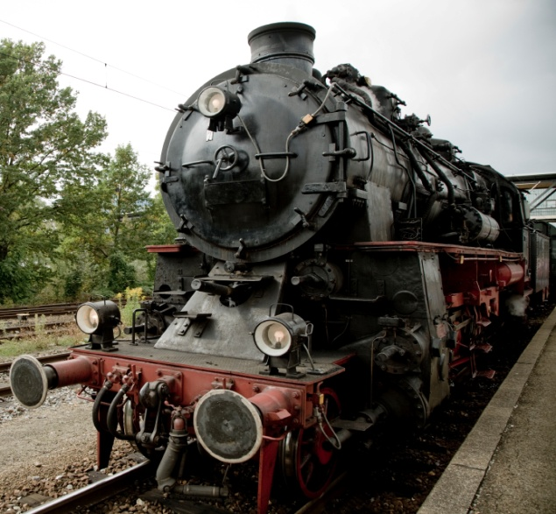
19.1 Railroads Lead the Way
1. Railroads became the driving force behind America’s economic growth.
2. Consolidation – the practice of combining separate companies in an industry.

Slide 3
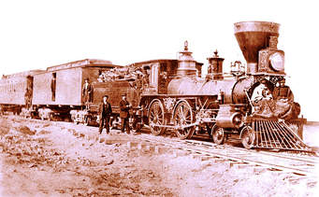
19.1 cont……
3. Railroad barons lived in an age when few laws regulated business. They played an important role in building the nations transportation system.
4. Railroads carried raw materials such as iron ore, coal, and timber to factories. They also carried manufactured goods from factories to markets and transported produce from farming areas to the cities.

Slide 4
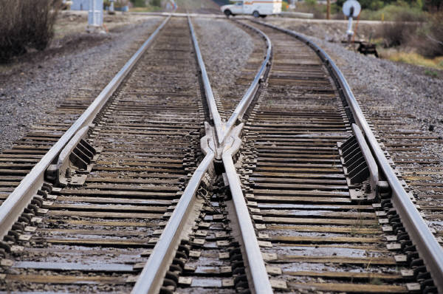
19.1 cont…..
5. During the 1880s, almost all railroad companies adopted a standard gauge of 4 feet 8.5 inches.
6. George Westinghouse devised air brakes that improved the system for stopping trains.
7. George Pullman developed the Pullman sleeping car.

Slide 5

19.1 cont…..
8. Large railroads offered secret discounts called rebates to their biggest customers.

Slide 6
19.2 Inventions
1. Samuel Morse introduced the telegraph in 1844.

Slide 7
19.2 Cont……
2. In 1866 Cyrus Field managed to lay a telegraph cable across the Atlantic Ocean.
3. Alexander Graham Bell invented the telephone in 1876.
http://www.biography.com/people/alexander-graham-bell-9205497

Slide 8
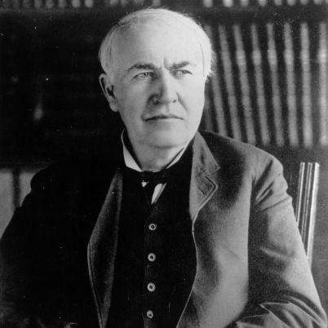
19.2 cont…..
4. Thomas Edison built the first central electric power plant in 1882 in New York City. http://www.history.com/topics/thomas-edison/videos#thomas-edison

Slide 9
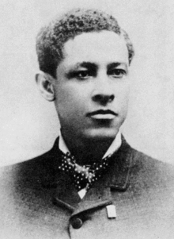

19.2 Cont……
5. Jan E. Matzeliger , an African American inventor, developed a shoe-making machine that performed many steps previously done by hand.

Slide 10
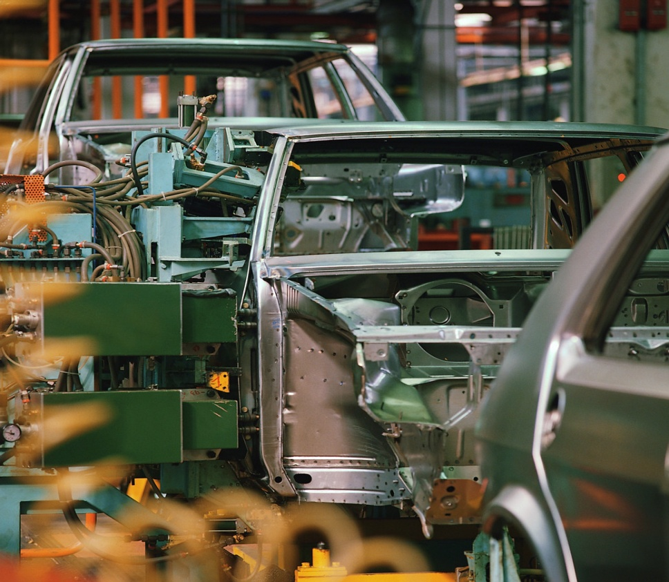
19.2 Cont….
6. Henry Ford came up with the idea of the assembly line. On the assembly line, each worker performed an assigned task again and again at a certain stage in the production of the automobile .

Slide 11
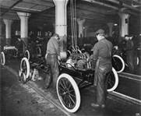
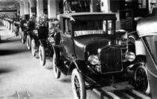
19.2 cont…..
7. The assembly line allowed for the mass production of goods which decreased manufacturing costs, so products could be sold more cheaply.

Slide 12
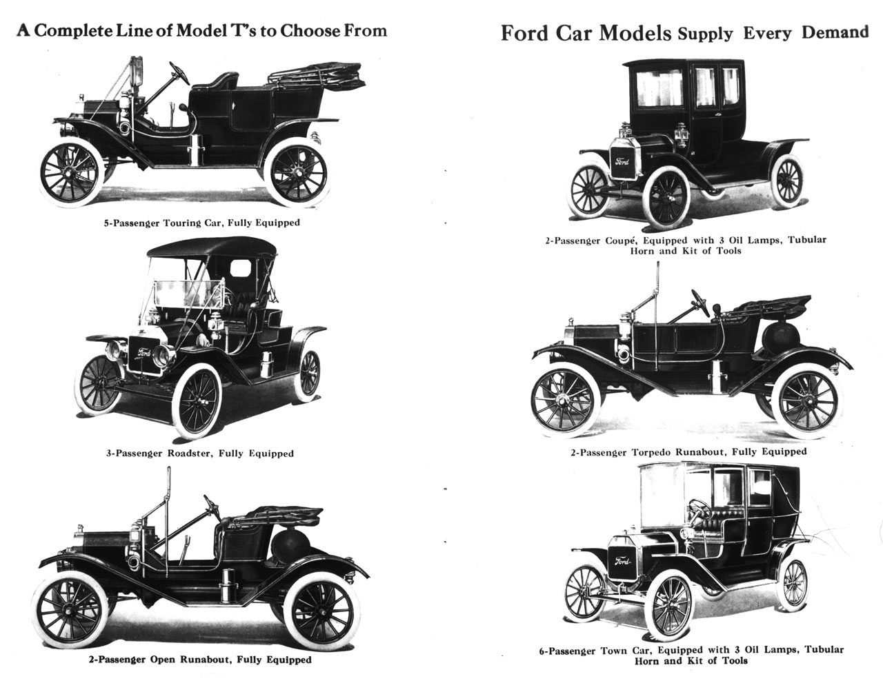
19.2 Cont….

Slide 13
19.3 An Age of Business
1. Edwin L. Drake drilled a well in Titusville Pennsylvania and struck oil. This lead to the creation of a multimillion dollar petroleum industry.

Slide 14
19.3 cont.
▪2. A corporation is a company that sells shares, or stock, of its business to the public to raise money.
3. A shareholder is a person who owns stock or shares in a company.
4. A trust is a group of companies that are managed by the same board of directors.

Slide 15
19.3 cont…..
5 A monopoly is when an industry is under the total control of one producer.
6 The leading figure in the early years of the steel industry was Andrew Carnegie.
http://www.biography.com/people/andrew-carnegie-9238756/videos/andrew-carnegie-wealthy-wise-2079162422
7. Philanthropy is the use of money to benefit the community.

Slide 16
19.3 cont…..
8. Carnegie donated $350 million to various organizations. He built Carnegie Hall in New York City and more than 2000 libraries around the world.
9. A merger is the combining of companies into a corporation.

Slide 17
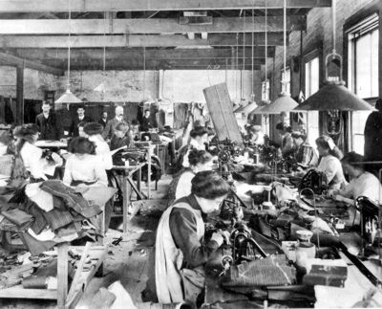
19.4 Industrial Workers
1. Garment workers toiled in crowded urban factories called sweatshops.
2. “Stand firm,” he Yelled. “ Let every man stand shoulder to shoulder and we will win this fight. We must have our rights. Strike while the iron is hot….” This quote came from someone who participated in the Chicago Haymarket Riot in 1886.

Slide 18
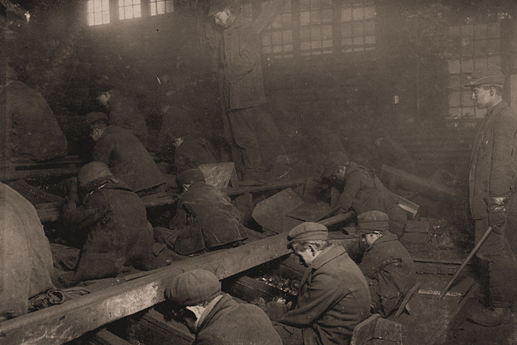
19.4 cont…..
3. In the1900s, thousands of children under 16 years of age worked in factories. Many states passed child labor laws. These laws stated that children working in factories had to be at least 12 years of age and should not work more than 10 hours a day. (Below-January 1911-Young boys separating coal-Pittston Pennsylvania)

Slide 19
19.4 cont…
4. Trade Unions – represented workers in certain crafts or trades.
5. In 1866 a group of national trade unions formed a federation that became known as the American Federation of Labor. (AFL) This union was led by Samuel Gompers

Slide 20
19.4 cont….
6. Strikebreakers – people who were hired to replace striking workers.
7. Attorney General Richard Olney granted an injunction, or court order, to stop the union from “obstructing the railways and holding up the mail.” This was known as the Pullman Strike.

