Slide 1
Sneaky Commas in a Series
Sneaky Commas in a Series
Created by
TEACHERS UNLEASHED

Slide 2
Well, hello there! My name is Wesley Weasel, and I am the forest’s utmost authority on using commas in a series. I have come today to teach you this very important grammar form.
What is a series you ask? Well…it is quite easy really. A series is when you have three or more words or phrases in a sentence that you need to separate. Let me show you.

Slide 3
Commas are used to separate words in a list. The list can be made up of nouns, verbs, or adjectives. It does not matter! You add the comma in order to have a small pause while you are reading. Here are a few examples.

Slide 4


A series of words
Weasels are very sweet, kind, and loving.
Before the last word, is the conjunction and telling you it is the last word in the series. Let’s see another one!
Notice after every word used to describe weasels, there is a comma. All except the last one!

Slide 5

A series of words
Weasels like to dance, climb, and eat.
It’s the same as before.
After every word used to describe what weasels like to do, there is a comma. Except the last one!
Remember…before the last word in the list, you need a conjunction like and or or!

Slide 6
A series of words
I like to boogie and groove.
Remember, if there are two words you do NOT need a comma before your conjunction.

Slide 7
Okay, here’s what I need you to do. I’ve got these sentences with lists of words, but they are missing their commas and conjunctions. On your whiteboard, please rewrite the sentence, and put the commas and other words where they should be. Good Luck!

Slide 8
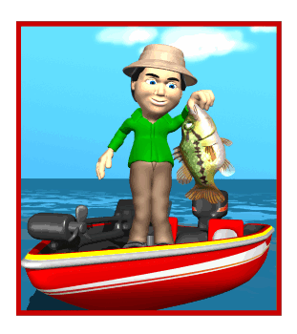
Add the commas
We like to go swimming, fishing, and camping in the summer.
We like to go swimming fishing camping in the summer.
Don’t forget to add the conjunction and to the last word in your list!

Slide 9
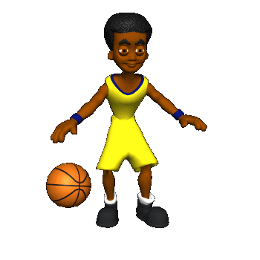
Add the commas
Greg, Carlos, John, and Steve are all coming over to play basketball at my house.
Greg Carlos John Steve are all coming over to play basketball at my house.
Don’t forget to add the conjunction and to the last name in your list!

Slide 10

Add the commas
When I went to the zoo, I saw monkeys, lions, giraffes, and elephants.
When I went to the zoo, I saw monkeys lions giraffes elephants.
Don’t forget to add the conjunction and to the last animal on your list!

Slide 11

Add the commas
“Tonight our specials are chicken, steak, and hamburgers,” said the waitress.
“Tonight our specials are chicken steak hamburgers,” said the waitress.
Don’t forget to add the conjunction and to the last food on your list!

Slide 12

Add the commas
Sally could not decide whether she wanted an apple, juice box, or sandwich.
Sally could not decide whether she wanted an apple juice box sandwich.
Don’t forget to add the conjunction or to the last food on your list!

Slide 13
Wow! Very impressive. You seem to have gotten that down, so now let’s move on to some harder stuff. Next, we’ll look at lists with phrases instead of just words. Phrases are a group of words, which make sense, but are not a complete sentence. Let me show you!

Slide 14

A series of phrases
I really like to play games, watch movies, and take naps.
I’ve made the phrases green to help you. See how they aren’t just one word? I have to put commas between them to separate them.
Before my last phrase, take naps, I have to put the word ‘and’ to show that it is the last phrase on my list.

Slide 15

A series of phrases
Sneaking around, doing pranks, and making jokes is what I do on the weekend.
Again, I made the phrases green to help you. See how I put a comma at the end of each phrase, except the last one!
Before my last phrase, making jokes, I made sure to put the word and, so people know my list is done!

Slide 16
Your turn again! See if you can put the missing commas in these sentences. Remember, you are looking for phrases this time, not just words. I do like to be sneaky, so be careful!

Slide 17

Add the commas
This weekend, I plan to ride the waves eat some gnarly soft tacos rap with my dudes.
This weekend, I plan to ride the waves,
eat some gnarly soft tacos, and rap with my dudes.
Don’t forget to add the conjunction and to the last phrase on your list!

Slide 18

Add the commas
To find my treasure you will need to go over the hill, through the woods, and under the bridge.
To find my treasure you will need to go over the hill through the woods under the bridge .
Don’t forget to add the conjunction and to the last phrase on your list!

Slide 19
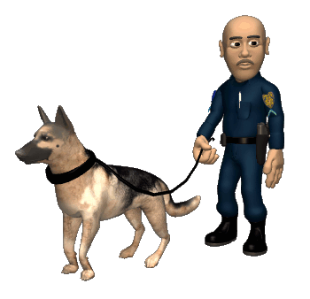
Add the commas
Police canines enjoy their job of sniffing out evidence, capturing criminals, and obeying their master.
Police canines enjoy their job of sniffing out evidence capturing criminals obeying their master.
Don’t forget to add the conjunction and to the last phrase on your list!

Slide 20
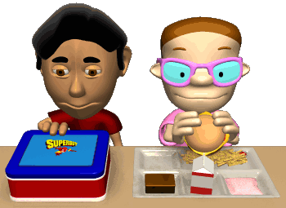
Add the commas
Harold could not decide whether he liked to buy hot lunch or bring lunch from home.
Harold could not decide whether he liked to buy hot lunch or bring lunch from home.
Don’t get tricked. This sentence only contains two choices: buying hot lunch or bringing lunch from home!

Slide 21
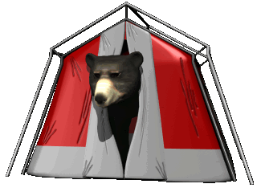
Add the commas
The bear could not be found in the woods, his den, or by the river.
The bear could not be found in the woods his den by the river.
Don’t forget to add the conjunction or to the last phrase on your list!

Slide 22
Great job, friends! I am so proud that you could not be tricked by my sneaky weasel-ness.
I’ve got a few final questions for you, so I can be sure you’ve mastered my tricky comma concept. Are you ready?

Slide 23

What is the correct way to punctuate the underlined items in this sentence?
My favorite foods are sushi peanut butter and jelly sandwiches and smoothies.
sushi, peanut butter, and jelly sandwiches, and smoothies.
sushi, peanut butter and jelly, sandwiches, and smoothies.
sushi, peanut butter and jelly sandwiches, and smoothies.
sushi peanut butter, and jelly, sandwiches, and smoothies.

Slide 24

What is the correct way to write the missing part of the sentence?
Charlie couldn’t decide whether he wanted ___________
a bike, a skateboard, or a scooter.
a bike, a skateboard or a scooter.
a bike a skateboard or, a scooter.
a bike a skateboard or a scooter.

Slide 25
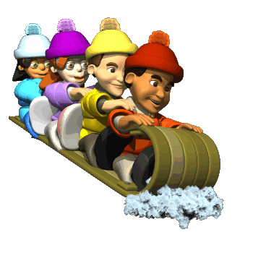
Which sentence is written correctly?
Kyle, Kennedy, Sarah, and Hailey are best friends.
b. Kyle Kennedy Sarah and Hailey are best friends.
c. Kyle, Kennedy, Sarah, and, Hailey are best friends.
d. Kyle, Kennedy, Sarah and Hailey are best friends.

Slide 26

What is the correct way to punctuate the underlined items in this sentence?
Please don’t use a pen or a crayon to do your work.
a pen, or a crayon,
a pen, or a crayon
a pen or a crayon
a pen, or, a crayon

Slide 27

What is the correct way to punctuate the underlined items in this sentence?
Is your favorite subject reading writing or spelling?
reading writing or spelling?
reading, writing, or, spelling?
reading , writing or spelling?
reading, writing, or spelling?

Slide 28

What is the correct way to write the missing part of the sentence?
__________ sounds like just what we need to relax.
Sleeping in a tent, hiking the trails, and, sitting by the fire
Sleeping in a tent, hiking the trails, and sitting by the fire
Sleeping in a tent hiking the trails and sitting by the fire
Sleeping, in a tent, hiking, the trails, and sitting, by the fire

Slide 29

Which sentence is written correctly?
Sofia is gifted in music. She plays the clarinet, the guitar, the piano, and the trumpet.
b. Sofia is gifted in music. She plays the clarinet the guitar the piano, and the trumpet.
c. Sofia is gifted in music. She plays the clarinet, the guitar, the piano, and, the trumpet.
d. Sofia is gifted in music. She plays the clarinet, the guitar, the piano and the trumpet.

Slide 30

What is the correct way to write the missing part of the sentence?
Would you bring me ___________?
a box of kleenex, some hot tea, and, an ice pack.
a box of kleenex, some hot tea and an ice pack.
a box of kleenex some hot tea and an ice pack.
a box of kleenex, some hot tea, and an ice pack.

Slide 31
You really cannot be tricked! I’ve done my best to outsmart you, but you understand commas in a series. Way to go, my weasel friends!

Slide 32
Psssst! Over here…
Thanks for choosing TEACHERS UNLEASHED
to teach those sneaky students how to master commas in a series!
For more of our products go to:
www.teacherspayteachers.com/Store/Teachers-Unleashed

