Slide 1
Fiction and Nonfiction
Advanced Language Arts-8

Slide 2
Elements of Fiction
Fiction is prose writing that tells about characters and events from the author’s imagination. All works of fiction share certain basic elements.
Setting is the time and place where the story takes place.
Plot is the sequence of events that takes you through a story. The plot includes the conflict (problem) and the resolution (conclusion or outcome).
Characters are people or animals that take part in the story’s actions
Point of view is the perspective from which a story is told (first-person is the perspective of a character and third-person is the perspective of a narrator).
Theme is a message about life that a story conveys to a reader.

Slide 3
Types of Fiction
Short stories – brief works of fiction made up of plot, character, setting, point of view, and theme.
Usually focus on one main plot and one main conflict.
Can usually be read in one sitting.
Novels – longer works of fiction that contain the same elements as a short story.
Novellas – works of fiction that are smaller than novels but longer than short stories.
Historical fiction – literature that draws, in part, on real people and events to tell invented stories.

Slide 4
Elements of Nonfiction
Nonfiction deals with real people, events, or ideas.
They are narrated from the point of view of the author, who is a real person.
Many things can affect the outcome of nonfiction writing
Mood – the overall feeling that the work evokes in a reader.
Author’s style – every feature of a writer’s use of language (rhythm, language and methods of organization).

Slide 5
Purposes of Nonfiction
To persuade
Speeches and editorials
To inform
Articles, reference books, historical essays and research papers present facts and information
To entertain
Biographies, autobiographies, and travel narratives are often written for the enjoyment of the audience.

Slide 6
The Baker Heater League
Contributions of the Pullman Car Co.
By Patricia C. McKissack

Slide 7
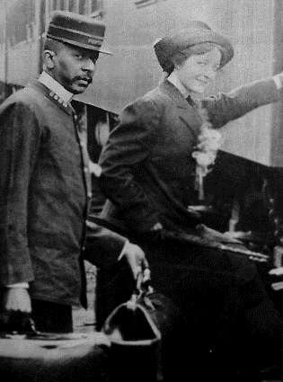
Origins
1867 – George Pullman decided to begin building super luxury train cars known as Pullman Cars and formed the Pullman Co.
Pullman also decided to begin supplying his cars with attendants known as Pullman Porters to provide the best in service to the customers

Slide 8
George Pullman
Engineer in Chicago decided to develop the Pullman Car out of his discomfort on a train from Buffalo to Chicago.
The car gained notoriety when it was chosen to be the carrier of President Lincoln’s body on his final trip to Springfield, Il.
Ironic, President Lincoln’s son Robert Todd Lincoln was named chairman of the company following Pullman’s death in 1897

Slide 9
Labor Begins to Organize
George Pullman decided to utilize the vast amount of cheap post Civil-War era labor and employed almost exclusively, former slaves. Pullman was the largest employer of African-Americans in the U.S. for nearly 80 Years.
The workers were paid very well. However, they were treated poorly even by the standards of the day.
Porters earned 810 dollars per year, commonly worked 20 hour shifts, and worked on average 400 hours per month.

Slide 10
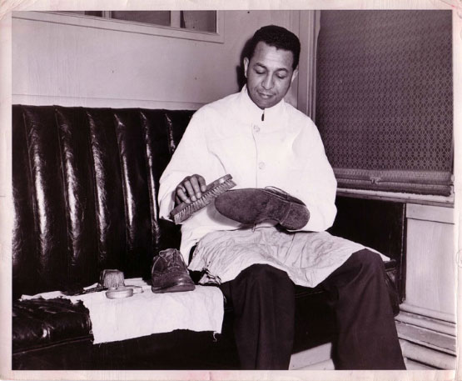
Labor Begins to Organize Continued
Porters of the Pullman Co. also were forced to purchase their own uniforms, shoes, and even shoe polish.

Slide 11
American Railway Union
The ARU was formed in 1893 by Eugene V. Debbs (Also a key member of the Socialist Party.
During the late 1800’s the U.S. saw a significant economic recession which led to a reduction in travel and spending.
This hit the rail industry very hard and forced companies to lower wages and hours for their workers.

Slide 12
ARU Continued
Before 1894, the Pullman Porters organized and asked that they be given better working conditions and wages.
When these demands were not met the U.S. saw it’s largest strike of the early industrial revolution.
President Cleveland was forced to send troops to push the porters to return to work! The strike empowered the union and showed that labor was beginning to organize.
The labor strike helped give birth to the “Brotherhood of the Sleeping Car Porter.” A labor union developed to help the porter gain access to better wages and working conditions.

Slide 13
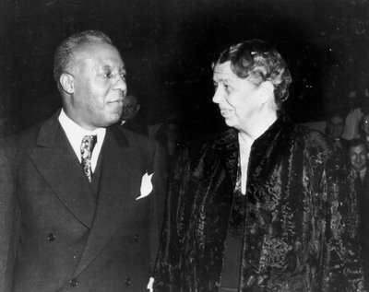
A. Phillip Randolph
The “Brotherhood,” was named in 1925 and the Labor Movement was born.
It took the union almost 12 years to gain a victory in negotiating a contract with the Pullman Co.
Randolph was also a key member in national politics for his entire life.

Slide 14
On to the Story
The Baker Heater League is a story about the lore and social culture associated with living as a porter on a Pullman Sleeping Car.
It is an illustration of their life in a society known as the “Baker Heater League”
This is a Historical Essay related to the life of porters

