Slide 1
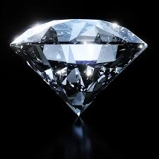
Word Definition
Picture Sentence
shining brightly; sparkling
brilliant
The diamond gave off a brilliant glow in the sunlight.

Slide 2
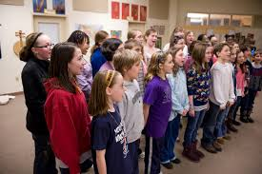
Word Definition
Picture Sentence
anything spoken or sung all at the same time
chorus
The school children sang in chorus .

Slide 3
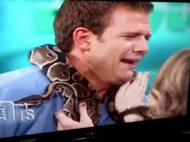
Word Definition
Picture Sentence
A person who lacks courage
coward
The woman called me a coward because I cried when they put the snake around my neck.

Slide 4
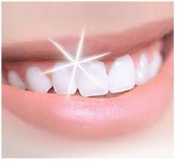
Word Definition
Picture Sentence
flashed or beamed with light
gleamed
The girl’s teeth were so white and shiny, they gleamed when she smiled.

Slide 5
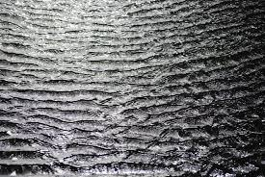
Word Definition
Picture Sentence
gleaming or shining faintly
shimmering
The water was shimmering in the fading sunlight.

