Slide 1
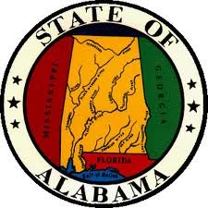
Discovering Alabama
Chapter 2
Spanish
French
English
Indians

Slide 2
Discovering Alabama
Chapter 2 Vocabulary
Immunity
Bartered
Cartographer
Palisade
Strategic Position
Mission
Garrison
Oral Traditions

Slide 3
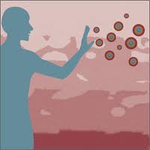
Discovering Alabama
Chapter 2 Vocabulary
• Immunity- resistance to disease

Slide 4
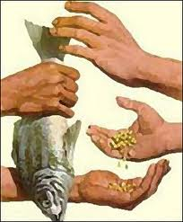
Discovering Alabama
Chapter 2 Vocabulary
• Bartered- traded goods

Slide 5
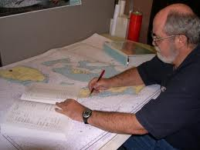
Discovering Alabama
Chapter 2 Vocabulary
• Cartographer- map maker

Slide 6
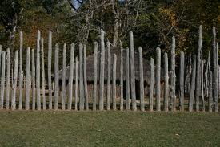
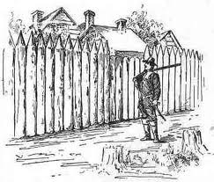
Discovering Alabama
Chapter 2 Vocabulary
• Palisade- high wall around a town

Slide 7
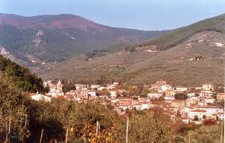
Discovering Alabama
Chapter 2 Vocabulary
• Strategic position- place useful for a strategy

Slide 8
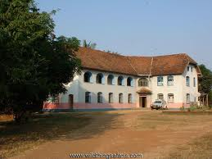
Discovering Alabama
Chapter 2 Vocabulary
• Mission- station or headquarters

Slide 9
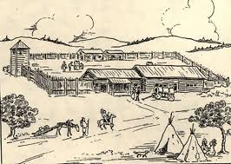
Discovering Alabama
Chapter 2 Vocabulary
• Garrison- place where soldiers are stationed for the purpose of defending it

Slide 10
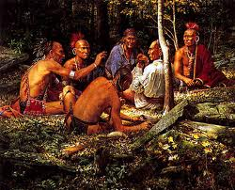
Discovering Alabama
Chapter 2 Vocabulary
•Oral traditions- cultural stories and tales

Slide 11
Discovering Alabama
ALCOS 3. List reasons for European exploration and settlement in Alabama and the impact of Europeans on trade, health, land expansion, and tribal reorganization of Native American populations in Alabama. Locating European settlements in early Alabama Explaining reasons for conflicts between Europeans and Native Americans in Alabama from 1519 to 1840 Examples: differing beliefs regarding land ownership, religious differences, cultural differences, broken treaties

Slide 12
Discovering Alabama
Think About It:
We have just learned about the prehistoric Indians that lived in our area many years ago. Look around the room…Notice that there aren’t many Native American students in your classroom. If the Native Americans were the first inhabitants in this area, then why aren’t we all Native Americans?
Turn and Talk to your group members about your thinking.
Question: What predictions can you make about the next events that occurred in Alabama’s History?

Slide 13
Chapter 2 Discovering Alabama
Many cultures have influenced Alabama!
Spanish
French
English
Indians

Slide 14
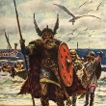
Discovering Alabama
*The New World was discovered more than once!
• The Norsemen (Vikings) reached Newfoundland in about 1000AD

Slide 15
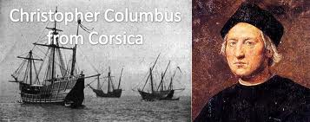
Discovering Alabama
*The New World was discovered more than once!
•Columbus landed in the Western Hemisphere in 1492. He didn’t know he found a new world. He thought he had found a way to Asia.

Slide 16
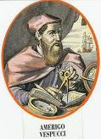
Discovering Alabama
*The New World was discovered more than once!
•In 1499, Amerigo Vespucci (Italian navigator) reached the northern coast of South America. A cartographer (mapmaker) named North and South America in his honor.

Slide 17
The Spanish
• 1519- Alonzo de Pineda entered Mobile Bay with 4 ships. He saw Indian villages and a deep river flowing into the bay. (Mobile Bay) His report was the 1st written account of the Alabama coast.
•1528- Panfilo de Narvaez set sail for Florida with 600 men. After losing some ships in a hurricane, his sent the other ships to explore Florida’s coast. They never returned.
•He met hostile Indians and one of his men, Juan Ortiz, was captured. Ortiz lived with the Indians for many years.
•Narvaez then entered Mobile Bay and met several chiefs. 2 of his men went with the Indians to get water and never returned.

Slide 18
The Spanish
• Hernando de Soto traveled all across Alabama.
• The Spanish came to the New World looking for wealth (gold and silver)
History begins with written records, and Alabama’s written history begins with Spanish journals.

Slide 19
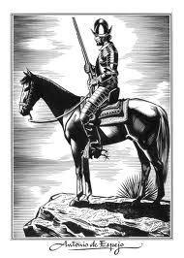
The Spanish in Alabama
Spanish entered Al. during the late Mississippian period.
The Spanish were not kind to the
Indians-they made them carry supplies,
bullied them, stole their corn, and
forced the women to be their servants.
The Indians were frightened by the
Spanish horses, swords, and armor.

Slide 20
3 Cultures in Alabama
Europeans and Africans brought in 2 new cultures to the Alabama Indian culture.
This was the beginning of the melding of Indian, European and African cultures.

Slide 21
Ch2 Lesson 1 Review Questions
When did Columbus discover the New World?
Who was Amerigo Vespucci?
Why did the Spanish come to the New World?

Slide 22
Ch2 Lesson Review Questions
ANSWERS
Columbus discovered the New World in 1492.
Amerigo Vespucci was an Italian navigator that North and South America was named after.
The Spanish come to the New World seeking wealth (gold and silver).

Slide 23
3---2---1
Activity
Think about what you have learned in today’s lesson. On a sheet of paper, write 3 details you learned from this lesson.
Next, write 2 connections you made with the text (text/text, text/self, text/world).
Write 1 question you still have concerning today’s topic.

Slide 24
Discovering Alabama
Chapter 2 Lesson 2
Spanish
French
English
Indians

Slide 25
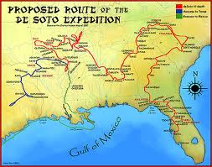
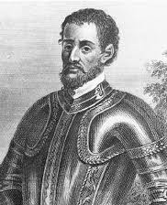
Hernando de Soto

Slide 26
Hernando de Soto
• Spanish governor of Cuba
• 1539- He landed near Tampa, Florida with 600 men and 213 horses.
• He rescued Juan Ortiz from the Indians. Ortiz became de Soto’s interpreter because he could speak Indian languages.
• De Soto followed Indian paths from village to village looking for gold and silver. Only found fresh water pearls while traveling to Georgia and South Carolina.
• 1540-crossed northwest GA. Into AL. in a southwestern direction and followed the Coosa river south.
• De Soto moved into a village called Talisi and got a message from Chief Tuskaloosa. They met the chief when they entered Atahachi. He was a tall, well built man.
• De Soto demanded food and men to help carry supplies. Chief Tuskaloosa said no, so deSoto took him hostage. Chief Tuskaloosa said that he would give him food and men but they had to go to Maubila (his village) to get it.

Slide 27
MAUBILA
Tuskaloosa was so big that the horse looked small.
When they reached Maubila, he went inside a house and refused to come out. The Indians began dancing and singing loudly, then attacked the Spanish.
The arrows were no match for the quilted garments and metal armor of the Spanish. Many Indians died.
The Battle of Maubila is believed to be the largest battle in North America between Indians and Europeans.
De Soto may have won the battle, but he lost 42 men, 7 horses, and the pearls he found.
The Spanish kept exploring and finding hostile Indians. De Soto became ill and died. He was buried in the Mississippi river so the Indians would never find his body and think he was immortal.
His men returned to Spain with only Desoto's journals.

Slide 28
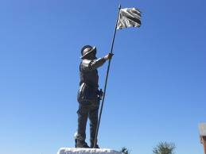
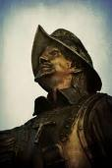
Don Tristan de Luna

Slide 29
Don Tristan de Luna
1559- de Luna landed in Mobile Bay to establish a Spanish town. He came to this area because of deSoto’s journals.
Days after he came, a hurricane sank his ships.
He continued to travel through Al., but the Indians did not want him there.
De Luna was never able to find the great towns deSoto wrote about.

Slide 30

Don Tristan de Luna
When the Spanish came, they also brought diseases (measles, mumps, small pox, tuberculosis) that the Indians had never had and could not fight off (no immunity).
Many Indians died, entire villages disappeared, and the Indian culture was weakened.
Other Europeans heard of the violent battle of Maubila and didn’t want to visit Alabama for almost 140 years .

Slide 31
Ch2 Lesson2 Review Questions (pg45)
What did Hernando deSoto bring on his expedition?
Why did Juan Ortiz become de Soto’s interpreter?
Describe Chief Tuskaloosa as he looked when de Soto and his men met him.
Why did deSoto take Chief Tuskaloosa hostage?
Did the Spanish or the Indians lose more men at Maubila?

Slide 32
Ch2 Lesson2 Review Questions Answers
Hernando deSoto brought 9 ships,600 soldiers, 213 horses, pigs, and other supplies on his expedition.
Juan Ortiz became de Soto’s interpreter because he could speak Spanish as well as the other Indian languages.
When de Soto and his men met Chief Tuskaloosa, he was described as tall and well built.
DeSoto took Chief Tuskaloosa hostage because he refused to give De Soto food and men to carry his supplies.
The Indians lost more men at Maubila.

Slide 33
Create a Historical Comic Strip
Activity
Think about what you have learned in today’s lesson. You are going to summarize Desoto's expedition by illustrating each major event. You will be able to illustrate 7 different events. On a sheet of paper, write down the seven events in order. This will help organize your thought before you begin illustrating.
Fold a sheet of white paper in half (hotdog style).Then, fold it in half two more times (hamburger style). Open your paper. You should have 8 equal boxes.
Next, use the 1st box as your title square. (Title, name, date, #)
Illustrate all 7 events in sequential order. You may use your textbook and chapter notes for detail.

Slide 34
Create a Historical Comic Strip
Activity: Example
DeSoto’s Expedition Tara Green September 14th, 2012 #1 | Beginning Event | 2nd Event | 3rd Event
4th Event | 5th Event | 6th Event | Concluding Event

Slide 35
Discovering Alabama
Think About It:
With your group members, get ready to brain storm!
List some possible reasons for exploring a new place
●We know that the Spanish explored North America seeking wealth…make a prediction about why the French went exploring.
Turn and Talk to your group members about your thinking.

Slide 36
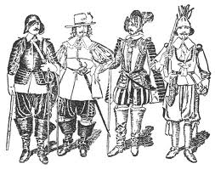
The French

Slide 37
The French
1699- a French expedition, led by Le Moyne Iberville and his brother(Bienville) sailed into Mobile Bay(“The mouth of La Mobilla”)
They also explored the island beside the bay and called it Massacre because they found may people killed. They later named it Dauphin Island because Dauphin is the mane used for the heir to the French throne.
1702 -they founded Fort Louis up the Mobile River at Twenty Seven Mile Bluff. The village outside the fort was called La Mobile.
The French wanted to trade with the Indians…not gold!

Slide 38
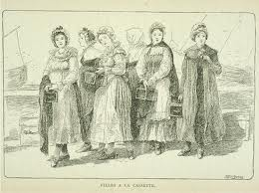
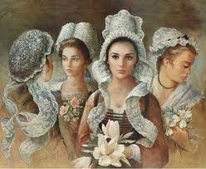
The Cassette Girls

Slide 39
The Cassette Girls
Only soldiers, traders, priests, and craftsmen (all men) lived in La Mobile. Iberville knew that he needed families and children to make the town grow.
1704-The French government sent 23 girls, along with nuns, on board the Pelican. More girls came later.
They brought their clothes in trunks called “cassettes”.
This frontier living was not like Paris!
They rebelled because they were shocked by the crude houses and frontier living conditions.
This rebellion was called “the Petticoat Insurrection”
Many remained in Mobile and others moved to New Orleans

Slide 40
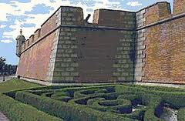
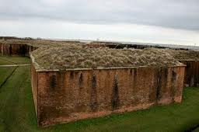
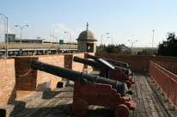
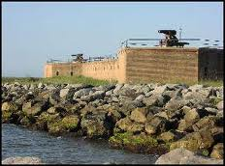
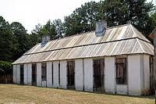
French Forts In Alabama

Slide 41
French Forts In Alabama
1711-the French decided to move Fort Louis south. They later built a brick fort that was then named Fort Conde. The town around the fort was called Mobile.

Slide 42
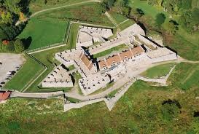
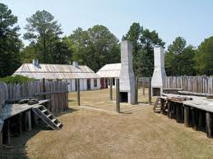
French Forts In Alabama
The French built other forts to increase their influence over the Indians and improve trade with them.
1717- Fort Toulouse (trading fort for the Indians)

Slide 43
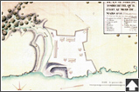
French Forts In Alabama
1736- Fort Tombecbe (garrison against the Chickasaw Indians)

Slide 44
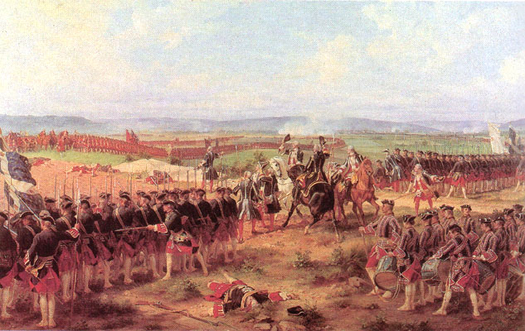
French Forts In Alabama
1688-1782- wars were fought between France, England, and Spain.
1763- English defeated France and Spain and France gave up all its land east of the Mississippi River to the British.

Slide 45
Ch2 Lesson3 Review Questions (pg53)
What was Dauphin Island’s original name?
What goods did the Indians and French trade?
Name 2 French forts.
What signs of French culture do we see today in Mobile?
Name 2 places that make good locations for forts and settlements?

Slide 46
Ch2 Lesson3 Review Questions
Answers
Dauphin Island’s original name was
The Indians and French traded fur pelts and deerskins for knives, tools, beads, and cotton cloth.
Two French forts are Fort Conde and Fort Tombecbe.
Some signs of French culture we see today in Mobile are street names, architecture, and Mardi Gras
Two places that make good locations for forts and settlements are the fall line and the place where two rivers flow together.

Slide 47
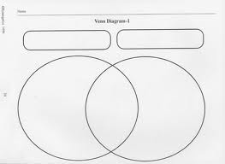
Spanish vs. French
Activity
Think about what you have learned in today’s lesson. Think about how the French expeditions were different than the Spanish.
Complete a Venn Diagram comparing the French and Spanish

Slide 48
Discovering Alabama
Think About It:
With your group members…
Imagine you were an Indian. Based on what you have learned about the Spanish and French, which group would you most likely get along with? Why?
Turn and Talk to your group members about your thinking.

Slide 49
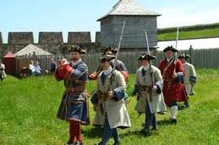
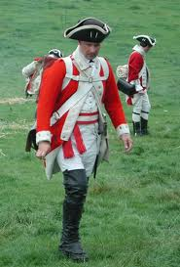

The English

Slide 50
The English
The English built a trading mission and called their settlement Fort Okfuskee.
They wanted to trade with the Indians
The English had better trade goods than the French because Great Britain had more factories = more goods.
1733- British founded the colony of Georgia so they were closer to Indian trading grounds.

Slide 51
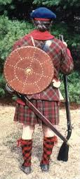
The English:
Lachlan McGillivray
Lachlan left his home in Scotland
to come to America when he was
a teenager.
1736- he rode with a group of
traders to the Alabama Indian
country.
He took care of animals on the ride and was paid with a jackknife (pocket knife). He traded the knife for other goods (deerskins) that he then sold and made money. He bought more goods to trade. He was on his way to making a fortune in the deerskin trade.

Slide 52
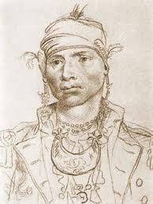
The English:
Lachlan McGillivray
He met and married a beautiful
girl named Sehoy. Her mother was
a Creek Indian and her father was a
French commander.
They had 2 daughters (Sophia and Jeannet) and a son (Alexander).
Alexander was sent to British
schools but at home, he was taught
the ways of the Creek Indians.
Alexander became an important
Creek leader.

Slide 53
Ch2 Lesson4 Review Questions (pg56)
What trade goods did the English want from the Indians?
How did Lachlan McGillivray get started as a trader?
Who were Sehoy’s parents?

Slide 54
Ch2 Lesson4 Review Questions
Answers
The English wanted beaver pelts for fur hats and deerskins for leather.
Lachlan McGillivray got started as a trader by joining a caravan of traders headed for the Alabama Indian country.
Sehoy’s father was a French commander and her mother was a Creek Indian.

Slide 55
1 PAGER
Activity
Step 1: Your teacher will assign your group one of the following topics: Spanish, French, English
Step 2: In the middle of a sheet of paper, you should illustrate a scene that involves your group’s topic. Use your textbook pictures to guide you. Illustration must be true to the time period.
Step 2: Any where on the paper, write 5 words that you think are important in learning the information in this lesson. These words can be words used in the textbook.
Step 3: At the top of the page-write 3 facts about your topic you learned in the lesson. Be sure these facts are meaningful to this lesson.
Step 4: Answer the following question at the bottom of your paper by using the question as part of your answer:
How has your topic (Spanish, French, English) changed life for the Indians?
***Watch the documentary on Fort Toulouse***
Purpose for watching…Look at how the Spanish, French, and English are portrayed in the movie. Was your visualization/illustration similar?

Slide 56
Discovering Alabama
Think About It:
Think about the documentary on Fort Toulouse. How were your visualizations similar to the reenactments? How were they different?
Turn and Talk to your group members about your thinking.

Slide 57
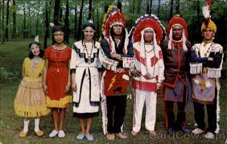
The Indians
Between the end of the Mississippian period and the arrival of Europeans in the late 1500’s, Indians had divided into large groups called nations.
Alabama’s Indian nations: Cherokee, Creek, Choctaw, and Chickasaw

Slide 58
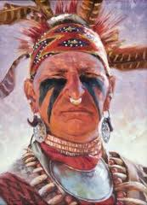
The Indians: The Creeks
Largest of the Alabama tribes
Real name was Muscogee
They were divided into
Upper Creeks and Lower Creeks
Enemies were the Choctaw
Spoke a form of the Muscogean
language

Slide 59
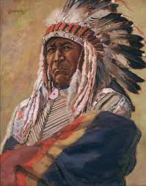
The Indians: The Choctaw
Brave warriors
The word Alabama comes from the Choctaw word Alibamos, meaning to cut or gather plants
Spoke a form of
the Muskogean
language

Slide 60
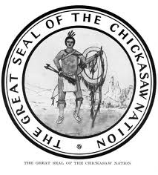
The Indians: The Chickasaw
Mostly lived in Mississippi but also in Northwestern Alabama
Brave fighters
They took horses from the Spanish
and developed herds of fine
ponies.
Spoke a form of the Muskogean
language

Slide 61
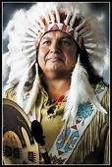
The Indians: The Cherokee
They hunted and lived in Alabama
Men and women were tall
Women were often warriors and part of government
Spoke an Iroquoian language

Slide 62
The Indian Culture
Religion was important to all nations
Green Corn Dance- summer ceremony that symbolized cleansing for the new year.
Towns were square; council house was in the center and cabins were around it.
Gathered berries and nuts, raised corn, pumpkins, sweet potatoes, beans, melons, squash, and gourds.
They made decorative ornaments, masks, pottery, and clay pipes
Played “Chunky”- spear toss at a rolling stone disk
People of different cultures competed for control and power of Alabama

Slide 63
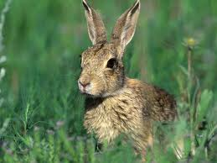
An Indian Myth
Read pg 63 in your textbook and summarize this Cherokee myth

Slide 64
Indian Women
Indian women worked hard keeping their home.
They raised children, skinned hides, ground corn and nuts, prepared food, made clothing and pottery, worked in fields, and took care of the sick
Indian families traced their family lines through the women (unlike Europeans-men)

Slide 65
Ch2 Lesson5 Review Questions (pg56)
How do we have information about how the Native Americans lived in Alabama?
Name the 4 major Indian nations that lived in Alabama when Europeans began to settle here.
Why are oral traditions important in cultures that do not have a written language?
What is a busk?

Slide 66
4 SQUARES
End of Chapter Activity
Step 1: Fold your paper in half (hamburger style) then repeat so that you have 4 squares.
Step 2: In the middle of a sheet of paper, you should draw an outline of Alabama.
Step 2: Label each box as: Spanish, French, English, Indians
Step 3: In each box, draw an illustration that demonstrates your knowledge of that group and how they influenced the history of Alabama.
Step 4: Write 4 words in each box that you feel are meaningful to understanding the events that occurred as each group explored Alabama.
Challenge: discuss your 4 words for each box with your group members. Use those words to create a 1 sentence summary to summarize that particular group’s influence on Alabama.

