Slide 1
Rococo Art
Mid-eighteenth century France

Slide 2
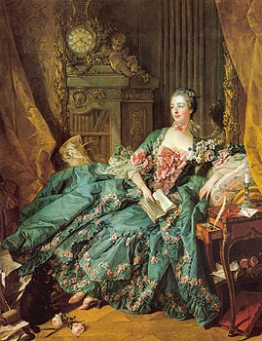
Rococo
Madame Pompadour –
by Francois Boucher
Madame de Pompadour was the mistress of King Louis XV of France.
Rococo style reached its peak of popularity during the reign of Louis XV

Slide 3
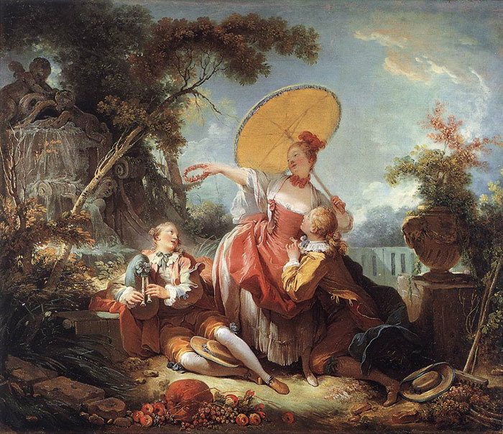
Painting by
Jean Honore Fragonard
Rococo theme: A lighthearted scene of nobles at play.
Rococo artists depicted lighthearted and often frivolous scenes of “nobles at play”

Slide 4
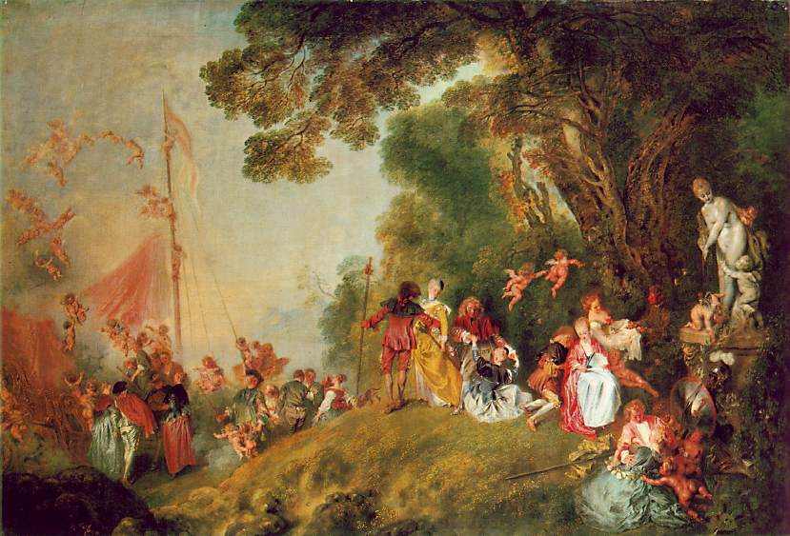
Rococo paintings featured light colored pastels

Slide 5
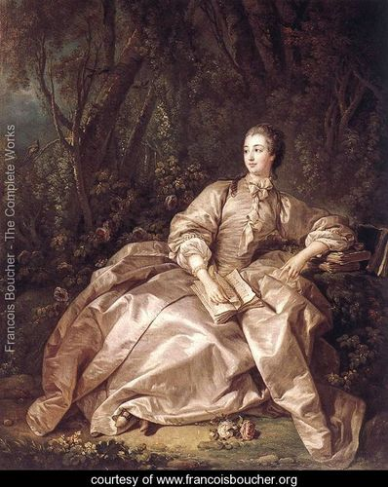
Recall that Rococo style reached its peak during the reign of Louis XV.
Francois Boucher painted “Madame Pompadour”, King Louis XV’s mistress.

Slide 6
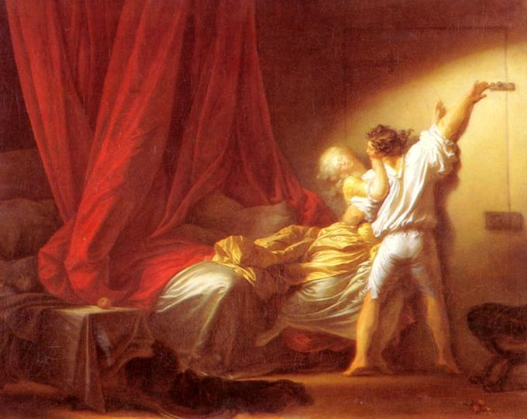
Rococo theme: A lighthearted scene of nobles at play.
Jean Honore Fragonard, “The Bolt”

Slide 7
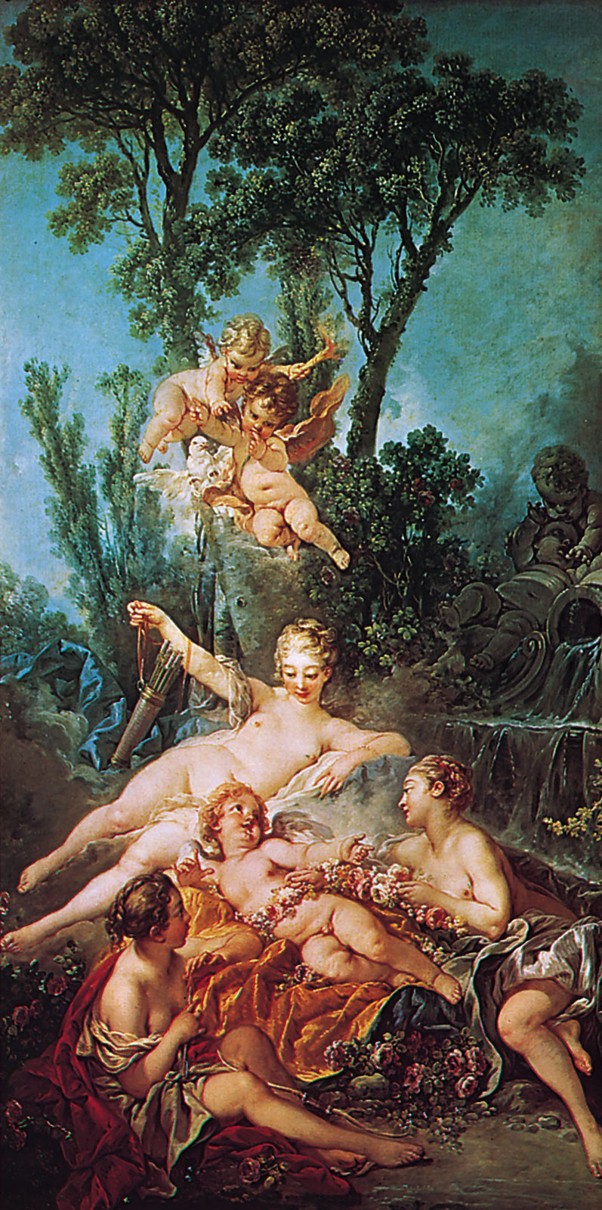
Francois Boucher
“Cupid a Captive”
Rococo theme: Light colored pastels

Slide 8
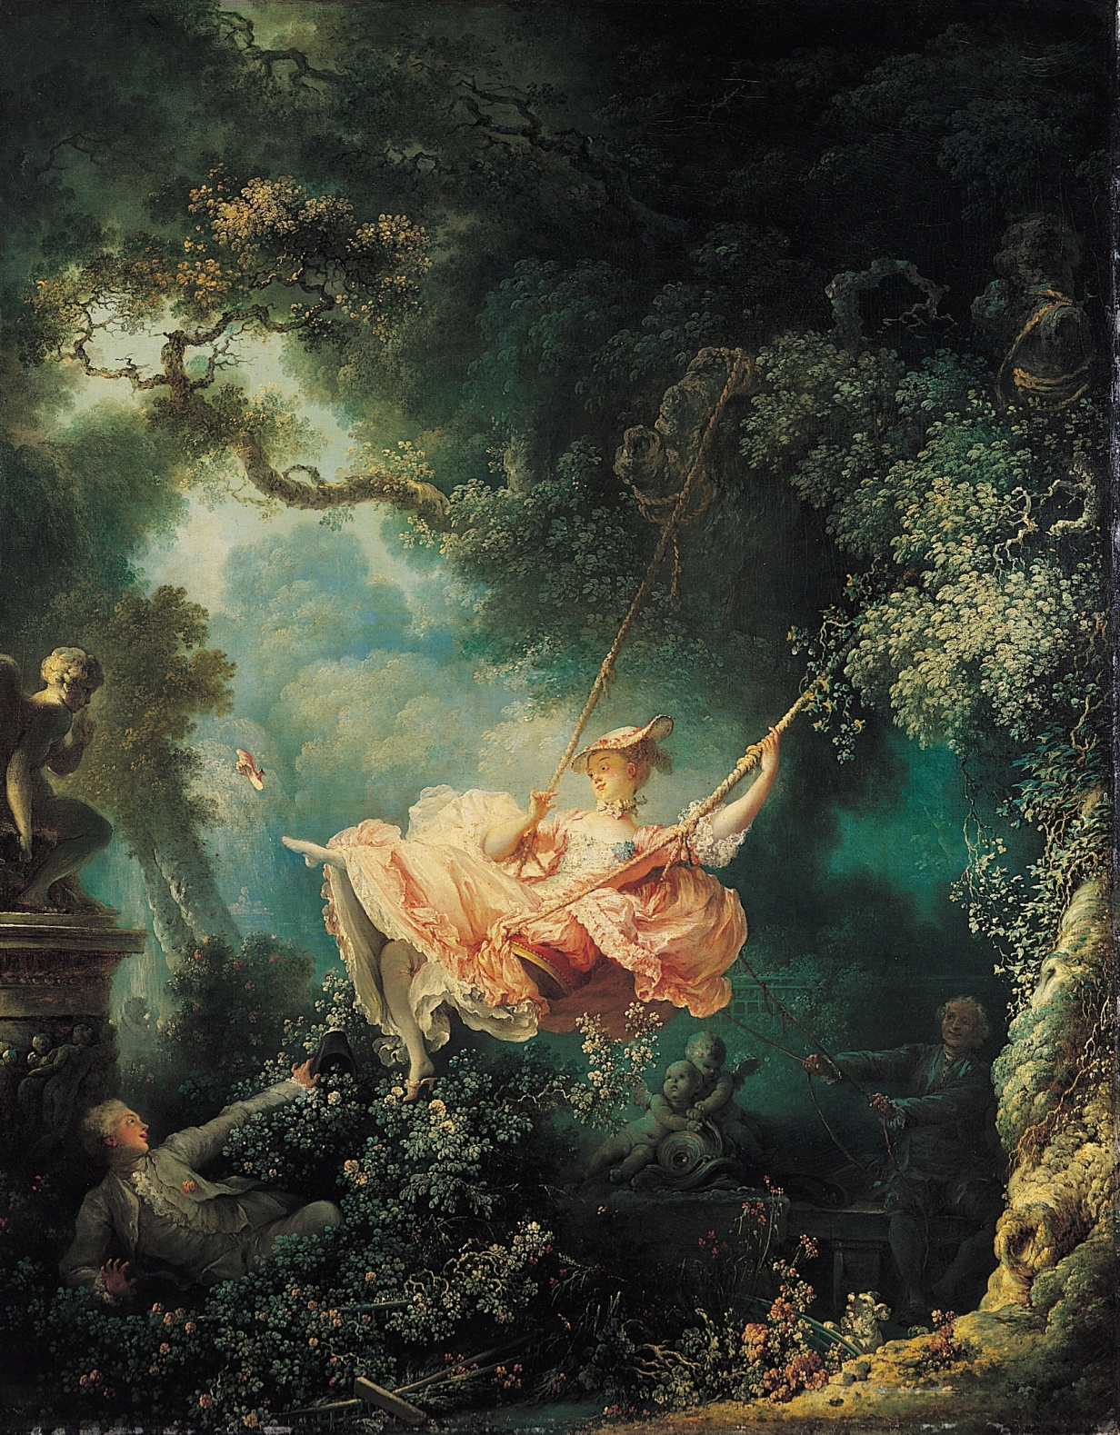
Jean Honore Fragonard
– The Swing
This is one of the most famous Rococo paintings. Know this painting!
Rococo themes:
A lighthearted scene of nobles at play.
Lightly colored pastels

Slide 9
This is one of the most famous Rococo paintings.
Know this painting!
Antoine Watteau, Pilgrimage to Cythera

Slide 10
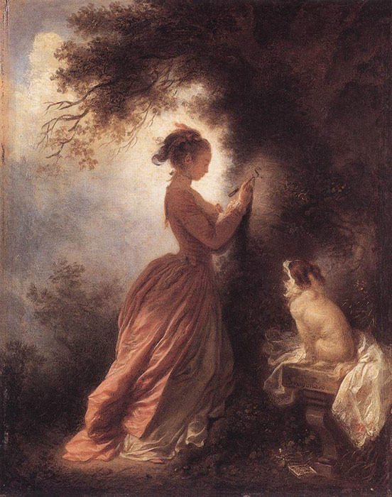
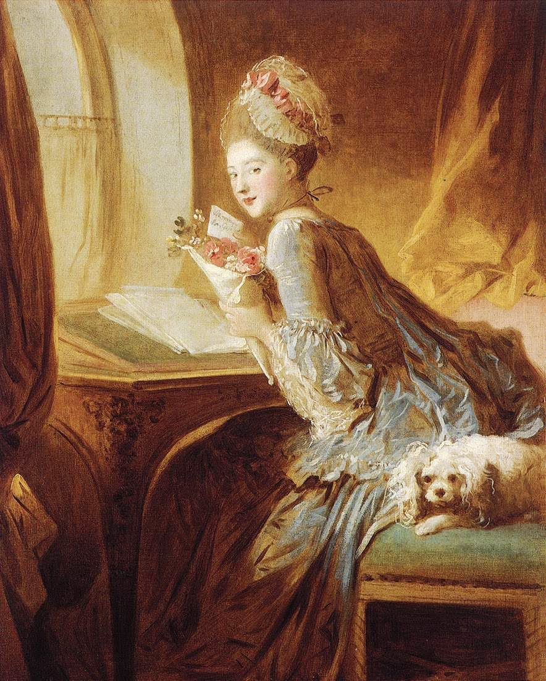
Two Rococo paintings by Jean Honore Fragonard.
Rococo theme: Lighthearted scenes of nobles at play. Features light colored pastels.

Slide 11
Lets Review
What are the features of Rococo Art?
From the reign of Louis XV.
It depicted lighthearted scenes of nobles at play.
It featured light-colored pastels

Slide 12
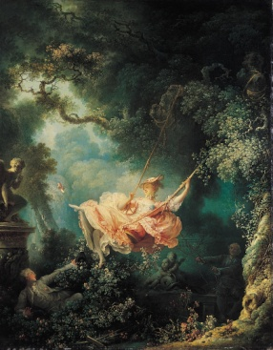
Lets Review
Who are the most famous
Rococo artists?
Francois Boucher
Madame de Pompadour
Jean-Honore Fragonard
The Swing
Antoine Watteau
Pilgrimage to Cythera

