Slide 1
Impressionism
Key Characteristics:
*Captured a moment in time; a slice of life
*Interested in the fleeting effects of light on color
*Depicted leisure activities of the Parisian bourgeoisie
Key artists and works
*Claude Monet, Impression Sunrise, Gare St.-Lazare
*Pierre-Auguste Renoir, Le Bal au Moulin de la Galette, Luncheon of the Boating Party

Slide 2
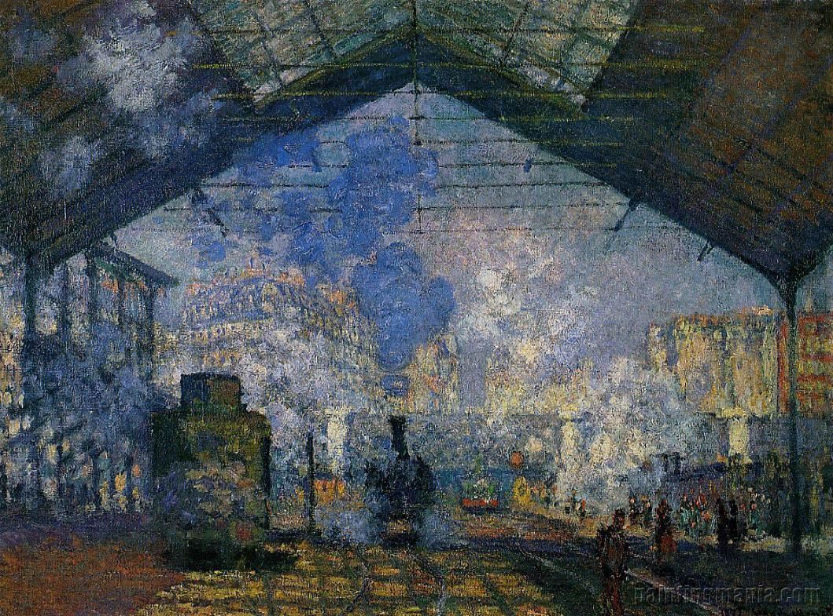
Claude Monet – Gare St. Lazare
Depicts a French train station in the late 1800s.
The train station is made of iron and glass, depicting the new technologies of the first industrial revolution.
Notice that the image is not detailed. We only get an impression of a train station.

Slide 3
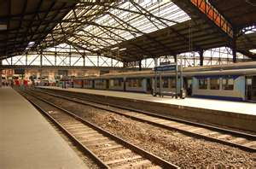
Claude Monet – Gare St. Lazare
This is an actual image of Gare St. Lazare

Slide 4
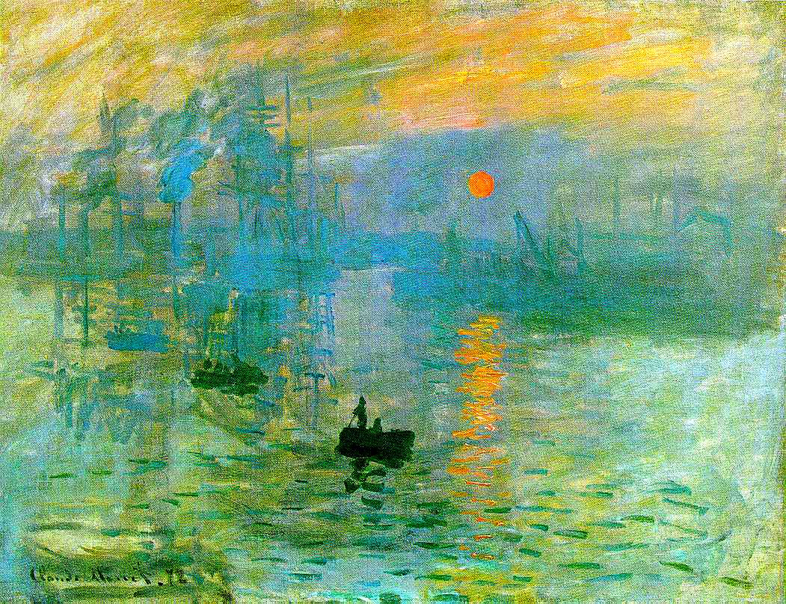
Claude Monet – Impression Sunrise
*This work displays the fleeting effects of light on color
*It only gives an impression of the ships and objects in the background
Note that it is difficult to determine where the water ends and the sky begins .

Slide 5
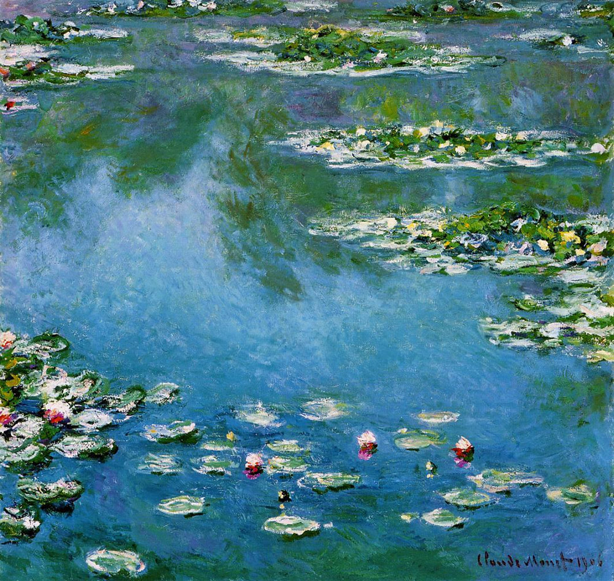
Claude Monet – Water Lilies
Monet was able to create a misty look by refraining from using hard edges and utilizing colors of same shades like green and blue that made the edges of the lilies and the water seems to appear as if they are parts of each other.

Slide 6
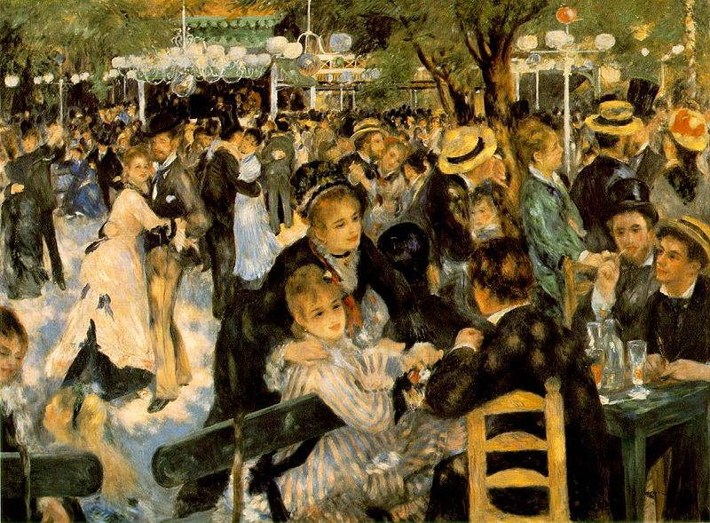
Pierre-Auguste Renoir – Le Bal au Moulin de la Galette
Commonly known as the Dance at Moulin de la Galette – it depicts a typical Sunday afternoon in the district of Montmartre of Paris.
Parisians would dress up, and spend time there dancing, drinking and eating galettes into the evening.
Galettes are round cakes or king cakes.

Slide 7
Pierre-Auguste Renoir – Le Bal au Moulin de la Galette - 1876
This painting is impressionist because it depicts the leisure activities of the Parisian bourgeoisie.
It captures a moment in time; a slice of life
This painting tells us a lot about the life of the bourgeoisie in Paris in the late 1800s.

Slide 8
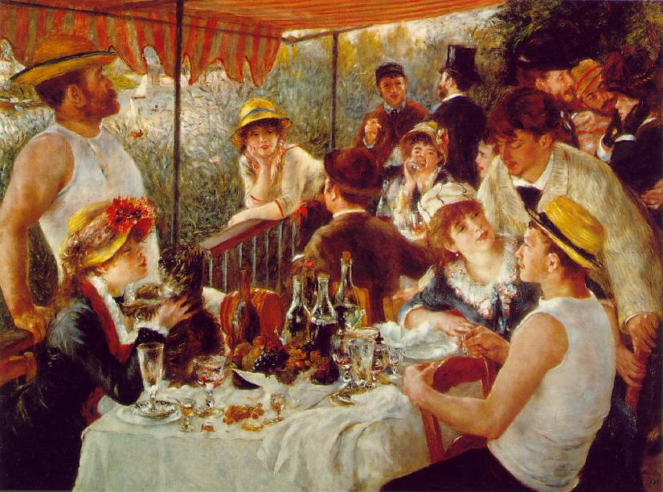
Pierre-Auguste Renoir – Luncheon of the Boating Party

Slide 9
Renoir – Luncheon of the Boating Party
Luncheon of the Boating Party represents the changing character of French society due to the industrial revolution. Renoir craftily uses shape, space, color and texture to create the scene he imagined. The figures and bottles add shape to the canvas and the overlapping of bodies gives a sense of space.
Why is this painting important? It depicts the lifestyle of the French Bourgeoisie in the late 1800s.

Slide 10

Here is a modern photograph, imitating Renoir’s Luncheon of the Boating Party

Slide 11
Cubism
Key Characteristics
*Presented multiple views of the same object
*Fragmented forms into flat, jagged shapes
*Portrayed flat, two-dimensional space without traditional liner perspective
Key artists and works
*Pablo Picasso, Les Demoiselles d’ Avignon, Guernica
*Georges Braque, Violin and Candlestick

Slide 12
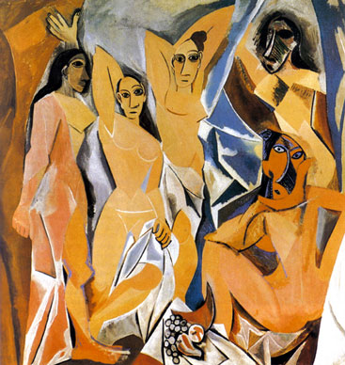
Pablo Picasso – Les Demoiselles d’ Avignon
Portrays 5 prostitutes from Avignon street in Barcelona, Spain
Each figure is depicted in a disconcerting confrontational manner and none are conventionally feminine.
Picasso demonstrates the modernist interest in the ugly underside of real life by depicting five prostitutes inside a brothel.

Slide 13
Pablo Picasso – Les Demoiselles d’ Avignon
How do we identify this as a Cubist work? It portrays flat, two-dimensional images without traditional linear perspective.

Slide 14
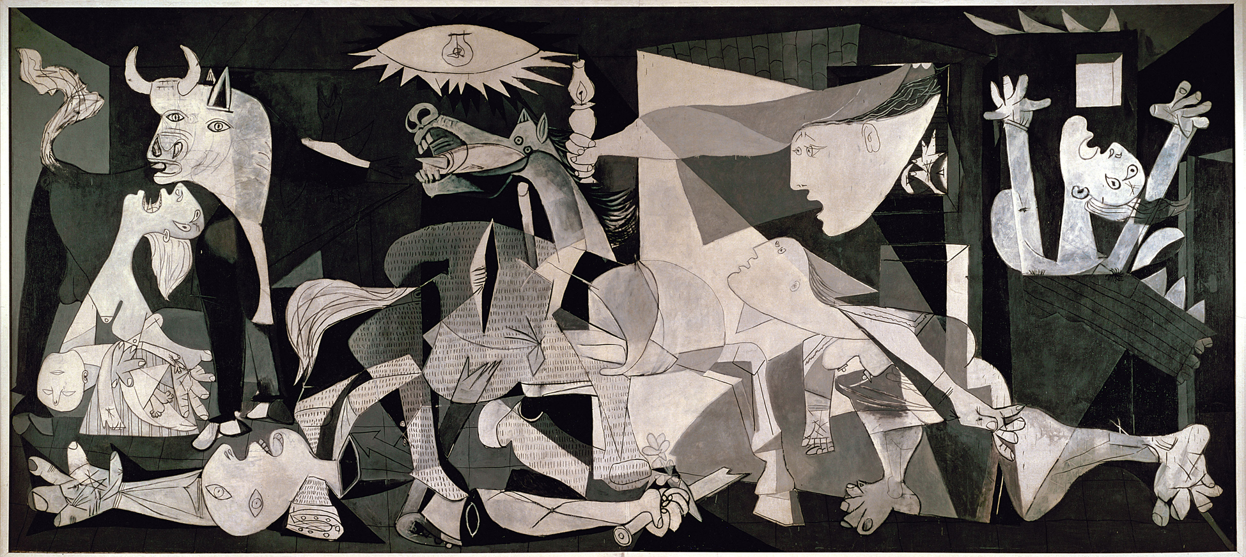
Pablo Picasso - Guernica
This was created in response to a bombing of Guernica by German and Italian warplanes at the behest of Spanish nationalist forces during the Spanish Civil War, 26 April 1937.

Slide 15
Pablo Picasso - Guernica
It portrays dismembered limbs, a wailing mother holding her dead child, a bull goring a horse (bull is a symbol of Spain), fires burning, and a light bulb whose light is presented as an evil eye.

Slide 16
Pablo Picasso - Guernica
Guernica shows the tragedies of war and the suffering it inflicts upon individuals, particularly innocent civilians. It has become an anti-war symbol.
Why do you suppose Picasso chose to do this painting in black and white?

Slide 17
Pablo Picasso - Guernica
Why is Guernica considered Cubism? It has fragmented forms in flat, jagged shapes. It portrays flat, two-dimensional space without traditional linear perspective.

Slide 18
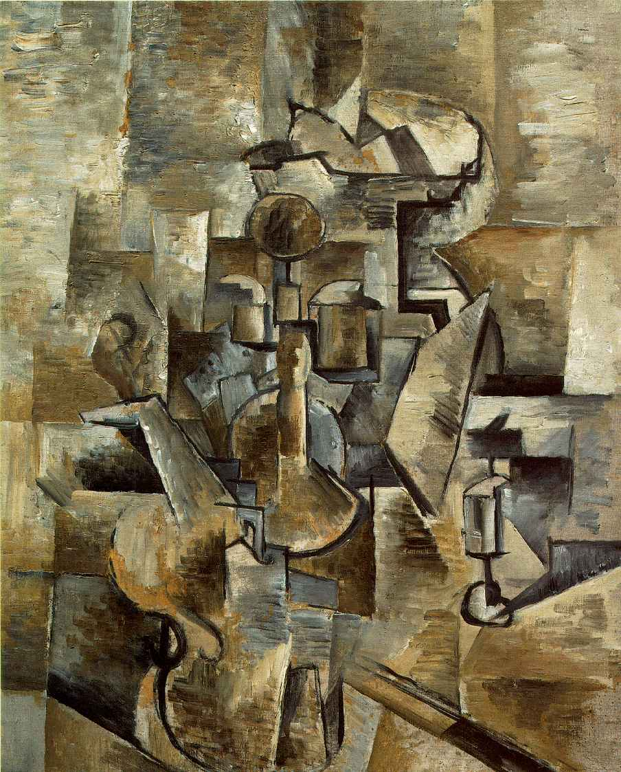
Georges Braque – Violin and Candlestick
This work is considered Cubism because it presents multiple views of the same object.
It also fragments the form of the violin into flat, jagged shapes.

