Slide 1
Romanticism
The Romantic Artists

Slide 2
Here are 6 Romantic artists and works you must know:
Caspar David Friedrich, Wanderer above the Mists
Delacroix, Liberty Leading the People
John Constable, The Hay Wain
William Turner, Hannibal Crossing the Alps
Francisco Goya, The Third of May 1808
Delacroix, Massacre at Chios

Slide 3
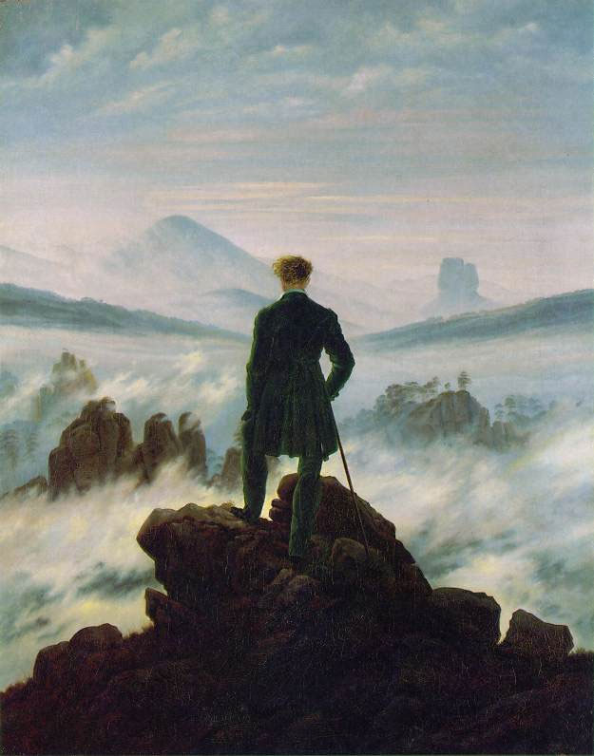
Wanderer Above the Mist
You need to know: Romantics were inspired by the beauty and power of nature. They rejected the rational, scientific approach to nature of the Enlightenment.
By Caspar David Friedrich
German Romantic Artist

Slide 4
Wanderer Above the Mist, by Caspar David Friedrich
In the foreground, a young man stands upon a rocky precipice, his back to the viewer. He is wrapped in a dark green overcoat, and grips a walking stick in his right hand. His hair caught in a wind, the wanderer gazes out on a landscape covered in a thick sea of fog. In the middle ground, several other ridges, perhaps not unlike the ones the wanderer himself stands upon, jut out from the mass. Through the wreaths of fog, forests of trees can be perceived atop these escarpments. In the far distance, faded mountains rise in the left, gently leveling off into lowland plains in the east. Beyond here, the pervading fog stretches out indefinitely, eventually commingling with the horizon and becoming indistinguishable from the cloud-filled sky.

Slide 5
Wanderer Above the Mist
John Lewis Gaddis described the wanderer’s position as “contradictory, suggesting at once mastery over a landscape and the insignificance of the individual within it.”
By Caspar David Friedrich
German Romantic Artist

Slide 6
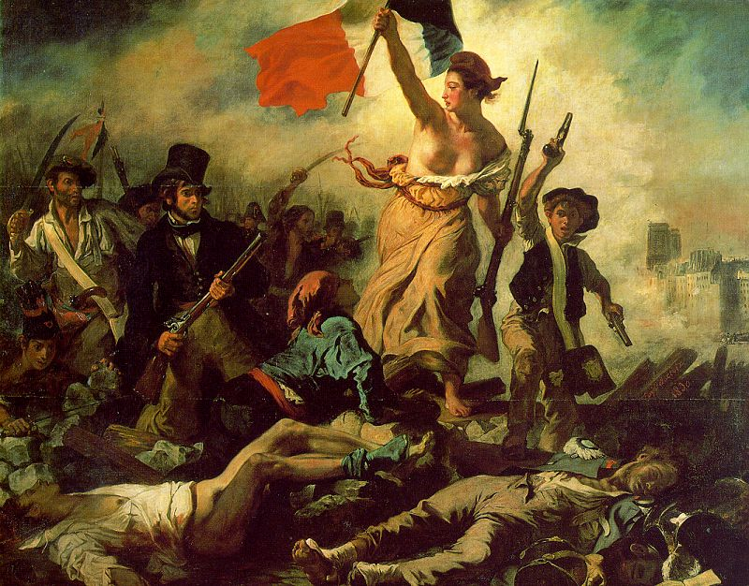
Eugene Delacroix
Liberty Leading the People

Slide 7
Eugene Delacroix
This painting celebrated the day, during the 1830 Revolution, that the French people rose and fought for their liberty. Delacroix used the painting as a political poster for the revolution. Delacroix was a member of the National Guard, and he placed himself into the picture as the man on the left wearing a top-hat
Liberty Leading the People

Slide 8
Eugene Delacroix
You need to know: Romantics artists made people aware of their common heritage. Romantic artists often stirred nationalist feelings and supported nationalist uprisings.
Liberty Leading the People

Slide 9
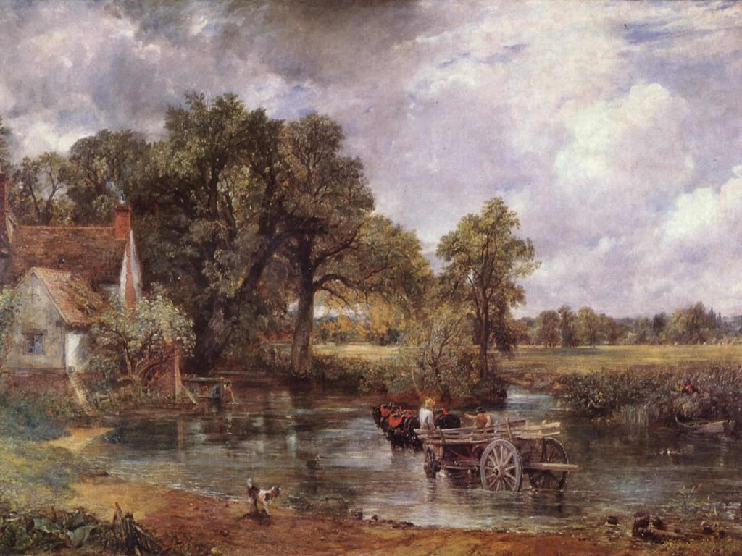
John Constable
The Haywain, 1821

Slide 10
John Constable
The haywain, a type of horse-drawn cart, stands in the water in the foreground. Across the meadow in the distance on the right, is a group of haymakers at work. The cottage shown on the left was rented by a farmer called Willy Lott and stands behind Flatford Mill. Today, the cottage and river path are still much as they were in Constable's time.
The Haywain

Slide 11
John Constable
The Haywain
You need to know: Romantics artists idealized country life and rugged individualism.

Slide 12
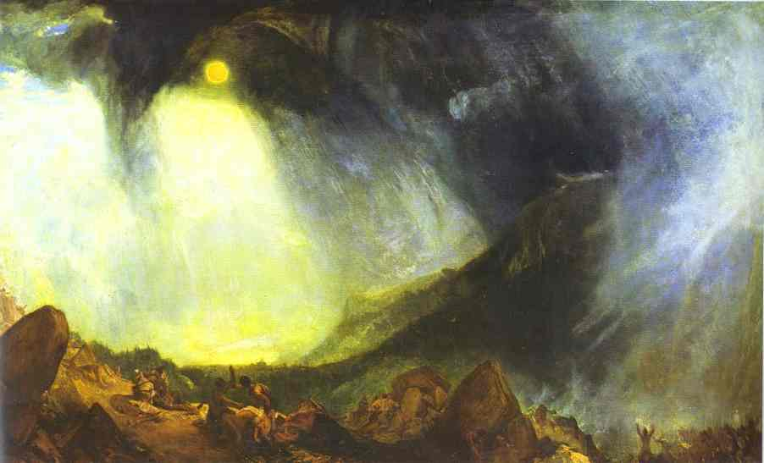
William Turner
Hannibal Crossing the Alps

Slide 13
William Turner
This work is intended to show a great man and his massive army (Hannibal and company) and their relative impotence when faced with the chaotic power of nature. The black cloud is a snow storm whose placement in the work is intended to encourage thoughts of the awesome power and chaos of nature.
Hannibal Crossing the Alps

Slide 14
William Turner
Hannibal Crossing the Alps
You need to know: Romantic artists liked to portray the power and fury of nature.

Slide 15
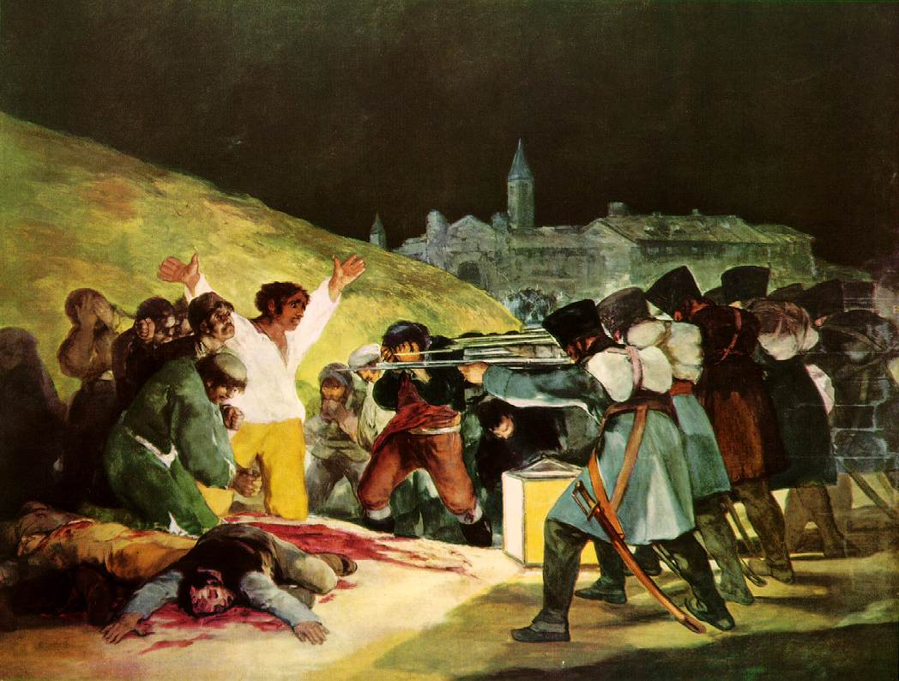
Francisco Goya
The Third of May, 1808

Slide 16
Francisco Goya
According to Kenneth Clark, "by a stroke of genius Goya has contrasted the fierce repetition of the soldiers' attitudes and the steely line of their rifles, with the crumbling irregularity of their target." A square lantern situated on the ground between the two groups throws a dramatic light on the scene. The brightest illumination falls on the huddled victims to the left, whose numbers include a monk or friar in prayer. To the immediate right and at the center of the canvas, other condemned figures stand next in line to be shot. The central figure is the brilliantly lit man kneeling amid the bloodied corpses of those already executed, his arms flung wide in either appeal or defiance. His yellow and white clothing repeats the colors of the lantern. His plain white shirt and sun-burnt face show he is a simple laborer.
The Third of May, 1808

Slide 17
Francisco Goya
You need to know: Romantics artists made people aware of their common heritage. Romantic artists often stirred nationalist feelings and supported nationalist uprisings.
In the work, Goya sought to commemorate Spanish resistance to Napoleon's armies during the occupation of 1808
The Third of May, 1808

Slide 18
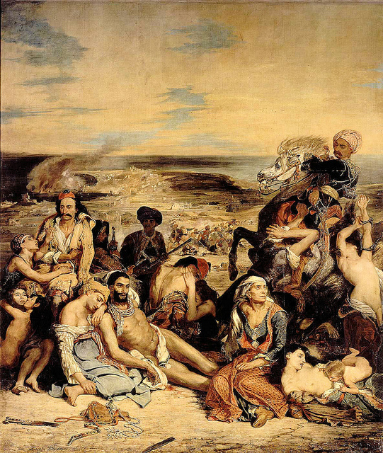
Eugene Delacroix
Massacre at Chios, 1824

Slide 19
This work depicts A military attack on the inhabitants of the island of Chios by Ottoman forces. The campaign resulted in the deaths of twenty thousand citizens, and the forced deportation into slavery of almost all the surviving seventy thousand inhabitants.
This work inspired support for Greek independence from the Ottoman Empire.

Slide 20
Eugene Delacroix
You need to know: Romantic artists often stirred nationalist feelings and supported nationalist uprisings.
Nationalism and Romanticism are interconnected.
Massacre at Chios, 1824

Slide 21
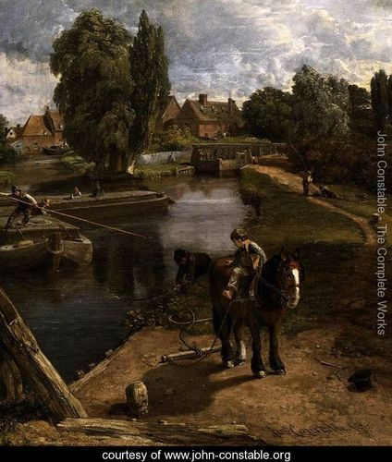
John Constable, Flatford Mill, 1817
You need to know: Romantics artists idealized country life and rugged individualism.

Slide 22
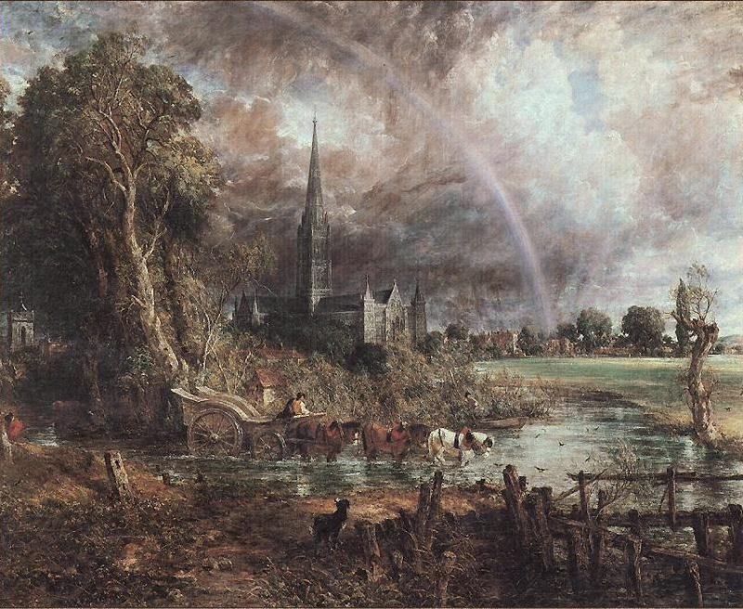
John Constable, Salisbury Cathedral from the Meadow, 1831
You need to know: Romantics artists idealized country life and rugged individualism.

Slide 23
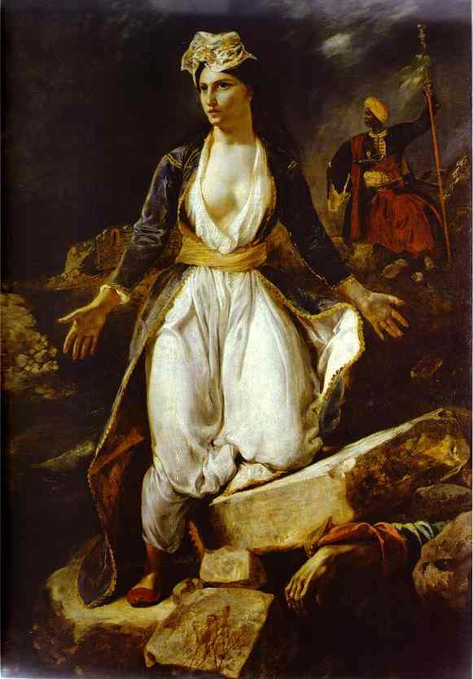
Eugene Delacroix, Greece on the Ruins of the Missolonghi
This painting was inspired by the Third Siege of Missolonghi by the Ottoman forces in 1826, during which many people of the city after the long-time siege (almost a year) decided to attempt a mass breakout to escape famine and epidemics. The attempt was resulted in a disaster, with the larger part of the Greeks slain.

Slide 24
Eugene Delacroix, Greece on the Ruins of the Missolonghi
Delacroix supported the Greek movement for independence from the Ottoman Empire.
You need to know: Romantic artists often stirred nationalist feelings and supported nationalist uprisings.

Slide 25
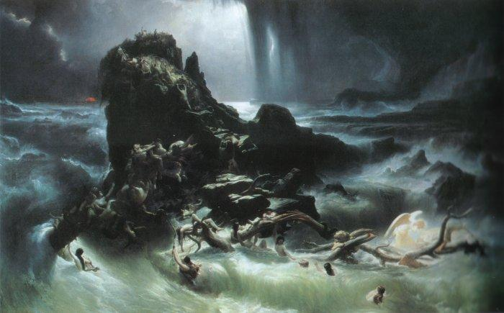
The Deluge, Francis Danby, 1840

Slide 26
The Deluge, Francis Danby, 1840
You need to know: Romantic artists liked to portray the power and fury of nature.
This painting depicts the story of the Flood as told in the book of Genesis. It shows the terrible punishment brought down by a wrathful God upon sinful mankind

Slide 27
Credits
http://www.mtholyoke.edu/courses/rschwart/hist255/la/delacroix.html
http://www.nationalgallery.org.uk/paintings/john-constable-the-hay-wain
http://bookstove.com/classics/hannibal-crossing-the-alps/
http://en.wikipedia.org/wiki/The_Third_of_May_1808
http://en.wikipedia.org/wiki/The_Massacre_at_Chios
http://www.artmagick.com/pictures/picture.aspx?id=6778&amp;name=the-deluge

