Slide 1
The Importance of being earnest
AP Lit

Slide 2
- author of text
- 1854 - 1900
- Irish dramatist, novelist, poet, essayist, journalist, lecturer
- known for his wit (epigrams), flamboyant dress, and ability to converse
- victorian age writer (1819-1901)
- sued his own father for libel (???). As a result, evidence of his homosexual affairs became known, and he was imprisoned for two years of hard labor
- After his release, he fled to france and died at the age of 46
Oscar Wilde

Slide 3
Characters
Jack Worthing (Ernest) — notice the spelling; AP readers will deduct for using “Earnest.”
Gwendolen Fairfax
Algernon/“Algy” Moncrieff (Bunbury)
Cecily Cardew
Lady Bracknell
Lane
Merrimen
Miss Prism
Rev. Canon Chasuble

Slide 4
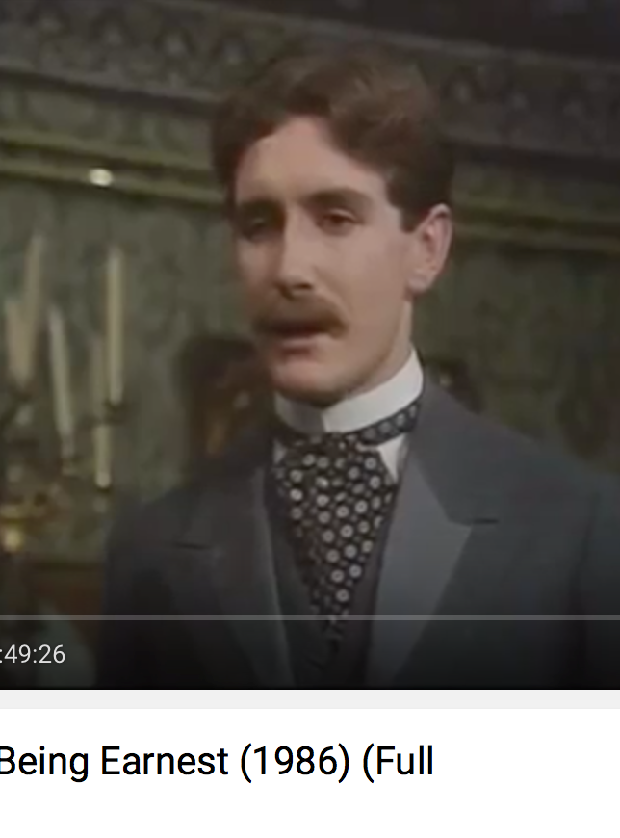
Jack wishes to marry lady gwendolen, but he cannot secure the approval of her mother, Lady Bracknell. When he is in the city, he goes by the name of Earnest; when he is in the city he participates in more ribald behavior; when he is in the country, he goes by the name of Jack, which he believes is his real name. As a baby, Jack was discovered in a handbag at Victoria Station. Therefore, he does not know his own history or his true family.
Jack Worthing

Slide 5
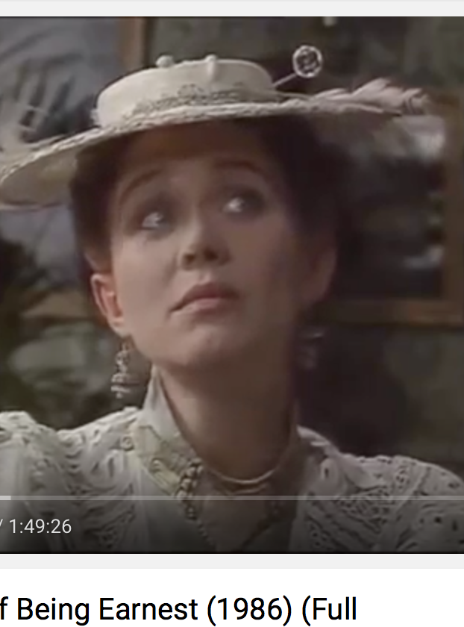
Gwendolen is the young, beautiful daughter of lady bracknell. She is in love with Jack, but a large part of her attraction comes from her belief that his name is earnest.
Gwendolen Fairfax

Slide 6
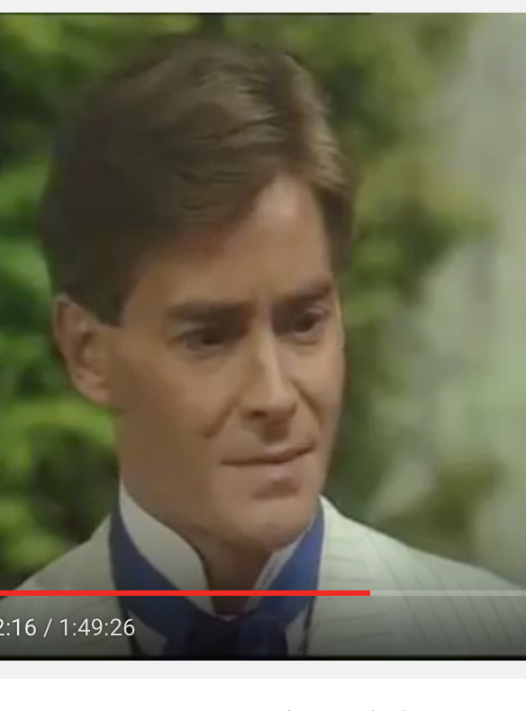
Algernon is a young bachelor who lives in london. he is a good friend of jack. Algy is a member of the victorian upper class, but his primary pursuit in life, “bunburying,” has left him with considerable debts. He falls in love with Jack’s ward, cecily, shortly after meeting her.
Algernon Moncrieff “Algy”

Slide 7
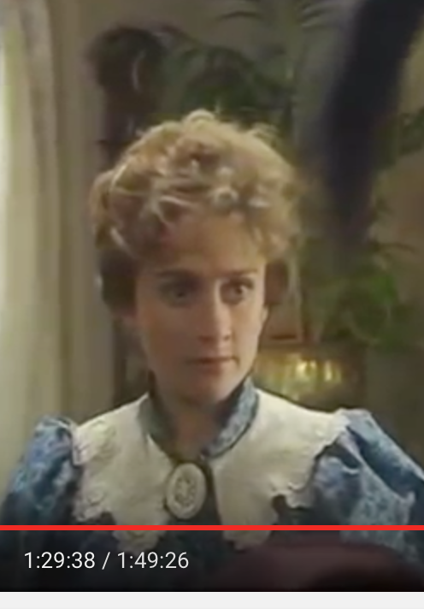
Cecily is Jack’s daydreaming niece and ward. cecily falls in love with algernon, believing him to be jack’s brother, ernest. She will be given access to a large sum of money when she comes of age.
Cecily Cardew

Slide 8
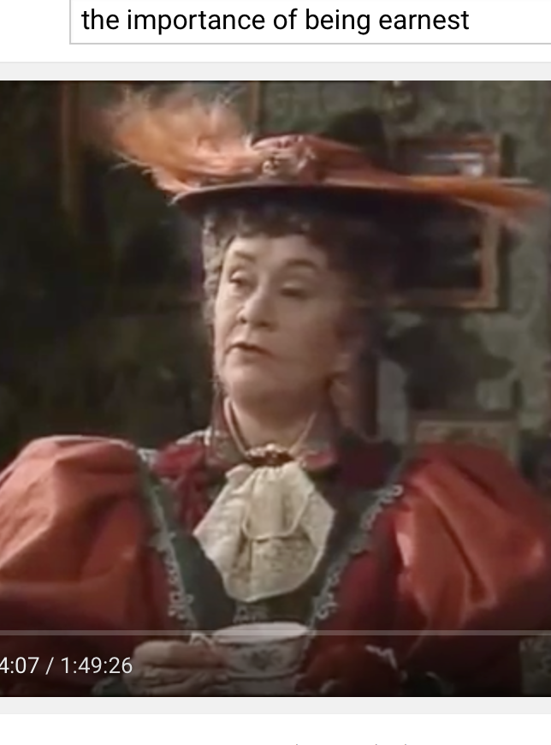
Lady Bracknell is the mother of Gwendolen and the aunt of algernon. a member of the aristocracy, she has an overpowering, confident demeanor. She forbids gwendolen to marry jack because of jack’s uncertain background. Lady bracknell is the ideal symbol of victorian rigidity.
Lady Bracknell

Slide 9
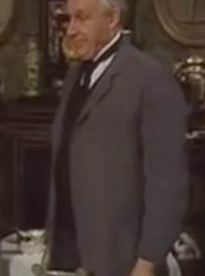
Algernon’s man servant
“A perfect pessimist.”
Lane

Slide 10
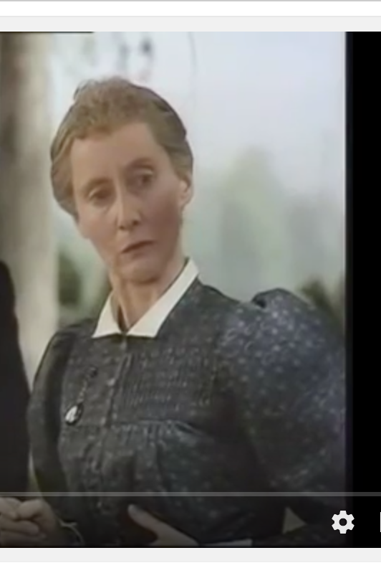
Miss Prism is cecily’s tutor/governess and a strong proponent of victorian morality. she once wrote a three-volume novel, and she enjoys flirting with Rev. Canon Chasuble
Miss Prism

Slide 11
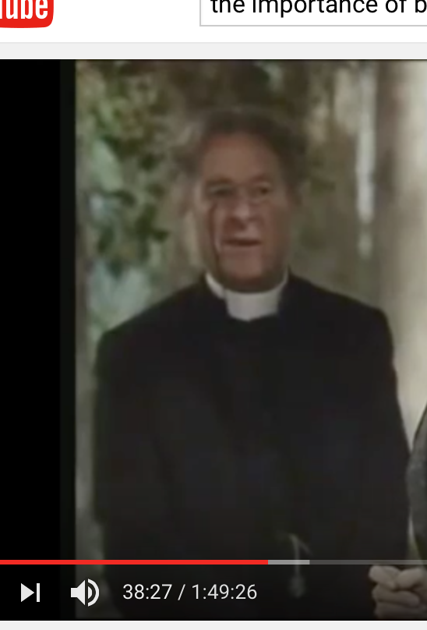
Rev. Chasuble has a crush on Miss Prism. Jack and algy ask him to re-christen them as ernest.
Rev. Canon Chasuble

Slide 12
Setting
The story takes place in 1890s London. However, the setting changes fromt he city to the countryside.

Slide 13
Structure of the play
Act 1 - Addresses the conflict of dual identities, provides background information on the major characters.
Act 2 - More conflicts are introduced and characters become entangled
Act 3 - Things begin to sort themselves out.

Slide 14
Point of view/narrative voice
Wilde reveals the story to an omniscient audience (???) who the characters are not aware of, which is typical of dramas. The audience is given all of the clues to understand the mix-up long before the characters figure it out, allowing the audience to enjoy the dramatic irony of seeing the ridiculous characters even though the characters take themselves very seriously.

Slide 15
Tone
Ironice, Satirical, Humorous, Cynical
The Victorian time period affects the tone. It was a period of decadence in France and England. The concerns of the characters are highly trivial and self-indulgent, and the whole thing is satirical in its portrayal of their superficial entanglements. For example, Algy’s seriousness of food outweighs his concerns over more serious matters, such as when Lane stole champagne.

Slide 16
Epigrams
A pithy saying or remark expressing an idea in a clever or amusing way. Often, epigrams are paradoxical.
“Oscarisms”

Slide 17
“I cam sympathize with everything, except suffering.”
“It is only shallow people who do not judge by appearance.”
“The way to get rid of temptation is to yield to it.”

Slide 18
Oscar’s Big question
What is the importance of being earnest?
The play satirizes society and yet sort of reveals the aristocratic trivialities of the society of the time. The issue then is perhaps to recognize the ridiculousness in our own lives and to be true to ourselves—earnest not necessarily in what society would declare important, but earnest in what is important to us. Perhaps we need a little more triviality about some things so that we can laugh at ourselves and remember that taking social conformity so seriously is as ridiculous as marrying someone for their name. This might also lead into not taking seriously everything you hear or read, remembering to think through things for yourself rather than blindly accepting what you’re told.

Slide 19
Topics vs. theme
Decadence
Marriage
Society
Morality
Honesty

