Slide 1
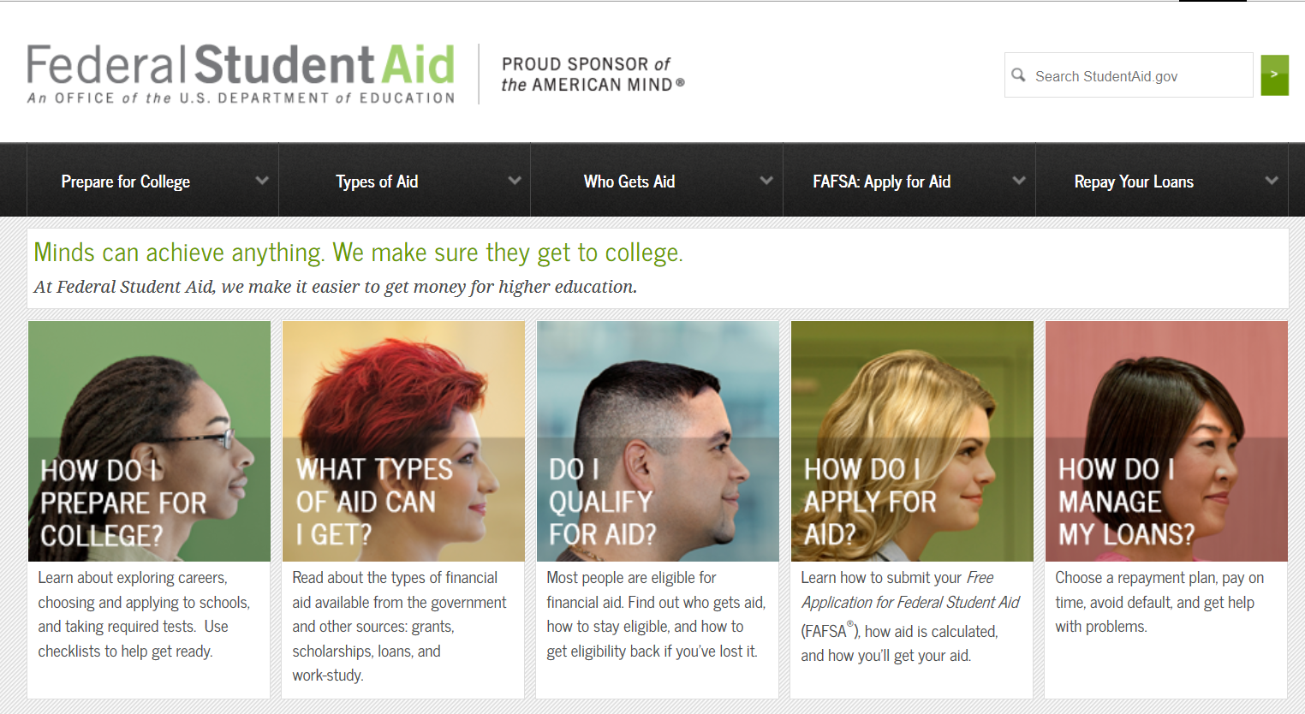
FINANCIAL AID…..
IN THE BEGINNING

Slide 2
OPEN YOUR DOOR AND
LIVE YOUR DREAM TO ACHIEVE…
YOUR FAFSA
fafsa.gov
YOUR Career
alcareerinfo.org
YOUR College
YOUR Future
mynextmove.org
PRESENTED BY:
STEPHANIE MILLER
President-Elect,
Alabama Association of Student Financial Aid Administrators
FA Solutions, LLC
Future
FAFSA
Career
College

Slide 3
OVERVIEW
What is financial aid?
Who can get it?
How much can I get?
How do I apply?
What happens next?
Where can I get more info?

Slide 4

You
are
NOT
alone!
EVERYONE
has questions!
Don’t be afraid to ask for help!
Financial Aid Professionals and Counselors are here to help!!!

Slide 5
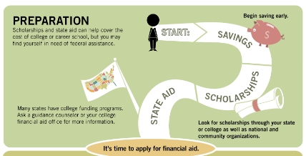
What is Financial Aid?
Money to pay for college or career school
  Grants
  Loans
  Work-study
  Scholarships

Slide 6
Who can receive aid?
U.S. citizen or permanent resident
High school graduate/GED holder
Eligible degree/certificate program
Valid Social Security number
Males registered for Selective Service
Satisfactory academic progress in college/career school

Slide 7
WHERE DO I BEGIN?
The first step in the financial aid process is to complete the Free Application for Federal Student Aid (FAFSA) online at www.fafsa.gov.
It is FREE!!!!!!

Slide 8
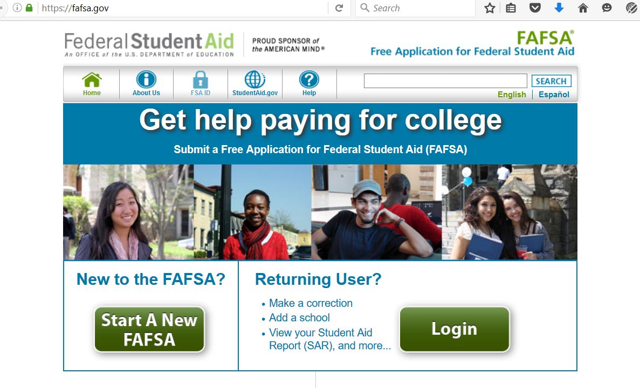
Apply for Aid: FAFSA
Resources on this website are also available in Spanish.
  Takes less than 30 minutes to complete online at https://fafsa.ed.gov
  Real-time help is available by phone at 1-800-4FED-AID , or via on-line chat
  IRS Data Retrieval Tool pre-populates tax information: http://studentaid.ed.gov/fafsa/filling-out#financial-info
        Determines families’ ability to contribute to cost of attendance
Notes:
The Department of Education's Office of Federal Student Aid provides financial aid in the form of loans, grants, and federal work study funds. Completing the Free Application for Federal Student Aid (FAFSA) is the first step in applying for federal grants, and loans. Remember, the first word in FAFSA is “FREE” – there’s no need to pay anyone to help you complete the FAFSA. Look for free FAFSA completion workshops offered by area high schools, colleges and community organizations to get help completing your FAFSA.
Real-time help to complete your FAFSA is available by phone at 1-800-4FED-AID . You can also chat live with a customer service representative in a secure online chat session.
Don’t assume that you may not be eligible to receive federal student aid! This application provides access to largest source of college funding, and your school will also use it to determine eligibility for institution-based financial aid.
FAFSA4caster will help you understand your options for paying for college.
Provide some basic information and the FAFSA4caster will estimate your eligibility for federal student aid. Your estimate will be shown in the "College Cost Worksheet" where you can also provide estimated amounts of other student aid and savings that can go towards your college education.
Visit the following website to access the FAFSA4caster: https://fafsa.ed.gov/FAFSA/app/f4cForm?execution=e1s1

Slide 9
WHY DO I NEED A FAFSA?
FAFSA completion starts the application process for Federal Pell Grants, Iraq & Afghanistan Service Grants, Federal Student Loans, Federal Parent PLUS Loans, Federal Work Study, Supplemental Grants, Perkins Loans, TEACH Grants and some scholarships depending on the organization.
- Even if you know you won’t qualify for a grant, you never know when you might need extra help.

Slide 10
What? A FSA ID??
To sign the FAFSA electronically on the web, the student and the parent must have a FSA ID.
Get a FSA ID at fsaid.ed.gov.
  Your parent will need a FSA ID too.
  Choose your own FSA ID or let the site choose one for you.
  Don’t tell anyone your FSA ID!
OR
Go to www.fafsa.gov, click FSA ID, click Create an FSA ID
**If someone already has a FSA ID, use the Forgot my Username and/or Password

Slide 11
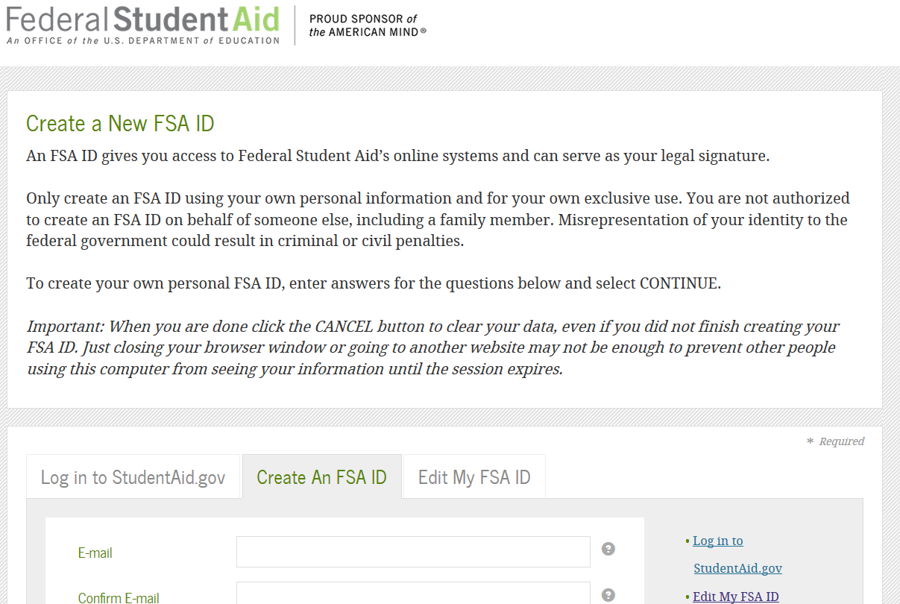

Slide 12
WHEN DO I START?
The FAFSA becomes available for the upcoming school year October 1st.
For example: If a student is attending Fall 2018 and Spring 2019, the 2018-2019 FAFSA should be filed. In most cases, if a student is attending the Summer 2018 prior to the Fall 2018 term, most schools will require the 2017-2018 FAFSA to be filed.
**You must complete the FAFSA every year.
**You may do a renewal after your first year.

Slide 13
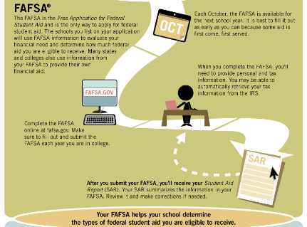

Slide 14
WHY DO I NEED TO
START SO EARLY?
The earlier you complete the FAFSA the more likely you are to receive additional funding that may be available.
- Some schools receive additional federal, state and/or institutional grants that have very limited funding. These grants may be given to students on a first come, first serve basis for those who qualify.

Slide 15
WHO GOES ON THE FASFA?
The FAFSA states that a student must use his/her biological parent(s) who he/she lived with more during the past 12 months. If did not live with one more than the other, give answers about the parent(s) who provided more financial support during the previous year.
If the biological parent is remarried, the student must use the step parent’s information too even if they do not provide the student with any support.
Grandparents or other relatives are not considered parents for FAFSA unless they have legally adopted the student
It does not matter who filed whom on taxes.
If your biological parents are not married, but live together in the same household both parent’s information must be on the FAFSA.
https://studentaid.ed.gov/sa/sites/default/files/fafsa-parent.pdf

Slide 16
Student and parent(s) need to gather information for the FAFSA:
Social Security Card Name (Use the name as appears on the card.)
Driver’s License for student only
Dates of Birth
Social Security Number
IRS Tax Returns
Asset Information:
bank and retirement plan statements, current business and investment mortgage information, business and farm records, stocks, bonds and other investment records
Free & Reduced Lunch, Food Stamp, Welfare and TANF Information
Social Security and Disability Benefits
Veteran’s Benefits
W2 Forms
Additional Income or Benefit Information
Documentation of U.S. Permanent Resident or other Eligible Noncitizen information

Slide 17
Why do I need tax information?
The U.S. Department of Education uses all of the information on the FAFSA to determine what types of aid a person will be able to receive. The tax information is one of the main criteria in determining if a student is eligible for need based aid.
The FSA ID is used with the FAFSA IRS Data Retrieval Tool (IRS DRT). This tool allows filers to pull in the tax information directly from the IRS.
Not all filers are eligible to use the Retrieval Tool:
If any of the following applies, a filer may not be eligible to use the IRS Data Retrieval Tool:
You filed taxes as married filing separately
You are married and you filed taxes as Head of Household
You filed an amended tax return
You filed an electronic tax return less than three weeks ago
You filed a paper tax return less than six weeks ago
You filed a Puerto Rican or foreign tax return
You have an identity theft situation with the IRS

Slide 18
The FAFSA is filed…..now what?
Once the FAFSA has been processed by the U.S. Department of Education, an email will be sent to the student’s email address as listed on the FAFSA.
The processed FAFSA is known as a Student Aid Report (SAR).
The SAR gives an Expected Family Contribution (EFC).
**Watch for e-mails or letters from the schools you are considering.
  Give the schools any additional paperwork they ask for.
  Meet all deadlines or you could miss out on aid!

Slide 19
Why would someone need more paperwork? Wasn’t the FAFSA enough?
The government may select a filer for a process called Verification.
Verification is a random selection that requires the filer to complete a verification worksheet, supply the IRS Tax Return Transcript, food stamp verification, child support payment verification and other items to the school.
The school may also ask for additional documents.
Each year the documents requested may change.

Slide 20
WHAT TYPES OF AID CAN I QUALIFY FOR BY COMPLETING THE FAFSA?
-Federal Pell Grants, Iraq & Afghanistan Service Grants Federal Student Loans, Federal Parent PLUS Loans, Federal Perkins Loans, Federal Work Study, TEACH Grants and Supplemental Grants.
- Federal Pell Grants, Federal Subsidized Student Loans, Federal Perkins Loans, Supplemental Grants and Federal Work Study aid are need based aid.
- Federal Unsubsidized Student Loans, TEACH Grant and Parent PLUS Loans are not need based aid.
*Please note that all students are not eligible for need based aid.

Slide 21
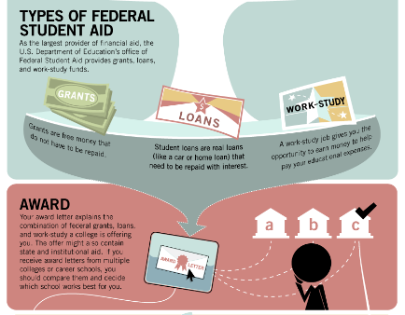

Slide 22
WILL MY FAFSA PAY FOR EVERYTHING?
The FAFSA doesn’t pay for anything, your financial aid package/award shows what funds have been offered to you. The Government assigns you an Expected Family Contribution (EFC) Number that lets the school know your need for Pell Grant and other need based aid.
- In most cases, no, your financial aid package will not cover all of your expenses. Federal Student Aid is not designed to pay for everything. It is a supplement to help you/your parents with educational costs.
- First time freshman can only receive $5500 in student loans ($2750 for the fall and $2750 for the spring.)
- Parents may apply for PLUS loans that will be in their name or if declined will allow the student to apply for an additional $4000 for the academic year.
- The maximum full time pell grant for 2017-2018 is $5920 ($2960/$2960 a semester).
    2018-2019 amount is not currently available (will be coming soon)
There are lifetime limits on federal student loans and pell grants.
- Funds from other programs are available; see StudentAid.gov/needmoney for details.
**Apply for scholarships – www.fastweb.com
*Many college scholarship applications open Oct. 1

Slide 23
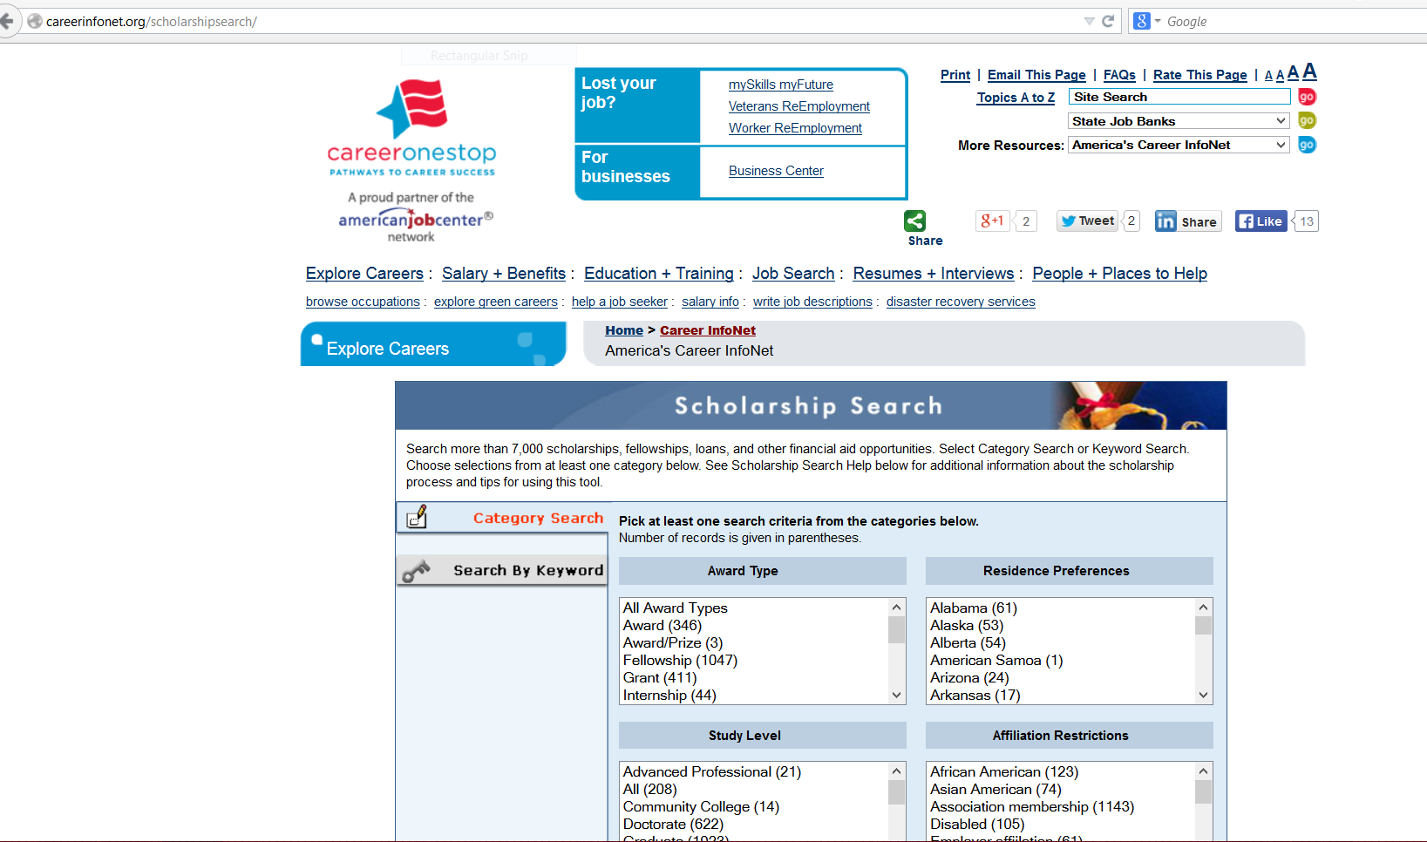
US Department of Labor
Scholarship Search careerinfonet.org/scholarshipsearch

Slide 24





Comparison Shop
College Navigator
College Scorecard
Net Price Calculator
Free Application for Federal Student Aid (FAFSA.gov)
Financial Aid Shopping Sheet
Apply for aid
Budgeting &
Borrowing
StudentAid.gov
Financial Awareness Counseling Tool (FACT)
Manage Debt
Entrance and Exit Counseling
Repayment Estimator
Stay Informed
StudentAid.gov

Slide 25
If you don’t know the terminology…check out
STUDENTAID.GOV
Shopping Sheet
Award letter
Expected Family Contribution (EFC)
Financial aid package
Cost of Attendance (COA)
Financial Aid Offer

Slide 26
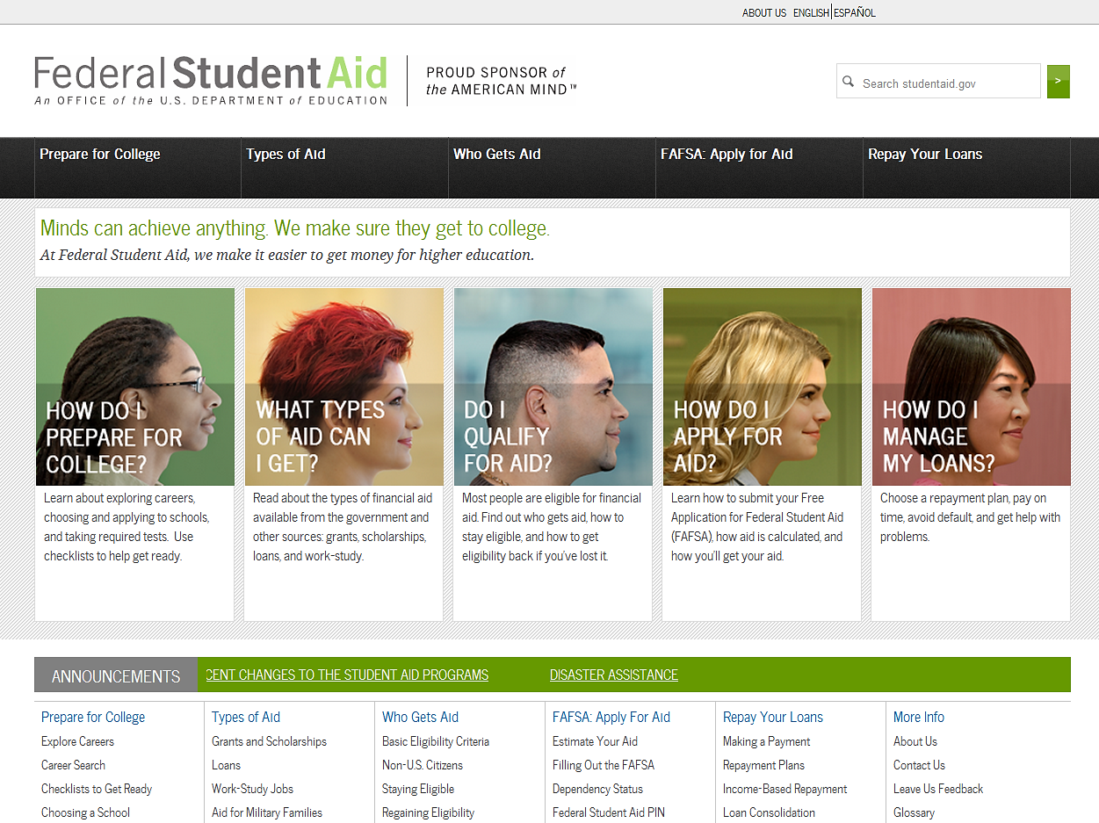
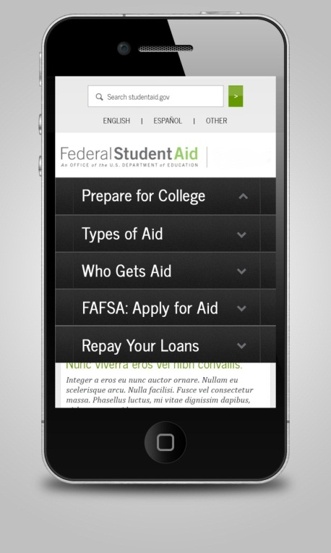
Stay Informed: StudentAid.gov
StudentAid.gov DESKTOP and MOBILE DEVICE browsing available
Notes:
Get ready for college or career school, learn about federal student aid and how to apply using the FAFSA, and get information on repaying student loans at www.StudentAid.gov to The site offers powerful, intuitive tools to assist you in searching for colleges, applying for aid, and managing loan repayment.

Slide 27
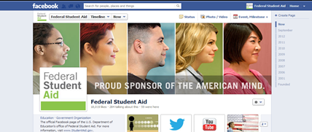

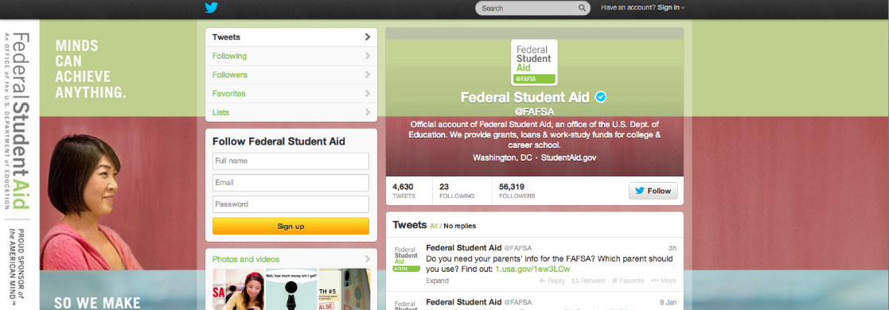



Stay Informed: Social Media
https://www.facebook.com/FederalStudentAid
https://twitter.com/fafsa
http://www.youtube.com/user/FederalStudentAid
Notes:
Stay in touch whether its via the Federal Student Aid website (StudentAid.gov) or via Twitter or Facebook. Federal Student Aid offers many valuable tools and resources to help students before, during, and after school.

Slide 28





Federal Financial Literacy Information
http://www.fdic.gov/consumers/consumer/moneysmart/
http://www.mymoney.gov/Pages/default.aspx
http://www.consumer.gov
http://www.federalreserveeducation.org
http://www.treasury.gov/Pages/default.aspx

Slide 29
QUESTIONS
?????

