Slide 1
Steps Leading to Civil War
Ch. 8 Sec. 1

Slide 2
The Wilmot Proviso
David Wilmot
In any territory the US gained from Mexico “neither slavery nor involuntary servitude shall ever exist”
This outrages Southerners
Democrats and Whigs pass the proviso in the House of Representatives

Slide 3
The Wilmot Proviso
Senate refuses to vote on it
John C. Calhoun
Warns that “political revolution, anarchy, and civil war” will erupt if North failed to listen to Southern concerns.

Slide 4
Popular Sovereignty
Idea that citizens of each new territory should be allowed to decide for themselves if they want to permit slavery or not
Proposed by Lewis Cass
Supported in Congress b/c it removed the slavery issue from national politics

Slide 5
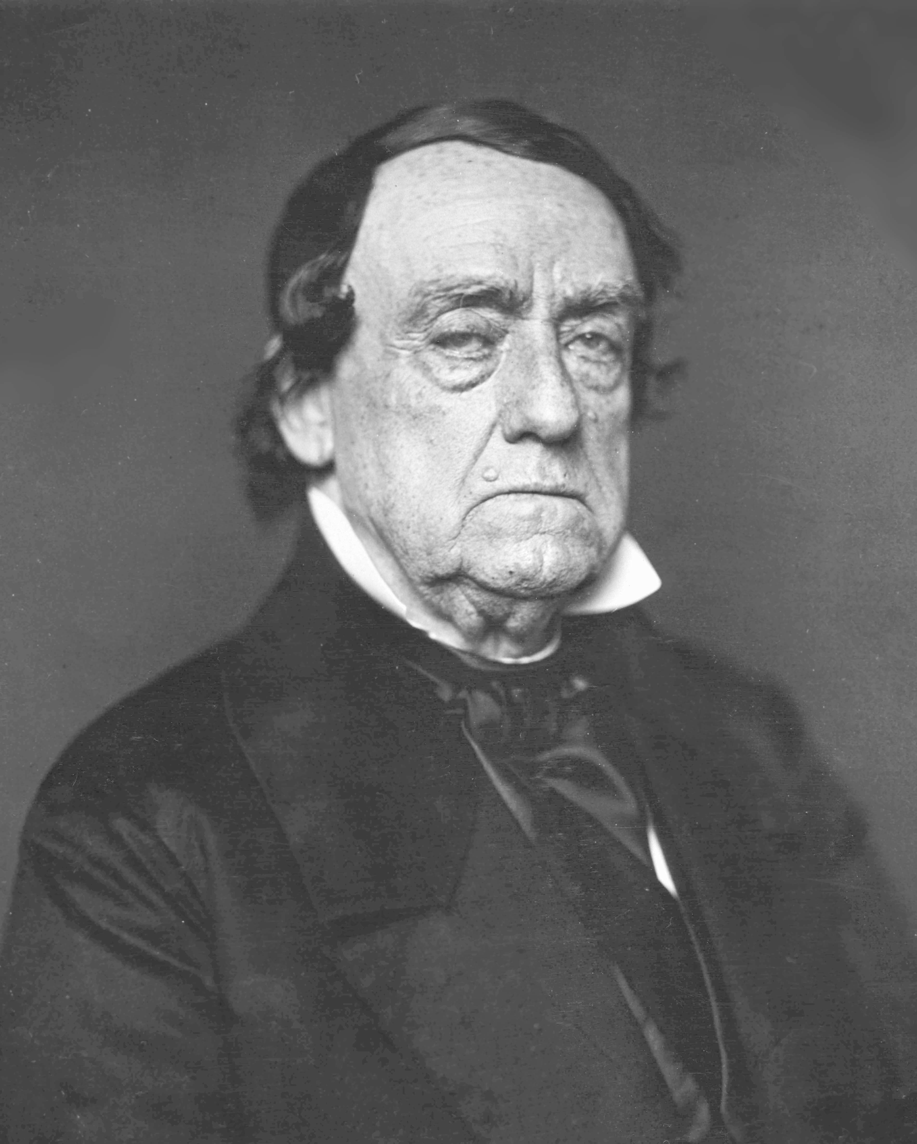
Election 1848
Democrat candidate
Lewis Cass- Popular sovereignty

Slide 6
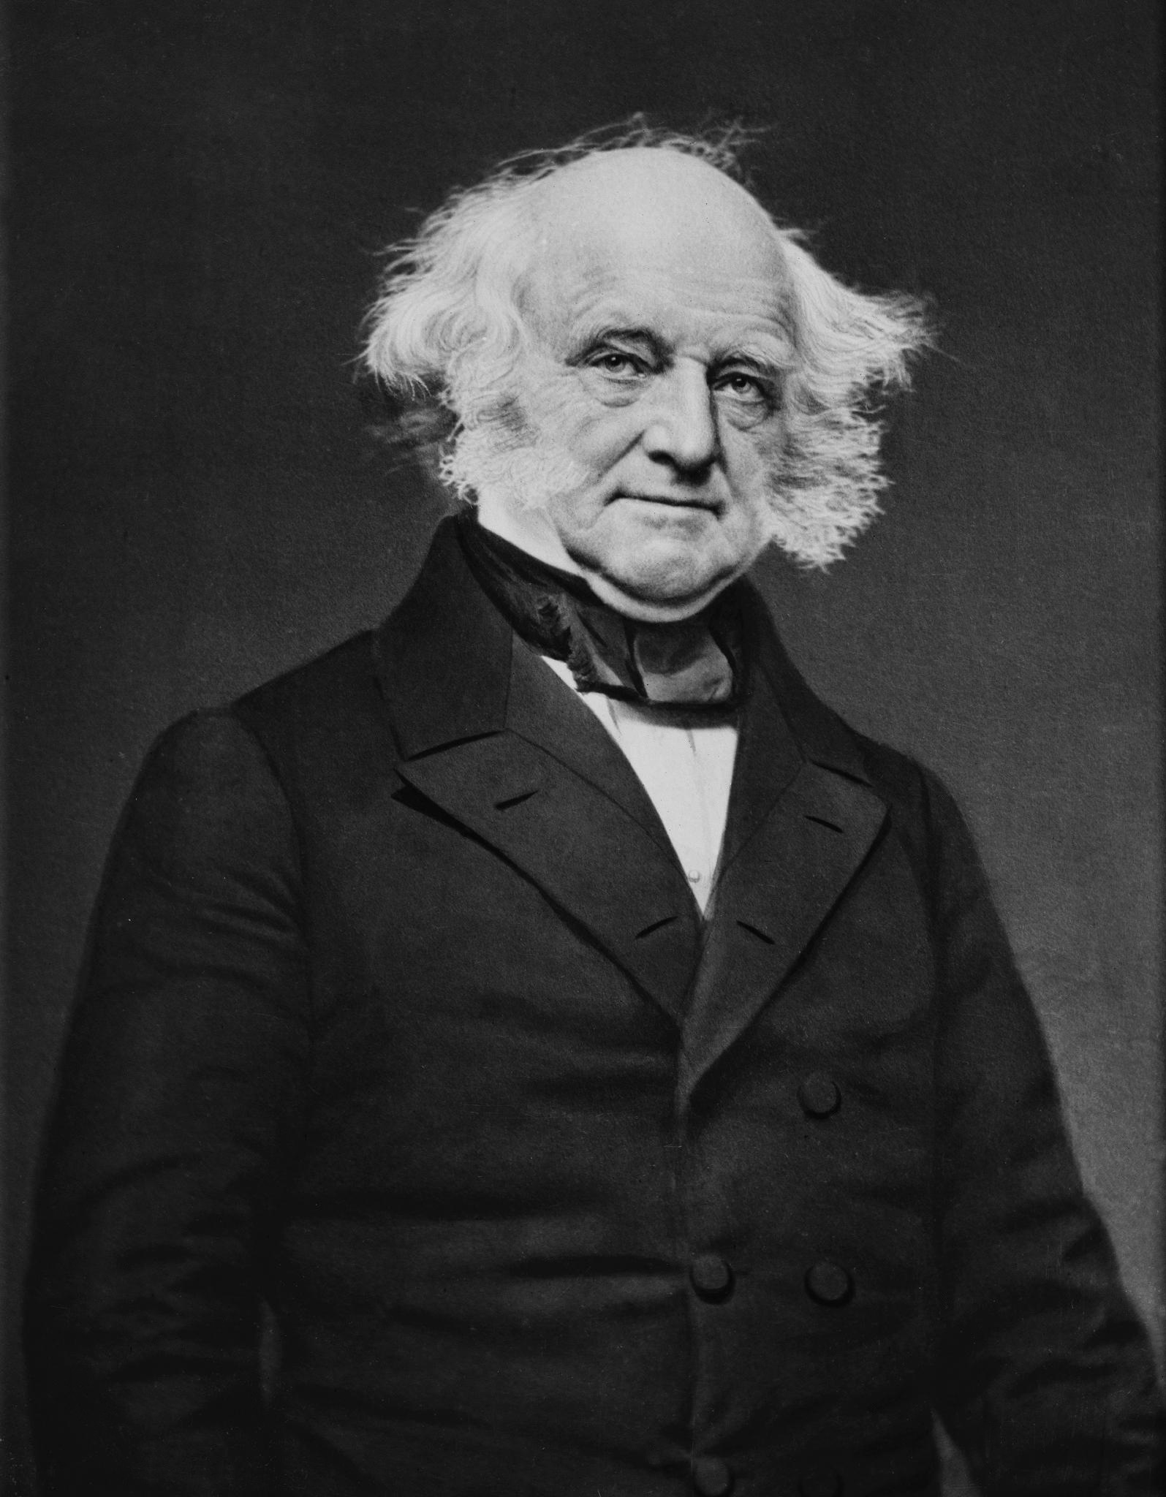
Election 1848
Free-Soil candidate
Free Soil, free speech, free labor, free men
Martin Van Buren ➔ Preserve the west for white farmers and against slavery to protect jobs for free men

Slide 7
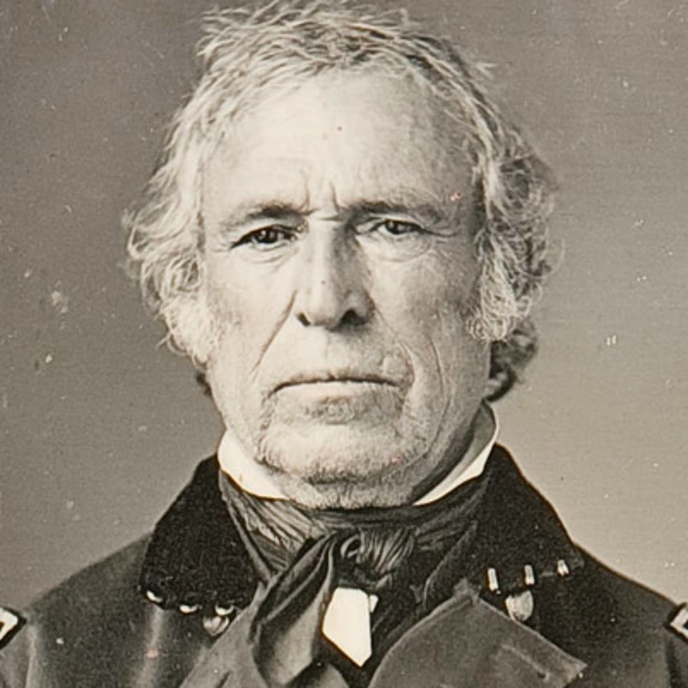
Election 1848
Whig candidate
Zachary Taylor – avoided the issue of slavery, because Whigs were split on the slavery issue
Zachary Taylor wins the election

Slide 8
California bound!
The discovery of Gold brings thousands into the California territory – ‘49ers
Apply for statehood – Do they enter as a slave or free state?
1849 – California applies for admission to the US as a free state
Southern states felt this may limit their rights
Southern politicians began to talk openly of secession

Slide 9
The Compromise of 1850
Bill proposed by Henry Clay
8 parts
Debated by Calhoun and Webster
Taylor opposed it but unexpectedly dies in office, VP Millard Fillmore takes over
Stephen A. Douglas divides the bill into small parts that could be supported
All original parts passed

Slide 10
Compromise of 1850
California enters as a free state | Victory for the North
Federal enforcement of the new Fugitive Slave Act | Victory for the South
Slave trade (not slavery) abolished in Washington D.C. | Moderate victory for the North
Texas border dispute w/ Mexico resolved, Texas gets $10 million | Moderate victory for the South
Popular sovereignty determines slavery in Utah and New Mexico territories | Moderate victory for both sides

Slide 11
Fugitive Slave Act
Part of the Compromise of 1850
Northern states must return escaped slaves to the south
Many northern states tried to use the “Doctrine of Nullification” to avoid obeying this law!

Slide 12
Fugitive Slave Act
Any African American could be captured and taken as a runaway
Incentive Rule- $10 for a convicted runaway to be returned to owner
Those who refused to assist could be jailed

