Slide 1
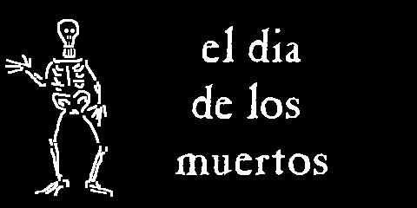

Slide 2
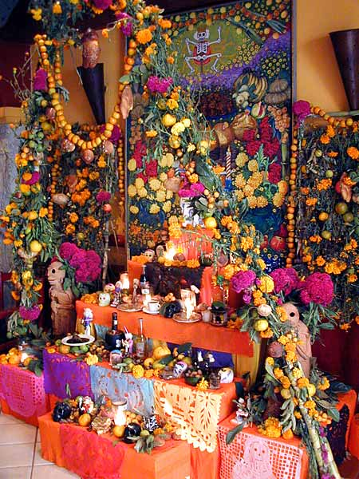
Customs vary throughout Mexico
Most celebrations include:
Decoration and family gathering at cemetery
Special foods
Ofrendas (offerings) on altars
Religious rites and prayers
Often there are fireworks!

Slide 3
In many regions, November 1 is dedicated to the remembrance of deceased infants and children
Adults are honored November 2

Slide 4
In mid-October markets begin displaying items needed for Dia de los Muertos including:
Skeletons (toys, figurines, sweets)
Papel Picado
Floral wreaths and crosses
Candles
Fresh flowers
-cempazuchiles (marigolds)
-barro de obispo (cockscomb)
Sugar or chocolate skulls and coffins
Pan de muerto (bread of the dead)

Slide 5
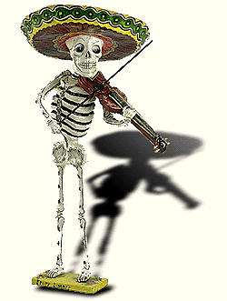
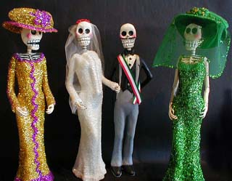
Calacas
Skeletons are often shown in everyday activities which depict a dead person’s profession or interests. The calacas are often placed on altars. This shows the spirit that he has not been forgotten.

Slide 6
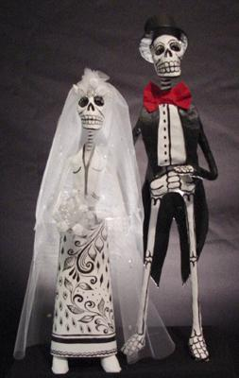

Slide 7
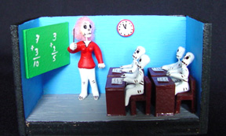

Slide 8
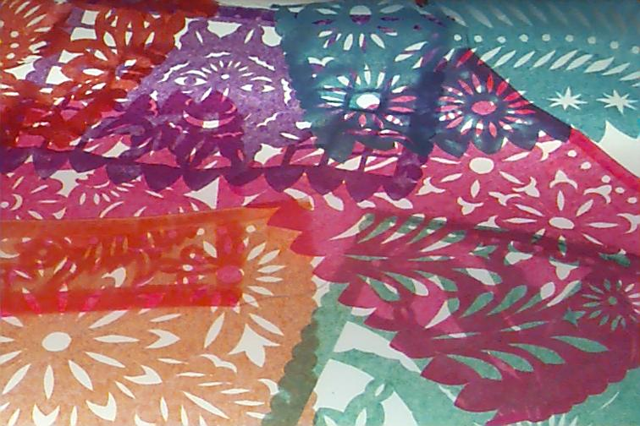
Papel Picado

Slide 9
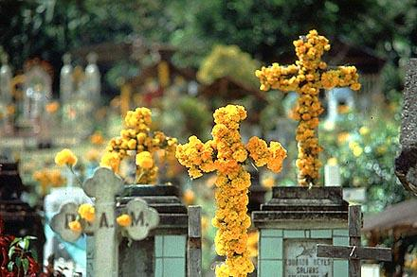
Floral wreaths and crosses

Slide 10
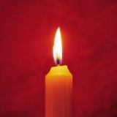
Velas (Candles)

Slide 11
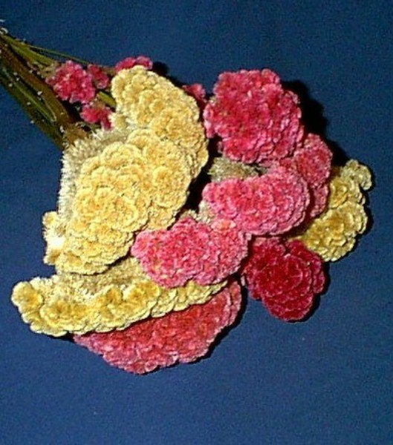
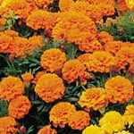
Fresh Flowers

Slide 12
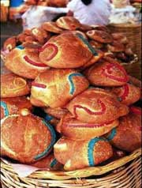
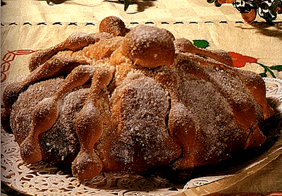
Pan de Muertos

Slide 13
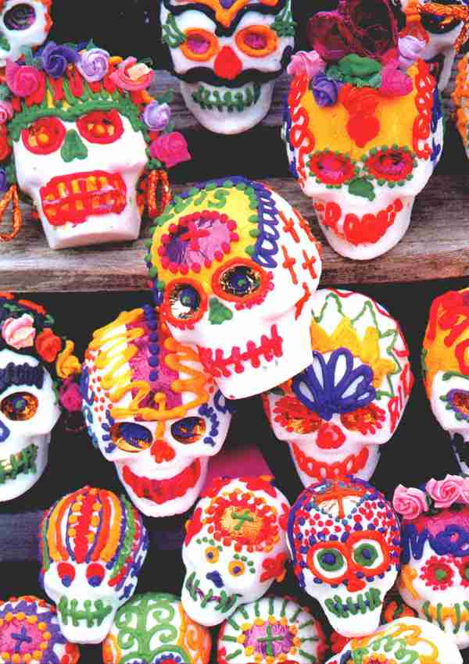
Sugar Skulls
Children are given sugar skulls with their names written on the forehead!

Slide 14
Altars in the home

Slide 15
*Altars have decorations: papel picado, candles, flowers, photographs of the departed, candy skulls with the name of the deceased
*Altars have foods and drinks: bottles of beer or tequila, cups of atole (a sweet drink made of milk, sugar, and corn starch) or coffee, pop (many families will sacrifice to purchase a favorite brand!) and fresh water, as well as platters of rice, beans, chicken or meat in mole sauce, candied pumpkin or sweet potatoes, fruits and breads.

Slide 16
Spirits return home…there they find many “goodies” they enjoyed while living
A wash basin and clean towel are placed on the altar for the spirit to “freshen up” after a long journey
Favorite foods and drinks
Favorite cigarettes or cigars
Toys and candy for spirits of deceased children

Slide 17
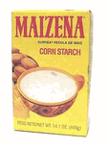
Atole de leche

Slide 18
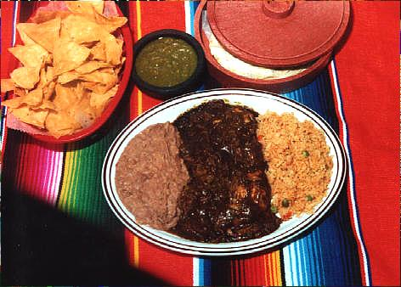
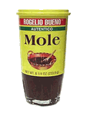
Mole (pronounced mole-ay)

Slide 19
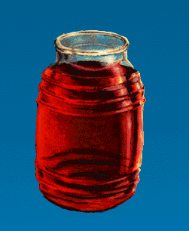
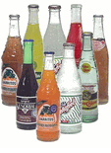
Bebidas (drinks)

Slide 20
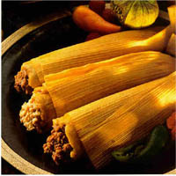
Tamales

Slide 24
The altar…
An area of the home is cleared of furnishings
Floors and walls are washed
A table is covered with clean sheets, a blanket, or tablecloth
Incense is usually burned
Many candles are lit

Slide 25
Family members clean tombs and gravestones
Pull weeds
Tombs are painted and repaired if needed
Graves are decorated with flower crosses, wreaths,
or floral arrangements

Slide 26
This young boy has returned from the market with flowers for the cemetery

Slide 27
Procession to the cemetery

Slide 28
The army band participates in a local parade

Slide 29
Many towns have parades including processions on horseback

Slide 30
A group of músicos entertains at the cemetery

Slide 31
En el cementerio
Family members gather at the cemetery. They bring picnics and mariachi bands may play favorite songs. Local restaurants set up food stands. An outdoor church service is usually held.

Slide 38
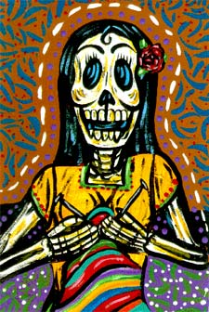

Slide 45
Customs Around the World
In the USA, most people avoid talking about death
Many other cultures around the world have rituals for remembering loved ones.
Many other cultures have similar rituals involving the lighting of lamps or candles and laying out food and drinks
Even ancient Egyptians had similar traditions or remembering loved ones

Slide 46
Images and information taken from www.mexconnect.com and www.azcentral.com

