Slide 1
George Lopez
Born: April 23, 1961 in Mission Hills, CA
Raised by his grandmother
Turned his painful experiences into material for his comedy act
By the 1980’s he was a well known comedian and also appeared on tv shows
In the 1900s he made his way to films such as Ski Patrol and Fatal Instinct
Was on e the few Latinos to be a television comedy star
The show George Lopez is partly based on his personal experience.
Became a spokesperson for the National Kidney Foundation
Named one of “The Top 25 Hispanics in America” by Time magazine

Slide 2
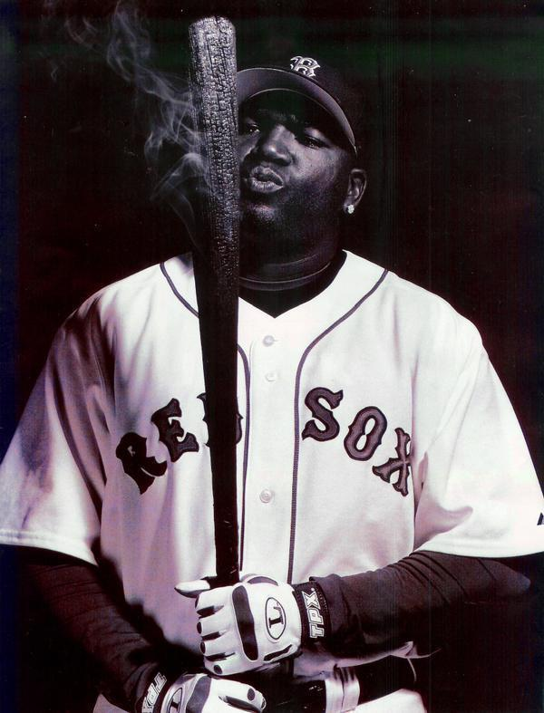
David Ortiz
By: David Sims

Slide 3
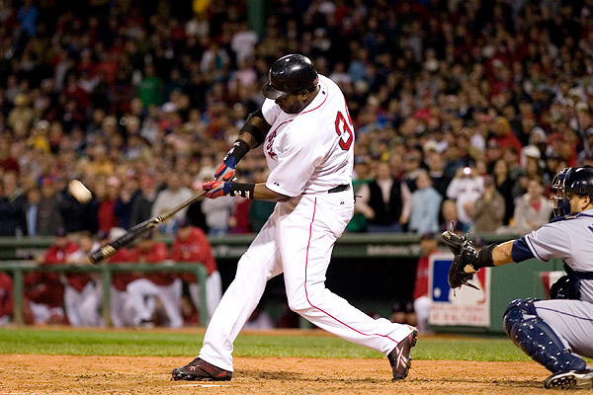
About Ortiz
Born November 18, 1975
Home Town is Santo Domingo, Dominican Republic
Has played for the Boston Red Sox since 2003.
Nicknamed "Big Papi“
Holds the Red Sox single-season record for home runs with 54, set during the 2006 season.

Slide 4
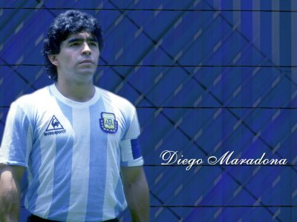
By Jake Elliff

Slide 5
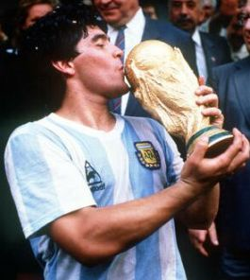
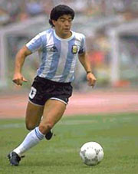
About Maradona
Born: October 30, 1960
Birthplace: Argentina
Ethnicity: Hispanic
Played from 1976-1997
Received many awards, including Greatest Player of the 20th Century
Current coach of the Argentina National Team

Slide 6
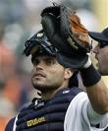
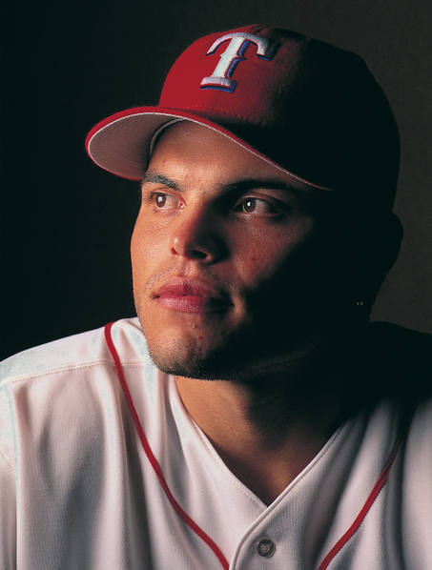
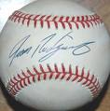
Ivan Rodriguez

Slide 7
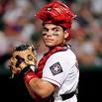
Ivan Rodriguez
Born in Vega Baja, PR
Birthday November 30, 1971
His Nickname is “ Pudge”
His Batting average is .253 With 8 homeruns in 2009
He is the Catcher for the Houston Astros Baseball team
Has an Ivan “Pudge” Rodriguez foundation to help families who's children are battling cancer

Slide 8
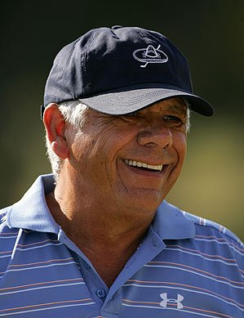
Lee Trevino
Lee Trevino (born in Dallas, Texas on December 1, 1939) is an American professional golfer. Trevino is an icon for many Mexican Americans and is often referred to as the “Supermex”.
After his discharge, Trevino became a club professional in El Paso, Texas. He made extra money by gambling for stakes in head-to-head matches. He began play on the PGA Tour in 1967. In his second U.S. Open golf championship, he shot 283, eight shots behind champion Jack Nicklaus, and earned $6,000 for finishing fifth. He won $26,472 as a rookie, 45th on the PGA Tour money list, and was named Rookie of the Year by Golf Digest.
A street in El Paso was named after him.
Played for the U.S. in the Ryder cup six times and had an impressive 17-7-6 win-loss-half record
Won the Vardon Trophy for the lowest scoring average 5 times
Co-authored his biography, titled They Call Me Super Mex.
Was inducted into the World Golf Hall of Fame in 1981
Was ranked as the 14th –greatest golfer of all time by Golf Digest magazine in 2000.

Slide 9
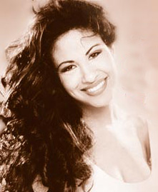
Selena Quintanilla Perez
By: Jayci Adams

Slide 10
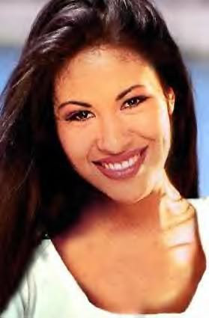
~Selena Quintanilla Perez
*Selena was born on April 16, 1971.
*In 1986 Selena received both the
Female Vocalist of the Year and the
Performer of the Year.
*Selena fell in love and eloped with
her guitarist Chris Perez despite her father’s opposition.
*She was murdered by Yolanda Saldivaron, the president of her fan club, on March 13, 1995.
*Her partially-completed album, Dreaming of You, was released the following July and reached the number one position.

Slide 11
Anthony Munoz
By Layton Hayes
He was 6ft 6 and he weighed 278 ponds.
He missed 3 games due to injuries.
He played one full game his senior year at the University of Southern California.
Anthony was elected to 11 consecutive Pro Bowls and was named All-Pro 11 straight times from 1981 through 1991.
He was named the NFL Offensive Lineman of the Year in 1981, 1987, and 1988 and the NFL Players Association Lineman of the Year in 1981, 1985, 1988, and 1989.
He was an offensive lineman
He played even though he had several knee injuries

Slide 12
Jennifer Lopez
By: Meredith Gower

Slide 13
Biography
Name: Jennifer Lynn Lopez
Nickname: J LO
Jennifer was born in the Castle Hill section of the Bronx on July 24, 1969. Her father, David, was a computer technician and her mother, Guadalupe, taught kindergarten. Jennifer is the middle child of three sisters. Jennifer's parents were born in Puerto Rico, but didn’t meet until they both came to America. Her mother's parents were Europeans who settled in Puerto Rico. She says that it was her parents' work ethic that made a difference in her life. Jennifer, at the age of 5, took singing and dancing lessons. She attended 12 years of Catholic school, including an all-girl high school. She played softball and tennis in high school and was a gymnast. After high school she worked at a law firm while still taking dance lessons at night. Not long after, she left home because of her mothers doubt of her pursuit in show business. Although she loved music, the film industry fascinated her.
Her big break came in 1990 when she was offered a job as a fly girl on Fox's hit “in Living Color”. After a two-year stay at “In Living Color” where actress Rosie Perez served as choreographer, Lopez then went on to dance for famed singer-actress Janet Jackson. Her first major film was Gregory Nava’s My Family in 1995 and her career went into over-drive when she portrayed slain Tejana singer Selena Quintanilla Perez in the movie Selena in 1997.

Slide 14
Eva Longoria By: Stephanie Housch
Born on March 15, 1975
Grew up in Corpus Christi, Texas
Actress on Desperate Housewives
She used to be called ‘la prieta fea,’ which means ‘the ugly dark one’
Her family was very poor when she was growing up
Her Parents were Mexican American

Slide 15
Biography
Born: February 4, 1973
Nickname: “The Golden Boy”
Facts:
American boxer of Mexican descent
Won a gold medal at the Barcelona Olympic Games
Ring Magazine’s “Fighter of the Year” in 1995 and top-rated Pound for Pound fighter in the world in 1997.
Retired on April 14, 2009
Defeated 17 world champions
Won 10 world titles in six different weight classes
Has generated more money than any other boxer
Released his first album on EMI/Latin Records and the album topped Billboards’s Latin Dance charts for several weeks. The single, “Ven a Mi,” was nominated for a Grammy
Started the Oscar De La Hoya Foundation in 1995. It funded projects including a cancer center and a neo-natal intensive care unit at White Memorial Medical Center in Los Angles

Slide 16
Manny Ramirez
Manny Ramirez was born Manuel Aristides Ramirez on May 30, 1972, in Santo Domingo, Dominican Republic.
Raised a short distance from Yankee Stadium, Ramirez attended George Washington High School in Washington Heights, a neighborhood in New York City . While attending the school, he was named All-City in 1989, 1990 and 1991 and was the New York City Public Schools High School Player of the Year in 1991.
Recruited to join the Majors out of high school, Ramirez, a right-handed outfielder, would prove to be one of the best hitters in league. He played with the Cleveland Indians from 1993-2000 and played for the Boston Red Sox 2001 until he was traded to the Los Angeles Dodgers in 2008.

Slide 17
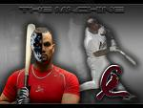
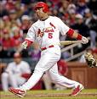
Albert Pujols
Born January 16, 1980 in Santo Domingo, Dominican Republic
Spanish name- Jose Alberto Pujols Alcantara
Immigrated to U.S. in 1996, first to New York City
6 ft 3 and weighs 230 pounds
Nicknames- Phat Albert, Prince Albert, and The Machine
Major League Baseball first baseman for the St. Louis Cardinals
The only baseball player in history to have at least 30 home runs in first 9 seasons
2001 Rookie of the Year
MVP (2005, 2008)

Slide 18
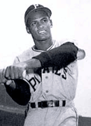
Roberto Clemente
Cylena Kromer

Slide 19
Born in small barrio San Anton in Carolina, Puerto Rico, Roberto Clemente was the youngest of seven children and was raised in a modest home with mother Luisa and father Melchor. At the young age of 17, Roberto was playing for the Santurce Cangrejeros in the Puerto Rican Winter League where he attracted legions of big-league scouts because of his hitting, fielding, and throwing ability.
He signed with the Dodgers for $10,000, but never got to play a single game in Brooklyn or Los Angeles. In the 1960's, however, no other player dominated the entire decade like Roberto Clemente did.
No other Latin American has ever achieved the numbers and recognition like Clemente did. But even though with his stellar, consistent play, Clemente thought the fame achieved was all too slow in coming as it always seemed for players of Hispanic background.
In 2002, Major League Baseball's Commissioner Allan H. (Bud) Selig announced that Sept. 18 will be known as "Roberto Clemente Day."

Slide 20
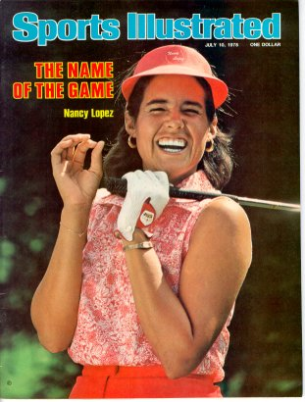
Nancy Lopez
Born January 6th,1957 in Torrence, California. Nancy Lopez received her first golf clubs at the age of eight and fell in love with the sport. After she moved back to Roswell , New Mexico. She enter golf tournaments and won the following.
She first won the pee-wee tournament at the age on nine then going on to win the state championship.
At the age of 12, Nancy won the New Mexico Women’s Amateur.
The next year she won USGA junior girls championship twice, The Western Junior, three times, and the Mexican Amateur in 1975.
In 1975, Nancy also entered the U.S. women’s open as an amateur and finish in tie for 2nd .
She also won many others.
Deanna Blackman 2nd
Nancy also won “Player of the Year “ three times. Also the Vare Trophy winner three times, and her stroke average in 1985 was 70.73. an LPGA record.
Lopez won enough tournaments to qualify for the LPGA hall of fame the youngest to ever be qualified .

Slide 21
America Ferrera
Maci Gardner

Slide 22
Biography
America Ferrera was born on April 18, 1984, in Los Angeles, California. She is the youngest of six siblings and born to Honduran immigrants. Her mother raised her and her siblings in the Woodland Hills section of Los Angeles, where she began at age eight acting in school plays and community theater. She made her film debut in 2002 by taking a role in Real Women Have Curves and has been seen, since then, in films such as Gotta Kick It Up!, Sisterhood of the Traveling Pants and its sequel. In 2006, she landed the lead role in TV series Ugly Betty, a role that won her both a Golden Globe and Screen Actors Guild Award in 2007.

Slide 23
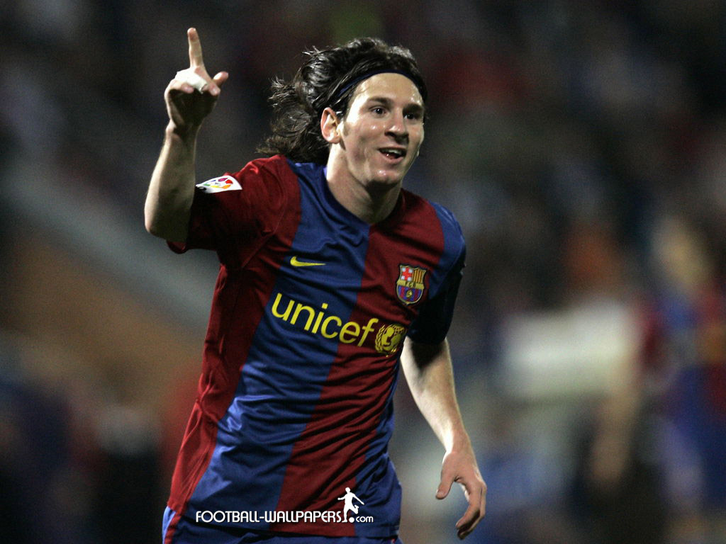
Luis Lionel Andres Messi
By J.T. Lovett

Slide 24
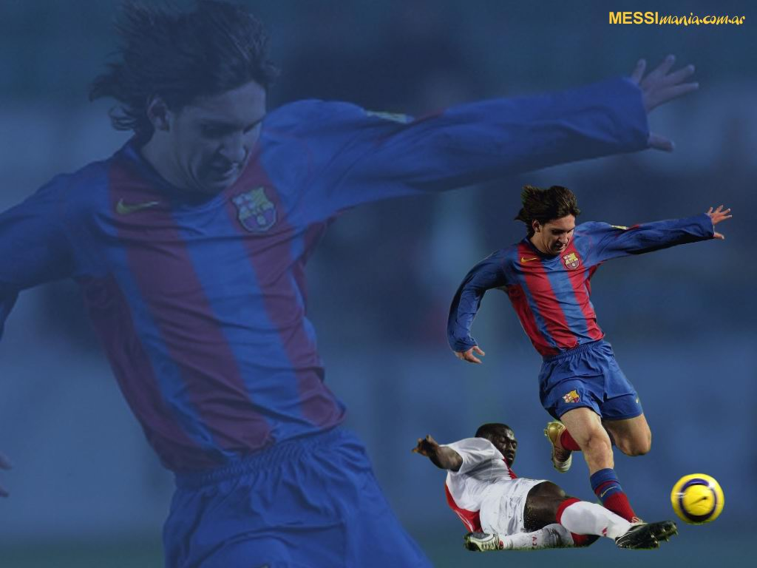
Lionel Messi Bio
Messi was born on June 24, 1987 in Rosario, Argentina. Futbol
became natural to Messi while he started at the age of 5.
At the age of 11 he suffered from a
hormone deficiency and Lionel’s
parents were unable to pay for the
treatments in Argentina so they moved
to Barcelona, Spain.
The career ladder for Messi was fairly easy.
At the age of 17 he finally got his chance to play
for his country in the U-20 league. In September
2005 Messi was given an improved
and extended contract until 2014

Slide 25
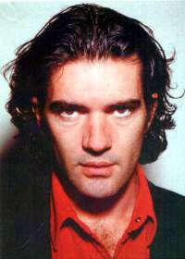
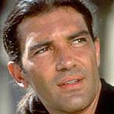
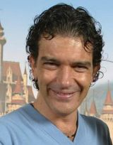
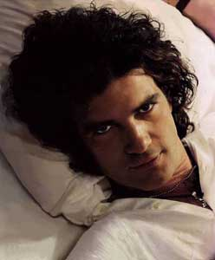
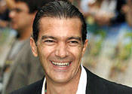
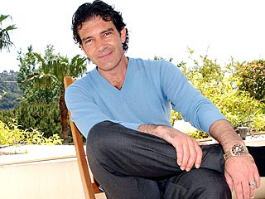
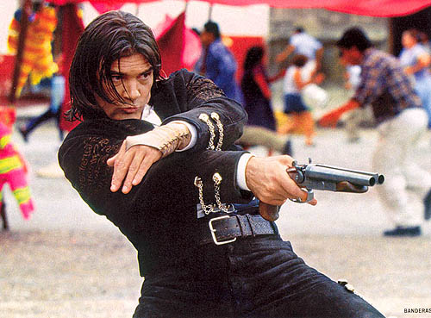
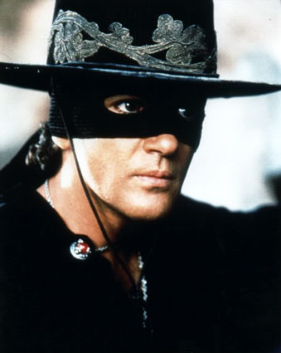
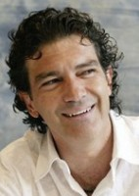
Antonio Banderas
By Josh Pinson

Slide 26
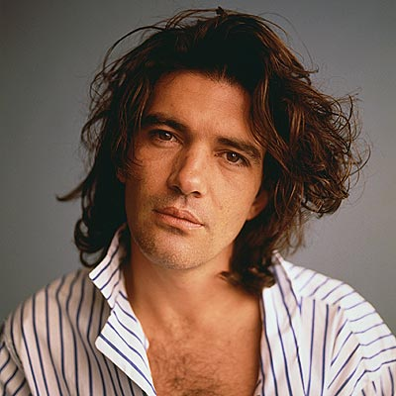
José Antonio Domínguez Banderas
Born on August 10, 1960
Wanted to play soccer, broke his foot
Started acting in ‘88
First U.S. film was Mambo Kings
Received an honorary doctorate on May 2000 from Dickinson College, Pennsylvania.
“I don't want anything I don't deserve, (but) if they offer me more money, I'm not stupid.”

Slide 27
Rafael Furcal
BY:CJ Knight

Slide 28
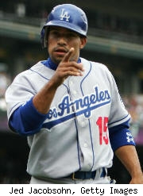
About Ralf
Born on 10/24/1977
He's from Loma de Cabrera, Dominican Republic
Height is 5’8 and 185 pounds
Debut 4/4/2000
Current team LA dodgers
Position: Shortstop/ infield

