Slide 1
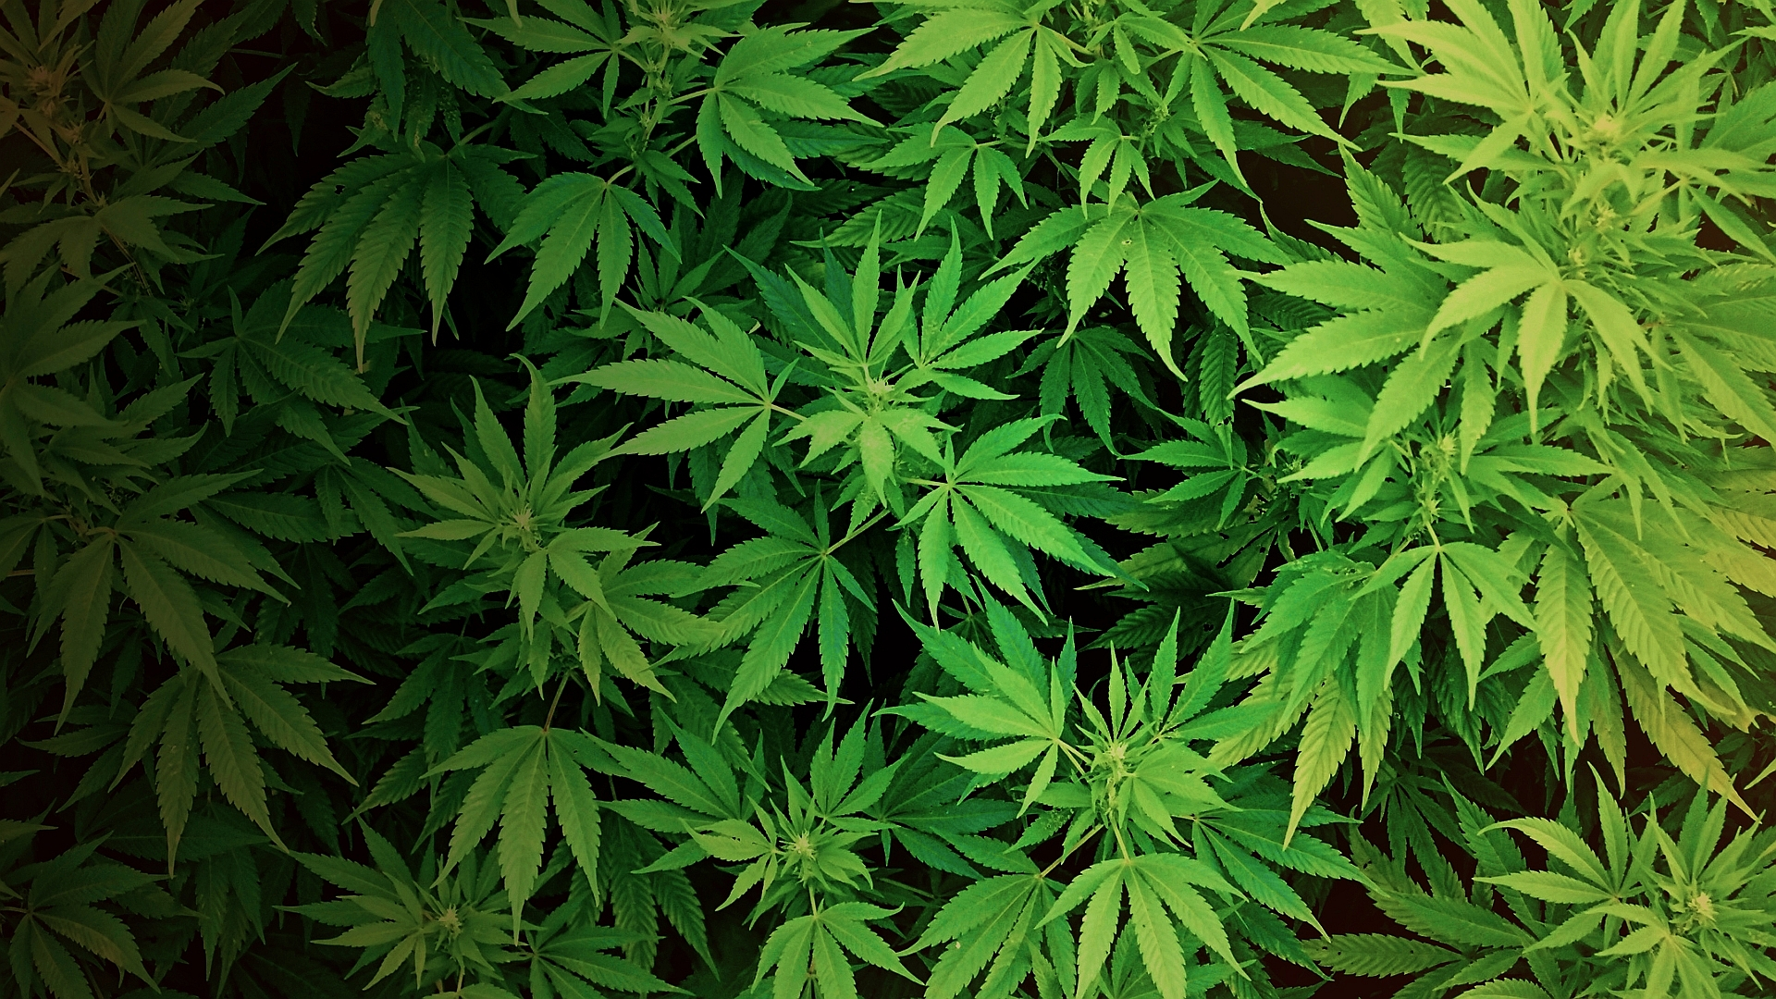
-Marijuana-
~By Paola Oros and Vanessa Alcala~

Slide 2
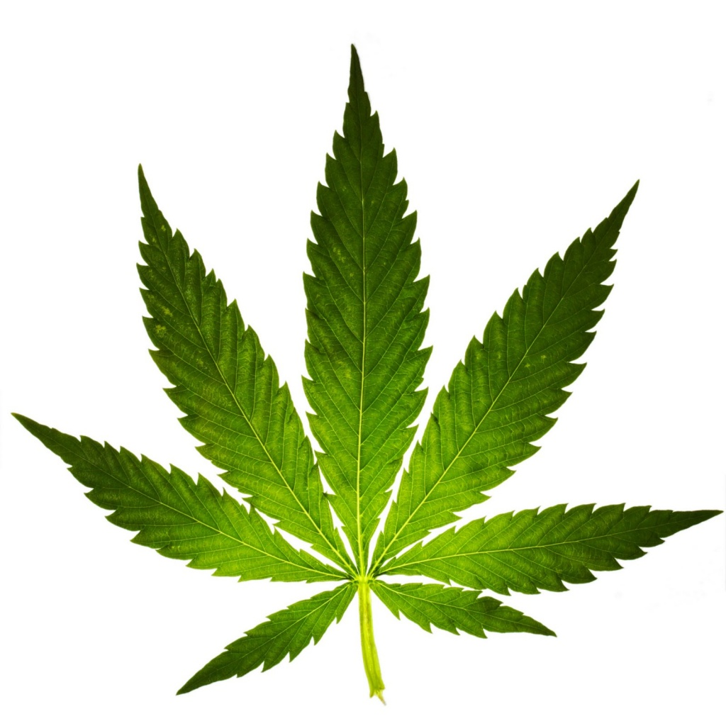
Description
Marijuana is the word used to describe the dried flower seeds and brown mix of leaves, flowers, stems and leaves of seeds from the hemp plant cannabis sativa.

Slide 3
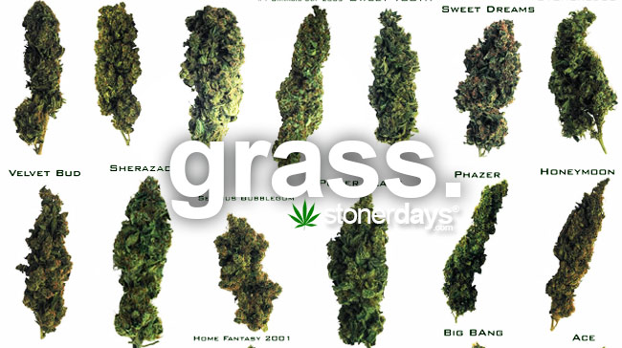
Slang Names
Weed
Mary Jane
Herb
Green
Gash
Flower
Dope
Bash
Wooch
Ashes

Slide 4
Short-Term Effects
Sensory Distortion
Panic
Anxiety
Poor coordination of movement
Lowered reaction on time
Increased heartbeat (risk of heart attack)

Slide 5
Long-Term Effects
Reduced resistance to common illness (cold, bronchitis etc.)
Suppression of the immune system
Growth disorders
Increase of abnormally structured cells in the body
Reduced sexual capacity
Personality and mood changes
Inability to understand things clearly

Slide 6
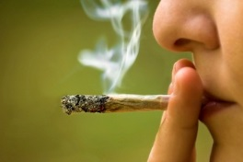
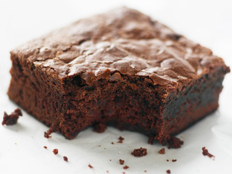
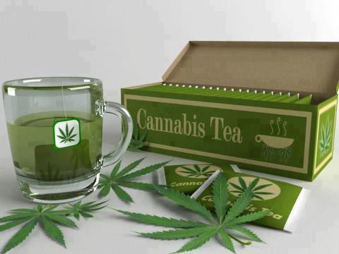
Methods of Use
Inhaling
Smoking
Consume it
Marijuana tea

Slide 7
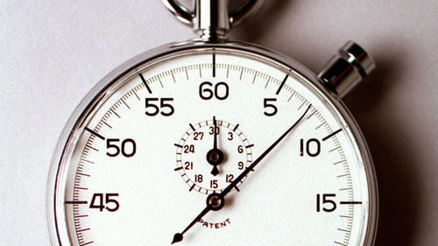
Signs of Addiction
Red, blurry, Bloodshot eyes
Constant, mucus-filled cough
Rapid heartbeat
Poor memory
Poor coordination
Slow reaction time

Slide 8
Withdrawal Symptoms Treatment Options
Distorted, impaired, coordination
Difficulty in thinking and problem solving
Ongoing problems with learning and memory
Insomnia
Most common symptom is depression
Cognitive behavioral therapy
Contingency management
Motivational enhancement therapy

Slide 9
Statistics

Slide 10
Sources
http://www.unitedpatientsgroup.com/resources/methods-of-consumption
http://www.timberlineknolls.com/drug-addiction/marijuana/signs-effects
http://www.theweedblog.com/list-of-marijuana-slang-terms/
http://www.drugfreeworld.org/drugfacts/marijuana/short-and-long-term-effects.html
http://www.drugabuse.gov/publications/research-reports/marijuana/available-treatments-marijuana-use-disorders
http://www.ncbi.nlm.nih.gov/pubmed/3009708
http://www.drugabuse.gov/drugs-abuse/marijuana
https://www.marijuana-anonymous.org/literature/pamphlets/detoxing-from-marijuana

