Slide 1
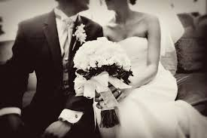
My Wedding
Breanna Rosales

Slide 2

description
My wedding will be an outdoor wedding at Blacklake Golf resort. The ceremony will be held outside. It will be a medium size wedding. The main color will be blue with some white. My father will be walking me down the aisle.

Slide 3
Guest List
Mr. & Mrs. Michael Rosales Sr.
Mrs. Margie Rosales & Guest
Ms. Nicole Del Rio & Guest
Mr. Brandon Rosales & Guest
Mr. Michael Rosales Jr. & Guest
Mr. Seth Rosales & Family
Mr. & Mrs. Steve Chaney & Family
Mr. & Mrs. Javier Martinez & Family
Mr. & Mrs. Terry Mohr
Mr. & Mrs. Joey Orozco & Family
Mrs. Cindy Zaragoza & Guest
Mr. & Mrs. Adrian Suepolvada
Ms. Isabel Furnaro
Ms. Rose Robles & Guest
Ms. Randee Garcia & Guest
Mr. Andrew Madrigal & Guest
Mr. Roy Ramirez & Guest
Mrs. Monique Hoorbery & Guest
Mrs. Kayla Velasco & Guest
Mrs. Letty Hoobery & Guest
Mrs. Krista Cano & Guest
Mrs. Angelica Perez & Guest
Mrs. Myriah Garcia & Guest
Mrs. Nina Garcia & Guest
Mrs. Cassie Perez & Guest
Mrs. Mikayla Perez & Guest
Mrs. Maxine Lopez & Guest
Mrs. Myranda Morales & Guest
Mrs. Natalie Zaragoza & Guest
Mrs. Jackie Lopez & Guest

Slide 4
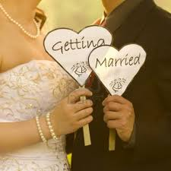
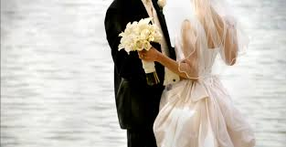
The Ceremony
The Ceremony will be civil. It will be held at at two o'clock pm. There will be music be processional while the bride is walking down the isle. They will be playing “Here Comes the Bride”. The vows will a mix of traditional and original.

Slide 5
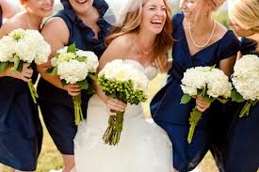
Wedding party
Maid of Honor
Vanessa Chaney
Bridesmaids
Nicole Del Rio
Citlaly Martinez
Best Man
Steven Orozco
Groomsmen
Brandon Rosales
Michael Rosales Jr.

Slide 6
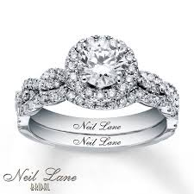
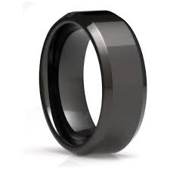
Wedding rings
Neil Lane Bridal Set
$9,299.00
Kay’s
Cash, credit card, layway and store credit card
Men’s Wedding band Tungsten Carbide
$249.00
Kays
Cash, credit card, layway and store credit card

Slide 7
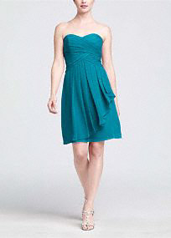
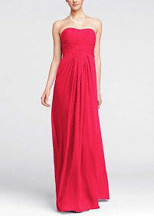
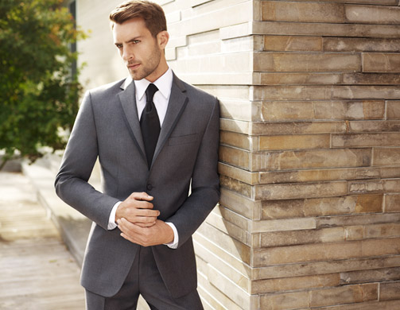
Wedding attire
Bridesmaid Dress
Short Crinkle Chiffon
$119.00
David's Bridal
Maid of honor
Long Chiffon Dress
$129.00
David’s Bridal
Best Man & Groomsmen
Vera Wang grey suit
$799.00

Slide 8
Wedding attire

Slide 9
Wedding attire
Groom
Vera Wang grey suit
$799.00

Slide 10
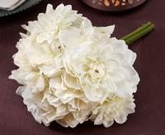
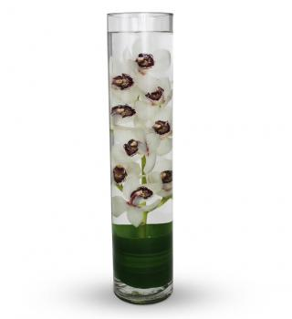
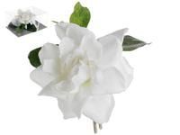
flowers
Boutonniere
1 flower:$7.79
Alforal flowers
Total: $77.90
Dahlia & hydrangea bouquet
1 bouquet: $14.99
Afloral flowers
Total:$59.96
Orchid center pieces
1 center piece:$39.99
Avas flowers
Total:$399.90

Slide 11
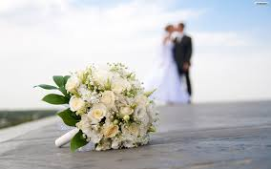
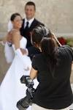
photographs
Katie’s Photography
Wedding Plus Package
Engagement session or rehearsal coverage
Full coverage of wedding day
Online viewing gallery for 12 months
Digital download gallery for 30 days
Blog post
$3500.00

Slide 12
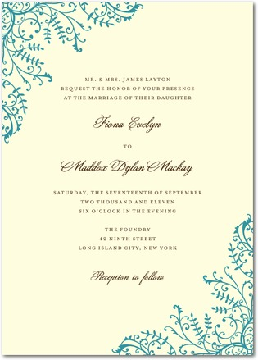


Invitations
Fine Filigree invitations
$2.00
Total:$200.00
Thank you cards
$1.29
Total:$129.00
Response cards
$1.09
Total:$101.09

Slide 13
Wedding party gifts

Slide 14
Wedding party gifts

Slide 15
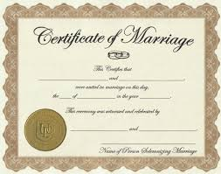
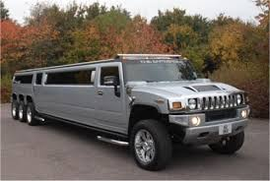
miscellaneous
Barb’s Transportations
H-2 Hummer Limousine will seat 10 -12 adults
$150.00 per hour
Total:1,200.00
Marriage License Fee
San Luis Obispo County
$100.00

Slide 16
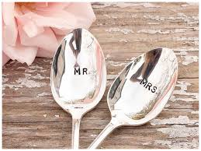

The reception

Slide 17

location
Blacklake Golf resort
The Stars Reception
Outside on the greens
Tables, glassware, linen, chairs, and tables included
Dance floor
Canopy
Venue manager
$1750

Slide 18


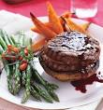
Food
Main Course
Hors D’oeuvres
Traditional Bruschetta
$55.00
Total:$220.00
Cesar Salad
Grilled Filet Mignon
Sauteed veggies
Garlic mashed potatoes
$42.00
Total:$4200.00
Assorted grillled sausage
$75.00
Total:$300.00
Gourmet Macaroni & Cheese Bar
$145.00
Total:$290.00

Slide 19


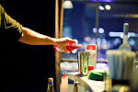
Beverages
Water, Lemonade and Ice tea will be served with dinner
Service Fee
Bartender
Glassware
Mixers
$150.00

Slide 20
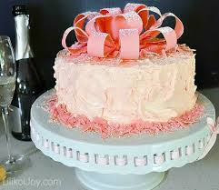
cake
Madonna Inn
Strawberry Cakes (In Season)
Full sheet/single layer
Serves 80-100 people
$179.00

Slide 21
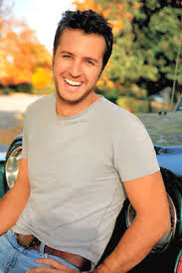
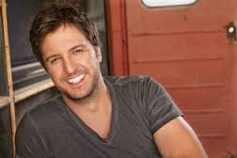
music
Luke Bryan will be performing at my wedding and playing during the reception
$750,000.00

Slide 22

miscellaneous
Monogram Napkins will be at the reception.
$69.00

Slide 23
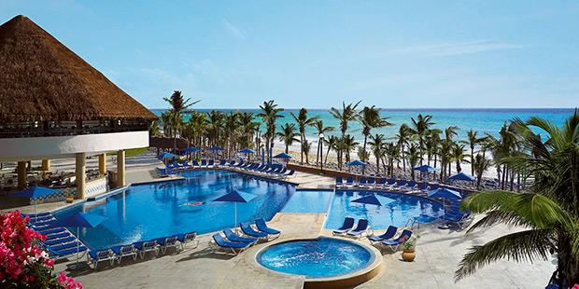
Honeymoon
Cancun, Mexico

Slide 24



honeymoon
Air Flight
Planned Activites
•Destination Services Representative (2 Adults )
•Personal Promo Code (2 Adults )
•SPF 100 Sunshine Protection Plan (2 Adults )
•ATV Single (1 Person Per ATV) (2 Adults )
•Chichen Itza w/ lunch (2 Adults )
•Coba Maya Encounter (2 Adults )
•Horseback Riding by the Jungle (2 Adults )
•Mayan Adventure (2 Adults
Hotel
Viva Wyndham Maya
Mexico | Playa del Carmen
Check In: Thu, Nov 20, 2014
Check Out: Tue, Nov 25, 2014
Depart Thu., Nov 20
7:00AM from Los Angeles, CA (LAX)
American Airlines 2424
Total flight time: 6hr 10mn
1 stop ( DFW )
3:10PM arrive Cancun (CUN)
Full Details
Return Tue., Nov 25
7:55AM from Cancun (CUN)
American Airlines 1394
Total flight time: 10hr 35mn
1 stop ( MIA )
4:30PM arrive Los Angeles, CA (LAX)
Total: USD $2,671.02

Slide 25
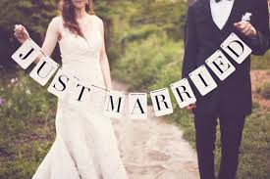
financing
After talking to my parents I will have them paying for half of my wedding. I would like to have my husbands parents put a quarter of the wedding. And myself and my husband will be put up the rest of the money for the wedding.

Slide 26
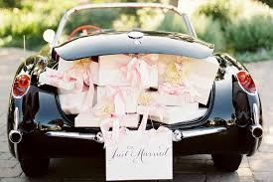
Bridal Registry

Slide 27
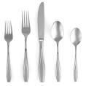
silverware
Gorham Tulip Frosted Flatware
Salad fork, dinner fork, dinner knife, soup spoon and tea spoon
$29.99
Macy’s
Total:$239.92

Slide 28

dishes
Signature Living Barcelona
4 dinner plates, 4 salad plates, 4 bowls, 4 mugs
$49.99
Macy’s
Total:$99.98

Slide 29

glassware
The cellar silhouettes
8 highball glasses, 8 double old fashioned glasses
$19.99
Macy’s

