Slide 1
Microsoft Excel 2013

Slide 2
Microsoft Excel 2013 is a spreadsheet application in the Microsoft Office Suite.
A spreadsheet is an accounting program for the computer, used for quick calculations. Spreadsheets are primarily used to work with numbers and text.
Spreadsheets can help organize information, like alphabetizing a list of names or ordering records, or calculate and analyze information using mathematical formulas.
By the end of this lesson, students should be able to:
Identify the parts of the Excel window
Understand the differences between a Workbook and a Worksheet
Understand a cell and its importance to Excel
Move around a workbook

Slide 3
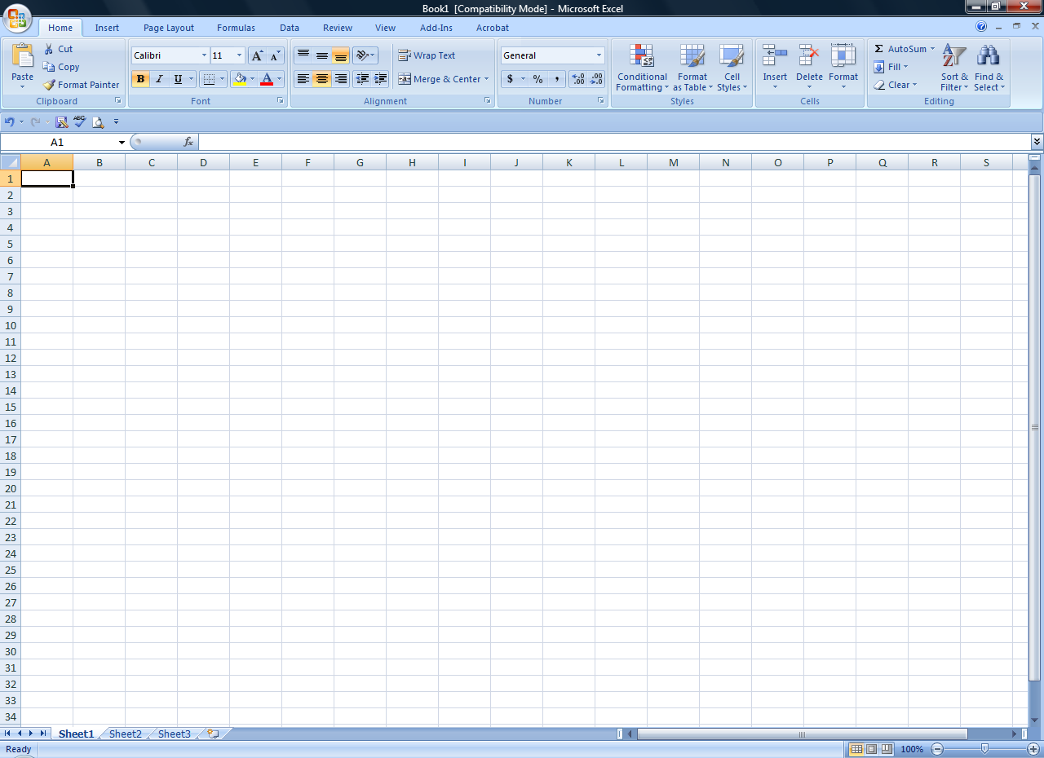
The Excel Window
Name Box
Ribbons
Toolbar Menus
Formula Bar
Cell
Column Headings
Worksheet Window
Row Headings
Navigation buttons
Sheet Tabs

Slide 4
Workbook
Also called a spreadsheet, the Workbook is a unique file created by Excel.
Title bar
The Title bar displays both the name of the application and the name of the spreadsheet.
Ribbons
The Menu bar displays all the menus available for use in Excel 2013. The contents of any menu can be displayed by clicking on the menu name with the left mouse button.

Slide 5
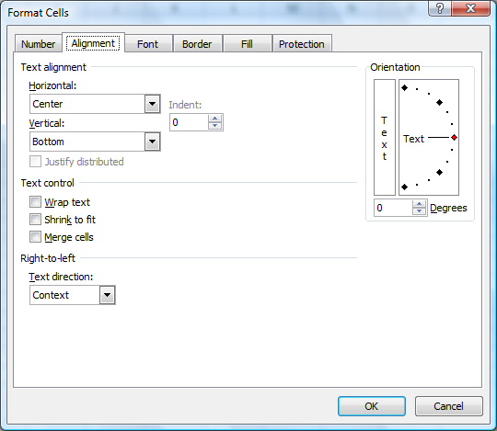
Ribbon Menus
Get a more detailed view of what a single menu can do by expanding it. This is the format cells menu.

Slide 6
Column Headings
Column Headings
Each Excel spreadsheet contains 256 columns. Each column is named by a letter or combination of letters.
Row Headings
Each spreadsheet contains 65,536 rows. Each row is named by a number.

Slide 7
Name Box
Shows the address of the current selection or active cell.
Formula Bar
Displays information entered-or being entered as you type-in the current or active cell. The contents of a cell can also be edited in the Formula bar.

Slide 8
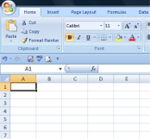
Cell
A cell is an intersection of a column and row. Each cell has a unique cell address. In the picture above, the cell address of the selected cell is A1. The heavy border around the selected cell is called the cell pointer.
Navigation Buttons and Sheet Tabs
Navigation buttons allow you to move to another worksheet in an Excel workbook. Used to display the first, previous, next or last worksheets in the workbook.
Sheet tabs separate a workbook into specific worksheets. A Workbook defaults to three worksheets. A Workbook must contain at least one worksheet.

Slide 9
Workbooks and Worksheets
A Workbook automatically shows in the workspace when you open Microsoft Excel 2013. Each workbook contains three worksheets. A worksheet is a grid of cells, consisting of 65,536 rows by 256 columns. Spreadsheet information--text, numbers or mathematical formulas--is entered in the different cells.
Column headings are referenced by alphabetic characters (letters) in the gray boxes that run across the Excel screen, beginning with the Column A and ending with Column IV.
Rows are referenced by numbers that appear on the left and then run down the Excel screen. The first row is named Row 1 and the last row is named 65536.
Important Terms
A workbook is made up of three worksheets.
The worksheets are labeled Sheet1, Sheet2, and Sheet3.
Each Excel worksheet is made up of columns and rows.
In order to access a worksheet, click on the tab that says Sheet#.

Slide 10
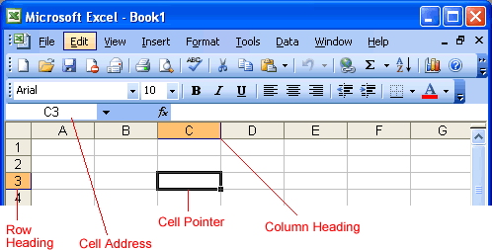
The Cell
An Excel worksheet is made up of columns and rows. Where these columns and rows intersect, they form little boxes called cells. The active cell, or the cell that can be acted upon, reveals a dark border. All other cells reveal a light gray border. Each cell has a name. Its name is comprised of two parts: the column letter and the row number.

Slide 11
In the following picture the cell C3, formed by the intersection of column C and row 3, contains the dark border. It is the active cell.
Important Terms
Each cell has a unique cell address composed of a cell's column and row.
The active cell is the cell that receives the data or command you give it.
A darkened border, called the cell pointer, identifies it.

Slide 12
Moving around the worksheet
You can move around the spreadsheet in several different ways.
To Move the Cell Pointer:
To activate any cell, point to a cell with the mouse and click.
To move the pointer one cell to the left, right, up, or down, use the keyboard arrow keys.
To Scroll Through the worksheet:
The vertical scroll bar located along the right edge of the screen is used to move up or down the spreadsheet. The horizontal scroll bar located at the bottom of the screen is used to move left or right across the spreadsheet.

Slide 13
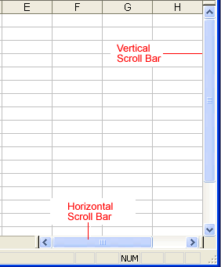
Moving around the worksheet

Slide 14
The PageUp and PageDown keys on the keyboard are used to move the cursor up or down one screen at a time. Other keys that move the active cell are Home, which moves to the first column on the current row, and Ctrl+Home, which moves the cursor to the top left corner of the spreadsheet or cell A1.
To Move between worksheets
As mentioned, each Workbook defaults to three worksheets. These worksheets are represented by tabs-named Sheet1, Sheet2 and Sheet3-that appear at the bottom of the Excel window.
To Move from one worksheet to another worksheet:
Click on the sheet tab (Sheet1, Sheet2 or Sheet 3) that you want to display

