Slide 1
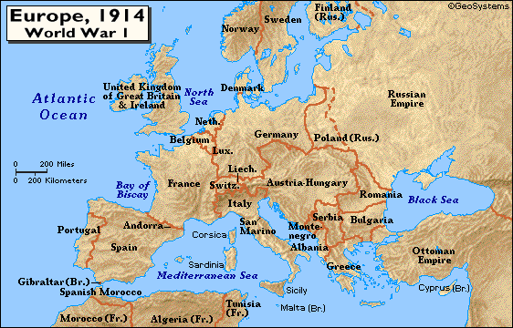
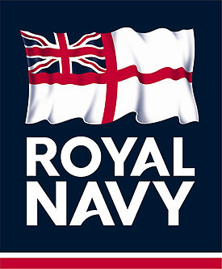
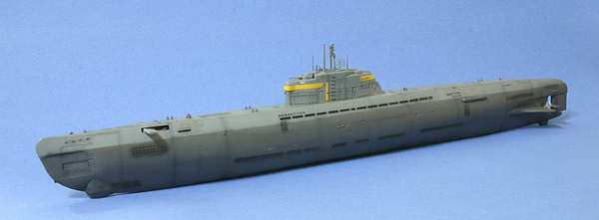
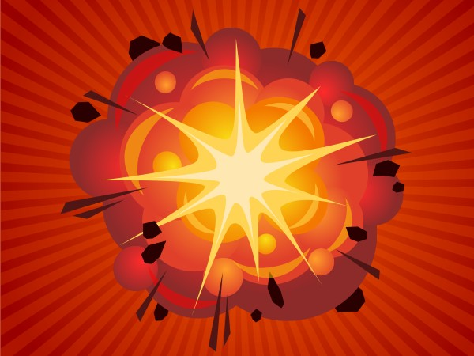

Slide 2
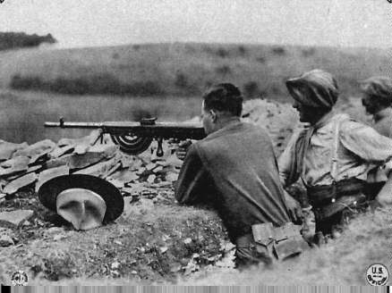
World War I

Slide 3
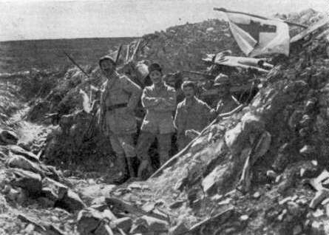
I. The Early War Years

Slide 4
The “MAIN” Causes of WWI
The underlying causes that created a powder keg in Europe that was ready to explode.
Militarism: The large European powers began an industrial military arms race.
Alliances: an intricate system of national treaties and alliances developed in Europe that would compel most of the world to declare war at the slightest incident.
Imperialism: A growing rivalry over European trade, colonies, and spheres of influence in Africa and Asia
Nationalism: (love of country and willingness to sacrifice and even die for it ) among the countries of the world
The Immediate cause of WWI (the spark that lit the keg’s fuse)
The assassination of Archduke Ferdinand of Austria-Hungary

Slide 5
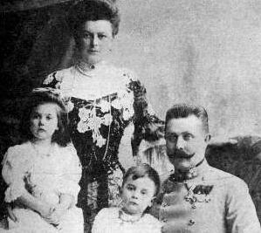
Archduke Franz Ferdinand & His Family

Slide 6
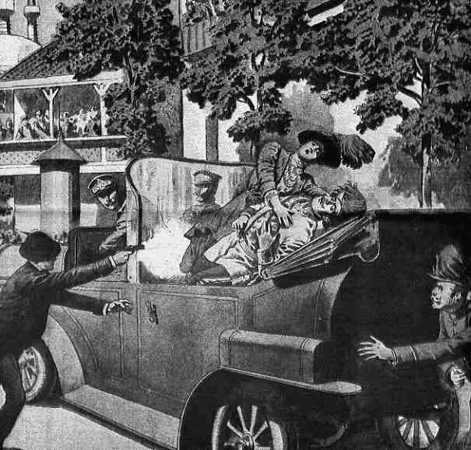
The Assassination: Sarajevo

Slide 7
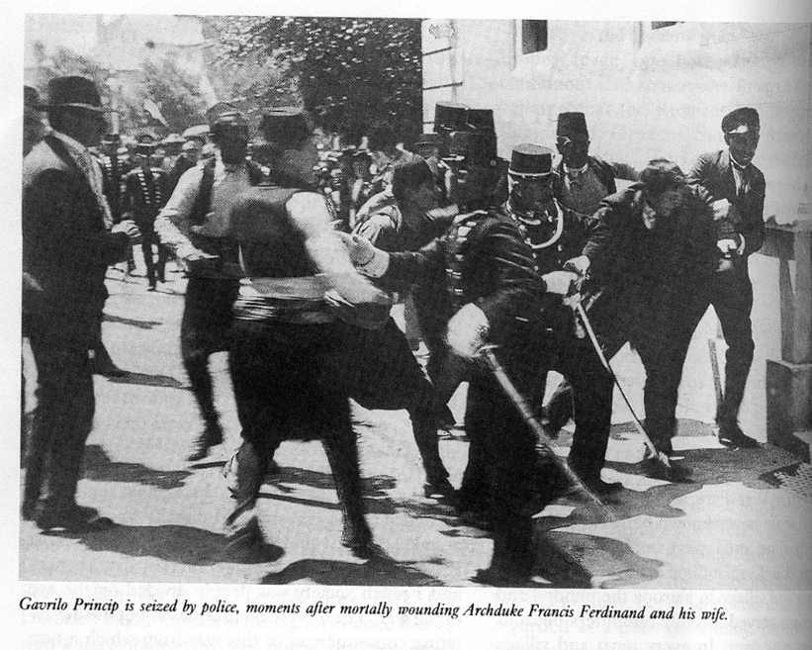
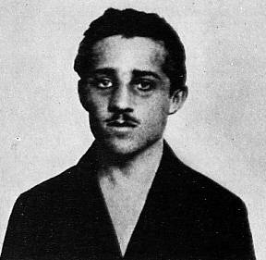
The Assassin:
Gavrilo
Princip
The Black Hand

Slide 8
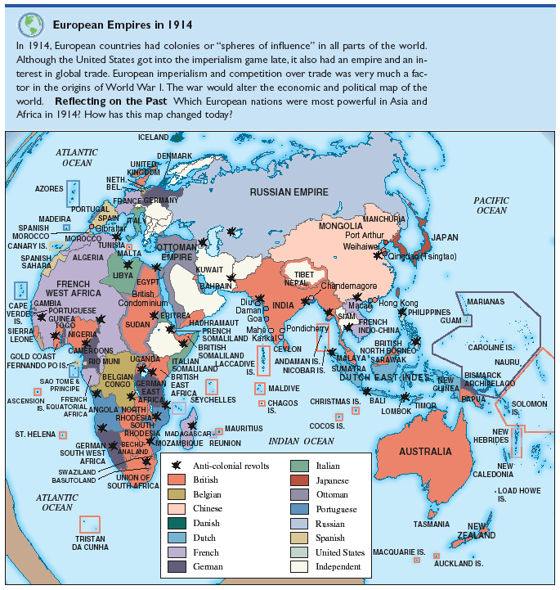
Imperialism

Slide 9
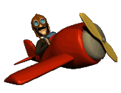
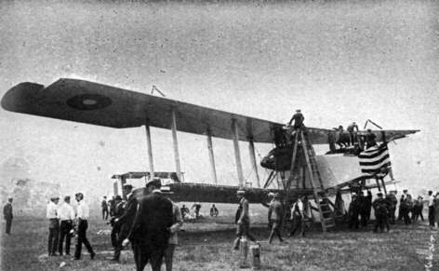
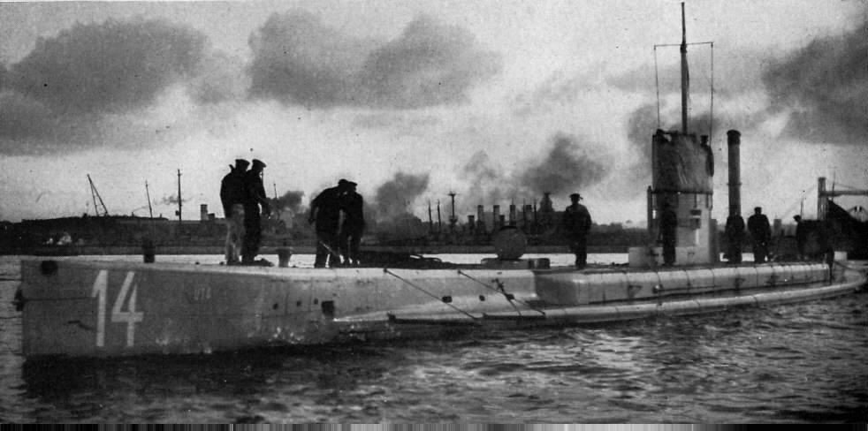
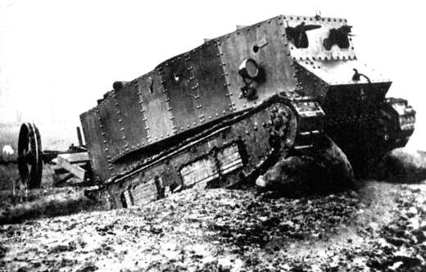

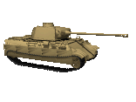
New Military Technology
The new industrialism meant new advances in the science of warfare
Rapid-firing rifles, improved explosives, motorized Gatlin guns, and enormous artillery pieces, submarines and tanks
Airplanes, poison gas and trench warfare strategies

Slide 10
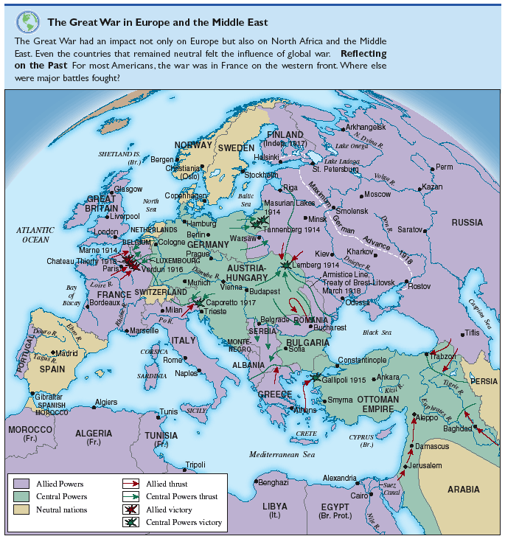
Alliances

Slide 11
The sides formed
Triple Entente (Allies)
  France
  Great Britain
  Italy
  Russia (1917 exit)
  United States (1917 entry)
Central Powers
  Germany
  Austria-Hungary (empire)
  Ottoman Empire
  Bulgaria

Slide 12
Nationalism
PRIDE !

Slide 13
American Neutrality
Despite President Wilson’s call for American neutrality, the feeling of nationalism in American immigrants was in favor of supporting the Allies. Why?
Ultimately, most Americans believed that France and England were fighting to preserve European culture against barbarians. What word describes a feeling of cultural and ethnic superiority?
To gain support of Americans, both sides in Europe used propaganda (information that influences opinion). Allied propaganda emphasized the German invasion of neutral Belgium and horror stories of German atrocities.

Slide 14
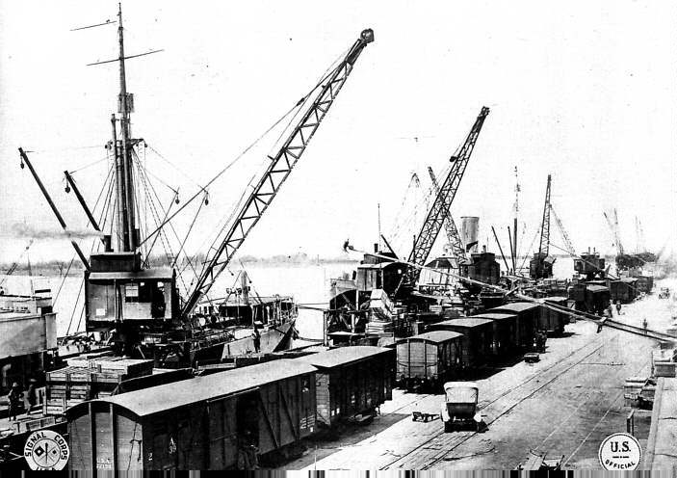
The United States
Enters the War

Slide 15

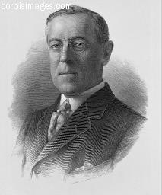
Reasons for U.S. Neutrality:
Many Americans wanted to remain isolated from European conflicts
Many believed that the war was not in US best interests & that the Atlantic served as a barrier of protection from European problems
President Wilson campaigned on the slogan “He kept us out of war”
Wilson believed that a neutral U.S. could arrange a fair peace agreement in Europe

Slide 16
Reasons why the U.S. Entered the War:
Economic ties
  The U.S. traded more with Britain and France. (U.S. was not strictly neutral) Many sympathized w/Br. & Fr.
Submarine warfare
  German U-boats attack ships in British ports
  U.S. protested unrestricted submarine warfare
  Wilson vows to hold Germany responsible for loss of American life or property
Germany sinks the Lusitania (British ship)
  128 Americans are killed
  At this point, Germany did not want war with the U.S. and agreed to stop attacking neutral ships.
  Later, Germany continued unrestricted submarine warfare in British waters

Slide 17
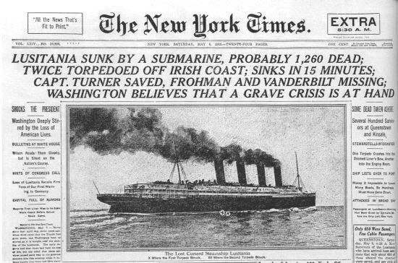
New York Times May 8, 1915/Ship torpedoed May 7, 1915

Slide 18

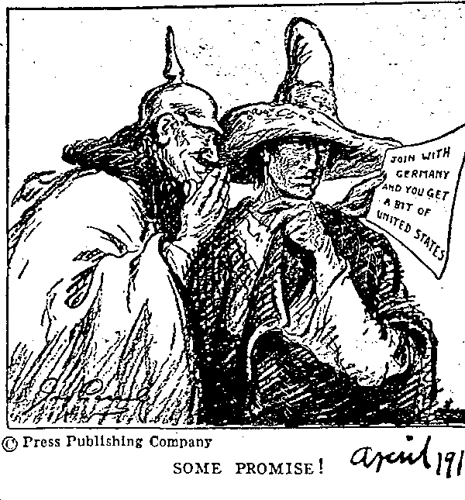
The Zimmermann Telegram

Slide 19
The Zimmermann Telegram
Germany’s foreign secretary (Zimmermann) sent a secret note to Mexico (February 1917)
Germany urged Mexico to attack the U.S. and in return, Mexico would gain back territory previously lost to the U.S.
Americans and Wilson are outraged by the Zimmermann telegram

Slide 20
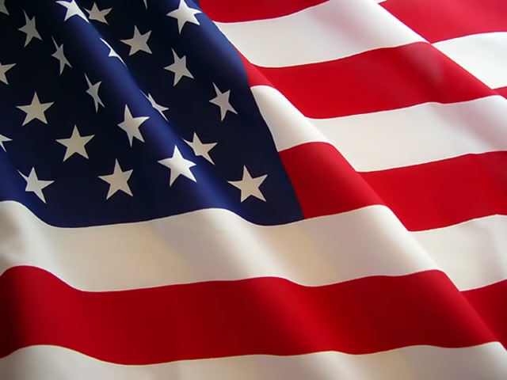
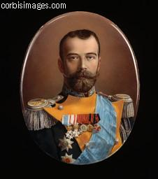
Other Reasons for U.S. Entrance
Russian Revolution
  When war broke out (1914) Russian people supported their Czar
  Heavy losses and economic hardship caused discontent
  In March 1917, the Czar was forced to step down (eventually executed)
  Wilson believed that the revolution would end Russian monarchy and bring democracy
  Without a Czar, it was easier for Wilson to support the allies (keeping the world safe for democracy)
Germany resumes unrestricted submarine warfare
  German U-boats sank several U.S. merchant ships

Slide 21

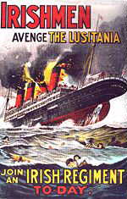
Propaganda
Propaganda is the spreading of ideas that help a cause or hurt an opposing cause
Each side pictured each other as savage beasts
Anti-German propaganda often referred to Germans as Huns
Many Americans came to favor Britain & France

Slide 22
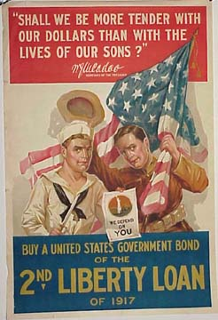
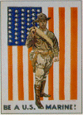
U.S. Declares War!
April 2, 1917, Wilson asks Congress to declare war against Germany
Wilson states “the world must be made safe for democracy.”
April 6, Wilson signs the declaration of war.
Americans begin to fear Germany’s power (economic & military)
America is pushed into the deadliest war the world has yet seen.

Slide 23
Summary
Why did the U.S. abandon neutrality and enter WWI?
  America had economic ties to the British & French
    Sold war millions in war materials to both/sympathy for Br. & Fr.
  Fear of German power
    Possible threat to US security
  Unrestricted submarine warfare
    German interference with US shipping
    Sinking of the Lusitania
  The Zimmerman Telegram
    Americans were outraged when details of the telegram were published in newspapers
  The Russian Revolution
    With the Czar gone, it was easier to support the allies (Democracy)

Slide 24
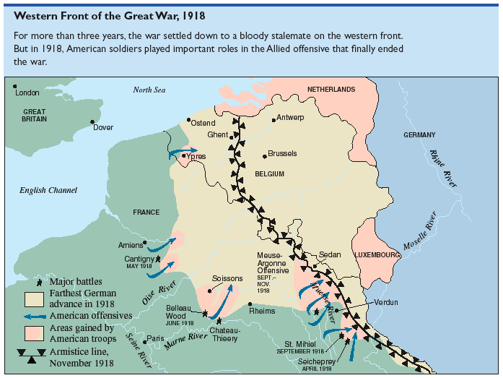

Slide 25
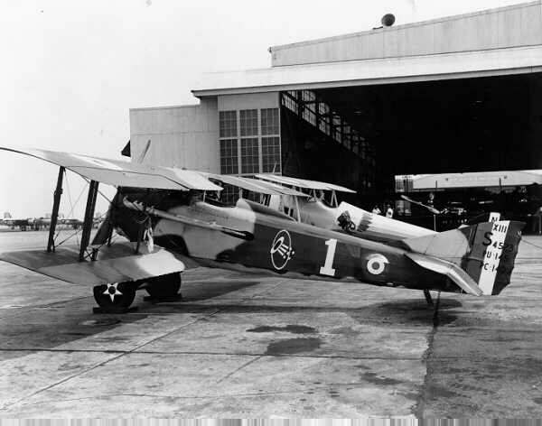
The Military Experience

Slide 26
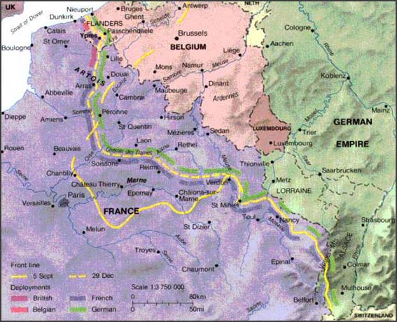
How did the U.S Help to Secure an Allied Victory in WWI?
Trench Warfare
STALEMATE

Slide 27
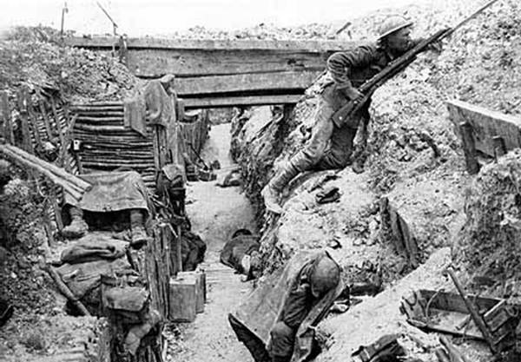
Fighting in Trenches
James Lovegrave, interviewed in 1993.
Life in the trenches was hell on earth. Lice, rats, trench foot, trench mouth, where the gums rot and you lose your teeth. And of course dead bodies everywhere

Slide 28
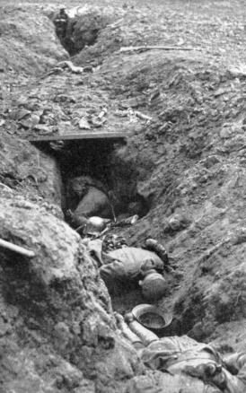
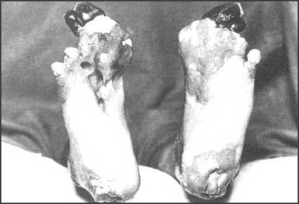
Fighting in Trenches
Captain Impey of the Royal Sussex Regiment wrote this account in 1915.
The trenches were wet and cold and at this time some of them did not have duckboards or dug-outs. The battalion lived in mud and water.

Slide 29
Fighting in Trenches
Henry Gregory of 119th Machine Gun company was interviewed after the war about life in the trenches.
One night, as we lay in bed after doing our two hours' sentry - we did two hours on and two hours off - my friend Jock said 'damn this, I cannot stand it any longer!' He took off his tunic - we slept in these - then he took off his jersey, then his shirt. He put his shirt in the middle of the dug-out floor and put his jersey and tunic on again. As we sat up in bed watching the shirt he had taken off and put it on the floor it actually lifted; it was swarming with lice.

Slide 30
Fighting in Trenches
Some of these rats grew extremely large. One soldier wrote: "The rats were huge. They were so big they would eat a wounded man if he couldn't defend himself." These rats became very bold and would attempt to take food from the pockets of sleeping men. Two or three rats would always be found on a dead body. They usually went for the eyes first and then they burrowed their way right into the corpse.
One soldier described finding a group of dead bodies while on patrol: "I saw some rats running from under the dead men's greatcoats, enormous rats, fat with human flesh. My heart pounded as we edged towards one of the bodies. His helmet had rolled off. The man displayed a grimacing face, stripped of flesh; the skull bare, the eyes devoured and from the yawning mouth leapt a rat."

Slide 31
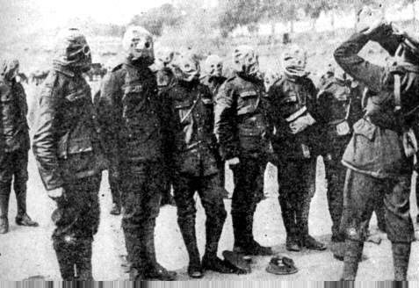
Fighting in Trenches
William Pressey was gassed on 7th June 1917. He survived the attack and later wrote about the experience of being gassed.
I was awakened by a terrific crash. The roof came down on my chest and legs and I couldn't move anything but my head. I found I could hardly breathe. Then I heard voices. Other fellows with gas helmets on, looking very frightened in the half-light, were lifting timber off me and one was forcing a gas helmet on me. Even when you were all right, to wear a gas helmet was uncomfortable, your nose pinched, sucking air through a canister of chemicals.
I was put into an ambulance and taken to the base, where we were placed on the stretchers side by side on the floor of a marquee. I suppose I resembled a kind of fish with my mouth open gasping for air. It seemed as if my lungs were gradually shutting up and my heart pounded away in my ears like the beat of a drum. On looking at the chap next to me I felt sick, for green stuff was oozing from the side of his mouth.
To get air in my lungs was real agony. I dozed off for short periods but seemed to wake in a sort of panic. To ease the pain in my chest I may subconsciously have stopped breathing, until the pounding of my heart woke me up. I was always surprised when I found myself awake, for I felt sure that I would die in my sleep.

Slide 32
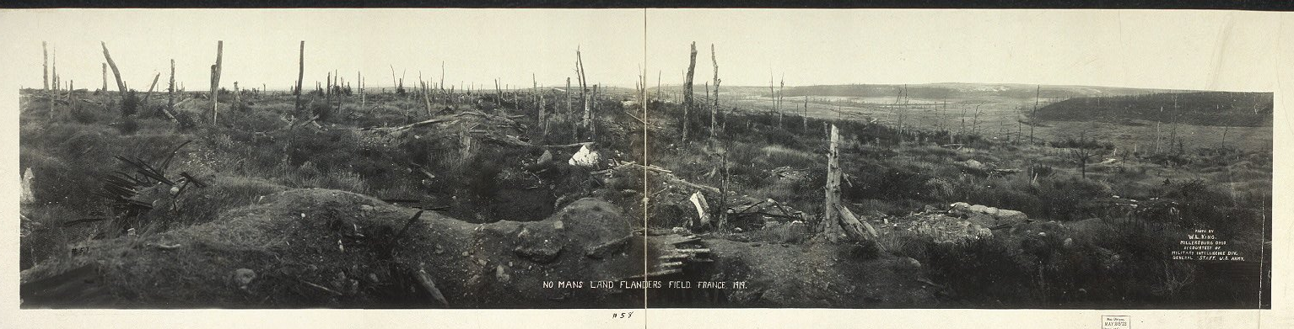
The War at a Stalemate
Why was the war at a stalemate?
  Both sides were dug in while engaging in the horrors of trench warfare
  During the stalemate, the frontline moved only a few miles for months at a time
  Neither side was able to gain ground, thousands of troops were lost on both sides
No Mans Land

Slide 33
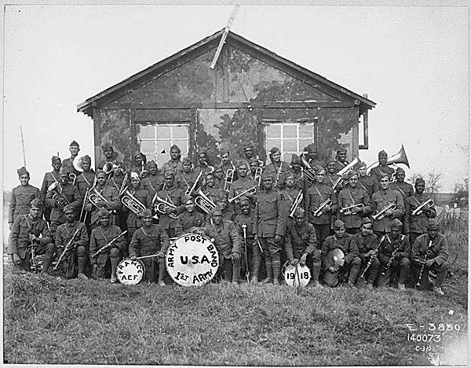
How did the U.S. Entry Break the Stalemate?
Americans in France
  1918, U.S. troops arrive in France in great numbers (General Pershing)
  American troops had an independent role and also helped British and French troops
  Strength & Energy of fresh U.S. troops broke the stalemate and turned the tide of the war toward the allies

Slide 34
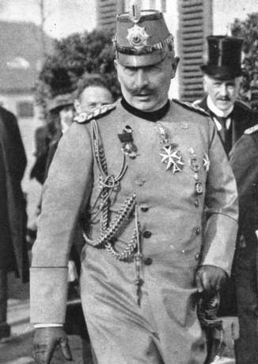
The War Ends
Germany realized that since the US entry into the war, it could not win
The German Kaiser abdicated his throne
Armistice is reached (Agreement to stop fighting)
The shooting stopped at 11am on November 11th 1918. (11th hour of the 11th day of the 11th month)

Slide 35
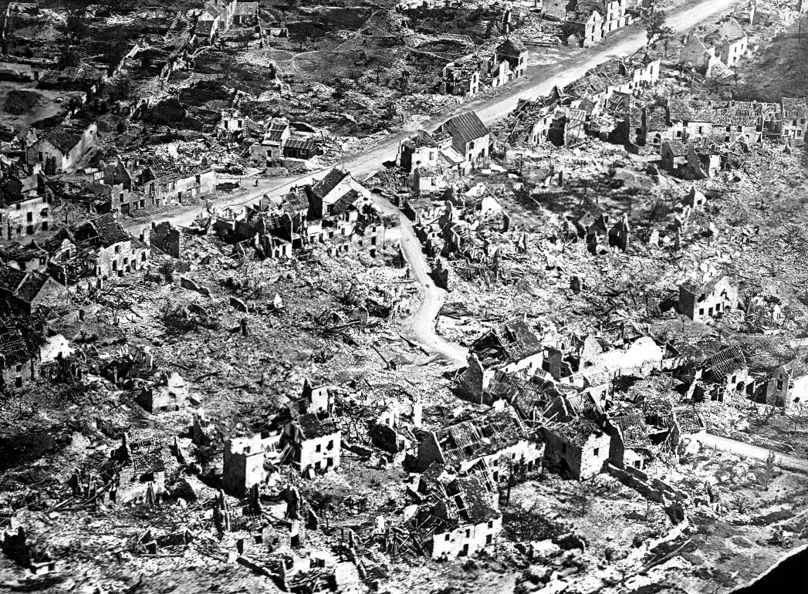
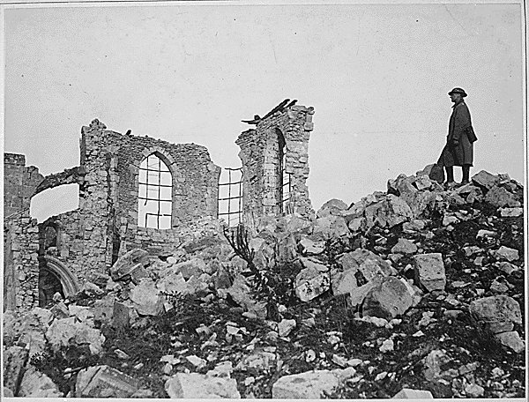
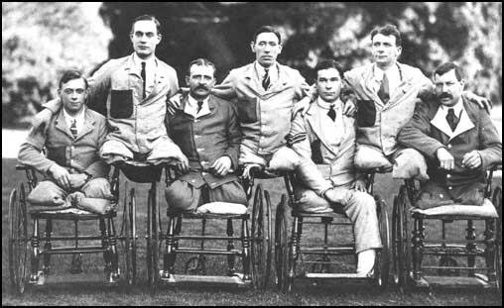
The Cost of War
8 to 9 million Europeans died in battle
50,000 Americans died in battle
More than 20 million soldiers on both sides were wounded
Northern France was in ruins
Millions of Germans were near starvation
Many European children were left orphaned and homeless
Flu epidemic killed more than 20 million people worldwide. (Twice as many as the war itself)

Slide 36

How did the U.S Help to Secure an Allied Victory in WWI?
Summary
U.S. troops added new energy, manpower, and firepower to the allied cause
U.S. industry, untouched by war, provided the weapons and technology needed to win
The entrance of the U.S. (toward the end of the war) broke the stalemate and pushed the allies to victory

Slide 37
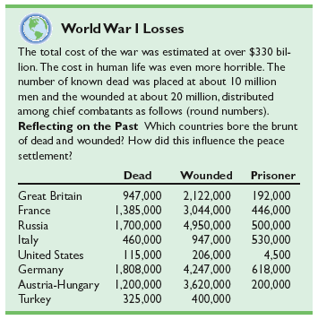

Slide 38
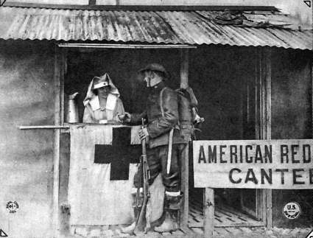
Domestic Impact of the War

Slide 39
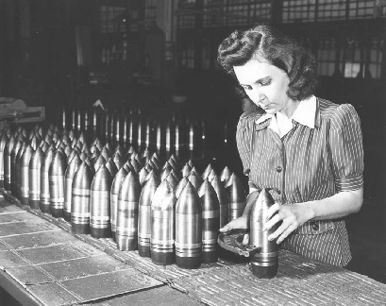
How did the U.S. organize
its war effort?

Slide 40
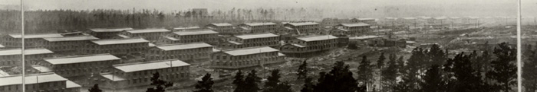
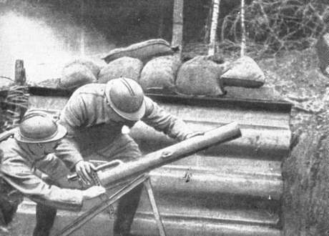
Camp Upton,Long Island
Training Center

Slide 41

Appeal to patriotism, team work

Slide 42
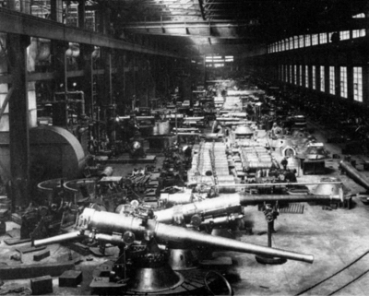
US Industry Mobilized for War

Slide 43
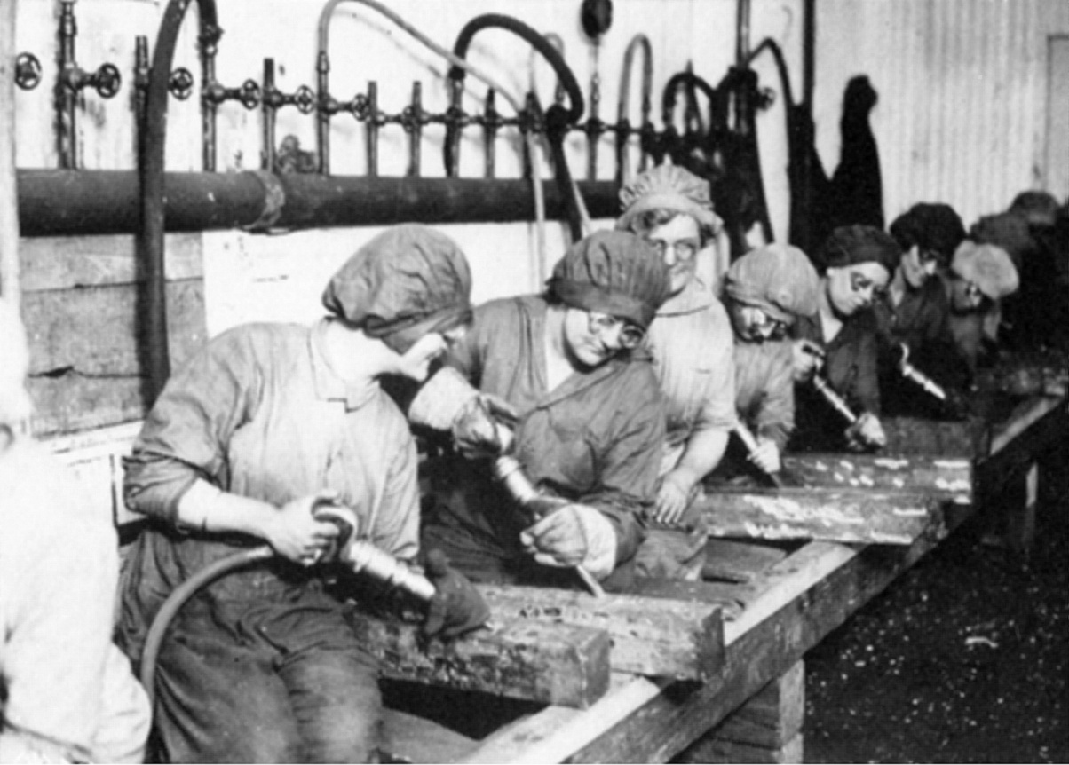
Women Work in Factories

Slide 44
War bonds/Financial Support

Slide 45
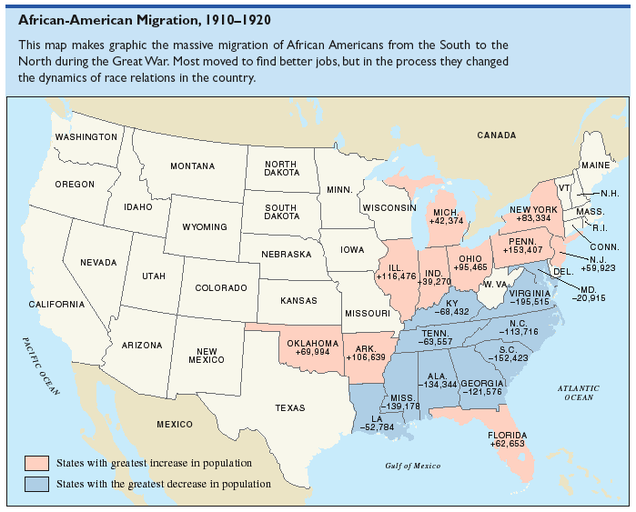

Slide 46
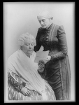
Suffrage for Women
In the fall of 1918, Woodrow Wilson asked Congress for support in the quest for women’s right to vote
While many still opposed women suffrage, careful organization and planning by women’s clubs produced demonstrations and arguments that the government could no longer ignore
The Nineteenth Amendment, securing a woman’s right to vote, was ratified in 1920

Slide 47
At the End of WWI A New Battle Rages Against A Global Pandemic
The fall of 1919, brought the end of the Great War, and the beginning of a Spanish Flu epidemic that claimed the lives of over 43,000 American servicemen, 675,000 Americans overall, and 40 million people worldwide in the space of little more than two years

Slide 48
Waging Peace/Post WWI
How did America react to the
Treaty of Versailles?

Slide 49
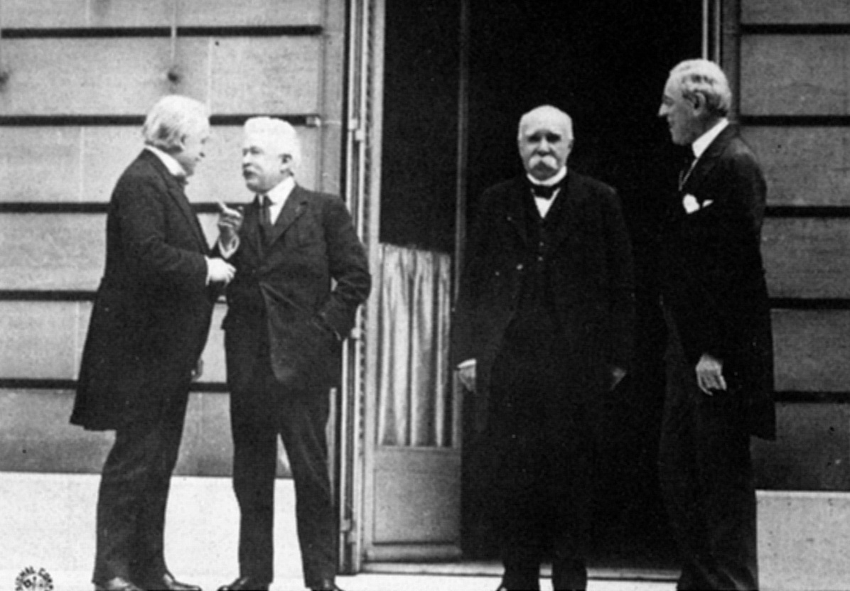
The Big 4/Settle Key Issues

Slide 50
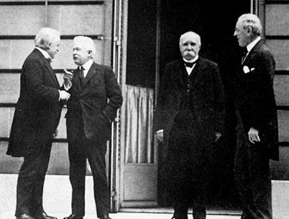
Winning the Peace: The Versailles Peace Conference
Paris and Palace of Versailles
Big Four:
  Woodrow Wilson (USA)
  David Lloyd George (GBR)
  Georges Clemenceau (FR)
  Orlando Vittorio (IT)
Russia excluded
Defeated powers humiliated
Wilson’s 14 points the major proposal

Slide 51
“I can predict with absolute certainty
that within another generation there will
be another world war if the nations of
the world do not concert the method
by which to prevent it."
Woodrow Wilson, 1919

Slide 52

Wilson’s 14 Points
To “make the world safe for democracy”
#1-5 - international law recommendations
#6-13 - European boundary restructure
#14 - League of Nations

Slide 53

Features of the Treaty of Versailles
Very Limited
German Military

Slide 54

REPARATIONS

Slide 55

Germany/Full Blame
for the War

Slide 56

The League of Nations
Wilson's 14 points

Slide 57

America's Reaction

Slide 58

Why did the US Reject the Treaty of Versailles?
Critics of the Treaty believed that the League would drag the US into future European wars (Senator Henry Cabot Lodge)
Americans were “war weary” and wanted to return to isolationism
Wilson suffered a stroke and was unable to sell the treaty to the people
The US refused to join the League of Nations, making the League a “paper tiger” or weak on the world stage.

Slide 59

Causes of WWI
Nationalistic pride
Competition for colonies
Military buildup
Tangled web of alliances
Assassination of Franz Ferdinand
Effects of WWI
Destruction in Europe
Boom in American economy
Suppression of dissent in the U.S.
Allied victory
Defeated empires lose their colonies
The U.S. emerges from the war as a
world leader and an economic giant

Slide 60


Slide 61



