Slide 1
SEX, DRUGS & ROCK N” ROLL

Slide 2
WHY??
Counter Culture of the 1960’s is a direct descendent of the Beat Culture of the 1940’s
Civil Rights—call to action for equality
Sit-ins, marches, protests, civil disobedience
Free Speech Movement
Sparked by Jack Weinberg incident
Rejection of conformist society (1950’s teen)
Vietnam war
Unjustifiable war, institution of the draft, get back to our human roots of peace and love

Slide 3
WHAT DID THE HIPPIES WANT?
Peace
Get back in touch with the innocence that has been lost through power struggles between races, social classes, sexes (need for open mindedness)
Love
Have a respect for each other and the planet we are all part of—massive consumerism, rampant development, greed, power are destroying elements of love
Revolution
Only through civil disobedience, freedom of self and acceptance of harmony can a perfect utopian society exist

Slide 5
What else is going on to fuel this?
VIETNAM!!!
LBJ and Nixon must win war (containment) but also cannot expand the war (war never declared). WHY??
Wanted to appease anti war sentiments (excuse) but really did not want to drag CHINA into war.
Credibility Gap growing
Journalistic term used to describe lack of trust towards government
This lack of trust motivated young people to desire revolution

Slide 7
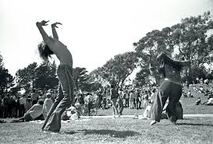
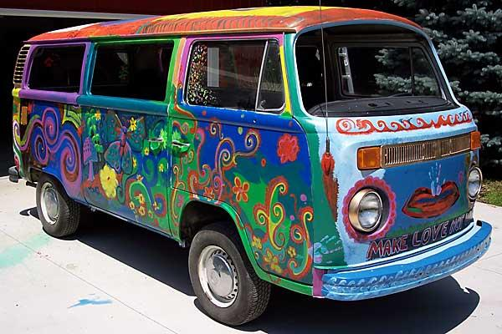
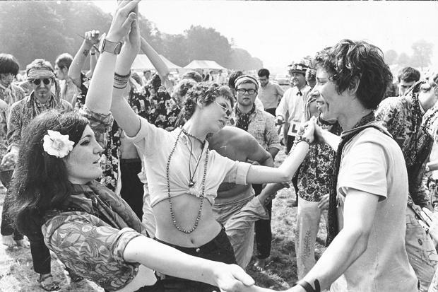

Slide 8
SEX
NEW FEMINISM--- “The Feminine Mystique”
Betty Friedan, 1962
Women are frustrated—don’t expect much out of life
Servers for children and husband
55 hours a week on household chores
Equal opportunity, equal pay, equal in the eyes of society
“The Pill” helped launch careers…also launched the sexual revolution
Helped break down double standards of sex

Slide 10
SEX
This led to the possibility of the Summer of Love 1967
75,000 young bohemians flock to San Francisco
Sparked by Ken Kesey and his Merry Pranksters, LSD, new styles of music and a desire to be free
Sex was an important part of the concept of personal freedom
Hair, clothing, personality helped propagate personal freedom
Roe vs. Wade was a major victory for Women’s sexual rights

Slide 11
DRUGS
LSD -- Lysergic acid diethylamide
Albert Hoffman 1938
Psychedelic Drug
CIA tested it on Bay area College students in early 1960’s (Ken Kesey)
“Expanded the mind” “created total unity of all humans” “Open the doors of existence”
Inspired the hippy movement, acid rock and the summer of love

Slide 12
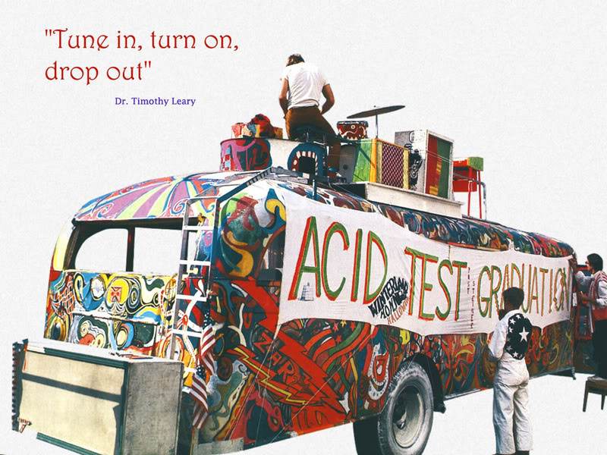

Slide 13
ROCK N’ ROLL
New forms of music
The Beatles, The Rolling Stones
Political
CCR, Joan Baez, Bob Dylan, CSNY
Acid Rock
Grateful Dead, Janis Joplin, Jimi Hendrix, The Doors
Next Thursday
Concert in Class!!

Slide 14
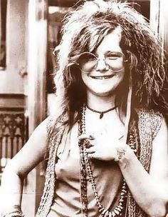
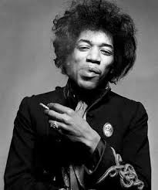
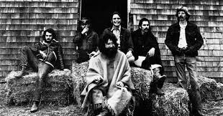

Slide 15
The End
1968
Tet offensive, MLK, RFK, Nixon and Reagan in office
1969
Last attempt to salvage ideologies of the era—Woodstock
1970
Kent State—last nail in the coffin

Slide 16
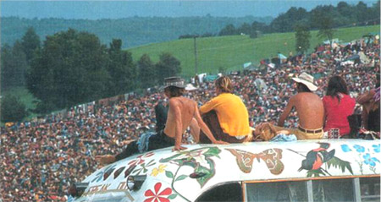

Slide 17
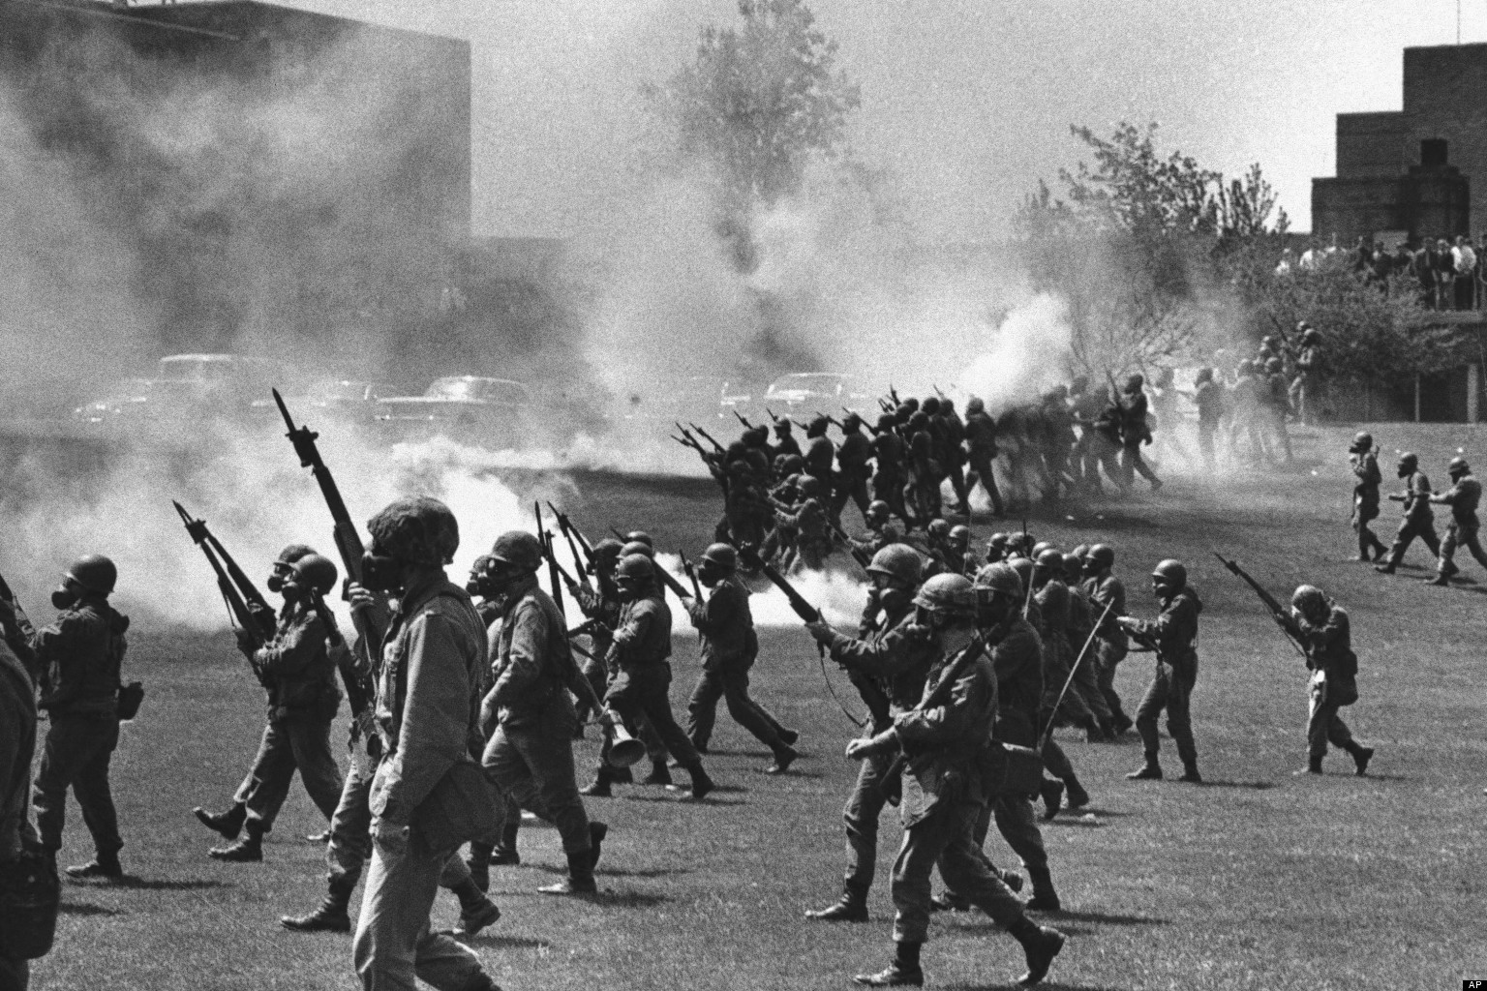

Slide 19
Impacts of 1960’s
Nixon
Watergate scandal
Uncovered massive abuses of power by Nixon’s administration
Phone tapping of Dem. HQ, ordered harassment of political opponents,
48 people indicted, Nixon resigns
Stagflation
Oil prices went up, deficit spending (great society), factories shutting down
High inflation, low consumer spending, high unemployment

