Slide 1
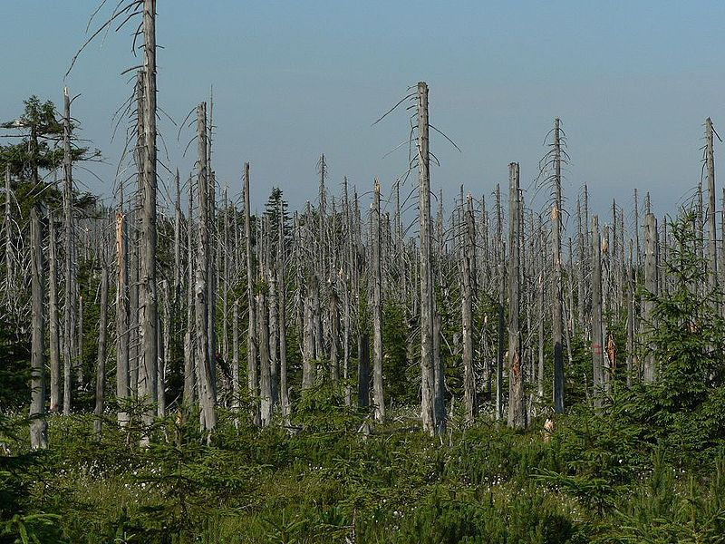
Acid Rain
ypte.org.uk

Slide 2
D22 – Learning Target
Explain how the release of sulfur dioxide (SO₂) into the atmosphere can form acid rain, and how acid rain affects water sources, organisms and human-made structures.

Slide 3
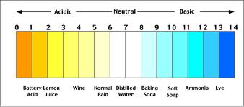
First, let’s review the pH scale
Substances with pH = 7 are neutral.
Substances with pH > 7 are basic.
Substances with pH < 7 are acidic.

Slide 4
What is the pH of “normal rain?”
Normal rain has a pH = about 5.6
Why is normal rain a weak acid?
The CO₂ gas in the atmosphere dissolves in the water vapor to form carbonic acid.
This is the same type of acid found in soda

Slide 5
So, what is acid rain?
First and foremost, acid rain includes more than just “rain.”
It is a mixture of wet and dry deposition from the atmosphere containing higher than normal amounts of nitric and sulfuric acids

Slide 6
What is deposition?
Deposition is the way that the pollution in the atmosphere falls to the ground.
What is wet deposition?
    This is when the pollution is deposited during the time of a storm
      Rain, snow or sleet
    Also, pollution can be deposited during fog

Slide 7
What is dry deposition?
What is dry deposition?
    This is when the pollution is deposited from the atmosphere in between storm events.
    Dry deposition can be in the form of small particles like dust, or even as smoke

Slide 8
Let’s talk about pH values
Pure water has a pH of 7.0.
Normal rain pH of approximately 5.6
As of 2000, the most acidic rain falling in the U.S. has a pH of about 4.3
How does this happen?

Slide 9
The Formation of Acid Rain
Acid rain is caused by sulfur dioxide (SO₂) and nitrogen oxides (NO_{x}) in the atmosphere.
These react in the atmosphere with water vapor (H₂O in gas phase)
The result is a mild solution of sulfuric acid and nitric acid in the atmosphere
These particles can travel long distances on wind currents

Slide 10
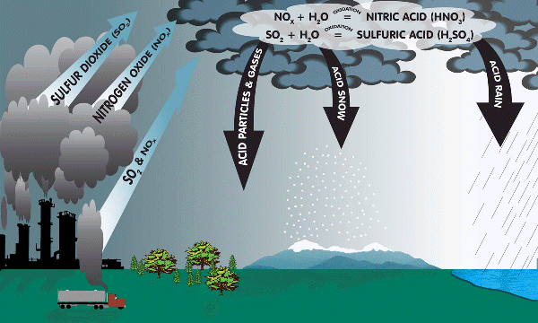
How acid rain is formed

Slide 11
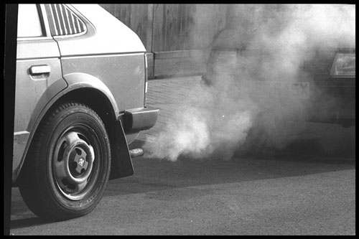
From where do Sulfur Dioxide (SO₂) and Nitrogen Oxide (NO_{x}) Particles originate?
SO₂ and NO_{x} are emitted from the combustion of fossil fuels.
  Electric utility plants contribute the greatest percentage of SO₂ and about 1/3 of NO_{x}
Other sources are:
  Automobile exhaust
    (1/2 of atmospheric NO_{x})
Natural sources
    Volcanoes
    Decaying vegetation
blog.usedcars.com

Slide 12
What are the effects of acid rain?

Slide 13
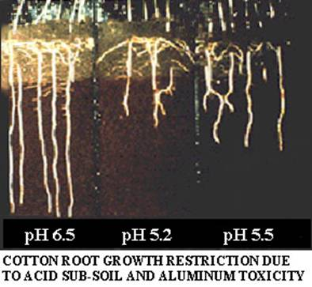
Acid Rain Causes Soil Damage
Acidic soils lose nutrients such as calcium, magnesium and potassium at a higher rate than normal.
Toxic aluminum ions will leach out of soils, and harm aquatic ecosystems
www.chemtrails.cc

Slide 14
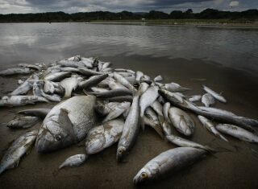
Damage to Aquatic Ecosystems
Acid rain releases aluminum from soils into lakes and streams which is highly toxic to many species of aquatic organisms

Slide 15
Specific effects on Aquatic Systems
Damages water systems by …
harming or killing individual fish or plankton which reduces overall population numbers
eliminating some fish or plankton species from a body of water, thereby decreasing biodiversity
disrupting the established food webs

Slide 16
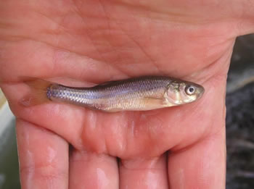
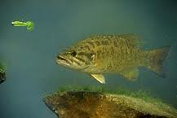
Effects on specific species
Minnows are an important part of the food chain, and cannot survive at pH less than 6.0
Smallmouth bass and other species such as walleye and lake trout, cannot survive at pH less than 5.3

Slide 17
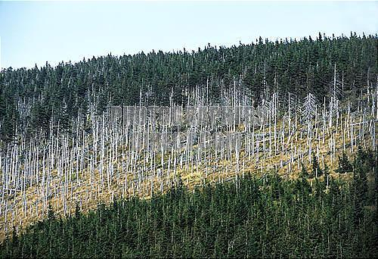
Forest Damage
Weakens trees …
  by damaging their leaves by removing the waxy outer coating
    This limits its protection and its ability to perform photosynthesis
  by limiting the nutrients available to them
  by exposing them to toxic substances slowly released from the soil
www.photographersdirect.com

Slide 18
How Does Acid Rain Affect Our Lives?
It reduces the amount of recreational areas available
It reduces the amount of food available
It erodes buildings and monuments
It corrodes painted finishes
It increases taxes

Slide 19
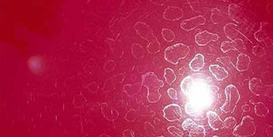
Acid Rain Damage to Car Paint

Slide 20
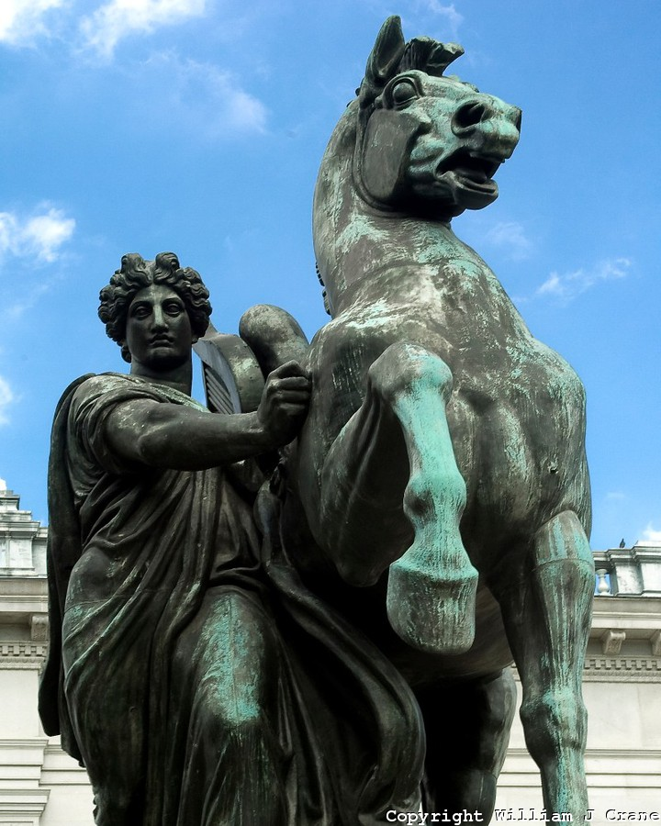
Acid Rain Damage to Metal Statues

Slide 21

Acid Rain Damage to Stone Statues

Slide 22
Ways to Reduce Acid Rain
Clean up smokestacks and exhaust pipes
Use alternative energy sources
Restore damaged ecosystems
Reduce the amount of electricity you use
Use energy-efficient appliances
Carpool, use a bicycle or walk

Slide 23
References
Acid Rain | US EPA. (2011). US Environmental Protection Agency. Retrieved from http://www.epa.gov/acidrain/index.html

