Slide 1
Blood
Cappiello
2014

Slide 2
Blood Question
Average blood volume per person
Vary male to female?
Men 5-6 liters
Women 4-5 liters
Factors that affect blood volume?
Body size
Fluid and electrolyte concentration
Amount of adipose tissue

Slide 3
Four components of Blood
Red Blood Cells
White Blood Cells
Plasma
Platelets

Slide 4
Blood Sample by Volume
Known as a hematocrit
RBC – 45%
WBC and platelets – Less than 1%
Plasma – 55%

Slide 5
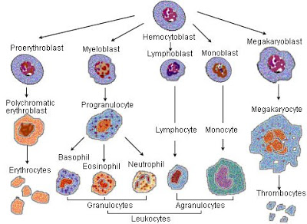
Origin of Blood

Slide 6
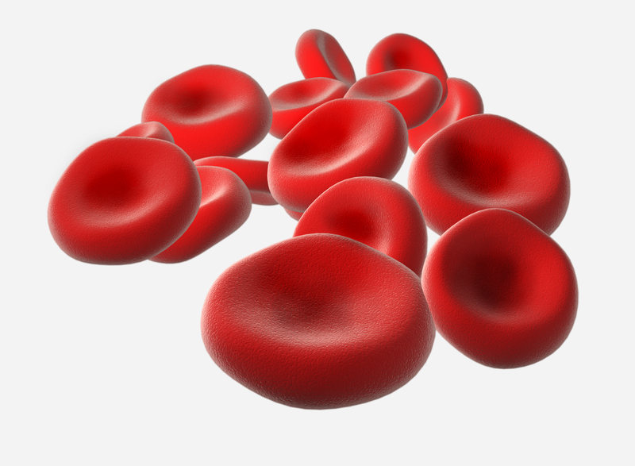
Red Blood Cells
Known as erythrocytes
Bio-concave discs
FXN: transport gases
1/3 hemoglobin (protein) by volume
Function of hemoglobin?
Cyanosis
Lack Nucleus and Mitocondria
Produce ATP through glycolysis

Slide 7
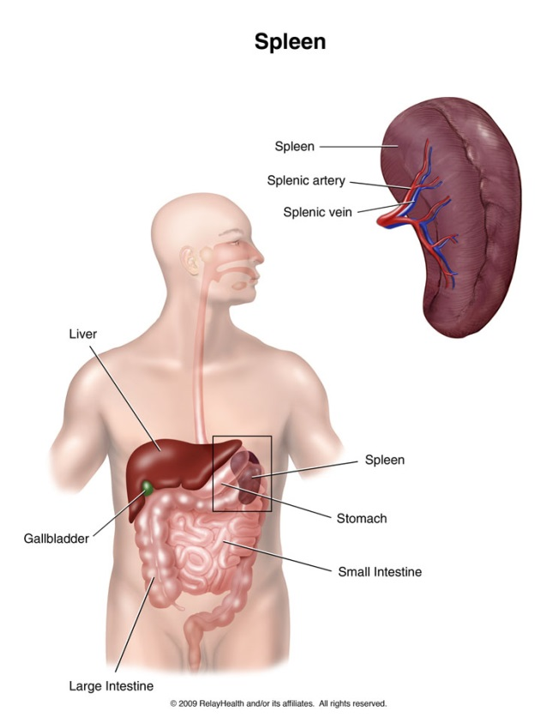
RBC Production/Destruction
Where are RBC Produced?
Where are RBC Destroyed?
Macrophages destroy in liver/spleen
Dietary factors that affect red blood cell production
Too little (anemic)
Protein increases the production of RBCs

Slide 8
White Blood Cells
Known as leukocytes – protect against disease
Develop from hemoctyoblasts in red bone marrow (see origin of blood slide)
WBCs transported to sites of infection (can leave bloodstream)
Five (major) types of WBC
Vary in size, nature of their cytoplasm, shape of nucleus, and staining characteristics.

Slide 9
2 Types of WBCs
Granulocytes- leukocytes with granular cytoplasm
Develop in the red bone marrow
Average lifespan: 12 hours
Includes Neutrophils, Eosinophils, and Basophils
Agranulocytes- cells without cytoplasmic granules
Include Monocytes and Lymphocytes
Monocytes (red bone marrow) Lymphocytes (organs of the lymphatic system

Slide 10
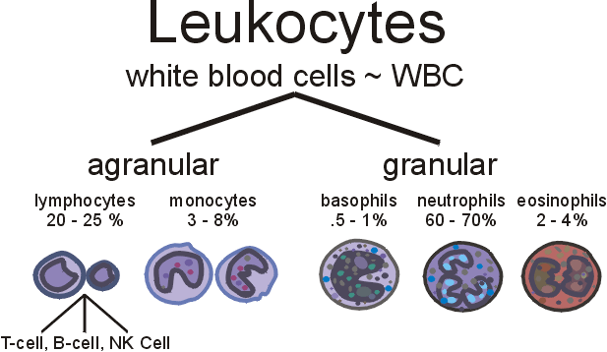
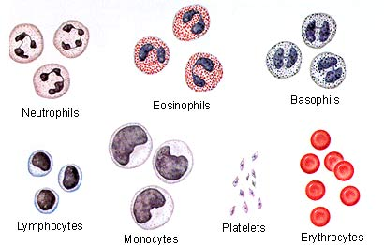
WBCs

Slide 11
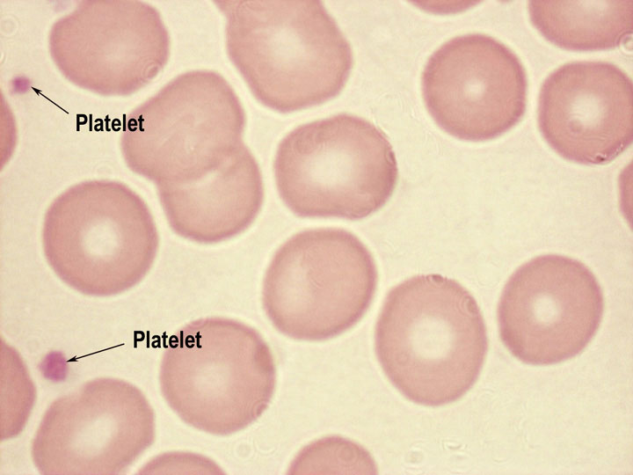
Platelets
Known as Thrombocytes (not complete cells)
Lacks nucleus and less than half the size of a RBC
Arise from red bone marrow
Amoeboid movement
Lifespan 10 days
FXN: close breaks in damaged blood vessels and initiate formation of blood clots

Slide 12
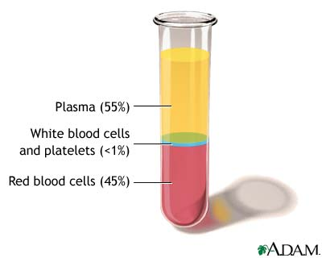
Plasma
Clear liquid that suspends cells and platelets
92% is water
Consists of plasma proteins, gases, nutrients, nonprotein nitrogenous substances and electrolytes

Slide 13
Plasma Components
Electrolytes
Water (92%)
Proteins (7%) – Albumins, Globulins, Fibrinogen
Wastes
Nutrients
Vitamins
Hormones
Gases (N2, O2, CO2)

Slide 14
Conditions/Diseases
Cyanosis
Sickle Cell Anemia
Anemia
Cancer (HIV and Leukemias)
Hemophilia
von Willebrand Disease
Hemolytic Disease

