Slide 1
Digestive System Diseases/Complications
Erin Hines, Nicole Nunez,
Christina Sanzari

Slide 2
DO NOW
What type of digestive disease causes regurgitation two or more times a week? (Regurgitation is the sour or bitter-tasting backing up into the throat or mouth)

Slide 3
Crohn's Disease
Inflammation of the lining of the digestive tract (one of the IBD)
Cause: Unknown. Immune system malfunction? Hereditary?
Symptoms: diarrhea, abdominal pain, cramping, ulcers, weight loss and appetite reduction (Children with the disease may have growth problems.)
Risk Factors: Young age, smoking, ethnicity, family history, where you live
Complications: bowel obstruction, fistulas, colon cancer, malnutrition
There is no cure for Crohn's.
Treatment: Anti-inflammatory drugs, immune system suppressors, antibiotics, surgery,

Slide 4
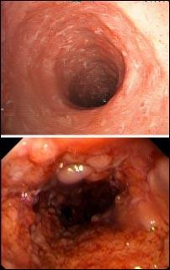

Slide 5
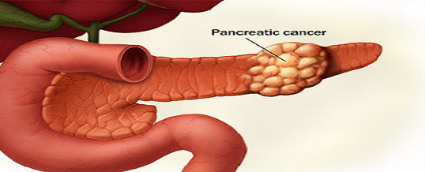
Pancreatic Cancer
Pancreatic cancer is a disease in which malignant (cancerous) cells form in the tissues of the pancreas.
Symptoms: Early stage pancreatic cancer there are very few vague symptoms. Many can be mistaken for less-serious digestive problems, Making the disease is rarely detected before it has spread to nearby tissues or distant organs via the bloodstream or lymphatic system.
Notes:
The pancreas is a gland located behind the stomach and in front of the spine.

Slide 6
Pancreatic Cancer (cont)
Risk Factors
Cigarette smoking
Age
Race
Gender
Chronic pancreatitis
Diabetes
Peptic ulcer surgery
Diet

Slide 7
Pancreatic Cancer Treatment
If the cancer is caught early and the it hasn't spread beyond the pancreas, it can be treated with surgery. Known as "Whipple procedure" http://www.youtube.com/watch?v=4Zxvm3MSb8k
The disease is often diagnosed after it has advanced and spread. At later stages, treatment such as chemotherapy can improve quality of life by controlling uncomfortable symptoms and complications of the disease.
Unfortunately Pancreatic cancer has one of the lowest survival rates
Without Surgery: Stage IA: 14% With Surgery : Stage I: 61%
Stage IB: 12% Stage II: 52%
Stage II: 6% Stage III: 41%
Stage III: 3% Stage IV: 15%
Stage IV: 1%

Slide 8
Colon Cancer
Begin as small, benign clumps of cells called adenomatous polyps and over time some become cancerous
Symptoms vary depending on location and size of cancer in large intestine. They include: change in bowel habits, rectal bleeding, blood in stool, persistent abdominal discomfort, weakness/fatigue, unexplained weight loss
Cause: Occurs when healthy cells in colon become altered. Healthy cells grow and divide in an orderly way to keep the body functioning properly. Growth can get out of control and cells continue dividing when new cells are not needed. This may cause precancerous cells to form in the lining of the intestine
Risks: Old age, African-American race, Crohn's disease, hereditary, low fiber high fat diet, smoking, obesity.

Slide 9
Colon Cancer Continued
Testing/Diagnosis
As previously mentioned, colon cancer originates from polyps. Polyps produce few, if any symptoms so doctors recommend regular screening tests to help prevent colon cancer by identifying polyps before they become colon cancer
A Colonoscopy uses a long, flexible tube that is attached to a video camera and monitor to view the entire colon and rectum. If suspicious areas are found, the doctor can pass surgical tools through the tube to take biopsies for analysis
Treatment
Surgery (for early, invasive, and advanced cancer), chemotherapy, and radiation
Notes:
130000 people are diagnosed with Colon cancer every year in the U.S

Slide 10
Colon Cancer Continued (2)
Stage I. Your cancer has grown through the superficial lining (mucosa) of the colon or rectum but hasn't spread beyond the colon wall or rectum.
Stage II. Your cancer has grown into or through the wall of the colon or rectum but hasn't spread to nearby lymph nodes.
Stage III. Your cancer has invaded nearby lymph nodes but isn't affecting other parts of your body yet.
Stage IV. Your cancer has spread to distant sites, such as other organs — for instance to your liver or lung.

Slide 11
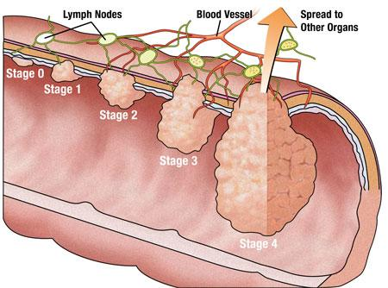

Slide 12
Anorexia/Bulimia Effects on the Digestive System
defined as psychological disorders, however they have severe physical consequences
irregular intake of food causes abnormalities and complications

Slide 13
Anorexia Nervosa
starvation
  ulcers: no food in stomach, stomach walls are unprotected from stomach acid
gastroparesis: delayed stomach emptying
  all muscles including stomach muscles are weak
  food may no longer move throughout the digestive tract as it should
  damage to the nerves which signal the stomach to digest and pass food
food may sit in the stomach for too long
  it may ferment and cause bacterial infections
  bezoars: solid lumps, cause pain and vomiting

Slide 14
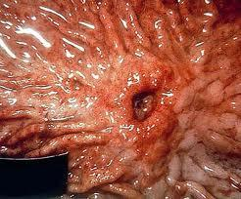
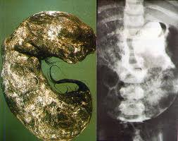
Anorexia Nervosa (cont...)

Slide 15
Bulimia Nervosa
Binge and Purge
  stomach acids (especially from frequent vomiting) erode lining of the stomach
  laxatives remove mucus from intestinal lining and may cause bowel infections
    limp muscle tone, contractions cannot occur
acid reflux
  bile and acids burn esophagus and mouth
    ulcer

Slide 16
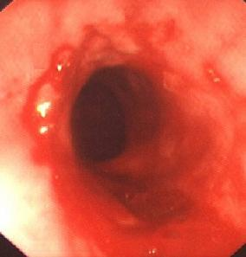
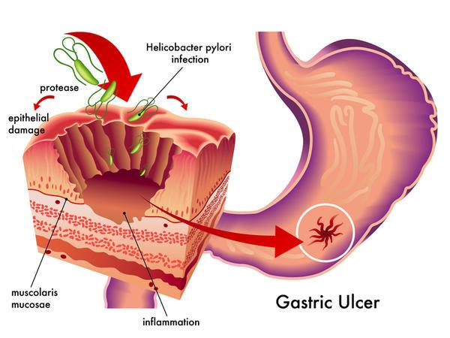
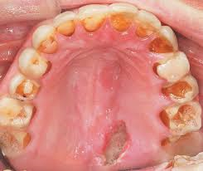
Bulimia Nervosa (cont...)

