Slide 1
Diseases of the immune system

Slide 2
Diseases of the Immune System
Asthma
Allergens
Rheumatoid Arthritis
Inflammatory Bowel Disease
Crohn’s disease
Ulcerative Colitis

Slide 3
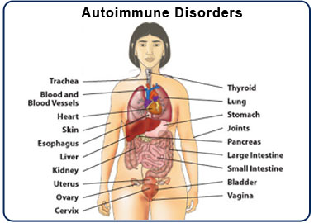
Autoimmune Disorder
A condition that occurs when the immune system mistakenly attacks and destroys healthy body tissue
There are more then 80 different types of autoimmune disorders

Slide 4
Allergens
Certain genes cause your immune system to react to normally harmless substances
These substances are caused allergens
Having an allergic reaction is the most common example of an overactive immune system
Allergens can be particles of dust, mold, animal dander, or food you eat

Slide 5
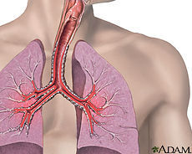
Asthma
Overactive immune system response in your lungs can cause coughing, wheezing, and trouble breathing
It can triggered by a common allergen like dust mites or by irritants like tobacco smoke
Even exercise can trigger asthma

Slide 6
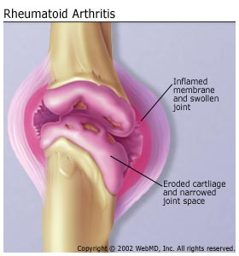
Rheumatoid Athritis
Chronic long term disease
Symptoms can come and go
Each persons experience is different
Can involve different body parts but the joints are always affected
Joints become inflamed
Inflammation is the immune system’s natural response to infection and threats

Slide 7
Inflammatory Bowel Disease
Inflammation of your digestive track
Can be painful and lead to life threatening complications
Symptoms usually develop over time rather than suddenly
The two most common forms of inflammatory Bowel Disease is Ulcerative Colitis and Crohn’s Disease

Slide 8
Crohn’s Disease
Affects the end of the small bowel and the beginning of the large bowel
Symptoms include persistent diarhea, abdominal pains, and fever
The most common complication is blockage of the intestine due to swelling
Two-thirds of patients with the disease will require surgery at some point during their lives

Slide 9
Ulcerative colitis
Limited to the large bowel (The colon)
Approximately half of all patients have mild symptoms
Others may experience abdominal cramping, bloody diarrhea, and nausea
Symptoms tend to come and go with long periods in between flare-ups
Medical therapy is recommended yet surgery may be needed

Slide 10
Quick Quiz
What is an Autoimmune Disorder?
How many autoimmune disorders are there?
What causes allergens?
What is the effect of an overactive immune system in your lungs?
What is the immune system’s natural response to infection and threats?
What is inflammatory bowel disease?
What are some of the symptoms with Ulcerative colitis?

Slide 11
Work cited
http://www.urmc.rochester.edu/Encyclopedia/Content.aspx?ContentTypeID=134&ContentID=123
https://www.google.com/search?q=asthma&source=lnms&tbm=isch&sa=X&ei=9c1GU5jAEMTB0AH_hIDABw&sqi=2&ved=0CAYQ_AUoAQ&biw=1280&bih=907#facrc=_&imgdii=_&imgrc=woCrUXJlPBEmpM%253A%3BgMIN21E86Nc18M%3Bhttp%253A%252F%252Fwww.nlm.nih.gov%252Fmedlineplus%252Fimages%252Fasthma.jpg%3Bhttp%253A%252F%252Fwww.nlm.nih.gov%252Fmedlineplus%252Fasthma.html%3B230%3B184
http://www.webmd.com/rheumatoid-arthritis/default.htm
https://www.google.com/search?q=rheumatoid+arthritis&source=lnms&tbm=isch&sa=X&ei=NNFGU4DTLu3F0AH_toHgCg&sqi=2&ved=0CAYQ_AUoAQ&biw=1280&bih=907#facrc=_&imgdii=_&imgrc=ELTYTFP06iZwKM%253A%3Bn_Xka6jd3g8MTM%3Bhttp%253A%252F%252Fwww.bccorefitness.com%252Fimages%252Frheumatoid_arthritis.jpg%3Bhttp%253A%252F%252Fwww.bccorefitness.com%252Farticles%252Fzhealth-arthritis-benefit-weight-training.html%3B280%3B300
http://www.cdc.gov/ibd/

