Slide 1
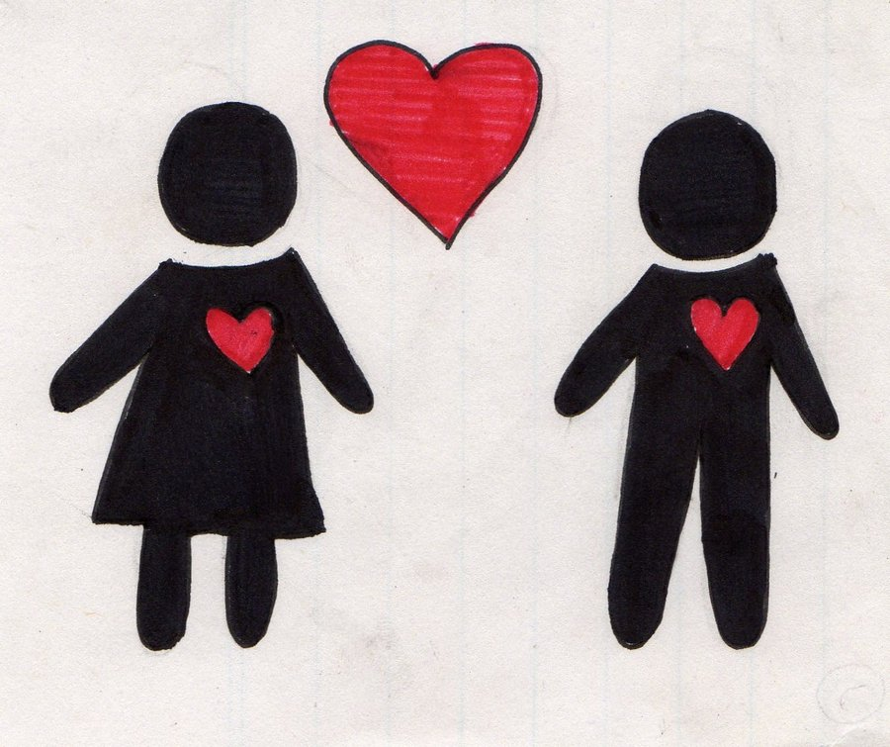
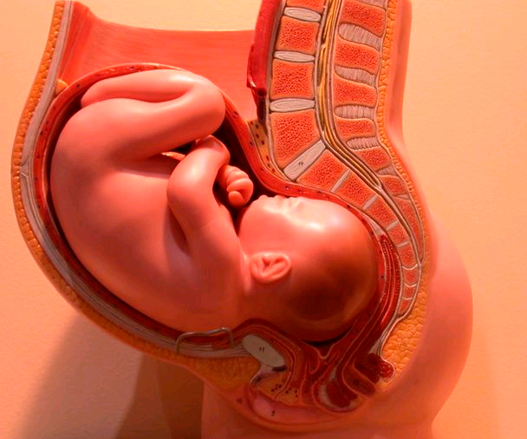
The Reproductive System
.

Slide 2
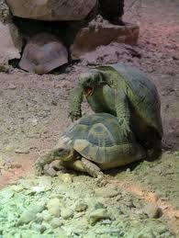
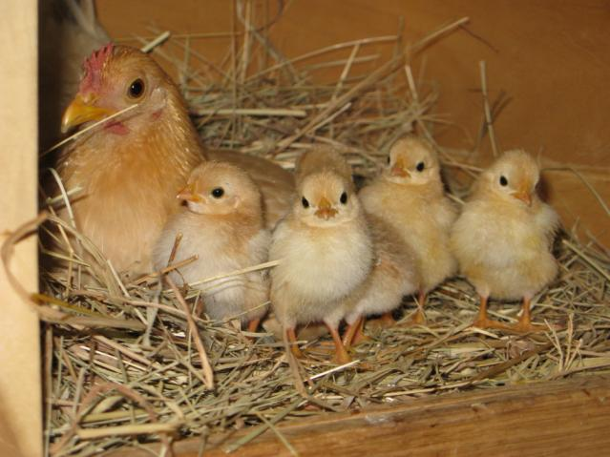
What is the Reproductive System?
“The reproductive system is the structural and physiological network whose purpose is the creation of a new life to continue the species. It is the only body system which is not concerned with supporting the life of its host.”
Two types of reproduction: Asexual and Sexual
Asexual reproduction is far less common in animals, but does occur. Ex. Hydra
Sexual reproduction involves male + female, asexual does not

Slide 3
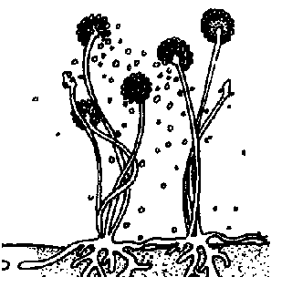
Asexual Reproduction
Advantageous for organisms who rarely encounter mates
Asexual reproduction: does not involve meiosis or fertilization.
Involves 1 parent
Primary reproduction in single-celled organisms – archaea, bacteria, protists
Includes binary fission, bacterial conjugation, fragmentation/regeneration and budding, parthenogenesis

Slide 4
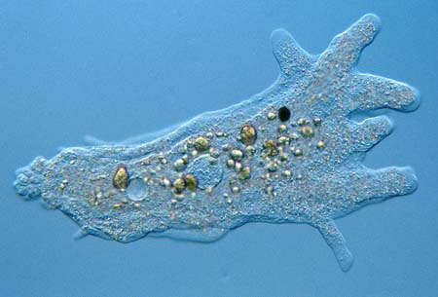
Asexual Reproduction
Binary Fission: Cell splits, replicated DNA divided evenly between both daughter cells
Bacterial Conjugation: Bacteria shoots out a tube and injects piece of its DNA into another bacteria
Fragmentation + Regeneration: body of parent breaks down, offspring arise and regrowth of lost body parts Ex. Fungi
Budding: Offspring grow out of parent Ex. Yeast, hydra
Parthenogenesis is the development of a new individual from an unfertilized egg

Slide 5
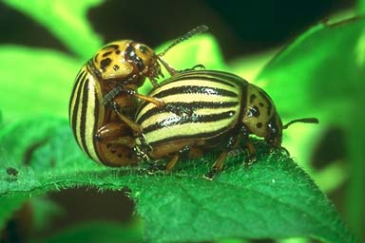
Sexual Reproduction
Fusion of female gamete (egg) and male gamete (sperm) to form a zygote
Includes meiosis and fertilization
Involves both a male and female counterpart
External fertilization: eggs are shed by the female and fertilized by the male, occurs mainly in moist environments
Internal fertilization: occurs when sperm are deposited in female reproductive tract & sperm and egg are united

Slide 6
Sexual Reproduction
Sexual Reproduction is difficult for organisms who rarely encounter a mate
Hermaphroditism is an evolutionary solution among sessile, burrowing, and other organisms lacking locomotion
Hermaphrodites have both male and female reproductive systems
Each animal donates and receives sperm during mating-Any two individuals can mate

Slide 7
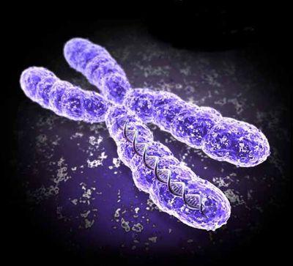
Advantages of Sexual Reproduction
An increase in variation of offspring which results in greater reproductive success in changing environments
An increase in the rate of adaptation
A shuffling of genes to eliminate harmful genes from a population

Slide 8
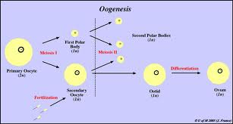
Gametogenesis
Process by which diploid or haploid precursor cells undergo cell division and differentiation to form mature haploid gametes.
Spermatogenesis: the production of mature sperm cells, occurs in the seminiferous tubules of the testes
Oogenesis: the development of the ova (mature unfertilized eggs), occurs in the ovarian follicle of ovary

Slide 9
Phyla Cnidaria
Hydra Vulgaris
A freshwater cnidarian
Exists only in polyp form and reproduces asexually by budding
Relatively simple reproductive system
Advantages/ adaptations: hydra bud asexually when food is available.
Can form many new organisms quickly.
Hydra do not move around much, it is much more efficient than finding a mate + conserves energy.

Slide 10
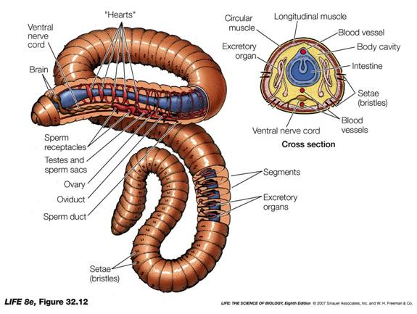
Phyla Annelida
Lumbricus Terrestris:
(common earthworm)
They are hermaphrodites but cross-fertilize
Some reproduce sexually by fragmentation
Advantages/ adaptations: Earthworms are slow moving, finding mates is not always easy. Having the ability to reproduce without a partner allows the worm to reproduce if conditions do not permit finding of a mate.

Slide 11
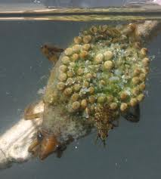
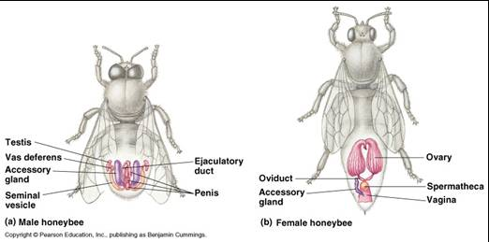
Phyla Arthropoda
Belostoma Flumineum
Fewer offspring than most insects because of increase in parental care
Complex reproductive systems
Advantages/Adaptations: Eggs are laid on the back of the males, who care for them until they hatch. Females actively search for mates.

Slide 12
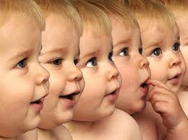
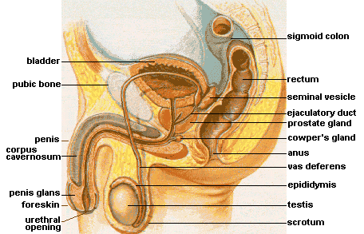
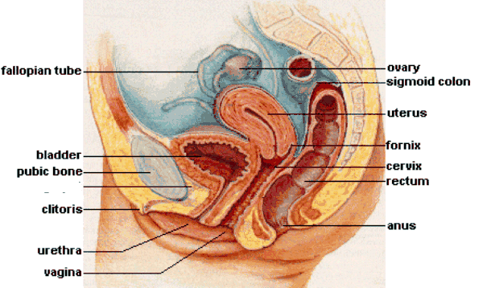
Phyla Mammalia -Homo sapiens

Slide 13
Fertilization of an Egg by Sperm - Conception occurs in the Oviducts

Slide 14
Female Reproductive Cycles
Two types of cycles occur: menstrual and estrous
Menstrual: The endometrium is shed from the uterus in a bleeding called menstruation (sexual receptivity is not limited to a specific timeframe)
- If an embryo has not implanted in the endometrium by the end of the secretory phase a new menstrual flow begins
--Estrous: The endometrium is reabsorbed by the uterus (sexual receptivity is limited to a “heat” period)
Menopause= cessation of ovulation and menstruation between the ages of 46 and 54

Slide 15
-Hormones coordinate the menstrual and ovarian cycles so that growth of the follicle and ovulation are synchronized with preparation of the uterine lining for a possible embryo
Five hormones participate:
GnRH
FSH
LH
Estrogen
Progesterone

Slide 16
Why is the Reproductive System Necessary?
Reproductive system provides a way to produce and transport gametes
Maximizes survival of offspring while in embryonic state
Provides environment for growth of offspring (womb)
Needed for species continuation/adaptation

Slide 17
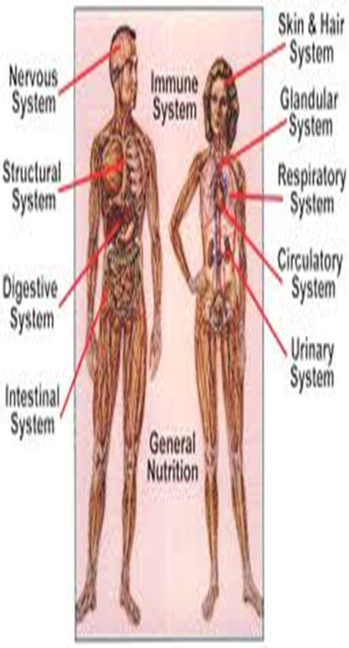
Interdependence of Reproductive System
All body systems are dependent on one another
The reproductive system is governed by the nervous/endocrine systems, determine when/ how many gametes produced + regulate cycles

Slide 18
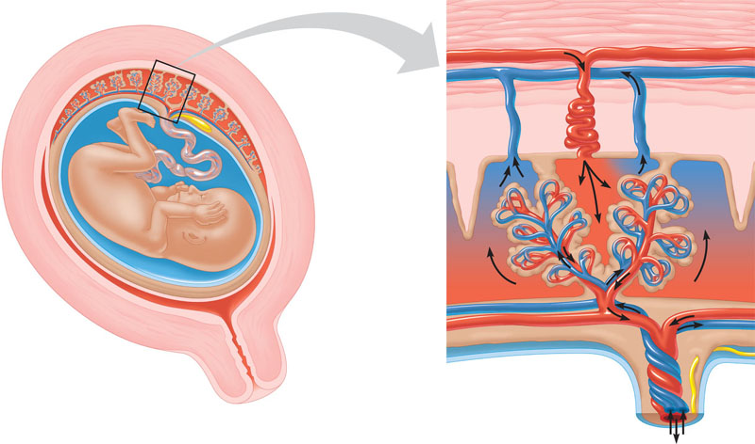
Maternal
arteries
Maternal
veins
Placenta
Maternal portion
of placenta
Umbilical cord
Chorionic villus
containing fetal
capillaries
Fetal portion of
placenta (chorion)
Maternal blood
pools
Uterus
Fetal arteriole
Umbilical arteries
Fetal venule
Umbilical vein
Figure 46.16
Umbilical cord
Requires nutrients be transported to via the cardiovascular system
-Oxygen from the respiratory system
-Digestive system supplies nutrients needed to maintain gamete production/facilitate pregnancy (women)

Slide 19
Diseases/Disorders of the Reproductive System
Disease/disorder that negatively impacts an aspect of reproductive system: ability to produce gametes, ability to transport gametes, etc.
Any disease or injury to the body –not only the reproductive system- could potentially harm the fetus during development.
Female Reproductive Disorders: Premenstrual Syndrome, Ovarian Cysts, Endometriosis, Uterine Leiomyomas, Female Infertility , Pelvic Inflammatory Disease
Male Reproductive Disorders: Testicular Cancer, Infertility, Erectile Dysfunction, Cryptorchidism, Prostate Cancer

Slide 20
Male Infertility
“Approximately 15% of couples are infertile.”-Mayoclinic
Male infertility – inability of the male to achieve pregnancy in fertile female.
Causes: abnormal sperm production/function, problems with delivery (sexual function), environmental/lifestyle factors/age
Symptoms: inability to conceive child, pain/swelling in testicular area, decreased facial/body hair/ other signs of chromosomal or hormonal abnormality

Slide 21
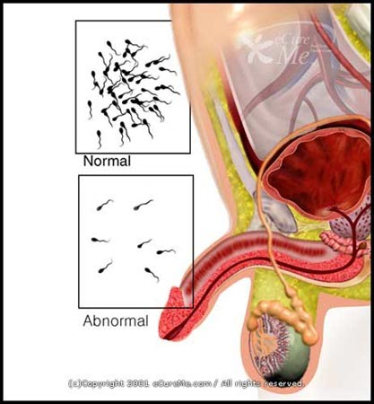
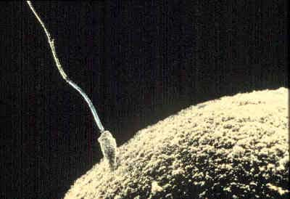
Male Infertility
Tests Include:
Semen Analysis- checks for number/ abnormalities of sperm
Ultrasound – check for blockages/ check prostate
Vasography – contrast dye injected into vas deferens, checks for blockages
Cures:
Surgery – remove blockage, correct abnormalities
Treating Infections – infections can take hold in reproductive tract, can be cured but fertility cannot always be restored
Hormone treatments – if hormone is deficient/ abnormal
ART – Assisted Reproductive Technology

Slide 22
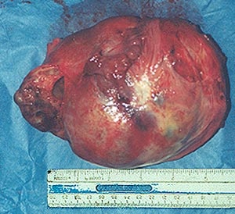
Testicular Cancer
Cancer that starts in the testicles, the male reproductive glands located in the scrotum.
Causes:
Abnormal testicle development
Klinefelter Syndrome – presence of extra X chromosome in male
Exposure to toxins
HIV infection

Slide 23
Testicular Cancer
Two main types: Seminomas and nonseminomas
Seminoma – slow growing, usually found in men during 30s or 40s. Cancer usually found in testes, can spread to lymph nodes. Very sensitive to radiation.
Nonseminoma- More common, tend to grow more quickly than nonseminomas. Composed of different types of cells, identified according to these different types:
| Choriocarcinoma | Embryonal Carcinoma | Teratoma | Yolk Sac Tumor |

Slide 24
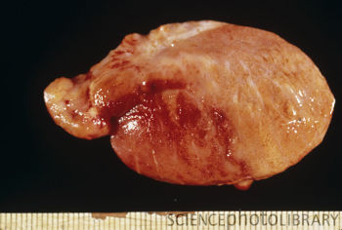
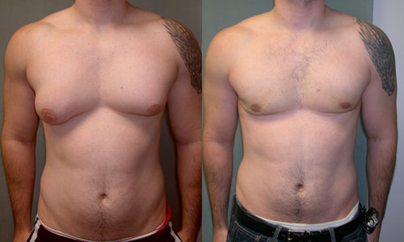
Testicular Cancer
Symptoms: Discomfort or pain in testicles, feeling of heaviness in scrotum
pain in lower back/abdomen
Enlargement of testicle/change in feeling of testicle
Gynecomastia (excess development of breast tissue in males)
Lump or swelling in either testicle

Slide 25
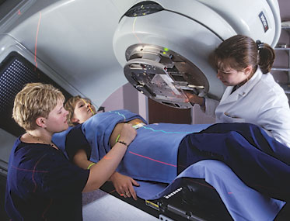
Testicular Cancer
Tests:
blood tests for tumor markers
Chest x-ray
Abdominal/pelvic CT scan
Ultrasound of scrotum
Cures: like all cancers depends on type/stage of cancer
Surgical Treatment – removal of cancer
Radiation Therapy
Chemotherapy – medications such as cisplatin, bleomycin, and etoposide used to kill cancer cells

Slide 26
The Reproductive System: Summary
Two types: Asexual vs Sexual
Asexual = 1 parent, does not involve meiosis or fertilization. Offspring same as parent.
Advantage: diverse mechanisms of asexual reproduction enable animals to produce identical offspring rapidly
Sexual = 2 parents (male and female),
Advantage: results in genetically diverse offspring that can adapt to the environment

Slide 27
Summary cont.
Reproductive systems have evolved differently in many animal phyla
These systems range from the production of gametes by undifferentiated cells to complex structural assemblies of gonads with accessory tubes and glands

Slide 28
Works cited
http://www.ncbi.nlm.nih.gov/pubmedhealth/PMH0002266/
http://www.religioustolerance.org/abo_fetu.htm
http://en.wikipedia.org/wiki/Human_embryogenesis
http://www.nlm.nih.gov/medlineplus/ency/article/002398.htm
http://www.mayoclinic.com/health/male-infertility/DS01038/DSECTION=alternative-medicine

Slide 29
http://www.biotopics.co.uk/genes1/asexual_and_sexual_reproduction.html
http://www.slideshare.net/yunnie_yupyup/asexual-vs-sexual-reproduction
http://biology.clc.uc.edu/courses/bio105/reproduc.htm
http://library.thinkquest.org/2935/Natures_Best/Nat_Best_Low_Level/Reproductive_page.L.html
http://drbenkim.com/organ-systems.htm
http://kilby.sac.on.ca/departments/science/snc2d/CourseDocs/sb_pdf/is10_unit_a2-3.pdf

