Slide 1
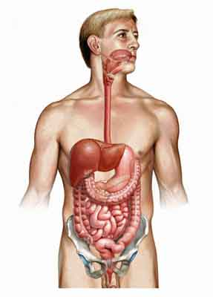
Gastrointestinal System
(Page 401-438)
Dawn Hubbell, Katelyn Fournier, Kristen Fournier, Alley Sordi

Slide 2
Digestion- The Mechanical and chemical breakdown of foods and the absorption of the resulting nutrients by cells.
Mechanical Digestion- Breaks large pieces into smaller ones without altering their chemical composition.
Chemical Digestion- breaks down food into simpler chemicals.
Gastrointestinal System carries out these processes.
Gastrointestinal System Contains:
-Alimentary canal: mouth, pharynx, esophagus, stomach, small intestine, large intestine, rectum, and anus.
-several accessory organs: salivary glands, liver, gallbladder, and pancreas.

Slide 3
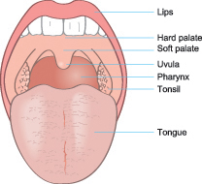
Mouth
-Receives food and begins to mechanically break down food into smaller particles with saliva. This is called mastication.
Cheeks and Lips
-cheeks consist of outer layers of skin, pads of subcutaneous fat
-inner lining has moist, stratified squamous epithelium
-lips contain skeletal muscles and sensory receptors
Tongue
-covered with a mucous membrane
-a membranous fold called the lingual frenulum connects the midline of the tongue to the floor of the mouth
-body of tongue is mostly made up of skeletal muscle which mixes food particles with saliva during chewing
-papillae are rough projections on the tongue surface
-the root of the tongue, or posterior region is anchored to the hyoid bone, it is covered with rounded masses of lymphatic tissue called lingual tonsils

Slide 4
Mouth cont.
Palate
-forms the roof of the oral cavity and consists of a bony anterior part and a muscular posterior part
-palatine tonsils are masses of lymphatic tissue that are closely associated with the palate
-the tonsils lie beneath the epithelial lining of the mouth which help protect the body against infection
Teeth
-there are two types of teeth, primary teeth and secondary teeth
-primary teeth develop between the ages of six months and 2-4 years. There are 20 teeth, 10 in each jaw
-These teeth fall out because of the pressure the secondary teeth put on them, therefore are pushed out of the mouth
-there are 32 secondary teeth, 16 in each jaw
-the secondary teeth begin to appear at six years but may not be complete until the third molars come in around ages 17-25.
-each tooth consists of two main portions; the crown and the root

Slide 5
Salivary Glands
-two types of secretory cells which include serous cells and mucous cells
-serous cells produce a watery fluid that has salivary amylase in it which splits starch and glycogen molecules into disaccharides.
-mucous cells secrete thick liquid called mucus which binds food particles and lubricates the food during swallowing
-if a person sees, tastes, smells or thinks about something appealing, more saliva is produced. If something is unappealing, then less saliva is produced.
-Salvation occurs when you could smell, taste or even see food. This occurs due to nerve signals that tell the salivary glands to secrete saliva to prepare and moisten the mouth. Each pair of salivary gland has their own job.
-There are three pairs of salivary glands that have contact with the mouth. The glands are split up into lobes.

Slide 6
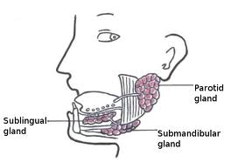
3 types of Salivary Glands
Parotids
-Large, irregularly shaped
-secrete 25% saliva, rich in proteins, watery
-Can feel if it is enlarged better if the person clenches their teeth
-Immunoglobins are secreted help to fight microorganisms and a-amylase proteins start to break down complex carbohydrates.
Submandibular
-secrete 70% of saliva in the mouth
-produce a thick secretion, rich in mucin(glycoprotein that acts as a lubricant) and small amount of proteins.
Sublingual
-Smallest of the salivary glands
-secrete 5% of the mouths saliva
-very sticky due to the large concentration of mucin
-The main functions are to provide buffers and lubrication

Slide 7
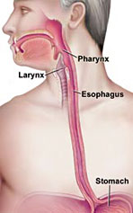
Pharynx and Esophagus
-cavity posterior to the mouth which leads to the stomach
-both do not digest food but are passageways which function in swallowing
-the pharynx connects the nasal and oral cavities with the larynx and esophagus
Three parts
-Nasopharynx: communicates with the nasal cavity and provides a passageway for air during breathing
-Oropharynx: passageway for food moving to and from the mouth and for air moving to and from the nasal cavity
-Laryngopharynx: passageway to the esophagus
-Esophagus is a food passageway from the pharynx to the stomach.

Slide 8
Stomach
Parts of the stomach: Divided into the cardiac, fundic, body, and pyloric regions
Gastric Secretions: Thick mucus membrane forms the inner lining of stomach , studded with small openings (gastric pits) that are at the ends of gastric glands
-Gastric glands have 3 types of secretory cells; mucous, chief, and parietal cells
-Chief secrete digestive enzymes
-Parietal release hydrochloric acid
-Together they form gastric juice
-When pepsinogen from chief cells comes in contact with hydrochloric acid from the parietal cells, it breaks down forming pepsin

Slide 9
Regulation of Gastric Secretions
Stomach Cont.
Gastric Absorption
Mixing and Emptying
-The rate gastric juice is produce is controlled both neutrally and hormonally
-gastric glands secrete abundant gastric juice and stimulate certain stomach cells to release peptide hormone, gastrin
-When food moves to the small intestine gastric juice secretion is triggered and proteins and fats cause the intestinal wall to release peptide hormone, cholecystokinin
-Gastric enzymes breakdown proteins
-The stomach only absorbs small volumes of water and certain salts
-Not well adapted to absorbing digestive products
-Mixing movements of the stomach wall aid in producing a semifluid paste of food particles and gastric juice, chyme
-The rate at which the stomach empties depends on fluidity of chyme and the type of food
-Carbohydrates pass through the fastest, followed by foods high in protein and fatty foods stay in the stomach the longest

Slide 10
Pancreas
Pancreatic Juice
-Contains enzymes that digest carbohydrates, fats, nucleic acids, and proteins
-Pancreatic amylase (carbohydrate digesting enzyme) splits molecules of starch or glycogen into double sugars
-Pancreatic lipase (fat-digesting enzyme) breaks triglyceride molecules to fatty acids and glycerol
-Two nucleases, which are enzymes, break down nucleic acid molecules into nucleotides
-Trypsin, chymotrypsin, and carboxypeptidase (protein splitting enzymes) split the bonds between certain amino acids in proteins
Regulation of Pancreatic Secretion
-Nervous and endocrine systems regulate release of pancreatic juice
-Duodenal mucous membrane releases peptide hormone secretin into the bloodstream
-Stimulates secretion of pancreatic juice

Slide 11
Liver
Liver functions
-Role in carbohydrate metabolism by helping maintain concentration of blood glucose
-Role in lipid metabolism is oxidizing fatty acids at a high rate, synthesizing lipoproteins, phospholipids, and cholesterol, and converting portions of carbohydrate and protein molecules into fat molecules
-Role in protein metabolism is deaminating amino acids, synthesizing plasma proteins, and converting certain amino acids to other amino acids
Composition of Bile
-Bile is yellowish-green liquid secreted from hepatic cells
-Contains water, bile salts, bile pigments, cholesterol, and electrolytes
-Bile salts are the only ones with digestive functions

Slide 12
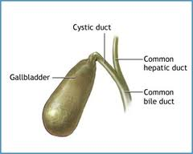
Gallbladder
Stores bile between meals, reabsorbs water to concentrate bile, and contracts to release bile into small intestine
Functions of Bile Salts
-Aid digestive enzymes
-Break down fat globules into smaller droplets (emulsification)
-Then they mix with water so the fat molecules can be digested more effectively

Slide 13
Small Intestine
Digestion in the small intestine produces a mixture of disaccharides, fatty acids, peptides, and monoglycerides. The final digestion and absorption of these substances occurs in the villi, which lines the inner surface of the small intestine.
It's completed digestion of the nutrients in chyme, absorbs the products of digestion, and transports the residues to the large intestine.
Parts of small intestine: The small intestine has three portions which include the duodenum, jejunum, and the ileum.
Structure of the small intestine wall: The inner wall of the small intestine appears velvety due to many tiny projections of mucous membrane called intestinal villi. Villi increases the surface area of the intestinal lining which aides in the absorption of digestive products. Each villus consists of a layer of simple columnar epithelium and a core of connective tissue containing blood capillaries, a lymphatic capillary called a lacteal, and nerve fibers. Blood capillaries and lacteals carry away absorbed nutrients, and nerve fibers transmit impulses to stimulate or inhibit villus activities.

Slide 14
Small Intestine Cont.
Secretion of the small intestine: The intestinal glands in the villi secrete large volumes of a watery type fluid which carries digestive products into the villi. The digestive enzymes break down food molecules just before absorption takes place. Peptidases are in the enzymes which split peptides into amino acids. The amino acids then split the double sugars into simple sugars. Then the intestinal lipase splits fats into fatty acids and glycerol.
Regulation of small intestine secretions: Distension of the intestinal wall activates the nerve plexuses within the wall and stimulates parasympathetic reflexes that also trigger release of small intestine secretions.
Movements of small intestine: The major mixing movement in the small intestine is segmentation. Segmentation is when small, ring-like contractions occur periodically, cutting chyme into segments and moving it back and forth. Chyme is the semifluid mass of partially digested food that passes from the stomach to the small intestine. Chyme moves slowly through the small intestine, taking three to ten hours to travel its length. At the distal end of the small intestine the ileocecal sphincter joins the small intestines ileum to the large intestine's cecum. After a meal a gastroileal reflex increased peristalsis in the ileum and relaxes the sphincter which forces some of the contents of the small intestine into the cecum
Interesting fact: The area of the small intestine is almost 200 square meters. It is about the area of a singles area of a tennis court and sometimes are about 100 times the surface area of the exterior surface of the body

Slide 15
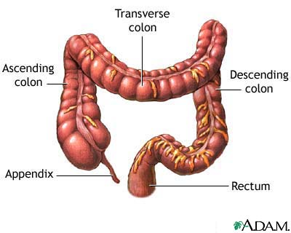
Large Intestine
Greater diameter than the small intestine. The portion of the alimentary canal begins in the lower right side of the abdominal cavity, where the ileum joins the cecum and from there the large intestine ascends on the right side, crosses to the left and descends into the pelvis. At the distal end it opens to the outside of the body as the anus.
Parts of the large intestine: cecum, colon, rectum, and anal canal.
Structure of the large intestine wall: the wall lacks the villi characteristic of the small intestine. The fibers of the wall form three distinct bands that extend the entire length of the colon which creates a series of pouches.

Slide 16
Large Intestine Cont.
Functions of the large intestine: The large intestine has little or no digestive function unlike the small intestine. Although, the inner lining contains tubular glands which are composed of goblet cells. Mucus is the only significant secretion the large intestine has. Mucus protects the wall against the abrasive action of the materials that pass through. Chyme that enters the large intestine contains materials that the small intestine didn't digest or absorb. The chyme also contains water, electrolytes, mucus, and bacteria. In the proximal half of the large intestine it absorbs water and electrolytes. The substances that remain become feces and are stored in the distal portion of the large intestine.
Movements of the large intestine: The movements in the large intestine are slower than in the small intestine. Peristaltic waves of the large intestine happen 2-3 times a day. A large section of the intestinal wall constricts vigorously, forcing the intestinal contents toward the rectum. When a person initiates a defecation reflex by holding a deep breath and contracting the abdominal wall muscles. This action increases internal abdominal pressure and forces feces into the rectum.
Feces: Feces are materials that were not absorbed or digested, plus water, electrolytes, mucus, she'd intestinal cells, and bacteria. They consist of about 75% water. The odor results from a variety of compounds that bacteria produces and the color derives from now pigments altered by bacterial action.

Slide 17
Nutrition and Nutrients
Nutrition is the study of nutrients and how the body utilizes them.
Nutrients include carbohydrates, lipids, proteins, vitamins, minerals, and water.
Macronutrients- carbohydrates, lipids, and proteins. Required in large amounts. Provide potential energy and have other specific functions. Expressed in calories.
Calorie- unit of heat that is used to describe the amount of potential energy
Micronutrients- vitamins and minerals. Required in small amounts.
Foods provide nutrients, and digestion breaks nutrients down to sizes that can be absorbed and transported in the bloodstream.
Essential Nutrients- nutrients that human cells cannot synthesize (ex: amino acids)

Slide 18
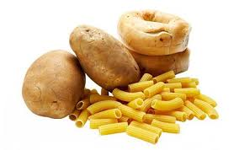
Carbohydrates
Organic compounds that include sugars and starches. The energy held in their chemical bonds is used primarily to power cellular process.
Digestion breaks down complex carbohydrates into monosaccharaides, which are small enough to be absorbed.
Cellulose (Fiber)- A complex carbohydrate that is abundant in food. Humans cannot not digest cellulose, so the portion of the food that is not broken down by intestinal flora passes through unchanged. Cellulose provides bulk that facilitates the movement of food.
Glucose- Some of the glucose in your body is used for energy, the rest is stored in the adipose tissue as fat for later use.

Slide 19
Lipids
Organic compounds that include fats, oils, and fatlike substances. They supply energy for cellular processes and for building structures such as cell membranes.
Triglycerides- Part of both plant- and animal-based foods.
Saturated Fats- found in foods of animal origin (meat, milk, eggs, lard) in excess are very unhealthy
Unsaturated Fats- found in foods of plant origin (seeds, nuts, plant oils)
Monounsaturated Fats- healthiest (olive, peanut, and canola oils)
Cholesterol- Not present in foods of plant origin (egg yolk, whole milk, butter, cheese, meat)
Beta oxidation- Chemical process that breaks fatty acids down into the molecules of acetyl coenzyme A.
Essential Fatty Acids- Fatty acids that the liver cannot synthesize.

Slide 20
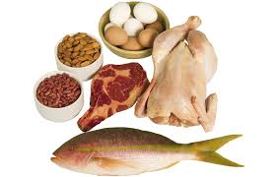
Proteins
Polymers of amino acids with a wide variety of functions. Includes enzymes that control metabolic rates, clotting factors, the keratin of skin and hair, elastin and collagen of connective tissue, antibodies that protect against infection, etc.
Supplies energy after digestion breaks them down into amino acids.
Protein sources- meats, fish, poultry, cheese, nuts, milk, eggs, cereals
Essential amino acids-amino acids that the body cannot synthesize
There are 20 amino acids. All are need at once for growth and tissue repair to occur.
Complete proteins- have an adequate amount of essential amino acids (milk, meats, eggs)
Incomplete proteins- has too little of essential amino acids
Partially complete protein- doesn't have enough amino acids to promote growth, but enough to live

Slide 21
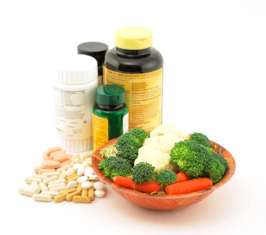
Vitamins Minerals
organic compounds that are required in small amounts for normal metabolism.
Classified by solubility:
Fat-soluble vitamins- A, D, E, K
Water-soluble vitamins- B, C
B vitamins- essential for normal cellular metabolism. Help oxidize carbohydrates, proteins, and lipids.
C Vitamins- necessary for collagen production, metabolism of certain amino acids, promotes iron absorption and synthesis of certain hormones from cholesterol, etc.
Inorganic elements that are essential for human metabolism. Found in bones and teeth. Play roles in nerve impulse conduction, muscle fiber contraction, maintenance of pH of body fluids, etc.
Major minerals- calcium and phosphorus, account for nearly 75% in weight of the mineral elements in the body
Trace elements- essential minerals found in small amount, account for .005% body weight

Slide 22
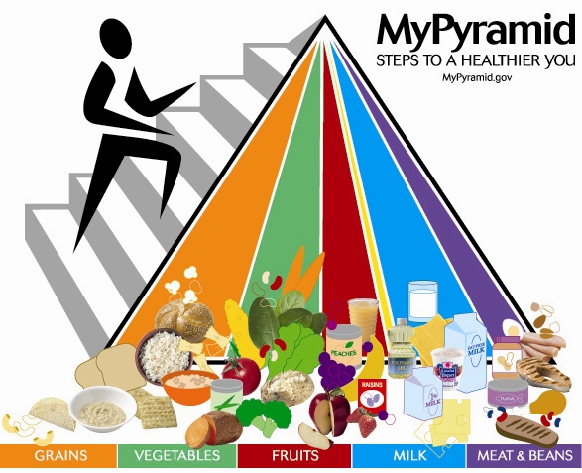
Adequate Diets
an adequate diet provides sufficient energy, essential fatty acids, essential amino acids, vitamins, and minerals to support optimal growth and to maintain and repair body tissues.
Intake varies with weight, age, sex, growth rate, physical activity level, and other genetic and environmental factors
Malnutrition- diet that lacks essential nutrients or a person fails to use available foods to best advantage

Slide 23
http://highered.mcgraw-hill.com/sites/0072495855/student_view0/chapter26/animation__organs_of_digestion.html

Slide 24
Crohn’s Disease
-Crohn's disease causes inflammation of the digestive system.
It is one of a group of diseases called inflammatory bowel disease.
-Symptoms: pain in the abdomen and diarrhea, Bleeding from the rectum, Weight loss, Fever, joint pain and skin problems
Children with the disease may have growth problems.
-The cause of Crohn's disease is unknown. It may be due to an abnormal reaction by the body's immune system. It also seems to run in some families.
-There is no cure for Crohn's.
-Treatment can help control symptoms, and may include medicines, nutrition supplements, and/or surgery.
-Some people have long periods of remission, when they are free of symptoms.
-Therapies can greatly reduce the signs and symptoms of Crohn's disease and even bring about long-term remission.
-Who: It most commonly starts between the ages of 13 and 30.

Slide 25
Gastroparesis (Delayed gastric emptying)
A medical condition of partial paralysis to the stomach resulting in food staying in the stomach for a longer than normal
-Symptoms: Vomiting, heartburn, lack of appetite, etc.
-Who/how to get it: Cancer patients, Anorexia Nervosa, Bulimia Nervosa, Stomach Flu, etc.
-Diagnosis: X-Rays, Manometry and gastric emptying scans
-Treatments: Dietary changes, oral medications, insulin adjustments, Viagra and mirtazapine

Slide 26
Irritable Bowel Syndrome (IBS)
A disorder that means there is a problem caused by the changes of the way your Gastrointestinal Tract works. There are spasms in your Large Intestine (Bowel) that create the symptoms.
It is not completely understood, but researchers believe it is a combination of physical and mental health Problem.
-Possible Causes: Brain-Gut Signal Problems, Gastrointestinal Motor Problems, Hypersensitivity, Mental Health Problems (Such as Stress), Bacterial Problems, Body Chemicals, Genetics, Food Sensitivity
-Most Common Symptoms: Abdominal Pain or Discomfort, Cramping, Bloating, Diarrhea, Constipation, or Both
-Who Gets It: Women are more likely to get it and have symptoms. People Younger than 50 (usually before age 35.) If you have a family member with IBS.
-Treatments: Change Your Diet, Take Medication, Counseling or Stress Relief.
-Medicines Include: Fiber Supplements, Antidiarrheal Medications, Antidepressant Medications, IBS Medications (Lubiprostone for Women)

Slide 27
Helicobacter Pylori
Spiral shaped bacterium found in the stomach that embeds into the protective mucus lining. It weakens the stomach lining, making the stomach more susceptible to damage from gastric acids.
-Contracted through contaminated food or drink
-Symptoms: Gnawing or burning abdominal pain, Loss of appetite, Weight loss, Bloating, Nausea, Fatigue, Vomiting, Burping, and Black, tarry stools
-Diagnosis: Blood Test, Stool Test, Breath Test, Endoscopy, Upper GI series
-Endoscopy: small camera goes down the esophagus, through the stomach, and into the small intestine to view the upper GI tract.
-Upper GI series: X-ray of the upper GI tract

