Slide 1
Carbon Based Polymers
Mr. Fleming

Slide 2
Content Standard
D 15. Explain the general formation and structure of carbon-based polymers, including synthetic polymers, such as polyethylene, and biopolymers, such as carbohydrate.

Slide 3
Essential Questions
What is a monomer and what is a polymer?
What is the difference between a biopolymer and a synthetic polymer?

Slide 4

What are “polymers”?
polymer- is a large molecule that is created when monomers are joined together.
monomer -is a single unit that is used to build a polymer. Polymers may be naturally occurring or man-made (synthetic).

Slide 5
Polymerization
Chemical reaction in which monomers are added together to form a polymer.
Reactants (Start With): Two or more monomers
Products (End With): Polymer and Water

Slide 6
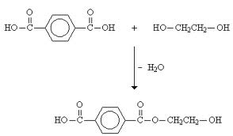
Polymerization

Slide 7

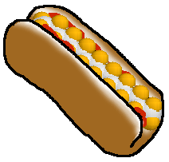

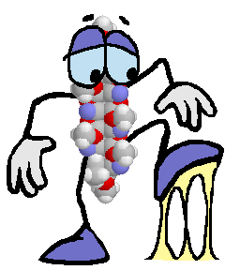
Polymers are everywhere!!!
Polymers at the movies…. Nylon carpet, polyester and acrylic seats, polyester curtains, nylon screen, polyester film strip, waxy polyethylene popcorn tub, starch in popcorn, polystyrene cups, plastic M&M bag, protein in hotdogs, gelatin in gummy bears, paraffin in Junior Mints, sticky stuff on the floor made of soda, butter, Skittles, Milk Duds and more…

Slide 8
Natural (Bio) Vs. Synthetic
Biopolymers
  Polymers that occur in nature and exist within living things.
Synthetic Polymers
  Polymers that come from petroleum oil.
  Made by scientists or engineers.

Slide 9
Natural (Bio) and Synthetic Polymers

Slide 10
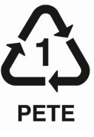
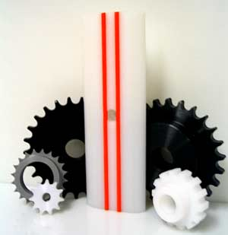

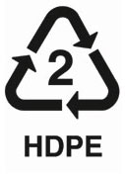
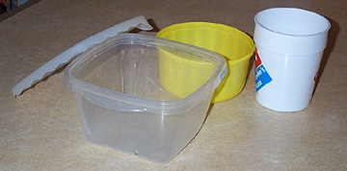
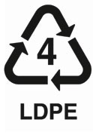
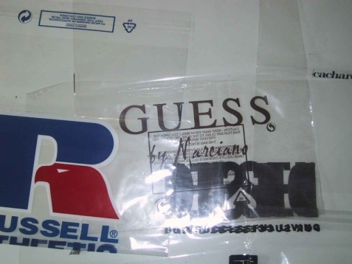
Some examples of synthetic polymer structures:
Polyethylene (PE)
used for: flexible bottles, ice trays, plastic bags

Slide 11
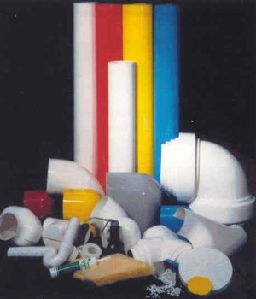

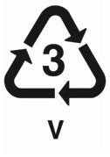
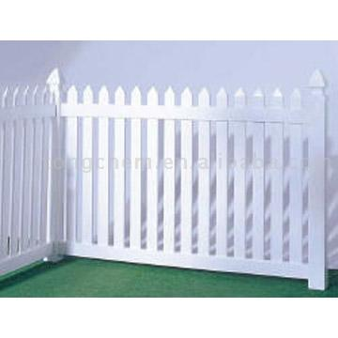
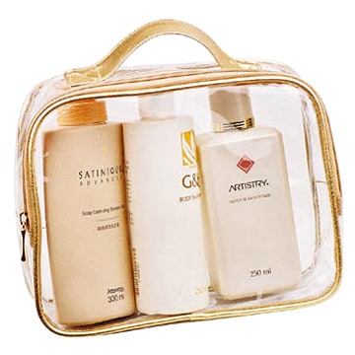
Polyvinyl Chloride (PVC)
used for: pipes, bottles, CD’s, computer housings

Slide 12
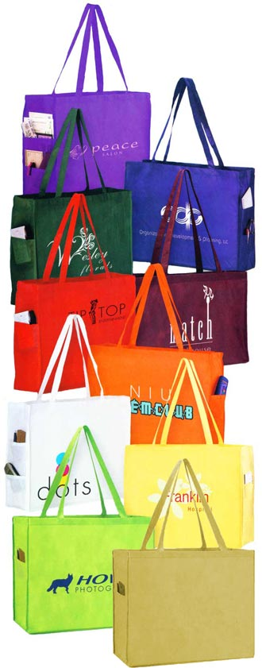
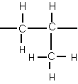
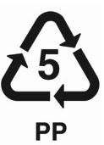
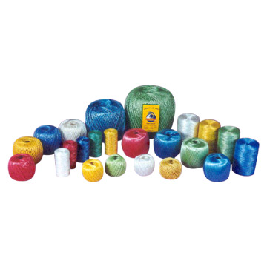
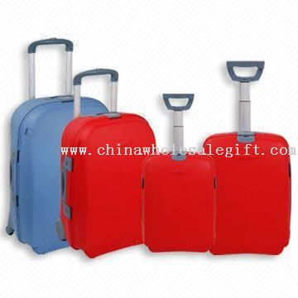
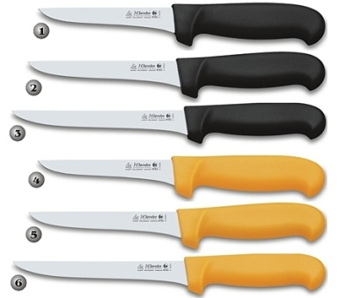
Polypropylene (PP)
used for: rope, luggage, carpet, film, polar fleece
propylene

Slide 13
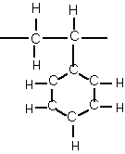
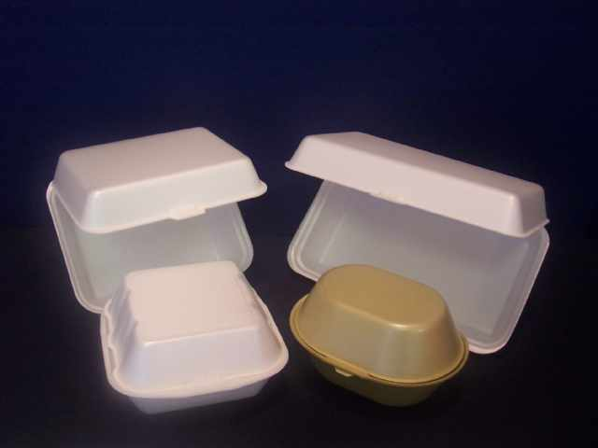
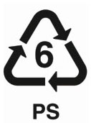

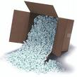

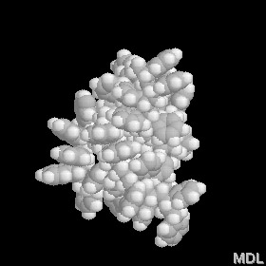
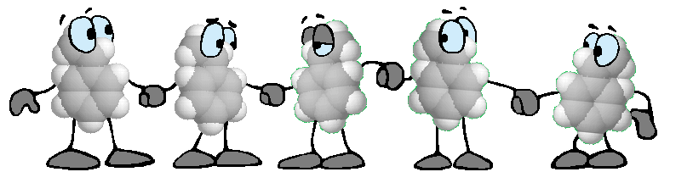
Polystyrene (PS)
used for: toys, packaging, egg cartons, flotation devices, hot cups

Slide 14
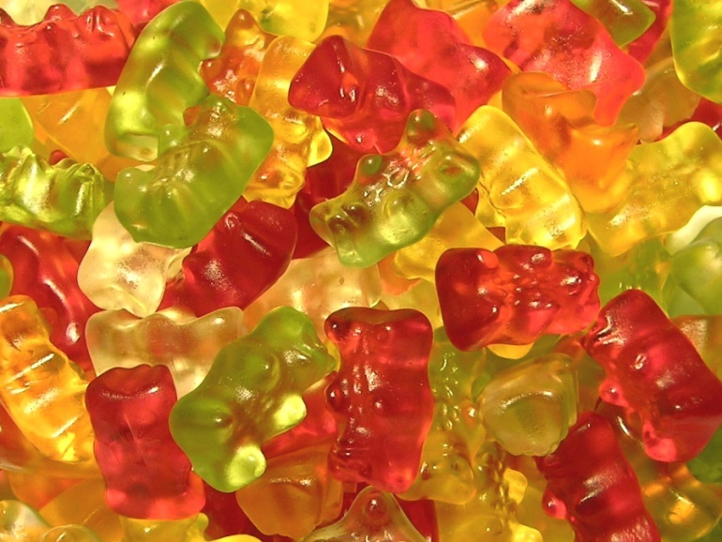
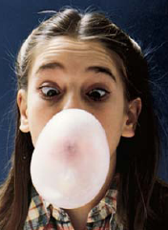

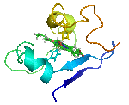
Some Natural Polymers in Food…
Gelatin in gummi worms and gummi bears are made from natural polymers!
Bubble gum contains styrene butadiene rubber!
Carbohydrates (starches) and proteins are examples of natural polymers!
natural polymers

Slide 15
Carbon Polymer Recall
What is a monomer?
A single unit that makes up a polymer.
What is a polymer?
Large molecule composed of monomers. Can be synthetic or natural.

Slide 16
Carbon Polymer Recall
_________________ is a chemical process by which monomers are added together to form a polymer.
Polymerization

Slide 17
Carbon Polymer Recall
What are two different types of polymers?
The two different types of polymers are natural and synthetic.
Which type of polymer is derived from petroleum oil? Provide an example of this type of polymer.
Synthetic polymers are derived from oil. An example of a synthetic polymer is polyethylene.
Notes:
http://www.cmu.edu/gelfand/k12-teachers/polymers/natural-synthetic-polymers/

Slide 18
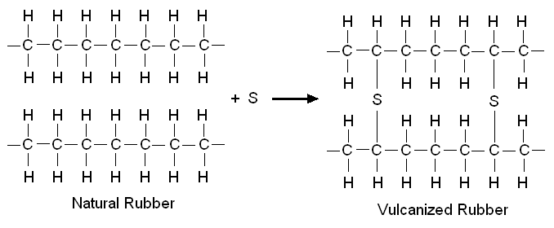
Vulcanizing Rubber to make it more flexible, tougher and temperature resistant and involves adding Sulfur atoms to create cross-links.

Slide 19
Properties of Polymers
Properties are determined by the structure of the molecules and depend on:
-type of monomers used
-chain length
-branching
-degree of cross-linking

Slide 20
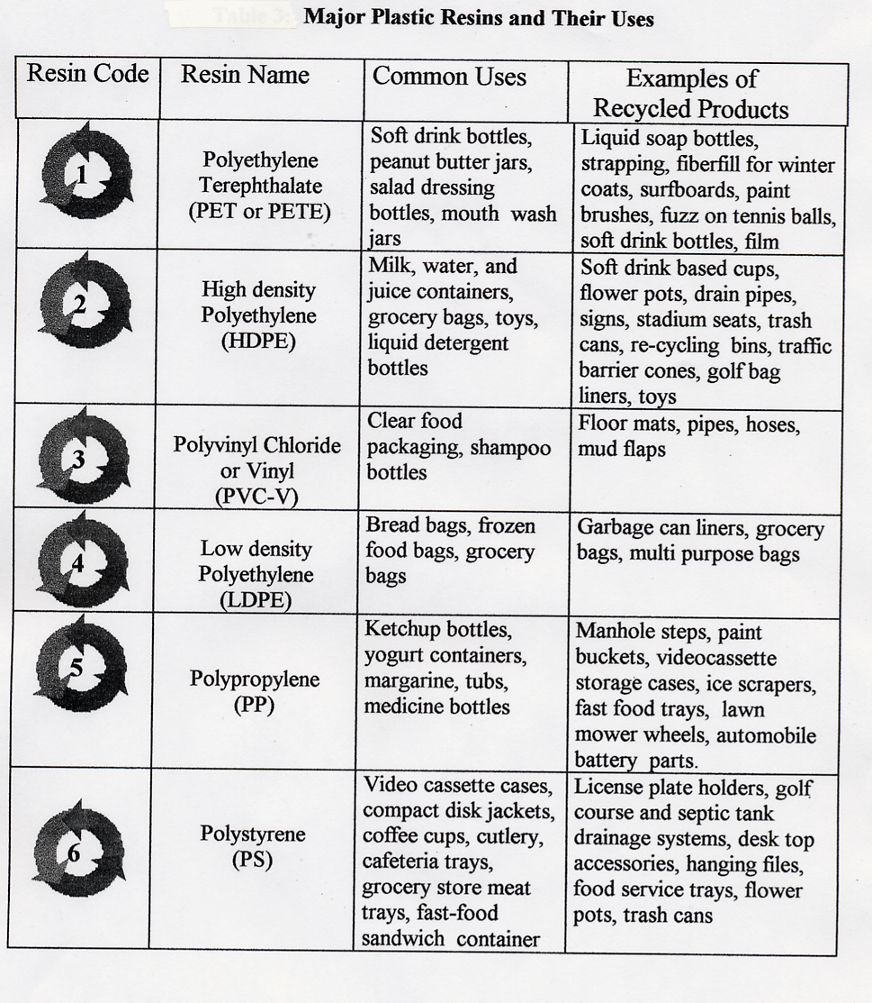

Slide 21
Carbon Polymer Recall
What is vulcanization?
The process by which sulfur is used to cross-link carbon chains. Used to make tires.

Slide 22
Carbon Polymer Recall
What are the three structures that affect properties of polymers?
  Chain Length
  Branching
  Amount of cross-linking

